Slide 1
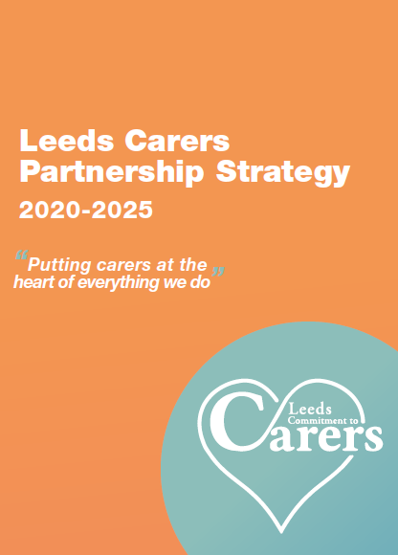
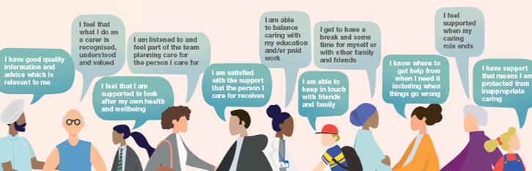
Carer Friendly Primary Care
Resource Pack
Version 1: July 2022

Slide 2
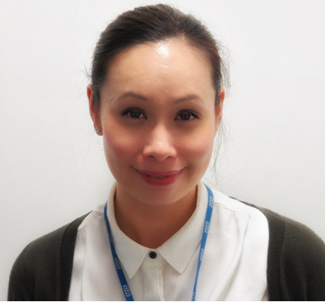


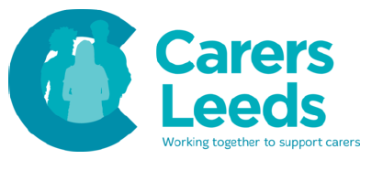

What's this pack about?
This carer friendly primary care resource pack has been co-produced by staff working in primary care in Leeds, carers and Carers Leeds with support from NHS England and West Yorkshire Health & Care Partnership. The resource pack aims to:
help primary care practices to be the best that they can be at identifying, recording and supporting patients who are providing unpaid care
provide key messages, practical steps, and links to online resources and information about local and national support
support the role of to Carer Champions enabling them to promote a carer friendly culture in primary care
Dr Gwyn Elias
Clinical Champion – Unpaid Carers

Slide 3
Why is it important for primary care to be carer-friendly?
Estimates suggest that 95% of carers will access primary care either for themselves or with the person they care for
We believe that more than 80% of carers have seen their GP in the past six months.
Carers are more likely to have seen their GP than any other health or social care professional
Carers often consider their GP to be their access point to all services and support – both for themselves and the people they care for
This means that primary care services are ideally placed to identify and support carers!

Slide 4
6 carer-friendly actions to get you started
Nominate a practice Carer Champion
Someone to co-ordinate the teams effort to provide the 'all-round 'support that carers need
Create a carers register by coding carers in the Electronic Patient Record
There are specific codes for recording that a patient is a carer
Ask your patients if they look after someone who depends on their support
Use your carers register, ask at new patient registrations and at all NHS annual health checks
Ask your carers if you can refer them to Carers Leeds
You can use the Yellow Card Scheme or refer online at Professionals Referral Form – Carers Leeds
Signpost or refer your carers to Linking Leeds Social Prescribing service
You can book an appointment directly using the practice clinical systems
Tell your patients who are carers about the free Digital Resource for Carers
Carers can create an account at carersdigital.org using the Leeds access code DGTL1942

Slide 5
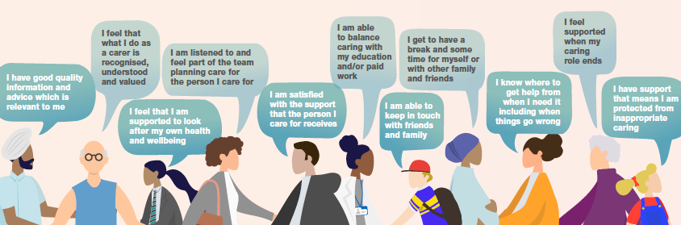
What unpaid carers in Leeds say are important to them:
The Leeds Carers Partnership Strategy includes eleven carer ‘I-statements’ which are based on what carers themselves have said is important to them

Slide 6
Becoming a carer friendly primary care practice
Becoming a carer friendly primary care practice starts with
recognising and valuing the role and contribution of unpaid carers
WHICH WILL HELP YOU TO…
Identify more unpaid carers including those who may not identify as unpaid carers (e.g. carers from diverse BAME communities)
THEN YOU NEED TO…
Do the things that you can do in our own roles, teams and organisations to support unpaid carers
AS WELL AS…
Being aware of the support that is available for unpaid carers and signpost or refer people to it (local and national)

Slide 7


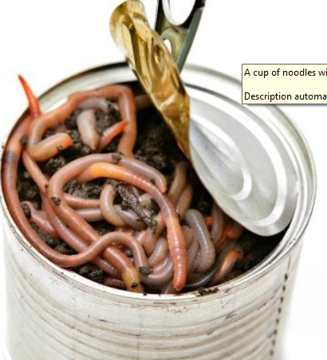
A common dilemma: opening the can of worms
The 'professional'
The 'unpaid carer'
I can see they're struggling – but what can I do in 10 minutes?
I don't know about the resources that might help them – and I don't have time to look
I need to know there are people out there who can help them
And once it all comes out, how will I get it back in the can?
We both know I'm struggling – but how can I admit that I am?
There probably isn't any support anyway – and if there is I wouldn't know where to look
What can they do – they're busy people
And once it comes out, how will I get it back in the can

Slide 8
Carer Friendly Primary Care Resource Pack
Navigation:
Clicking on any gold box will take you to a new slide with more information
Clicking on the XX symbol will bring you back to this slide
Clicking on the symbol will take you back to the relevant theme
You can exit the slideshow from any slide by right-clicking and choosing End Show
Recognising & valuing the role of unpaid carers
Identifying unpaid carers
Things you & your practice can do
Support that is available for unpaid carers

Slide 9
Recognising and valuing the role of unpaid carers
Carer [noun]
/’keərə(r)
Looks after family or friends who have a disability, illness or who need support in later life:
Washing them. And their laundry. And their dishes.
Keeping appointments. And records. And tempers.
Giving medicine. And time. And hugs.
Filling forms. And fridges. And silences.
Dealing with doctors. And nurses. And pharmacists.
And social workers. And benefits agencies.
And care workers. And a lack of sleep.
Doesn't get paid
May need support to balance life, work and caring
Might be one of your colleagues
Population and diversity of unpaid carers in Leeds
The benefits of identifying and supporting unpaid carers
NHS Carer Quality Markers
Carer awareness training and e-learning

Slide 10
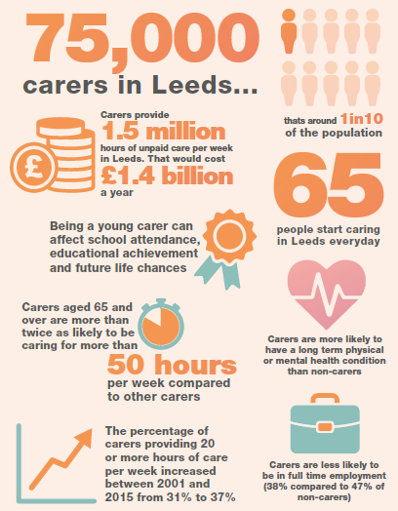
Population and diversity of unpaid carers in Leeds
Carers come from all walks of life, all cultures and backgrounds, and can be of any age.
The majority (around 76%) of carers in Leeds are working age while around 20% are aged 65 and above.
58% of carers in Leeds are female and generally speaking, female carers provide more hours of care per week than male carers
Carers from Black, Asian and minority ethnic (BAME) communities in Leeds tend to provide higher levels of care than carers from white British backgrounds
The more hours of care you provide the more likely you are to report bad or very bad health. 13% of carers providing 50 hours or more of care per week report bad or very bad health compared to 5.3% of people with no caring responsibilities
We are currently waiting for data from the 2021 Census to be published, after which we will update this information.

Slide 11
The benefits of identifying and supporting unpaid carers
Identifying and supporting carers has long since moved beyond simply being an issue of morality, or being ‘the right thing to do’. It is now widely recognised that we need carers to continue caring. Effective carer support:
Helps us to manage increasing demand for health and care services
Carers provide the bulk of care in our city and without them the NHS and social services would be overwhelmed
Carers prevent and delay the point at which the person they care for becomes dependent on health and care services
We need to prevent carer ‘burn-out’ and/or ‘breakdown’ otherwise both the cared-for person and the carer may become dependent upon health and care services.
Can help to break down barriers to carers getting support
Carers often don't recognise themselves as carers and those that do may not know how to find help or even that help exists.
Some carers don't want other people to know or might think that telling someone might count against them.
The word carer is often used incorrectly to mean paid care-worker
Carers can be isolated and some are simply too tired to ask for help
Is good for the economy
It's estimated that over 1.5 million hours of unpaid care are provided across Leeds every week
Research published by Carers UK estimates the cost to replace the unpaid care provided by carers in Leeds to be around £1.4billion per year

Slide 12
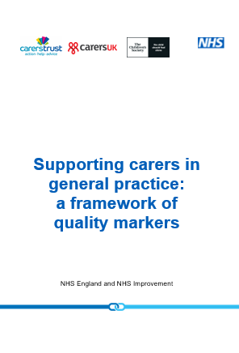
NHS Carer quality markers
In 2019, NHS England published a Framework of Quality Markers which offer of practical ideas that have been developed in partnership with carers, primary care teams and other key stakeholders.
Collectively, these provide a framework for improving how general practice can better identify and support carers of all ages.
Click on the image to open the document in a new window

Slide 13
Carer awareness training and e-learning
Carers Leeds have delivered Carer Awareness Training to many GP practices in Leeds over the last few years and developed some great partnerships in the process; including setting up carer support clinics and working together to ensure that carers are identified and supported in a variety of different ways. We have also developed a Carers Champion Network, ensuring that Carer Champions are kept informed, can share information with each other and feel supported in their role.
Carers Leeds Carer Awareness Training explains who carers are, what carers do, looks at the impact of caring on a carers health, enables staff to understand the importance of identifying carers in primary care and looks at what primary care can do to support their patients who may also be carers. The training also includes an overview of the Carers Leeds service.
The training is free and usually takes an hour and can be delivered either online or face to face. It is suitable for all members of staff. Contact Jo.jenner@carersleeds.org.uk 07399 492263 to discuss further or arrange training.
The Royal College of General Practitioners (RCGP) and e-Learning for Healthcare (e-LfH) developed a course for healthcare workers which includes e-learning sessions on identifying carers, organising your practice to support carers, supporting young carers, caring for people with challenging conditions, and providing support for the carers of older people. The course can be accessed at e-lfh.org.uk/Component/Details/391231

Slide 14

Identifying unpaid carers
Asking the right questions
Supporting self identification
Coding unpaid carers
Using your carer register

Slide 15
Asking the right questions
It can be difficult to identify carers as anyone can be a carer and people move in and out of caring roles according to their circumstances. Carers do not have any defining features that make them stand out from a crowd, and the person that the carer is caring for may not even be registered with your practice. Identifying carers is an activity in which the whole practice team is involved and staff who are the first point of contact, such as receptionists, are crucial.
Many carers don't consider themselves as carers, so rather than asking ‘Are you a carer?’ ask ‘Do you look after a relative or friend who couldn't manage without your help?’ Consider asking about young carers too: ‘Is there a child or young person in the family who helps to provide care or support to another family member?’
Look for the opportunities to open a conversation about their caring role and show an interest – you could ask how are you?, how are you doing?, are you managing?, do you need any help or support?
Ask carers how they are prioritising their own health and wellbeing and acknowledge its importance
Engagement with carers is a vital part of good patient care and gaining consent from the cared-for person at the earliest opportunity to share information can ensure that joint working can happen.

Slide 16
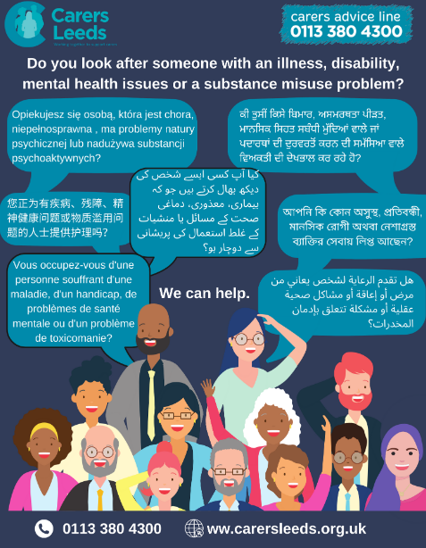
Supporting self identification
Inviting carers to tell you about their caring role can be a useful way to identify carers, particularly if the carer is registered with your practice, but looks after someone registered with another practice. Having prompts around the practice are a good reminder to initiate and encourage carers to self-identity. For example, you could
Put posters in the reception area or on a noticeboard introducing the Carer Champion and inviting carers to come and talk to you
Put something in the practice leaflet and/or newsletter and on the practice website
Include a question on new patient registrations forms and ask everyone who has an NHS annual health checks if they are a carer
Use social media to ask people to let you know they are carers
Ask you patients to tell you who their carers are
Consider including information in languages other than English to help identify carers from diverse BAME communities

Slide 17
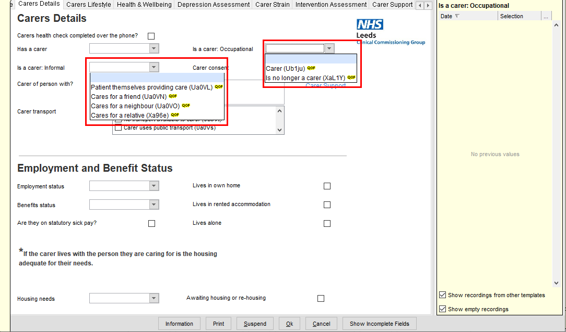
Coding unpaid carers
Once a carer is identified it is really important to code/record their caring status in their electronic patient record in System1 or EMIS.
Make sure you use the 'Informal Carer' option (the screen is slightly different in EMIS)
If the person they care for consents then it is also recommended that the carer is identified and their contact details recorded on their patient record too.

Slide 18
Using your carers register
Recording carer status in patient records should help you to populate a practice carers register which can then be used to:
Help you support carer health and wellbeing
Involve carers in patient care
Provide carers with relevant information and advice
Tell your patients who are carers about the free Digital Resource for Carers - Carers can create an account at carersdigital.org using the Leeds access code DGTL1942
Signpost or refer carers to local and national support organisations
Around 1 in 10 people are carers – this means that a practice with 5,000 patients should have around 500 carers on their carers register

Slide 19

Things you and your practice can do
Nominate a carers champion
Support carers health and wellbeing
Involve carers in patient care
Provide relevant information and advice

Slide 20

Nominate a carers champion
A Carer Champion is a member of staff who acts as a key contact for carer information for the practice.
While identifying and supporting carers requires a whole team approach, a carers’ champion can provide information for the team and co-ordinate the team effort to provide the 'all-round 'support that carers need. Specific tasks that a carers’ champion could undertake include:
Being an in-practice contact point for carers
Monitoring carer numbers
Pro-actively exploring ways that the practice might identify more carers
Developing links with local carers support services (e.g. Carers Leeds & Family Action)
Sourcing information that the practice could provide for carers
Developing a practice carer support policy
Keeping colleagues up to date with local and national carer developments
Seeking feedback from carers about how the practice is currently supporting carers and how it might improve support in the future

Slide 21
Support carers health and wellbeing
Carers tend to neglect their own health. Sometimes this is because of practical reasons, for example they may not be able to leave the home to attend GP or specialist appointments, or for hospital treatment. Sometimes it is because carers focus so much on the care of the people that they are looking after that they simply pay no attention to their own health needs. Here are some things you can use your carers register to do:
Offer unpaid carers an Annual Health Check. There is a standard template which is available in the Template Repository in System 1 and EMIS
Invite unpaid carers for annual flu vaccinations and COVID vaccinations/boosters
Provide appointments at times in the day when carers can leave the people that they care for
Provide consecutive appointments for carers before or after the person they care for
Talk to Carers Leeds about a Carer Support Worker coming to your practice to see carers​
Whenever you see a carer with a patient, it is always worth asking the carer how he or she is

Slide 22
Involve carers in patient care
Carers usually know the people that they care for better than anyone else and this knowledge can be extremely useful in planning and implementing patient care, and also in identification of problems that may require intervention. However, respecting the confidentiality of patients can leave us anxious about talking to carers. Finding ways to share information appropriately can make a critical difference to the ability and confidence of carers in their caring roles.
Talk to patients about information-sharing and seek permission for carers to be given appropriate information about their care and treatment
When care is being planned, ask carers about any problems that they may be having and seek their views about the best course of action to support the patient
Where a patient is reluctant for all information to be shared, talk through the consequences of this decision as there may be some aspects of their condition about which they are comfortable for information to be shared.
Where patients do not want any information given to their carers, ensure that there is general information on relevant health conditions available, for example leaflets on medical conditions or the effects of medication.
Introduce agreements on information sharing to be recorded prominently in the patient’s notes so that other members of the team are also aware of them.
Ask carers to feedback any difficulties encountered once a new care plan has been instituted.

Slide 23
Provide relevant information and advice
The Carer Champion and the primary care team are unlikely to be able to provide expert advice on all matters that are important to carers, but they can where, they identify issues of concern to carers, signpost carers to appropriate medical, social and voluntary services to support them.
Make good links with Carers Leeds and Family Action (Young Carers) and use their leaflets
Provide condition specific information and signpost carers to condition-specific organisations such as Stroke Association, Alzheimer's Society, Mind etc
There is lots of useful information at Support and benefits for carers - NHS (www.nhs.uk)
Citizens Advice also have information on carers issues, welfare benefits, debt and employment issues, both through its website Carers: help and support - Citizens Advice and through its local offices
Use social media and AccuRX (if available) to share information and top tips with carers

Slide 24
Support that is available for unpaid carers
Carers Leeds
Short breaks and respite care
Support for young carers
Support for working carers
Social Prescribing
Organisations who provide online support
Planning for emergencies
Carers assessment
National organisations
Money & benefits

Slide 25

Carers Leeds
Carers Leeds Carers Leeds is a Leeds based charity that provides a single point of access for carers aged 16 and over in Leeds. Their experienced and dedicated staff team provide a comprehensive information, advice and support service tailored to carers individual needs and circumstances.
Carers Leeds: 0113 380 4300
Link to Carers Leeds Advice Line
Link to support for carers of people with dementia
Link to support for carers of people with a learning disability
Link to support for carers of people with mental health issues
Link to support for carers of people with a physical disability
Link to support for people affected by another persons drug and alcohol use
Link to support for parents or family members caring for a child or young person with additional needs
Link to support for young adult carers (age 16-25)
Link to support for bereaved carers
Link to befriending support for carers
Link to resources recommended by Carers Leeds
Link to events & support groups

Slide 26
Social Prescribing
Linking Leeds is the free, city-wide Social Prescribing service for people in Leeds. Social Prescribing is a way of linking individuals with a range of local community services to improve their social, emotional and mental wellbeing.
Wellbeing Coordinators are based within GP practices providing one-to-one support over the phone and face to face. Community outreach from GP surgeries and other community locations is undertaken as appropriate.
There are three ways to access Linking Leeds:
Practice introduction – anyone working in a GP practice can make an appointment with one of the Wellbeing Coordinators
Self-introduction (self-referrals) – carers can visit the Linking Leeds website, or by email or telephoning the Hub
Partner introduction (other professional)
Website: Linking Leeds | Community Links (commlinks.co.uk)
Online referral form: https://linkingleeds.com/referral-form/#gp-form
Email: linking.leeds@nhs.net
Telephone: 0113 336 7612

Slide 27
Money & benefits
Unpaid Carers often face financial hardship through a combination of costs of caring and loss of income through leaving work to care. The following support can help unpaid carers toa access support and advice.
The Money Helper Service MoneyHelper has been set up to provide free and impartial money advice. Information about the support available for carers, including benefits and tax credits, and how to manage the money of the person being cared-for
Turn2us Fighting UK Poverty - Turn2us is a national charity providing practical help to people who are struggling financially and includes a benefits calculator and grant finder. There is a section specifically for unpaid carers Carer - Turn2us
The Leeds Money Information Centre Money Information Centre (leeds.gov.uk) provides free, confidential and impartial help and advice on a range of money related matters such as debt, money, energy and utilities. They can also provide one to one tailored support via digital, telephone and face to face appointments.

Slide 28
Organisations who provide online support for carers
Carers UK Digital Resource for Carers
Leeds City Council have teamed up with Carers UK to give carers in Leeds FREE access to a wide range of digital tools and essential resources that may help make their caring situation easier. Carers can create an account at www.carersdigital.org using the access code DGTL8267
Mobilise
Mobilise brings together the collective knowledge and expertise of unpaid carers to provide FREE online guides & factsheets covering a wide range of topics. Carers can subscribe to regular email updates and even join for a virtual cuppa and chat.
Bridgit
Bridgit Care are a Yorkshire based carer-led organisation who provide a range of online resources for carers Resources designed with carers for carers at Bridgit Care as well as technology solutions
Carers Leeds Digital Inclusion
Carers Leeds can offer support for carers who for whatever reason are excluded from using digital equipment. This may be because they don't know how to use it or because they can't afford it.

Slide 29
Planning for emergencies
A carers contingency/emergency plan can provide peace of mind that should an emergency occur meaning that an unpaid carer is temporarily unable to look after the person they care for, arrangements are in place which can be activated swiftly to mitigate the impact and ensure that people can continue to be cared-for in their own home rather than being admitted unnecessarily to hospital and/or residential care.
The 'Carers Emergency Card' is available free of charge from Carers Leeds Carers Leeds Emergency Card Carers are asked to carry it with them at all times and write the contact details of someone they have spoken to and who has agreed to step in and take over caring in an emergency.
The 'Carers Emergency Plan' Includes information that would help someone to take over caring and includes contact details of up to 3 people they have spoken to and who has agreed to step in and take over caring in an emergency. The Carers Emergency Plan is available from [ADD LINK(S) HERE WHEN AVAILABLE]
Carers can register their emergency plan with Assisted Living Leeds who will coordinate an emergency response using the information from their emergency plan. Assisted Living Leeds may also be able to deploy an emergency responder to cover a short gap while emergency care is arranged. [ADD LINK(S) HERE WHEN AVAILABLE]
Carers UK Digital Resource for Carers, Mobilise and Bridgit all provide alternative options for carers to complete an emergency plan
The Lions Association ‘Message in a Bottle’ scheme is a simple but effective way for people to keep their basic personal and medical details where they can be found in an emergency and in a common location – the fridge. For more information please contact Carers Leeds or The Lions Association https://lionsclubs.co/Public/messsage-in-a-bottle/

Slide 30
Carers assessment
Local Authorities must undertake a carers assessment where an individual provides or intends to provide care for another adult and it appears that they may have any level of needs for support. The Local Authority must also meet a carers need for support where the carer meets the national eligibility criteria, and draw up a support plan setting how needs will be met.
A carers assessment is simply the way professional workers from Health or Social Care organisations find out what the caring situation is, and what would help carers to continue caring. It is not a ‘test’ of how well carers are providing care!
A Carers Assessment is different to a Needs Assessment which is the assessment of someone with care and support needs. However, it is possible and sometimes makes sense, for the two assessments to be combined and carried out at the same time
The NHS website has a detailed section on Carers Assessment at Carer's assessments - NHS (www.nhs.uk)
Leeds Adult Social Care can arrange a carers assessment and can be contacted on 0113 222 4401 (weekdays 9am to 5pm, except Wednesdays from 10am)

Slide 31
Short breaks and respite care
A short break is anything that means that a carer has some time off from their caring responsibility, and in most cases, this will involve someone else taking over their caring role. This can range from
A family member or friend taking over caring for a short time
Local support for example Neighbourhood Networks, Dementia Cafes, Community Centre, Faith Groups etc – The Leeds Directory Leeds Directory In Your Community has lots of information about community facilities, getting out and about, and activities and events
The Time for Carers Grant Time for carers – Carers Leeds can provide an unpaid carer with a payment of up to £250 so that they can have a break from caring. The scheme is funded by Leeds City Council and administered by Carers Leeds
Carefree Carefree - A New Kind of Charity (carefreespace.org) is a charity that aims to provide low-cost short breaks for carers by matching them to spare hotel or holiday cottage accommodation. Carers Leeds act as an agent and refer carers to the Carefree charity
Social care support arranged by Leeds City Council’s Adults and Health Directorate which could include:
Home based short breaks service provided by a care agency
Attendance at a day service
Shared Lives service
Respite in a residential care home
(please note that Social Care services may incur a charge to the person with care and support needs)

Slide 32
Support for young carers
We know that caring can impact on a young person’s health, social life, education, and self-confidence. COVID-19 has added additional challenges.
Family Action provide specialist information, advice and support for young carers, their families and the organisations and staff working with them Leeds Young Carers Support Service Family Actions team of Community Engagement Practitioners can deliver training to local organisations to help them identify young carers, break down barriers, assess their needs, offer support and promote services and activities available to them in their local community. The service also includes specialist support for young carers whose needs cannot be met through universal support or early help. Telephone: 0113 733 9126: E-mail: Leedsyoungcarers@family-action.org.uk
Young carers can be referred into 0-19 Public Health Integrated Nursing Service who will undertake a health needs assessment and work on a support plan with a young carer to ensure their health and social neds are met. To refer in please call 0113 8435683
West Yorkshire Health and Care Partnership launched a Young Carers Support App which is free and available to download on both Android and IOS The App is a comprehensive resource not just for young carers but also for any professional working with young carers and young people. The Partnership's Bitesize Website also provides resources for those who work with children and young people enabling them to be able to identify and support young carers
MindMate is a Leeds-based website for young people, their families and the professionals who support them to explore emotional wellbeing and mental health issues and offer information about where support is available.
Both the Children's Society Supporting Young Carers | The Children's Society and Carers Trust Young Carers - Help & Support | Carers Trust websites also include good information and advice for young carers.

Slide 33
Support for working carers
Working Carers are people who balance their unpaid caring role with full or part time employment, which for some can be challenging. Working carers can bring a wealth of skills and experience gained through caring and should have the same opportunities as anyone else in terms of recruitment, access to support, development, and progression. Working carers who are experiencing challenges balancing work and caring can be signposted or referred to Carers Leeds.
It is estimated that as many as 1 in 5 employees are balancing work and care. That means that some of the your Primary Care workforce are themselves working carers! Here are some thing you can do to support them:
Register your practice with Employers for Carers which includes access to case studies, legislation and model policies, good practice, e-Learning and essential guides for employers, line managers and working carers. Membership is free through Leeds City Council's umbrella membership model. Visit EfC Digital and use the membership code #EFC1942 to create a new account
Contact Carers Leeds and join their Working Carers Employers Forum
Roll out working carer e-learning module to all line-managers and promote ‘Carer Aware’ e-learning to all staff (e-learning is available within Employers for Carers)
Encourage staff to declare they are a working carer and record it on electronic staff records
More information about supporting working carers in the NHS, including introducing a working carer passport scheme, is available at NHS England » Supporting our working carers

Slide 34
National organisations
Carers UK are the UK's only national membership charity for carers and provide a wide range of information for carers as well as campaigning for better recognition and support of carers. Carers UK have a national helpline which can be contacted by phone at 0808 808 7777 or by emailing advice@carersuk.org . Carer UK website Homepage - Carers UK includes a wide range of information, advice and resources for carers and people who work with carers.
Carers Trust is also a charity for, with and about carers. Carers Trust work to improve support, services and recognition for anyone living with the challenges of caring, unpaid, for a family member or friend who is ill, frail, disabled or has mental health or addiction problems. Carers Trust website Homepage - Carers Trust includes a wide range of information, advice and resources for carers and people who work with carers
National Institute for Health and Care Excellence (NICE) published a quality standard Supporting adult carers | Quality standards | NICE which covers the provision of support for adults aged 18 or over who provide unpaid care for 1 or more people aged 16 or over with health and social care needs. It describes high-quality care in priority areas for improvement and supports delivery of the NHS outcomes framework and Long Term Plan.

