Slide 1



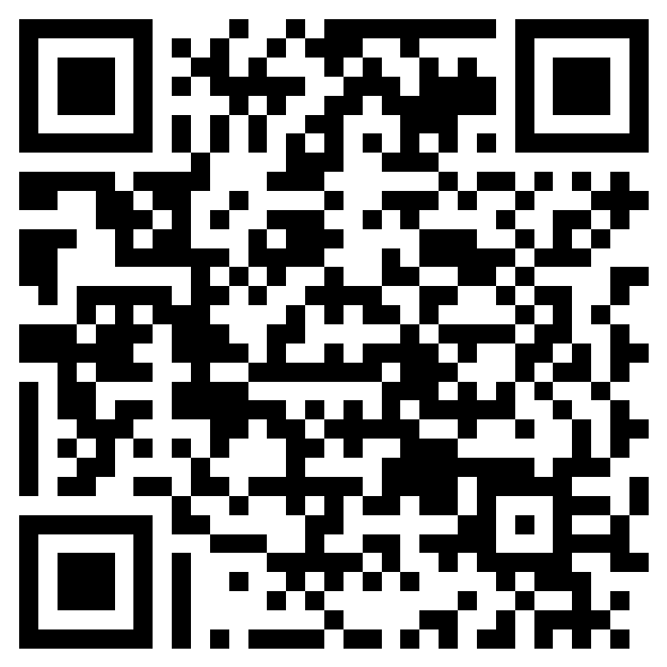
Pain in People Living with Dementia (CAPPPeD)
Poster
Final v1.3 Date 23.05.2024
What is it about?
In people living with memory difficulties:
How does pain affect mood?
How does pain affect behaviour?
How does pain affect daily life?
What does taking part involve?
A researcher will arrange to meet with you and a close relative or friend who agrees to take part together with you. You will be asked to complete some short questionnaires about pain, other symptoms, and will then take part in an optional short interview.
Who can I contact if I want to take part
or find out more?
Contact the team via:
CAPPPeD@nottingham.ac.uk
07557 197497
Or click on the QR code to request us to contact you directly!
CAPPPeD IRAS ID: 326402 Ethics Ref: 24/NW/0027. This study is funded by the National Institute of Health and Care Research (NIHR)

