Slide 1

Our Journey to Securing New
General Practice Premises
Drop-in Sessions
Our plan for the registered population of
Ivy Medical Group
Serving Burton Joyce, Bulcote, Lowdham, Stoke Bardolph, Lambley and the villages
Don’t forget to sign in! Thank you

Slide 2
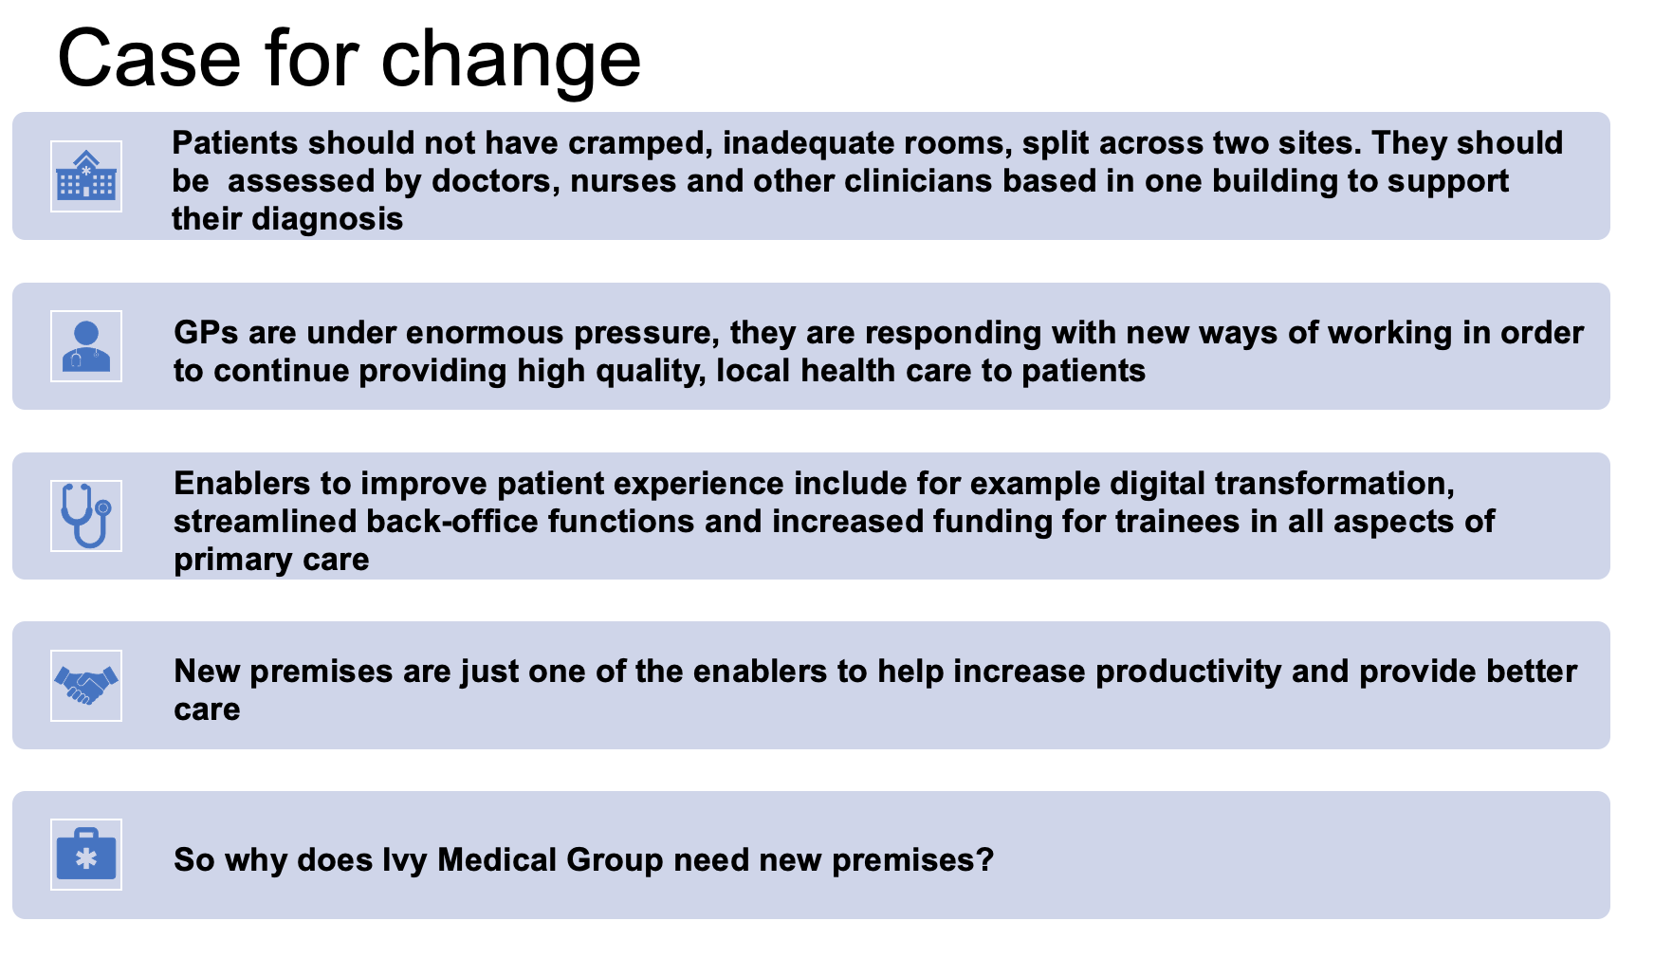

Slide 3
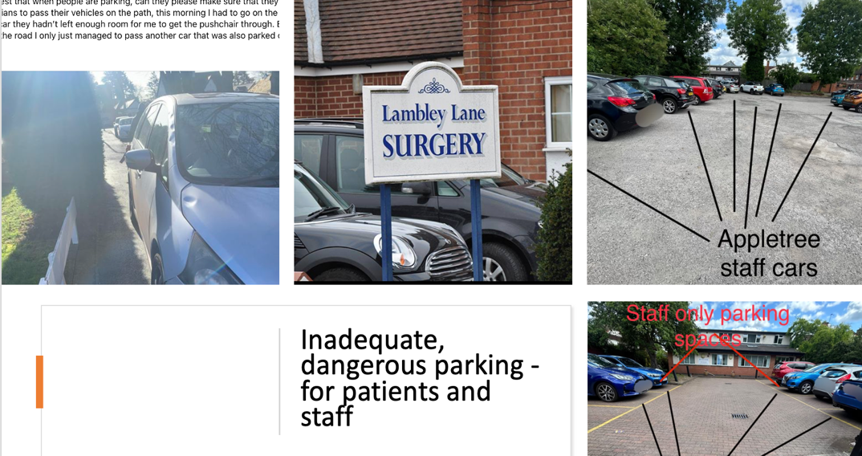

Slide 4
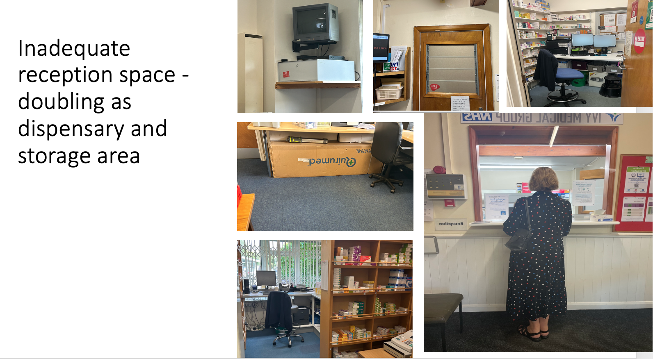

Slide 5
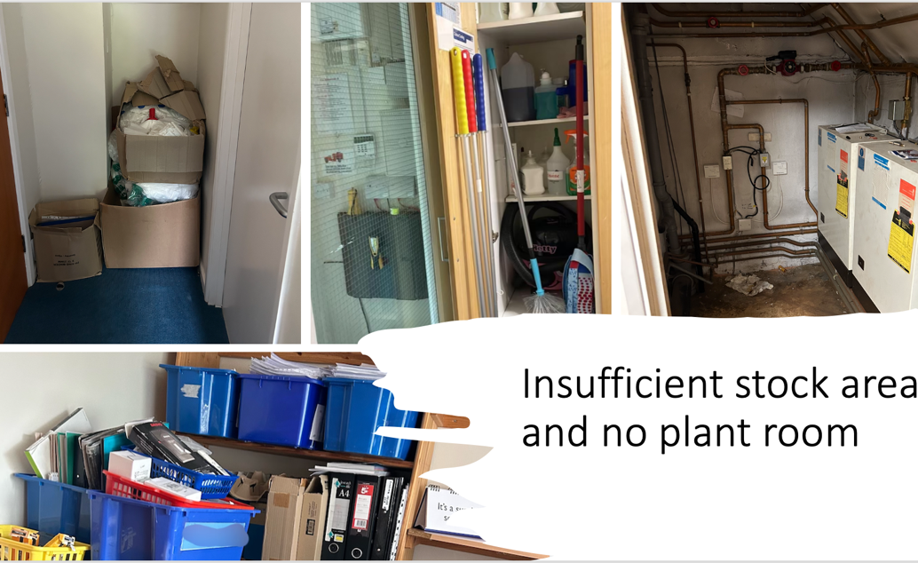

Slide 6
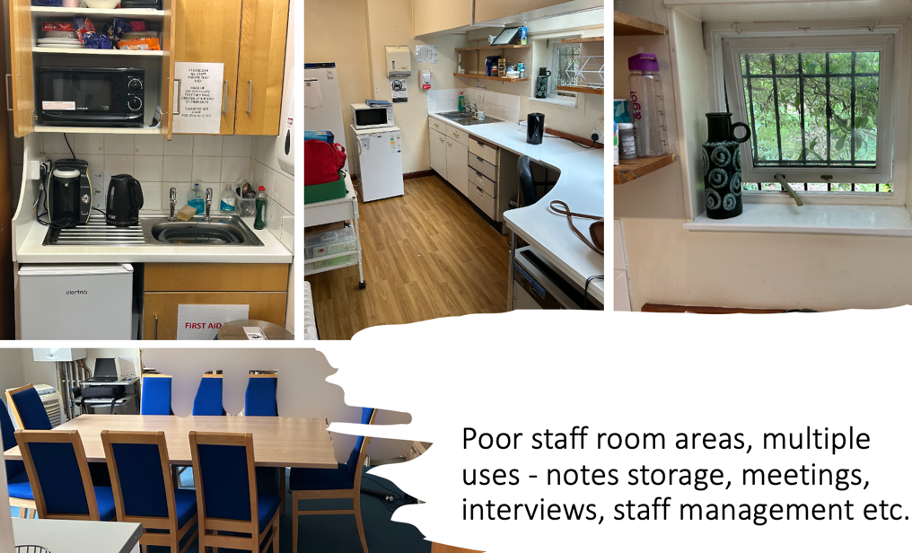

Slide 7
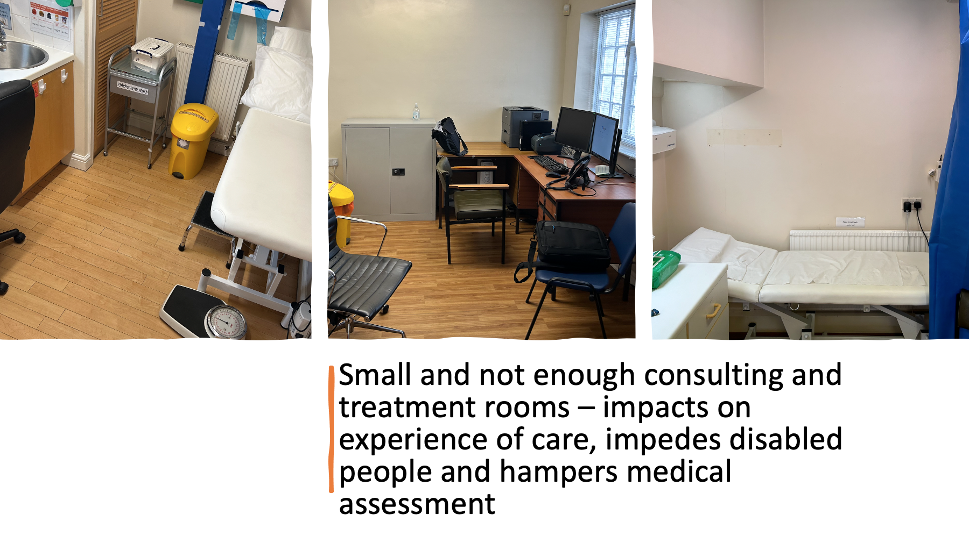

Slide 8
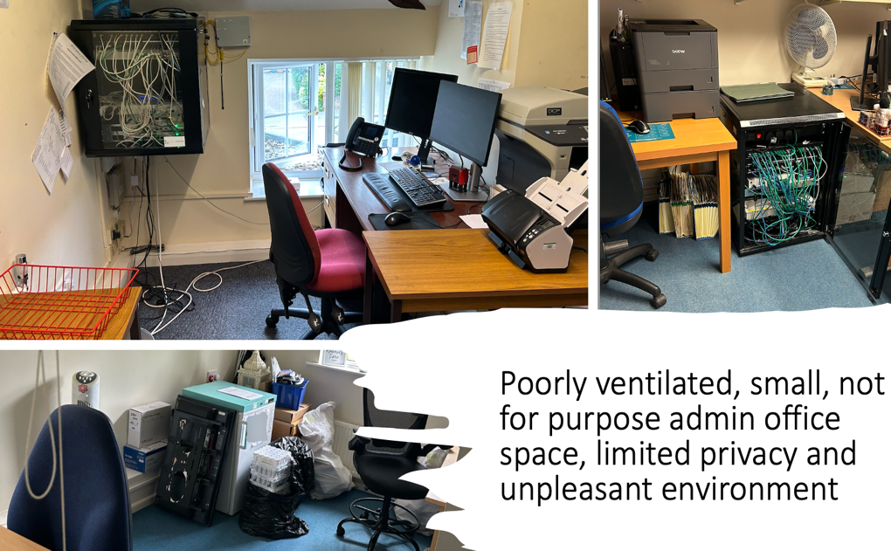

Slide 9
Space we have vs an example of space needed
Now | Needed
X2 buildings to pay rent, X2 receptions to staff, seating for 18 patients | One building, one reception with seating for THIRTY patients
No staff room or change | Staff room with staff changing
X2 buildings with inefficient heating and poor environmental ratings | One building with solar/heat source with reduced carbon footprint
X2 IT hubs | One hub
X2 building to clean | One building to clean
X6 consulting rooms No clinical trainee room, no counselling rooms, no group room | 11 rooms (almost double) and one group room
X1 combined staff/meeting/store room | One staff training room, one staff room, purpose built storage and a library
Parking for 6 -9 cars pavement parking at Lambley Lane causing problems with access for wheelchair/pushchair access Restricted road access for emergency vehicles Poor safety for staff arriving and leaving in darkness | Easy accessible parking on site for around 20 patients Secure staff parking Increased parking for evenings and weekends for community use
Poor access – high reception desks, no green spaces, poor disabled toilet access | One welcoming access point with gardens and green space. Purpose built toilets

Slide 10
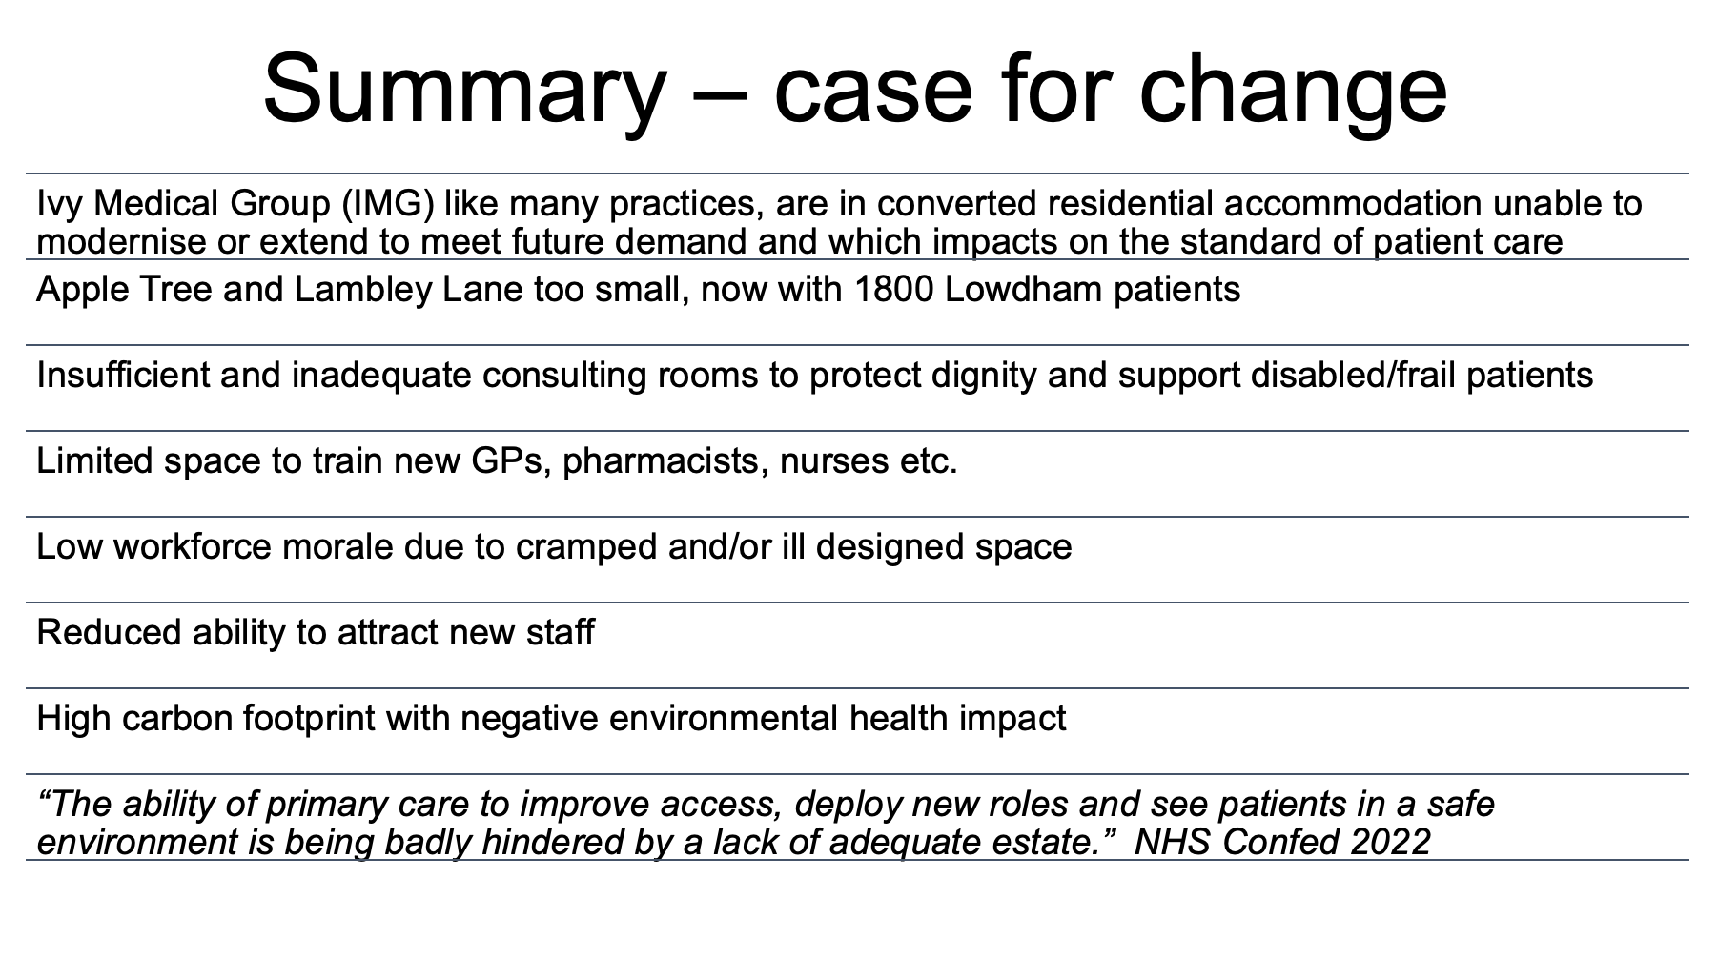

Slide 11

Context for new premises
90% of all patient contact is within general practice
First non-emergency access - the ‘front door of the NHS’.
In 1948 - GP patient list 2,461 and in 2023 closer to 9,000.
Number of GPs are falling patient numbers and complex needs increasing.
GPs need to continue to meet the challenges of a growing and ageing population with the next generation of pro-active, preventative health care, education, advice and treatment.
GPs want to give patients earlier diagnoses and more life-long control over staying well.

Slide 12
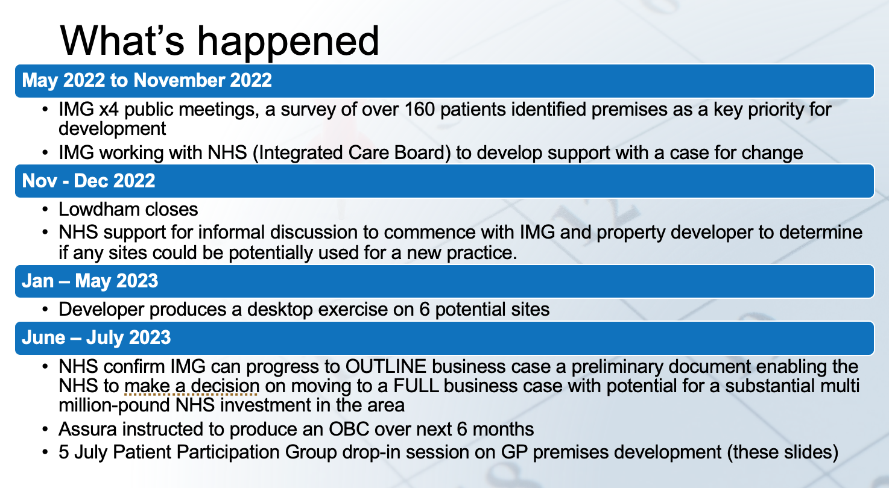

Slide 13
Premises Development - Letter from IMG
Sent to patients on 15 June 2023 to inform them of the process to date
Highlighted the OSB site due to patient feedback and the planned Parish Council public meeting on 20 June 2023
Follow up actions:
Learn lessons from communications to bring cohesion and partnership working with stakeholders, patients and residents
Assura meeting with Parish Council (OSB leaseholder) and IMG 12 July 2023
Extracts from the letter:
I must stress that no site has yet been identified as a preferred location and the business case will look at all possible sites.
The Old School Building (OSB) site in Burton Joyce, owned by the Old School Trust (OST) is a possibility.

Slide 14

…and what’s next
June – Dec. 2023
Assura will draw up an outline business case and relook at all potential sites for the new premises and align to local plans
The area is affluent with high land prices, flood plain and green belt so sites are more difficult to secure
November 2023 onwards
The outline business case will be considered by the NHS
2024/2025
If NHS approve the outline business case a full business case will be submitted
If NHS approve the full business case the new build will commence
2026/2027
New premises open

Slide 15
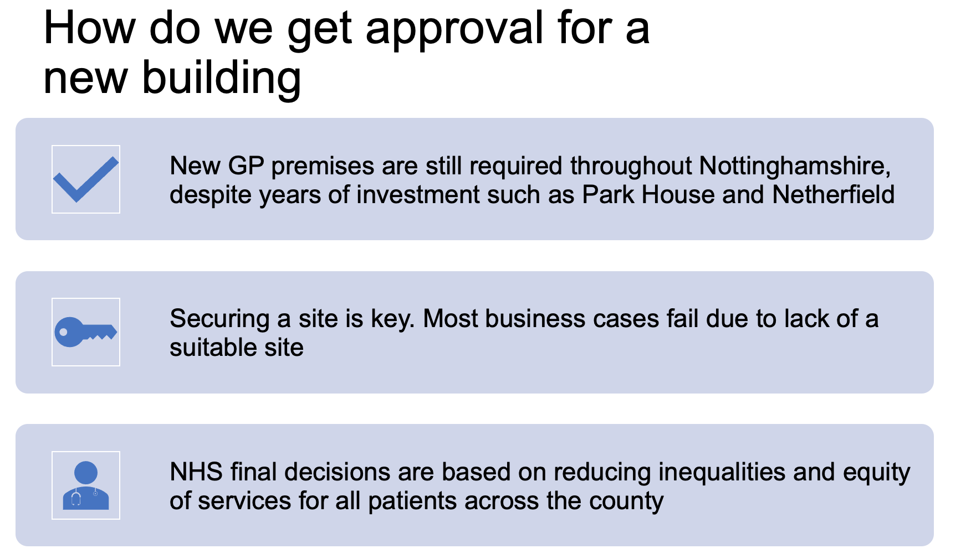

Slide 16
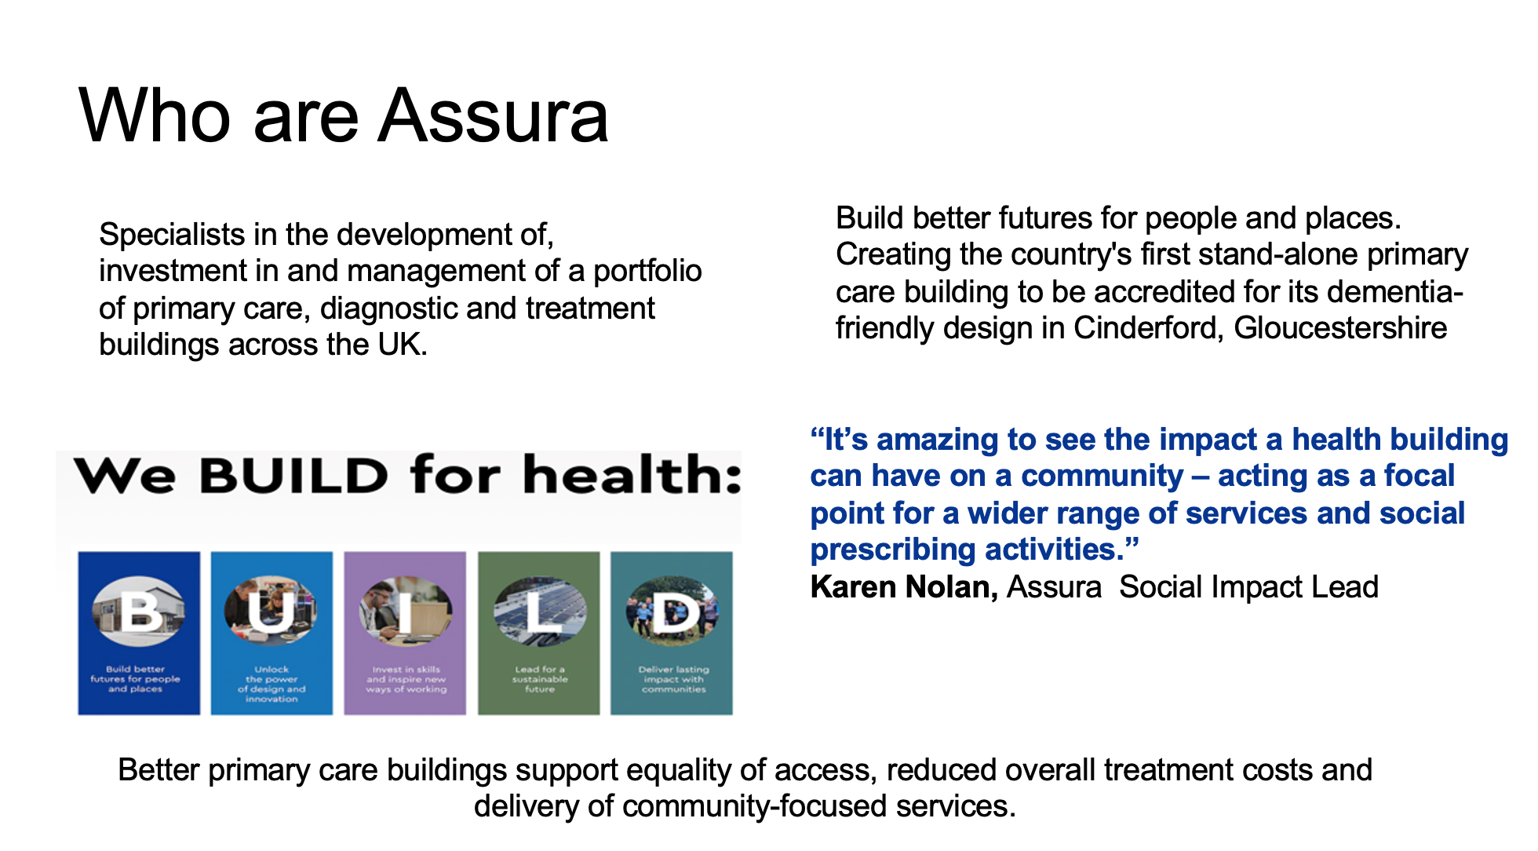

Slide 17
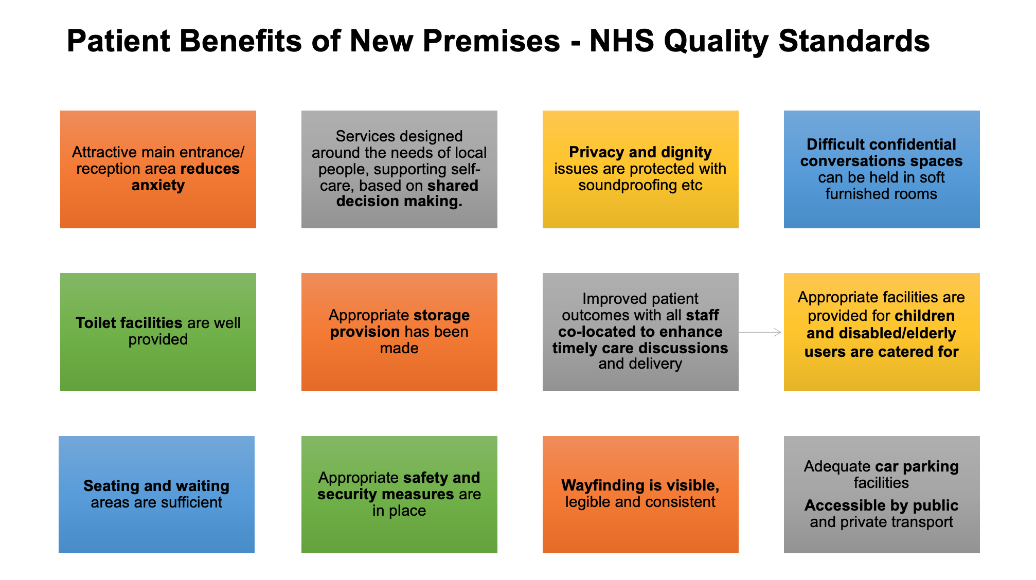

Slide 18
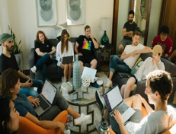
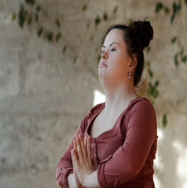
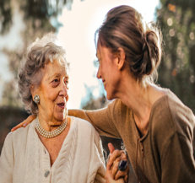
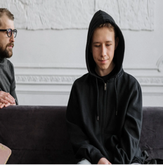


What extra services could a new GP premise bring for patients
More space for services, for example:
  A mental health group for under 25s to enable support and signposting with their issues
  Sensory areas such as a garden to support patients attending with dementia, sight and hearing loss and those with physical and learning disability
  Gardens cared for by Bridle Lodge residents to increase community integration and reduce their anxiety when accessing care
  Hosting clinical staff who provide a service for more than one GP such as phlebotomy, physiotherapists and mental health workers
  Outreach clinics from the acute or mental health hospital e.g. outpatient follow-ups

Slide 19
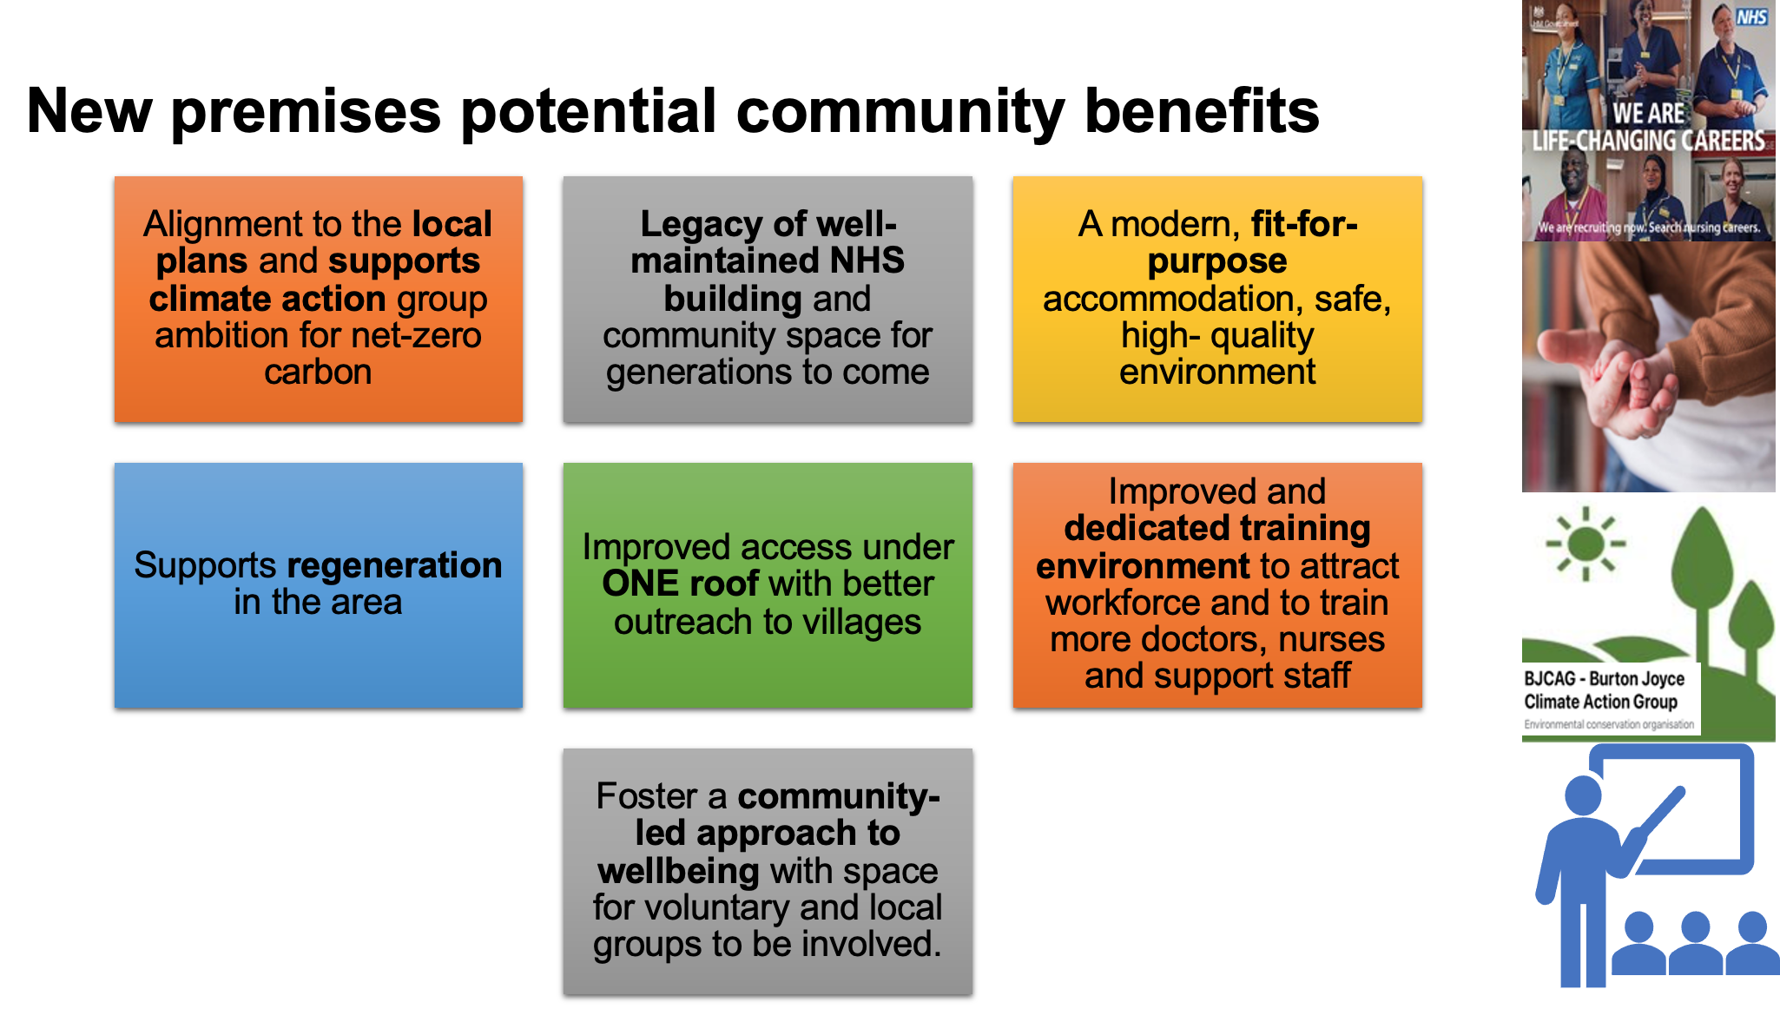

Slide 20

What could our new premises look like?
Click on the links below
Virtual tour, Cinderford, Gloucestershire
https://vimeo.com/458538142?share=copy
Virtual tour, Netherfield, Nottingham
https://vimeo.com/458537085?share=copy

Slide 21
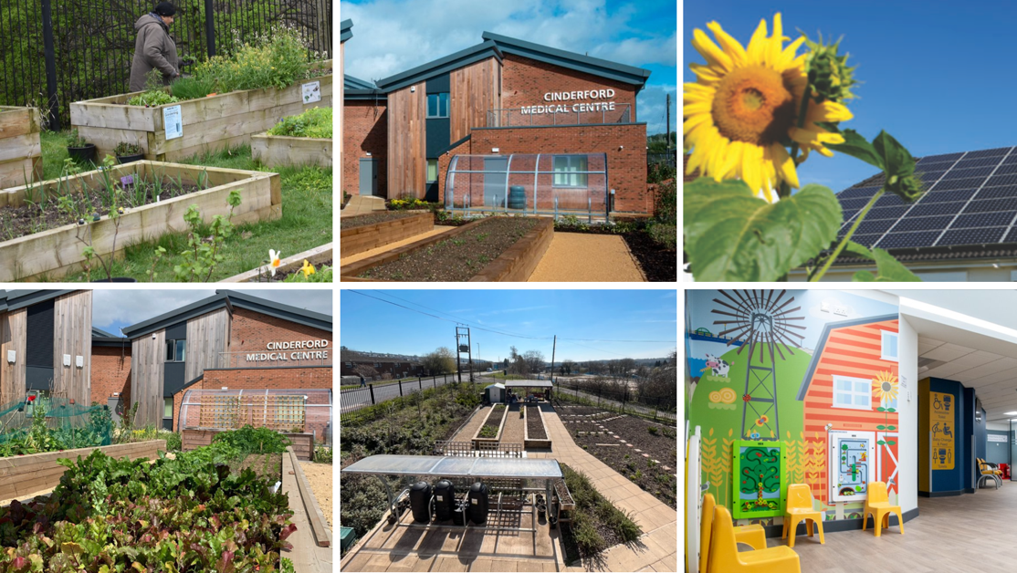

Slide 22
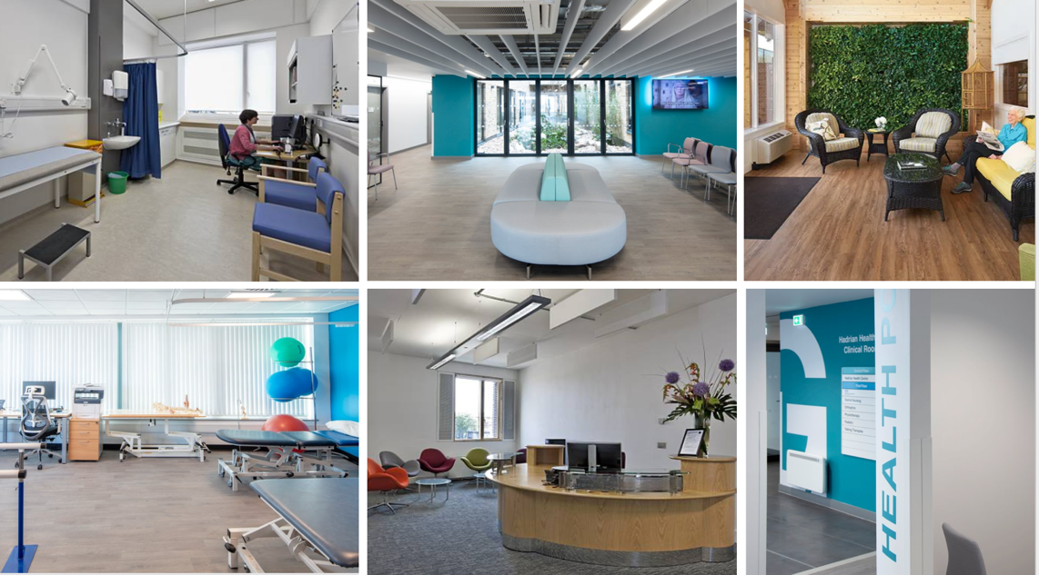

Slide 23
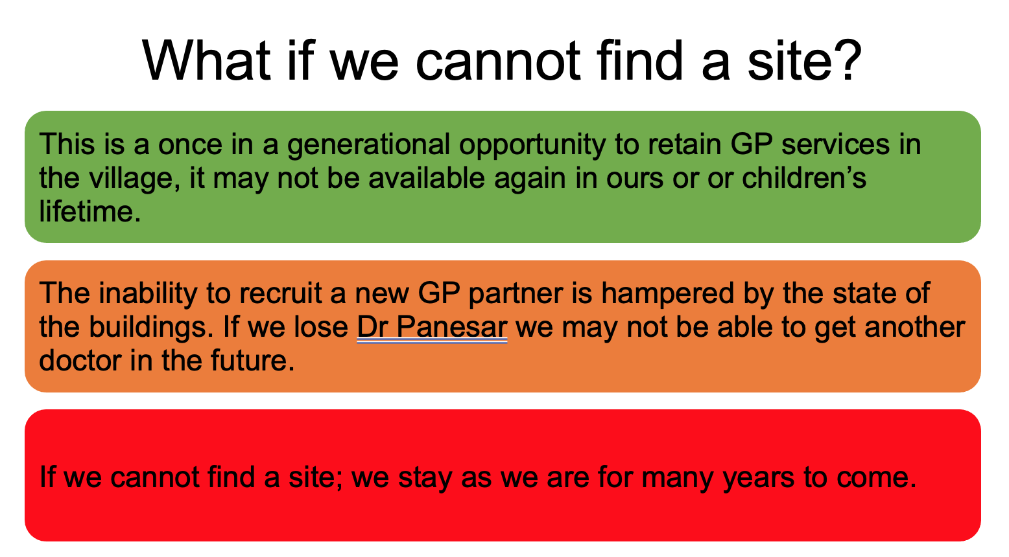

Slide 24
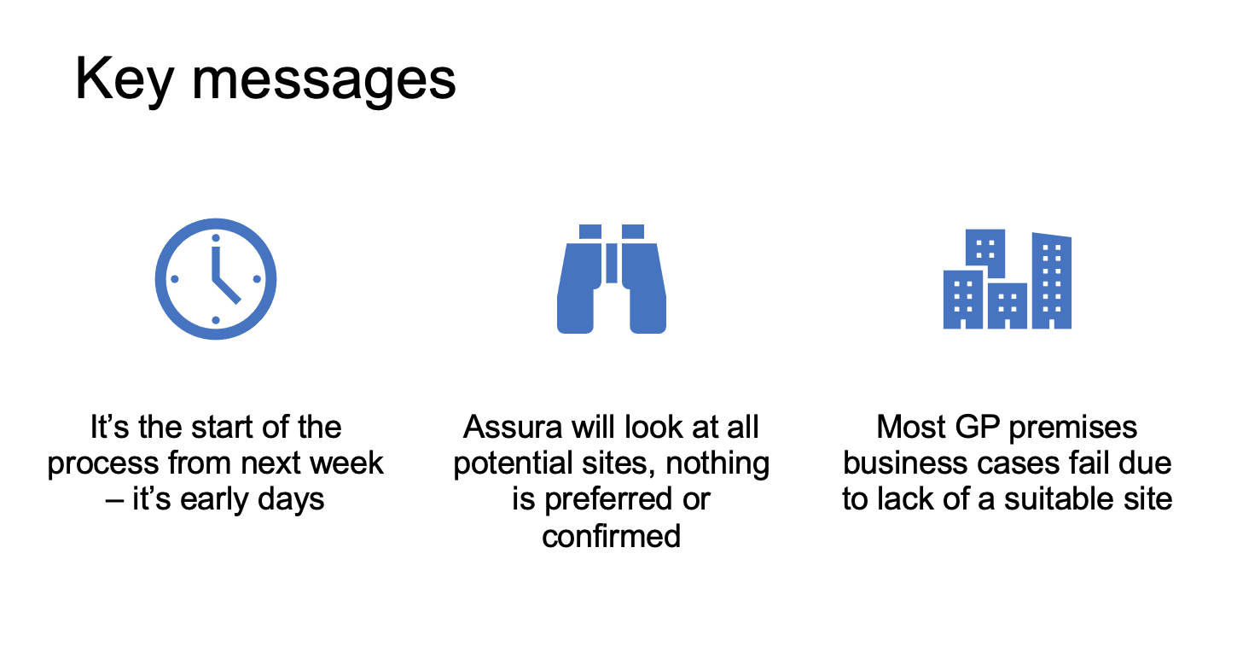

Slide 25
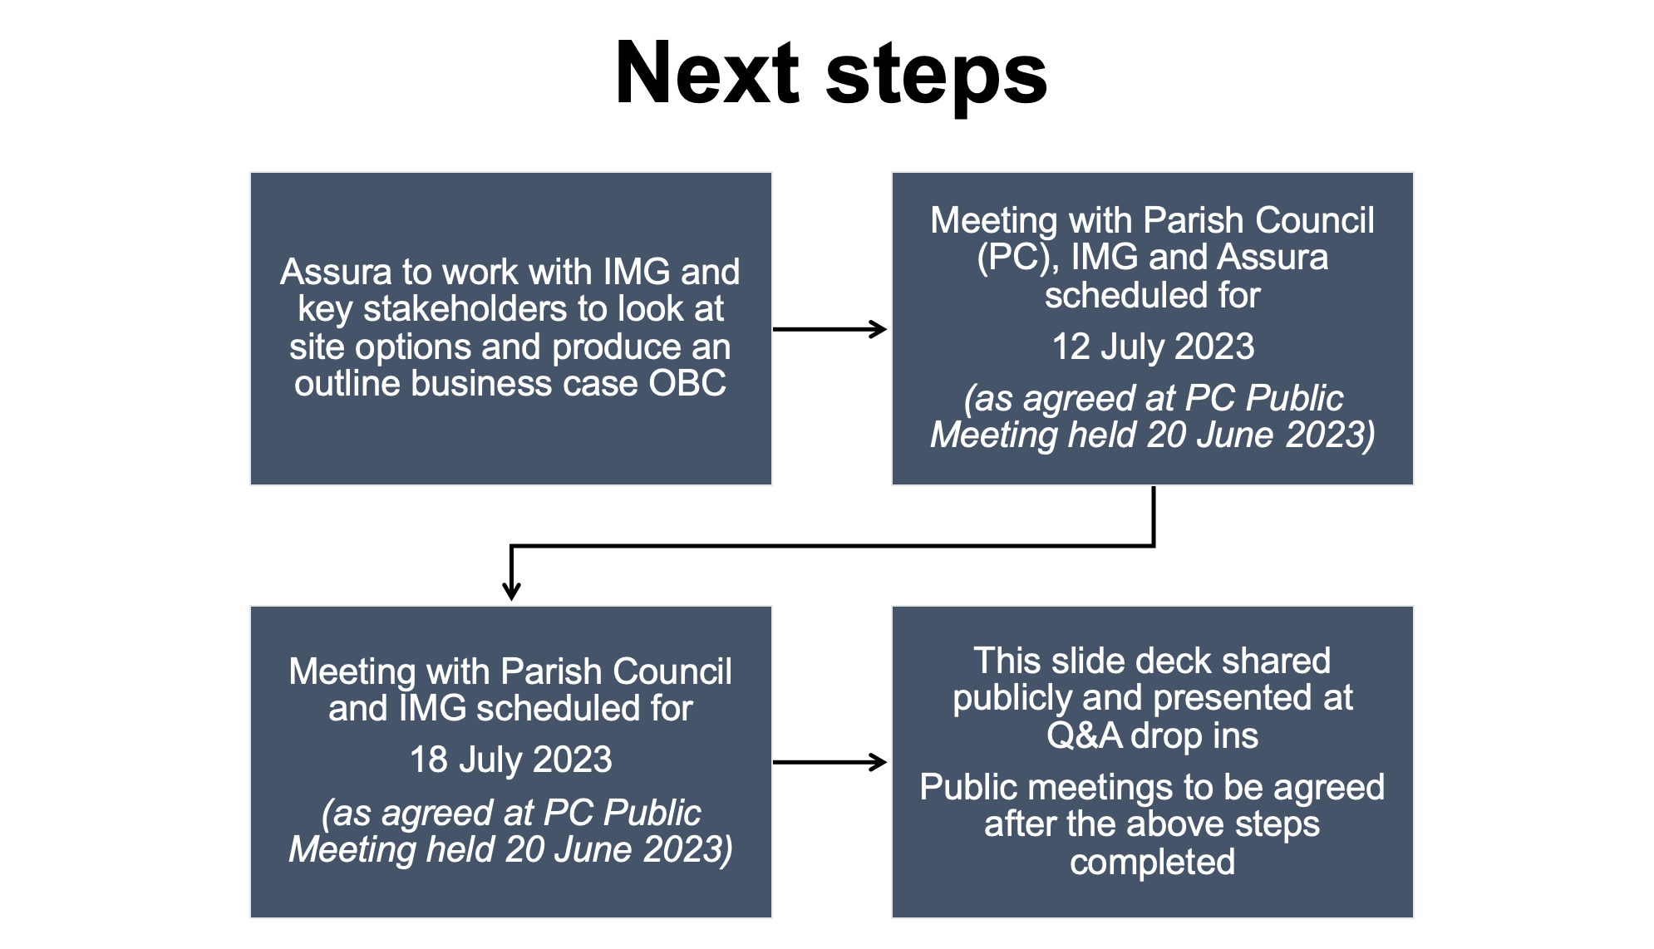

Slide 26
Contact
For all IMG premises queries please contact Tracy Madge on
tracy.madge@nhs.net
The next slides present how GPs are funded for information only

Slide 27
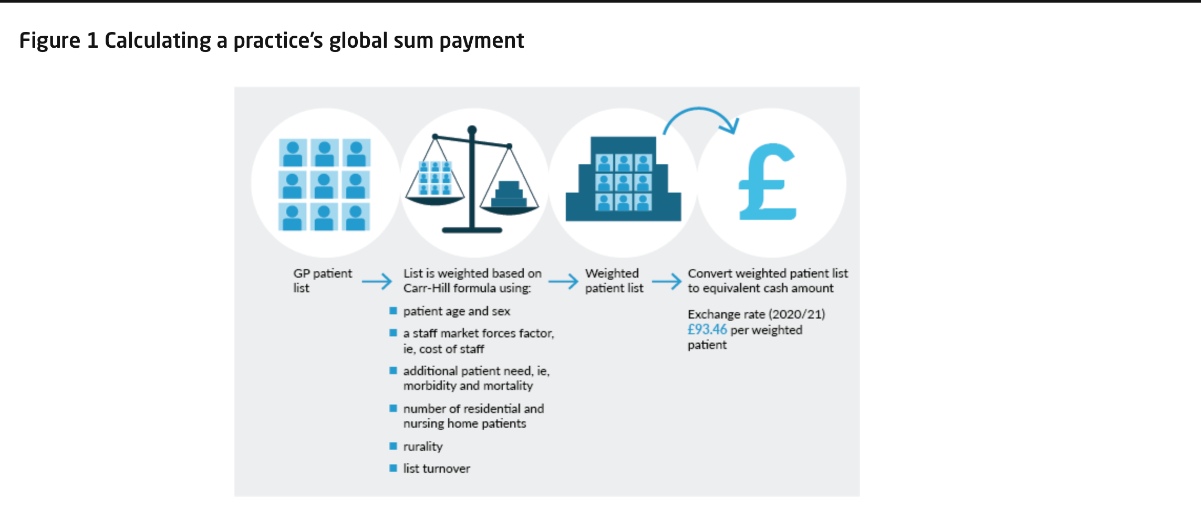
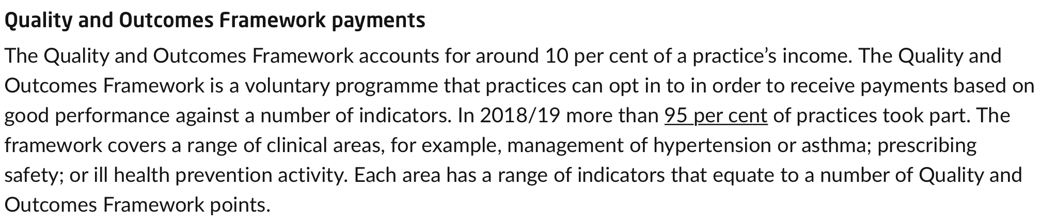
How GPs are funded

Slide 28
