Slide 1
Ivy Medical Group
Survey of Lowdham Patients
12 July 2023
Melanie Maddock, Practice Manager
Bob Barrett, Patient Participation Group (PPG), Lowdham Resident
Tracy Madge, PPG Secretary

Slide 2
Context
The Lowdham branch of Ivy Medical Group (IMG) closed in November 2022 after a CQC inspection
IMG committed to providing services from Burton Joyce. As of 30 June there are 1790 patients living in Lowdham registered with IMG
In May a survey was issued to Lowdham patients to ask them for views about the service
182 patients responded providing a snapshot

Slide 3

Survey Outcome
Q1 Access to all services since closure of Lowdham Surgery
182 Responders
146 Able to access all services – 80%
36 Unable to access all services – 20%

Slide 4


Survey Outcome
Q1 Of those unable to access – key issues
Appointments 21
Access 7
Treatment/tests 3
Prescriptions 2

Slide 5

Survey Outcome
Q2 - Difficulties with services
Collecting Meds 5%
Getting to BJ 10%
Making Appointment 26%
Obtaining Prescriptions 9%
Other 6%
None of the Above 44%

Slide 6

Survey Outcome
Q2 - Other Issues
All – includes ‘Poor Service comments’ 6
Access 2
Prescriptions 1
Parking 1
Admin 1

Slide 7

Survey Outcome
Q3 - Electronic Prescriptions to Pharmacy (EPTP)
Aware of EPTP – 69%
Unaware EPTP – 19%
Would like to be contacted 12%

Slide 8

Survey Outcome
Q4 - Medication delivery available if dispensed by IMG
Aware of service – 35%
Unaware of service – 34%
Would like to be contacted - 8%
Not Applicable - 11%

Slide 9

Survey Outcome
Q5 - Anything else IMG can do whilst seeking new premises
Assistance with getting to the surgery 5%
Delivery of medication 5%
No Other services required at this time 71%
Ordering repeat prescriptions 11%
Something else 8%

Slide 10

Survey Outcome
Q5 - Requests for Follow Up
40 Patients left contact details

Slide 11
Main findings
Main findings
Dissatisfaction with access to appointments and ease of booking
Better communication
Access to surgeries/location at Burton Joyce
Easier access to treatments

Slide 12
What we have done so far
Launched Patient Triage
PPG meetings and NHS App workshops in Lowdham
Developing services with Lowdham pharmacy
Dedicated Lowdham meeting 12 July

Slide 13
What we will keep doing

Slide 14
Questions

Slide 15
Information about new premises and patient traige
Tracy Madge and Bob Barrett, PPG members

Slide 16

Why New Premises are so important?
CQC – inspection result
Insufficient and inadequate consulting rooms
limited space to train new GPs, pharmacists, nurses etc
Low workforce morale due to insufficient or ill designed space
Reduced ability to attract new staff
High carbon footprint with negative environmental health impact

Slide 17

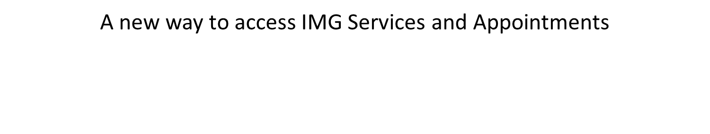

Slide 18
PATIENT TRIAGE
A new online booking system to request help for non-urgent medical or admin queries.
System is provided by a third party provider - Accurx
Currently, access is via the IMG website www.ivymedicalgroup.co.uk
But can still come into the practice and reception will complete form for you
But can still phone the practice and reception will complete form for you
Requests will be responded to within 48h during opening times – but could be sooner.
If request is urgent call 111, or use 111 Online, or visit an Urgent Care Centre.

Slide 19
PATIENT TRIAGE
Access currently via website
Also available via the NHS App
Shortly available via the IMG App
Benefits
All requests for advice or help dealt with the same
Online form totally confidential only seen by Clinician
No need for the 8.00 am phone call rush
An afternoon request could still result in an appointment that day
Clinician reviewing requests all the time, so truly urgent issues get correct priority

Slide 20
PATIENT TRIAGE
If we go to the IMG website www.ivymedicalgroup.co.uk we see:
Let’s look at a short video explaining what to do:
https://www.youtube.com/watch?v=dYkBX-w3r7E
If clinician review assesses you need to see a GP
Urgent Appointment
Sent a Text or get phone call with a time
Not quite Urgent
Sent text with link to online booking to enable you to book date and time of choice from available slots
Or contacted by phone if requested to book via reception

Slide 21
PATIENT TRIAGE – Via NHS App
It is already designed to work with NHS App
Likely to be further workshops later.

Slide 22
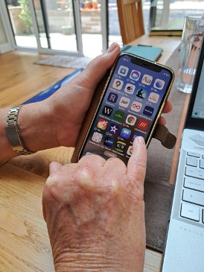
Accessing Patient Triage via NHS App
Open your phone (or tablet)
Open the NHS App

Slide 23
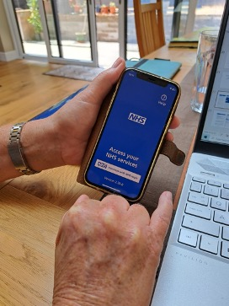
Accessing Patient Triage via NHS App
Unlock the NHS App

Slide 24
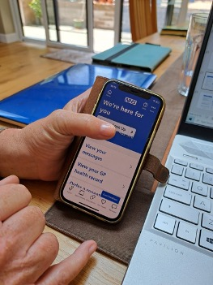
Accessing Patient Triage via NHS App
You should see the welcome screen
“We’re Here For you”

Slide 25
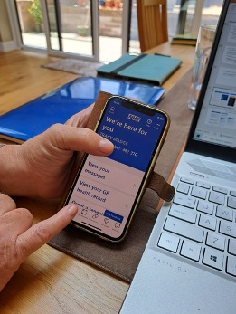

Accessing Patient Triage via NHS App
Click on the Stethoscope symbol at bottom of page
DO NOT click on Appointments!

Slide 26
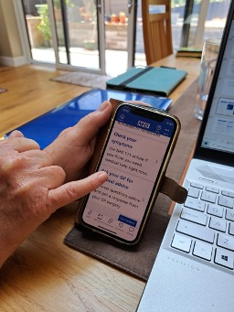
Accessing Patient Triage via NHS App
Scroll down until you see
“Ask your GP for medical advice”

Slide 27
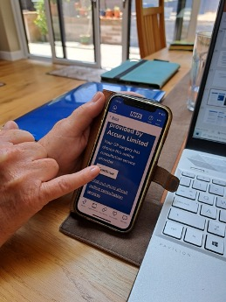
Accessing Patient Triage via NHS App
You will see the Accurx welcome screen
Click Continue

Slide 28
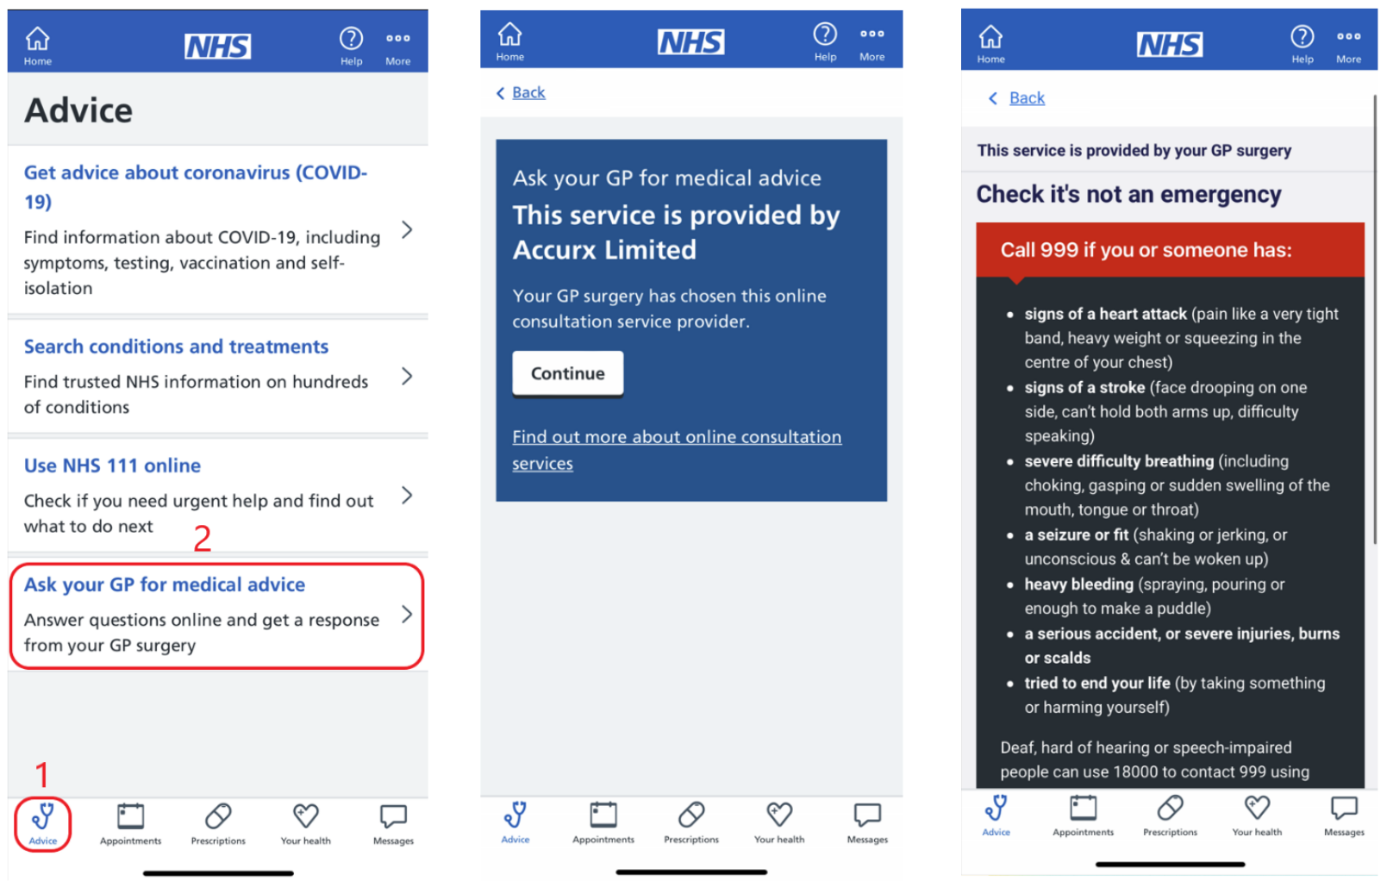

Slide 29
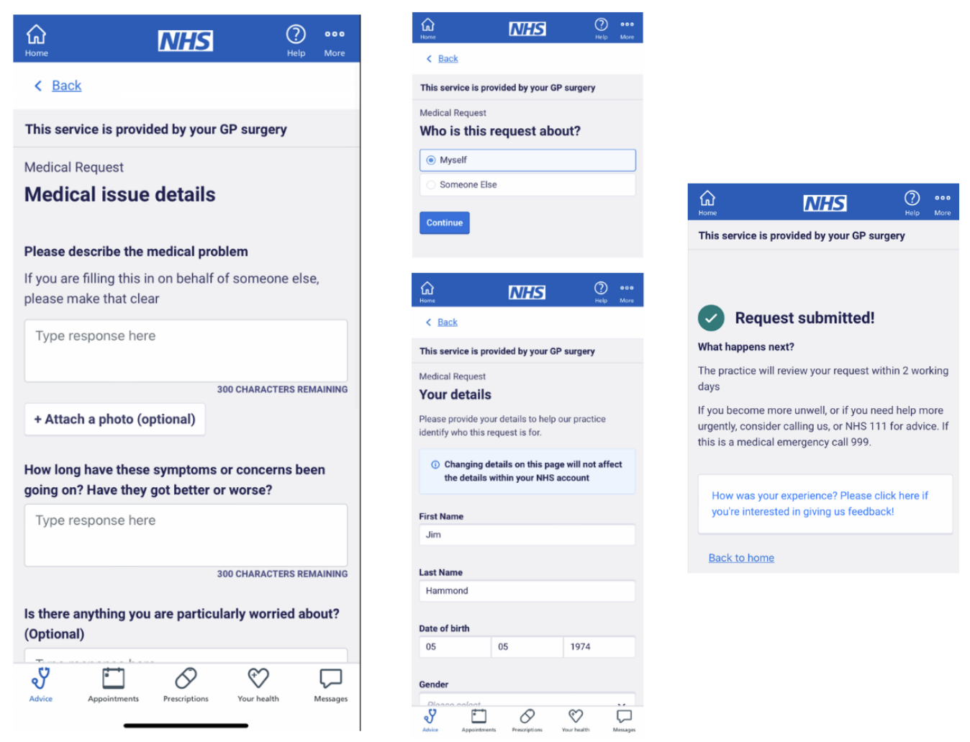

Slide 30
Need help to get online doctor appointments Need to request sick notes etc.? We can help set your phone/tablet up and show you how to book appointments A Patient Participation Group Initiative
If you would like to learn more about how to install and use the App and want help to use the new appointment booking system come along to our free workshops:
18 July 2023, 4:30 - 5:30, Lowdham - Village Hall (Meeting Room)
2 August 2023, 4:30 – 5:30 Burton Joyce – Carnarvon Room
Sessions are suitable for both patients and carers. We have experts on hand to help you set the app up too. Refreshments provided.
*Further sessions can be organised on demand. We can do small group sessions and one to one on request.

