Slide 1
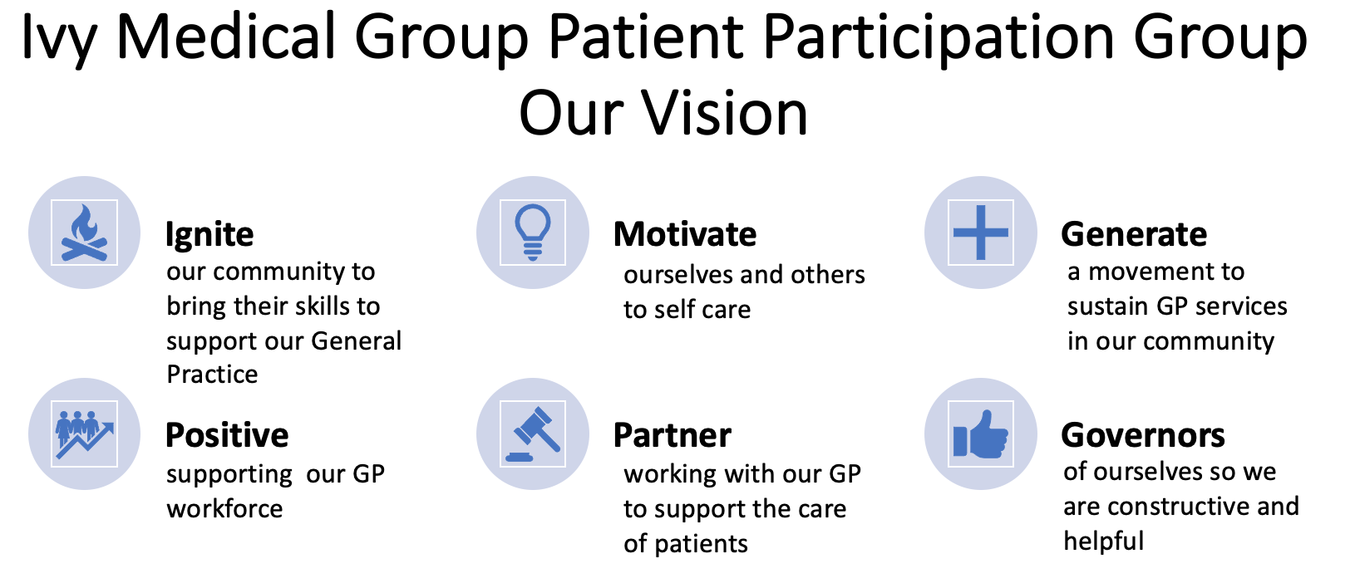
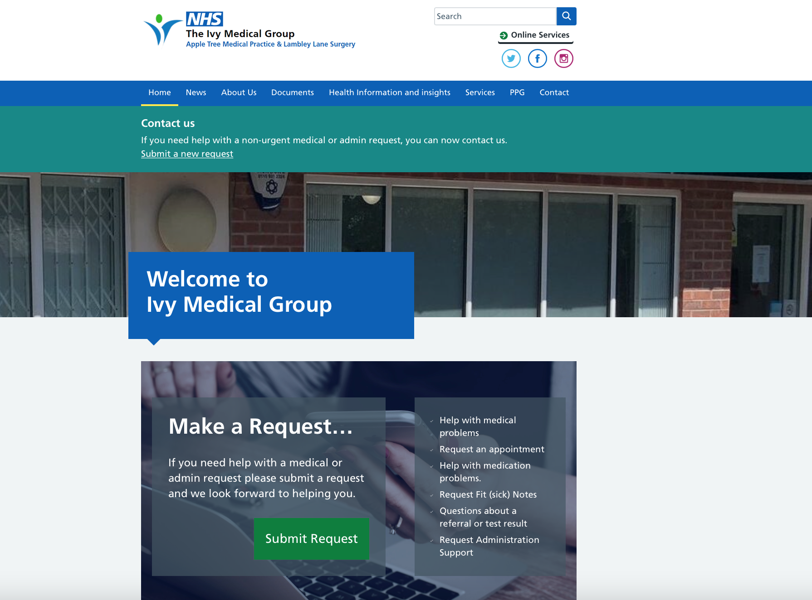
IVY MEDICAL GROUP
PATIENT PARTICIPATION GROUP
ANNUAL REPORT
2022-2023

Slide 2
Chair’s Report
Thank you for reading the first Ivy Medical Group (IMG) Patient Participation Group (PPG) Annual Report for 2022-2023. I am very proud to have recently taken over the Chair role from Steve Scott who was our Chair from November 2022 to October 2023. We extend our thanks to Steve for helping to get the PPG up and running again after Covid.
Prior to this Janet Kenwood was the PPG Chair, a position she had held since 2011. Sadly Janet passed away in July 2021. On behalf of IMG and the PPG we want to state how grateful we all were for her tireless support of the practice and her commitment to patient services. We extend our condolences to her husband Gerald.
I have been a PPG member since 2018, I held the Chair post after Janet’s passing. There have been significant changes since I joined. These changes were informed by PPG public meetings held in 2022 and the result of a local patient survey to understand how patients viewed the GP service. Views were grouped into five themes to form the basis of our first PPG annual plan.
Since November 2022 we have held three formal meetings and met informally three times. We have supported the practice to deliver improvements on the fives themes which include:
Access with the online patient triage service. We have held seven workshops to help people use this service via the NHS App and online.
Best practice has been adopted with the launch of the Electronic Prescription Service and patient triage. The PPG have undertaken a survey for End of Life Care and under 18 experiences. We will take forward actions from the findings during 2024.
Improved communication a new website with PPG access. PPG members regularly update notices boards in surgeries and local venues. We share our news on social media and use the surgery text message services to reach out to all patients. The PPG have published five articles on health awareness, known as health insights. These are shared widely.
Valuing the workforce and volunteers has seen new nurses and GPs join the surgery and the practice supporting the delivery of workshops and public meetings. We have fully recruited to our PPG with three new members bringing a wealth of experience to the team. If we secure new premises the working environment will be greatly improved and recruitment much easier.
Premises have now been seen as a priority by the local NHS and we are working with a developer to look for site options. The PPG held a public meeting in July 2023 and continue to support this exciting development.
This is an exciting time for IMG and the PPG. We will continue to support the delivery of improvements against the themes We will always put the best interests of patients at the heart of everything we do as we move forward into 2024.
The PPG wish you and your loved ones a healthy and happy Christmas and all the best for 2024.
Ingrid Glover
Chair, IMG PPG

Slide 3
Principal Report
I am extremely proud of our Patient Participation Group (PPG) and especially humbled by the hours of voluntary hours they have given to Ivy Medical Group over the last year. It is a profoundly challenging time for the NHS and the team and I are grateful for the support the PPG have given to us.
The Ivy team have responded positively to the challenges we face and we continue to work hard to provide care for all our patients. We are always striving to hear from our patients and the PPG are actively feeding back to the team on areas we need to review and also with compliments. We know we have more to do; the PPG feedback on areas of concern, we have the results from the national patient survey and we are learning from complaints and complements which we welcome.
Our PPG members are from a diverse range of personal and professional backgrounds which aims to be representative of the patient population we serve. The PPG have produced and published several topic based health insights and supported our journey to new premises. A recent end of life care and under 18 survey will give us valuable information to improve care for both these groups in 2024. The PPG have held several meetings in Lowdham and we continue to work with the pharmacy in the village to develop local services.
The PPG’s support with patient triage has attracted attention from across NHS organisations in Nottinghamshire and we are proud to be leading the way. The PPG NHS App and patient triage workshops have been instrumental in IMG being a leading practice on uptake of the NHS App.
The PPG are a vital part of our extended team. They are the voice of our patients and the ears and eyes within the community. Be assured they are always raising issues for improvement which we take seriously and we address these proactively, as we know they will improve the experience of care for all patients
Whilst we will reflect on how the last year has played out, it is also important to look ahead. I am committed to listening to patients and responding positively, working closely with the PPG.
I would like to extend a personal thank you to Janet Kenwood who was our PPG chair for over 10 years and who sadly passed away in 2021. The team and the PPG send condolences to her husband Gerald and their family.
I wish you and your families all the best for the coming festive season and a healthy and happy 2024.
Dr Paramjit Panesar
GP Principal, IMG

Slide 4
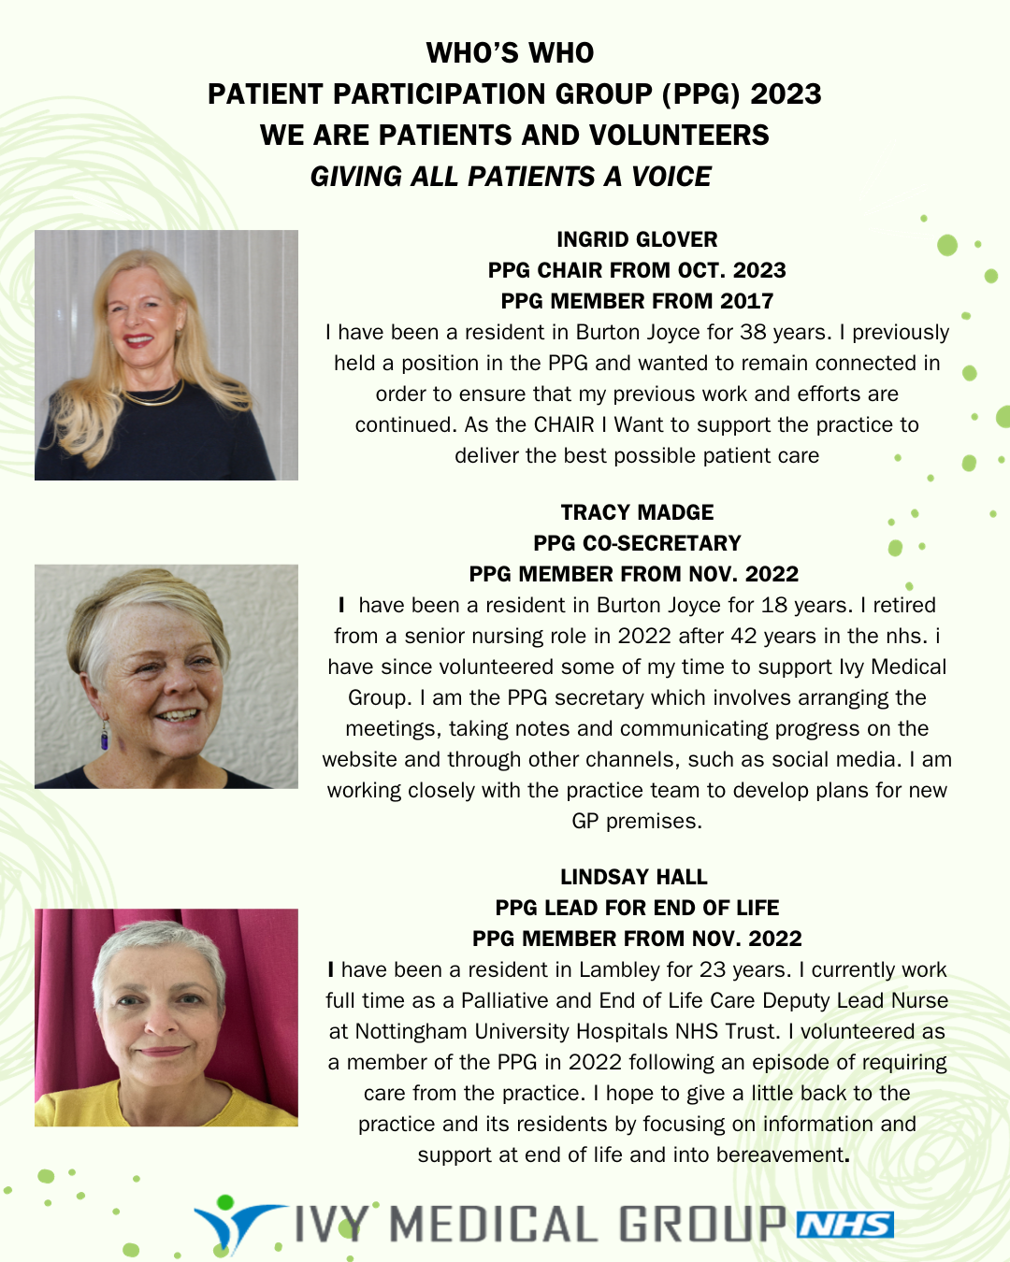
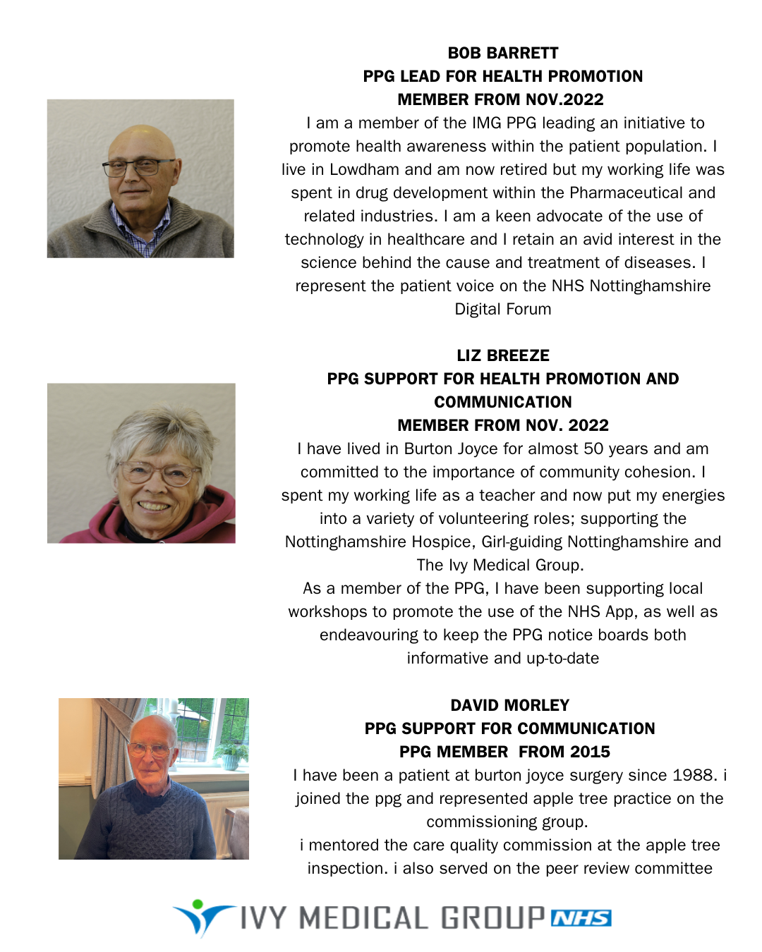
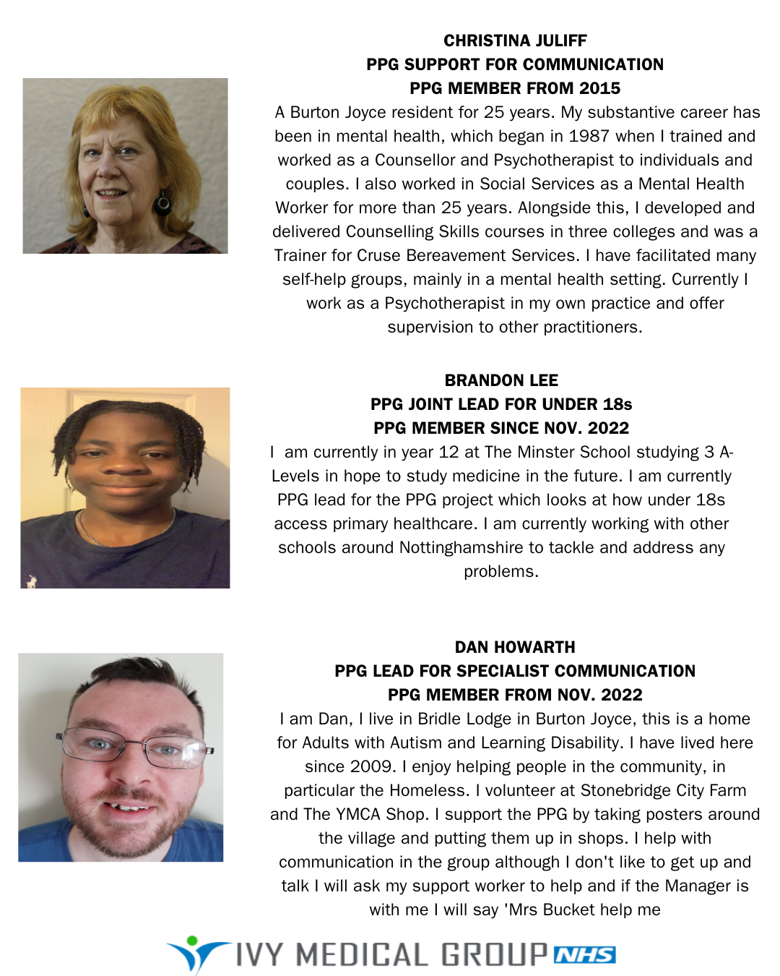
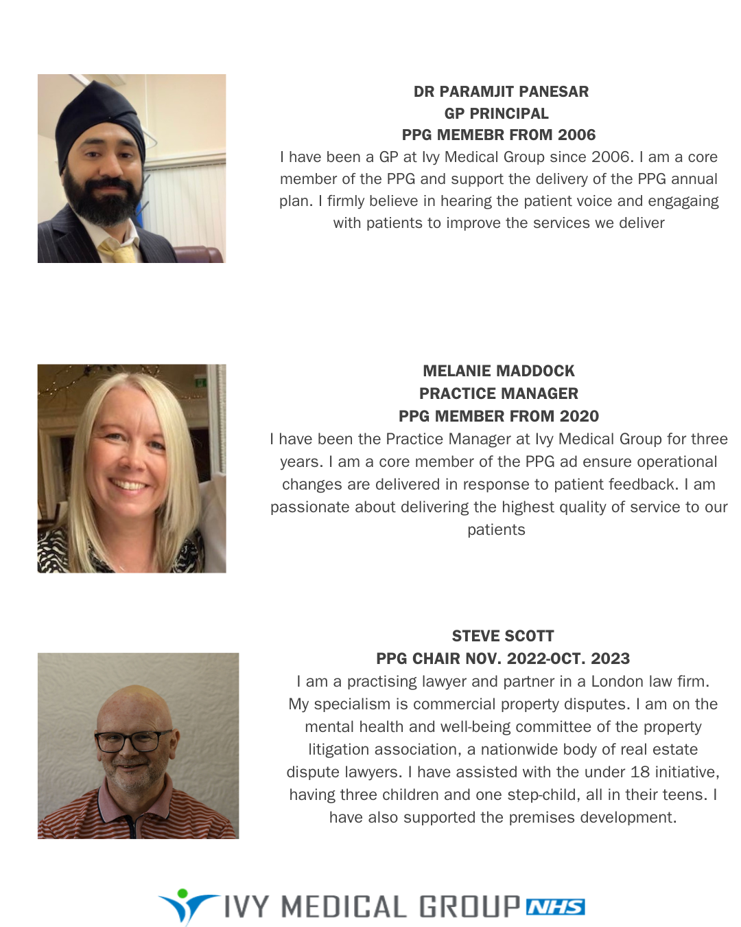
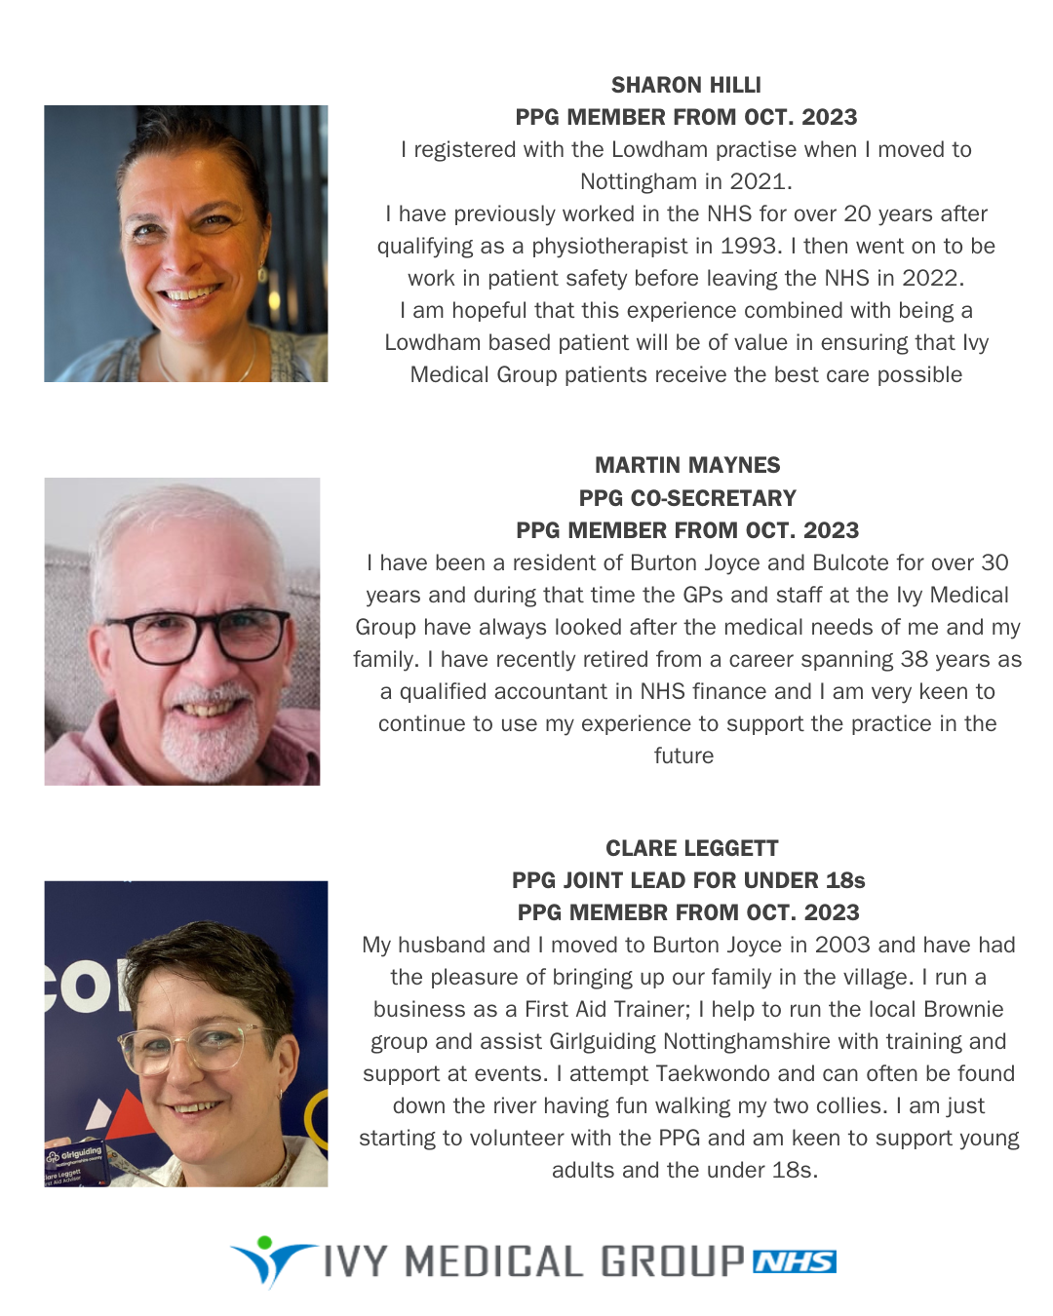
Your Patient Participation Group 2022

Slide 5
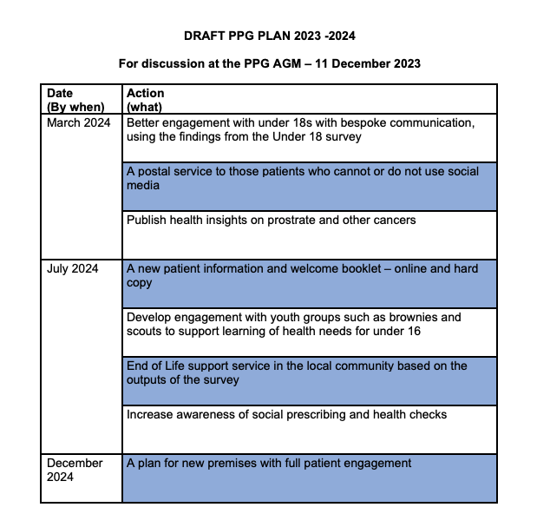
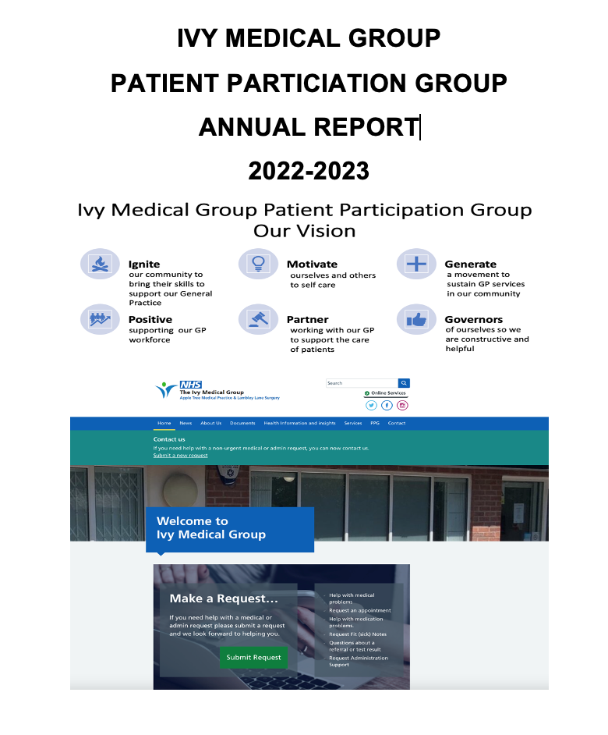
Our first AGM and annual report 2023
The Annual General Meeting 2023 is the first to be held for Ivy Medical Group (IMG) PPG.
It aims to celebrate the achievements of the PPG in 2023 and to engage with fellow patients about future plans to take forward in 2024
Our PPG strives to be representative of the population of IMG. We have Brandon who is under 18 and Dan who has learning disabilities. We have seven women and five men
Since November 2022, PPG members have collectively given around 300 hours of their own time voluntarily, to deliver workshops, produce health insights, collate views, post information and ensure patient voices are heard, recorded and acted upon at PPG meetings
Our Annual Report is a thank you to our former and current PPG volunteers. This includes our former and current PPG chairs – Mrs Janet Kenwood, Mr David Morley, Mr Steve Scott and Mrs Ingrid Glover
Thank you to Dr Panesar and Melanie Maddock (Practice Manager) for their unwavering support of the PPG.

Slide 6
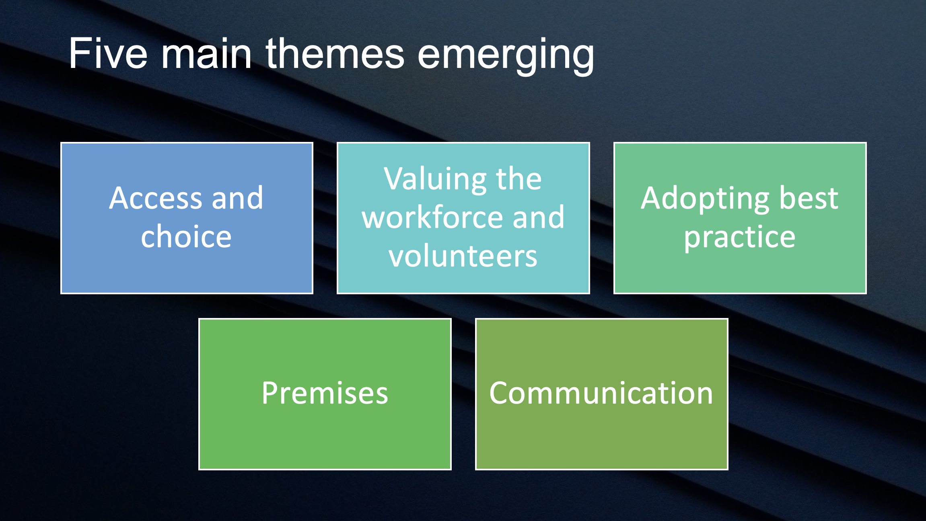
What we have achieved in 2022 - 2023
A listening PPG - engaged with you, the patients asking you for your views about the service
Published the report from the above engagement with five themes – See below
What Ivy and the PPG have done
Ivy launched patient triage with 7 PPG led workshops using the NHS App and website to get faster access. Showing use of best practice
Invested in a new website with PPG access to share news and services with as many patients as possible
Communicated via paper - with Dan and Liz, our PPG leads, ensuring posters and information is shared with non-technical patients by using local venues such as the post office and the co-op notice board (see poster on communication)
Supported the journey to new premises (see poster on premises)
Held 4 public meetings in 2022 with over 160 attendees; Surveyed over 140 people. Specific premises meeting with over 80 attendees and a Lowdham patient meeting in July 2023 with over 40 attendees

Slide 7
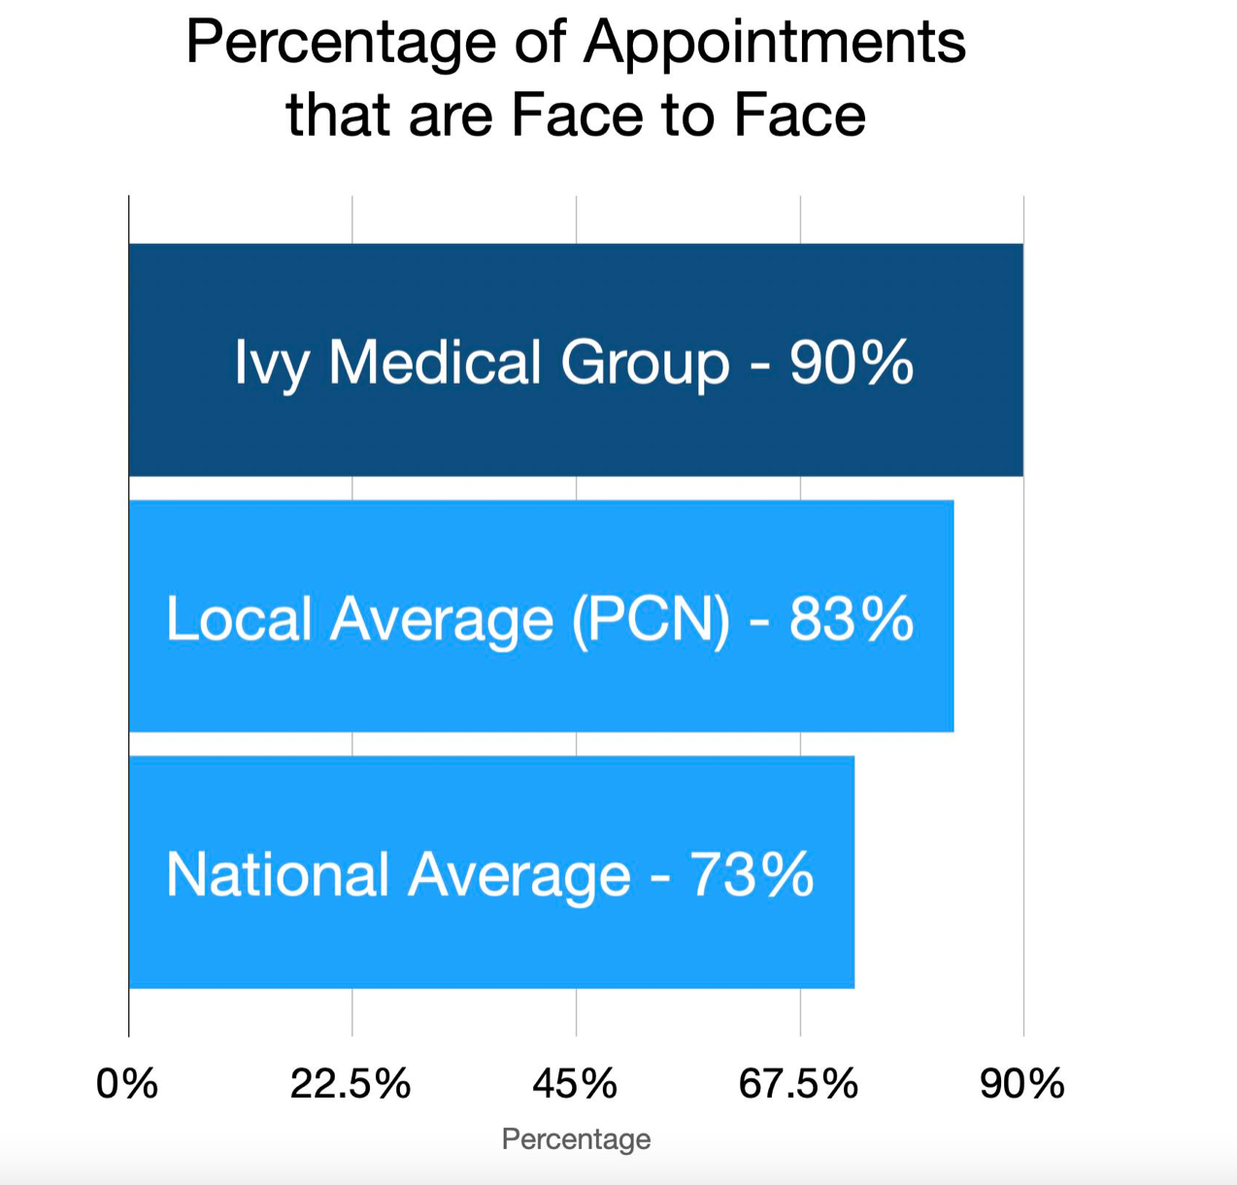
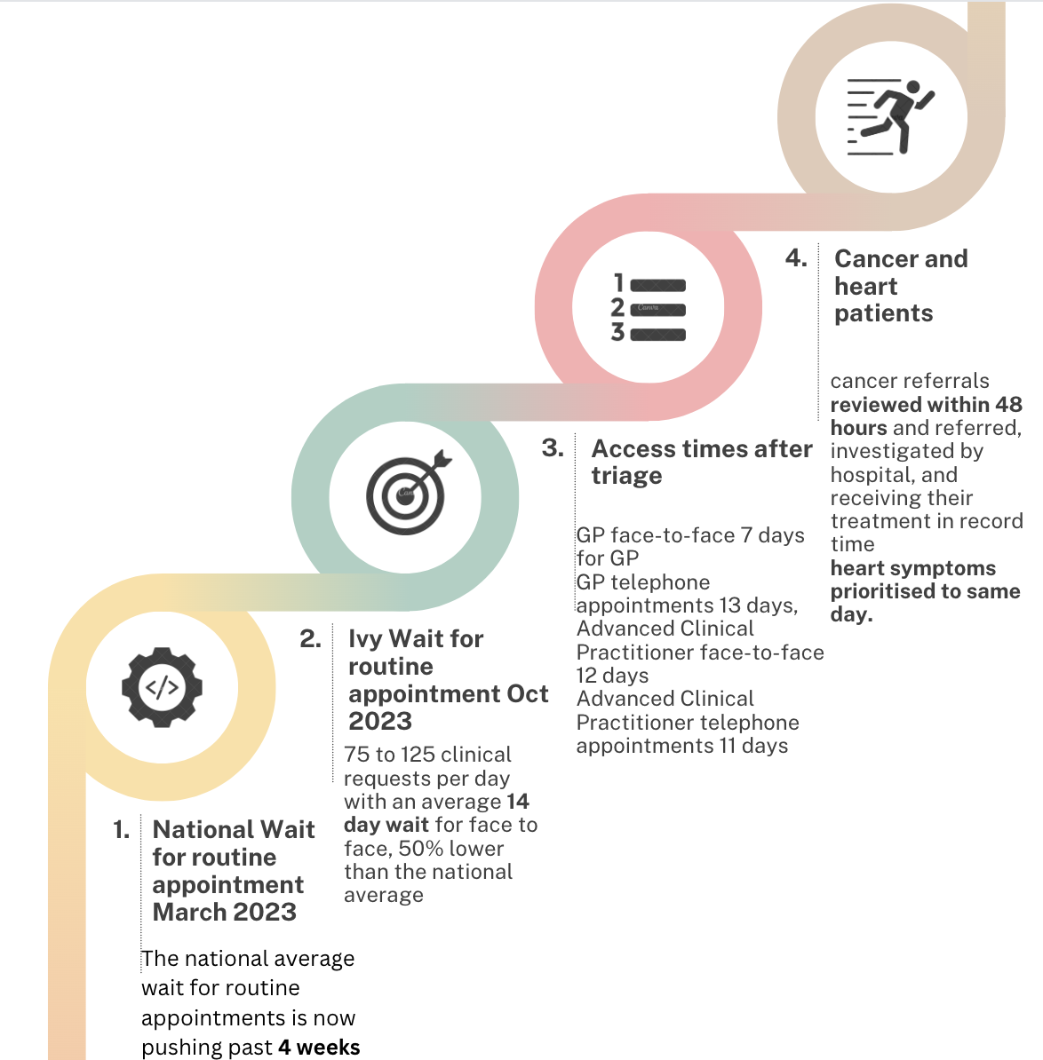
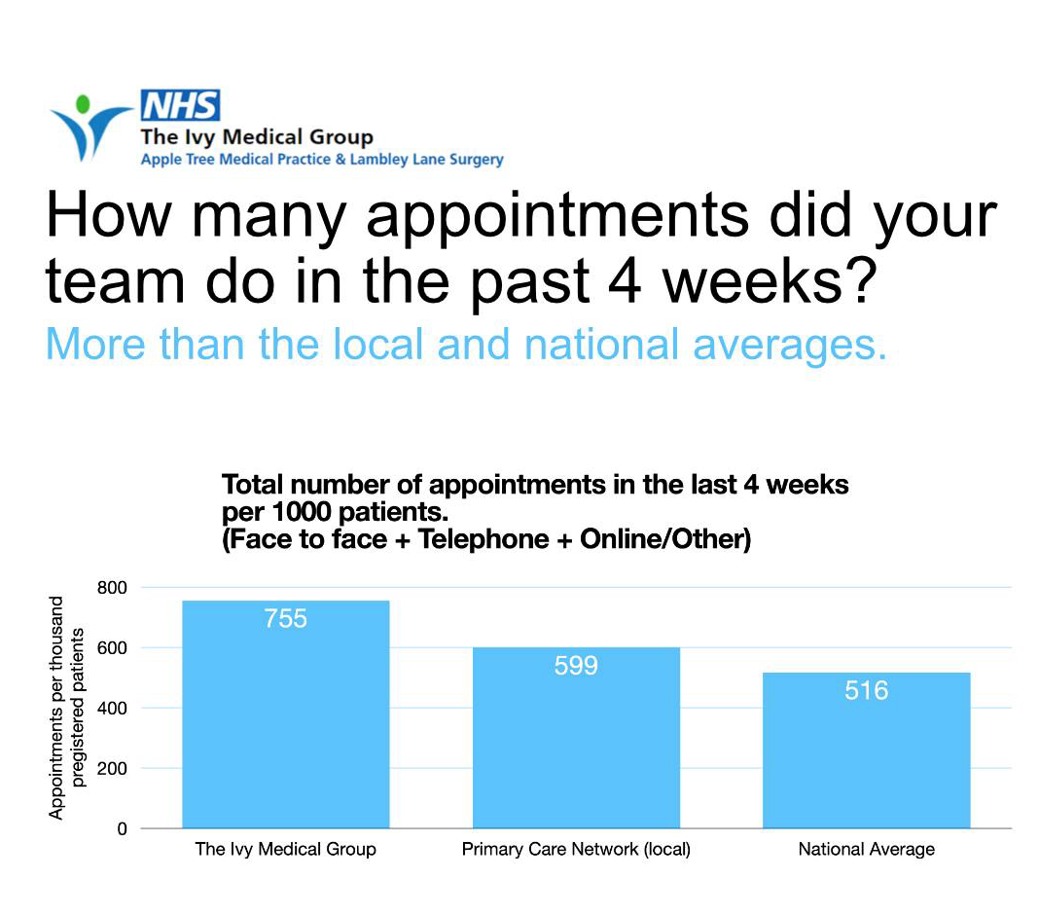
Patient Triage:
Reaching patients who found it hard to reach us.
Nov. 2023
As of June 2022, there were 6,495 GP practices in England. Of these 2500 are using patient triage – Ivy Medical Group is in the top 3 for delivering improved patient outcomes using this process
Nov. 2023
Please note that when the GP is at capacity and has no more appointments other NHS organisations provide urgent and emergency care, for example urgent care centres and Emergency Departments

Slide 8
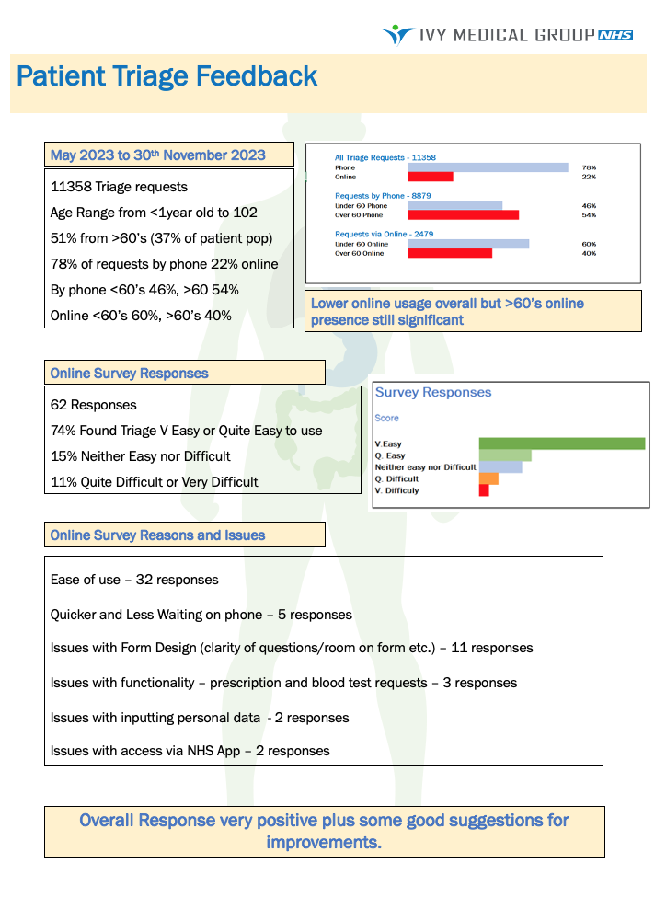
Patient Triage Feedback

Slide 9
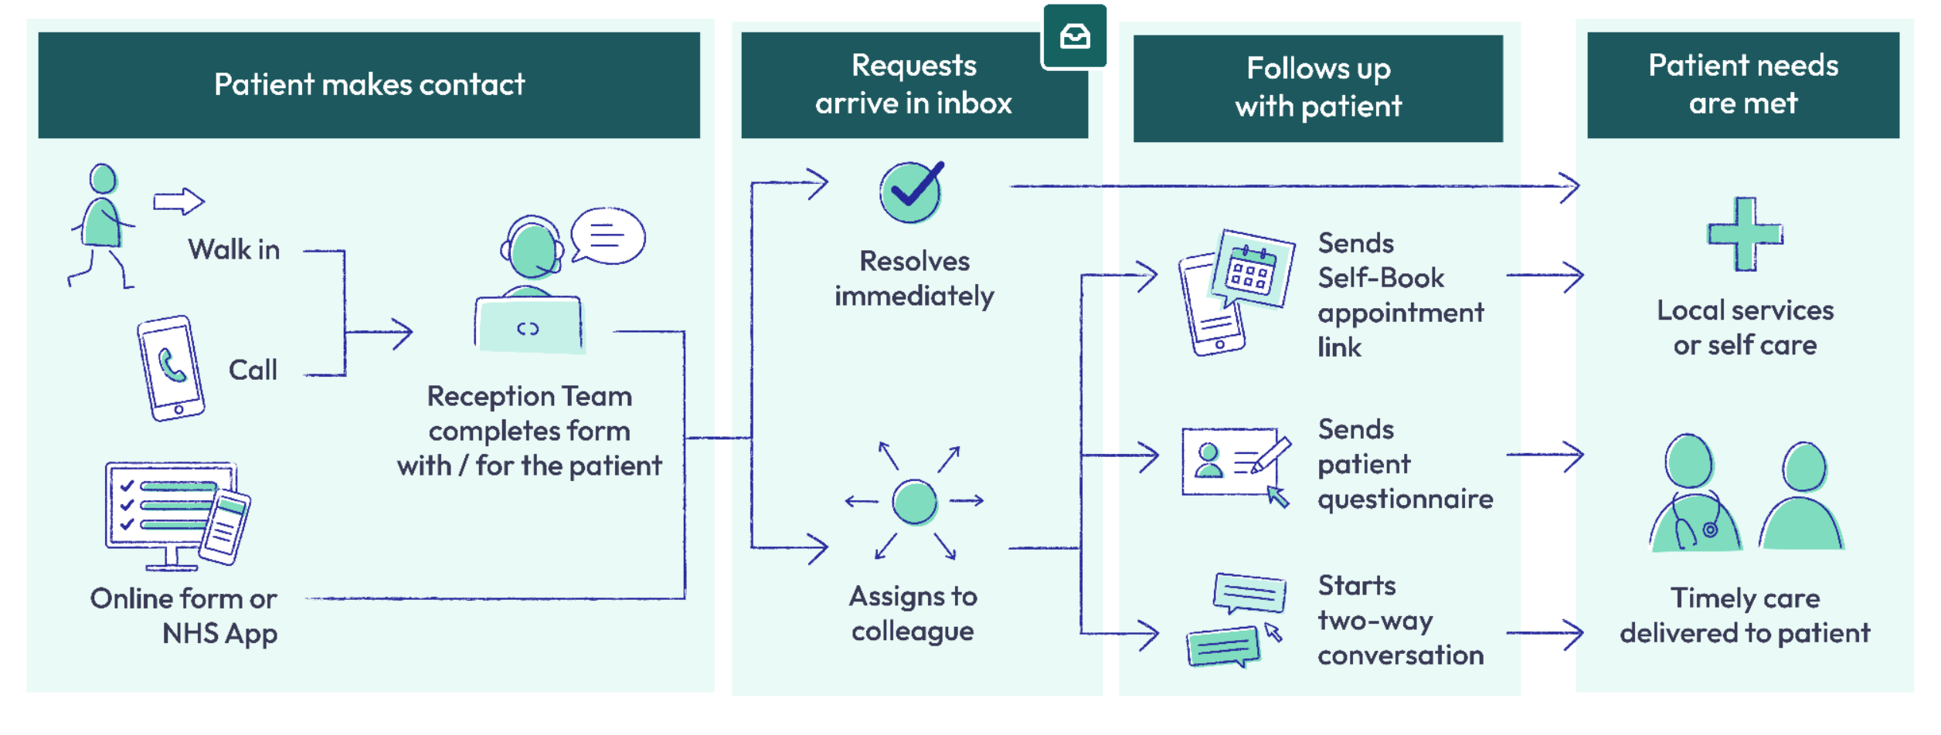
You don’t need to phone the practice, but you still can! The phone is no faster than online or walking in – they are all the same
We know it’s not always possible for patients to fill out an online request themselves. The new service lets reception staff or your friends/relatives submit a request on your behalf - whether they’re there in-person or on the phone, improving patient access and streamlining contact points.
All online and reception contacts are assessed by a senior clinician such as Dr Panesar. This service identifies serious, life-threatening conditions faster than ever before.
Patient Triage – it’s a GAME CHANGER

Slide 10
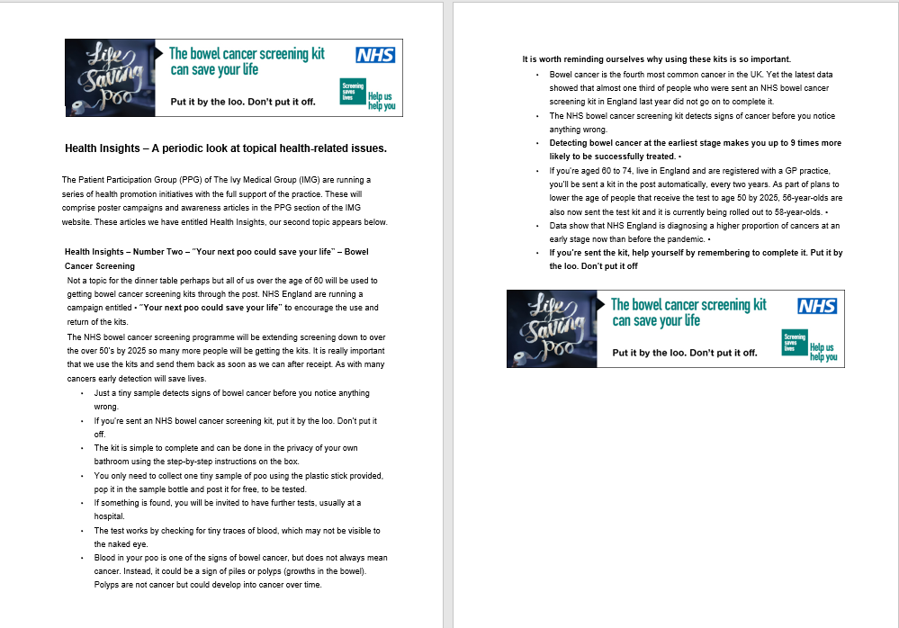
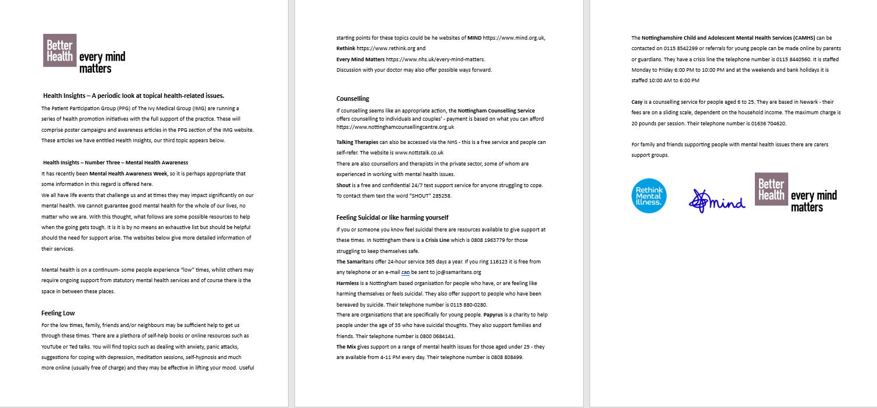
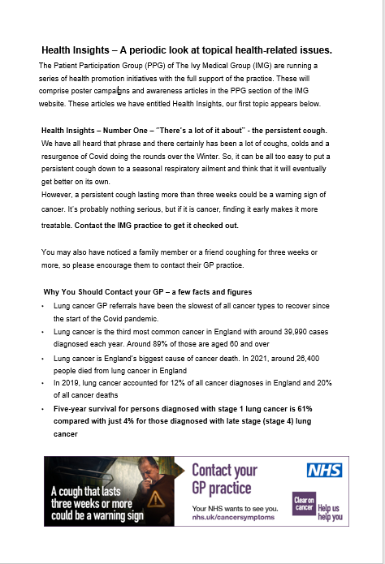

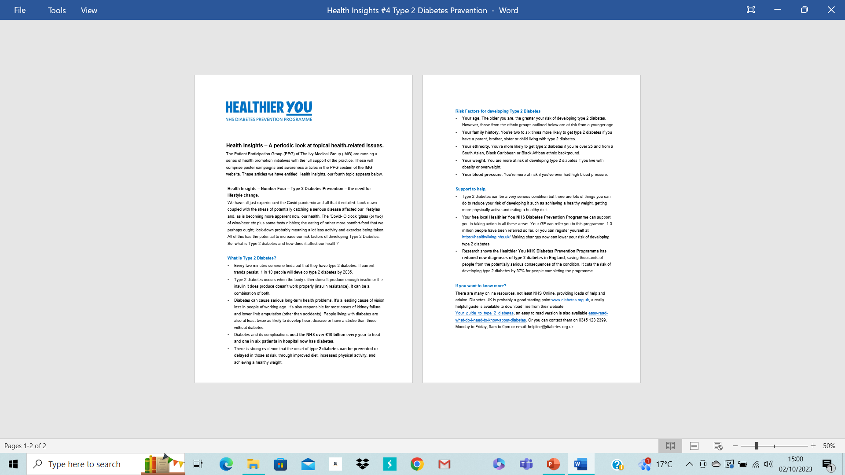


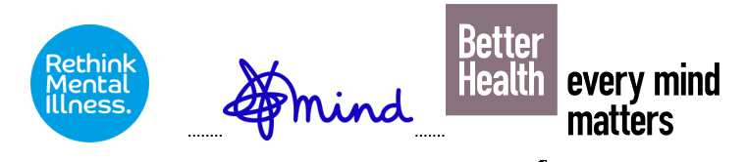
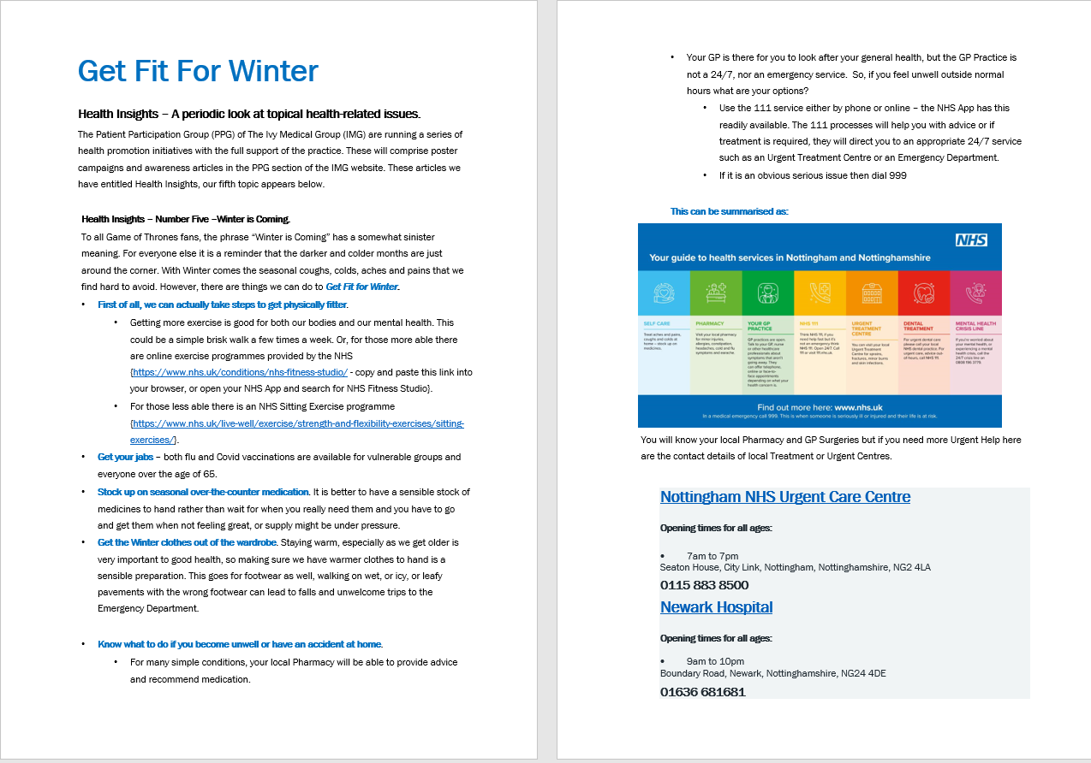
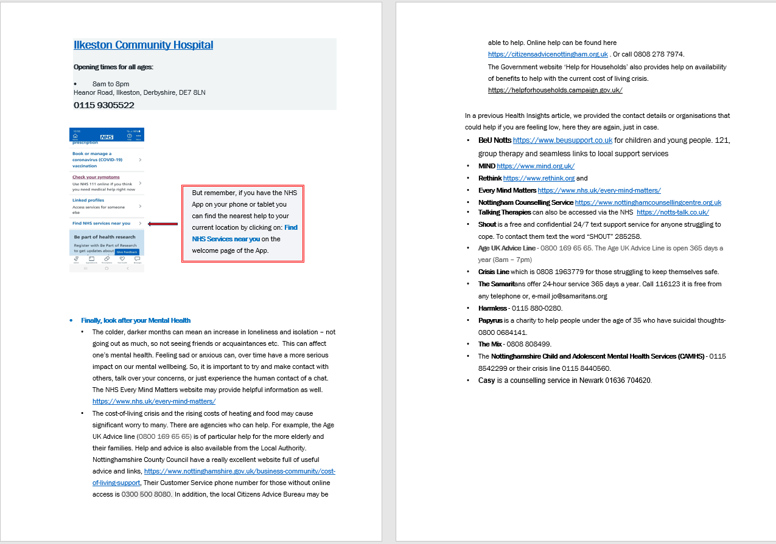
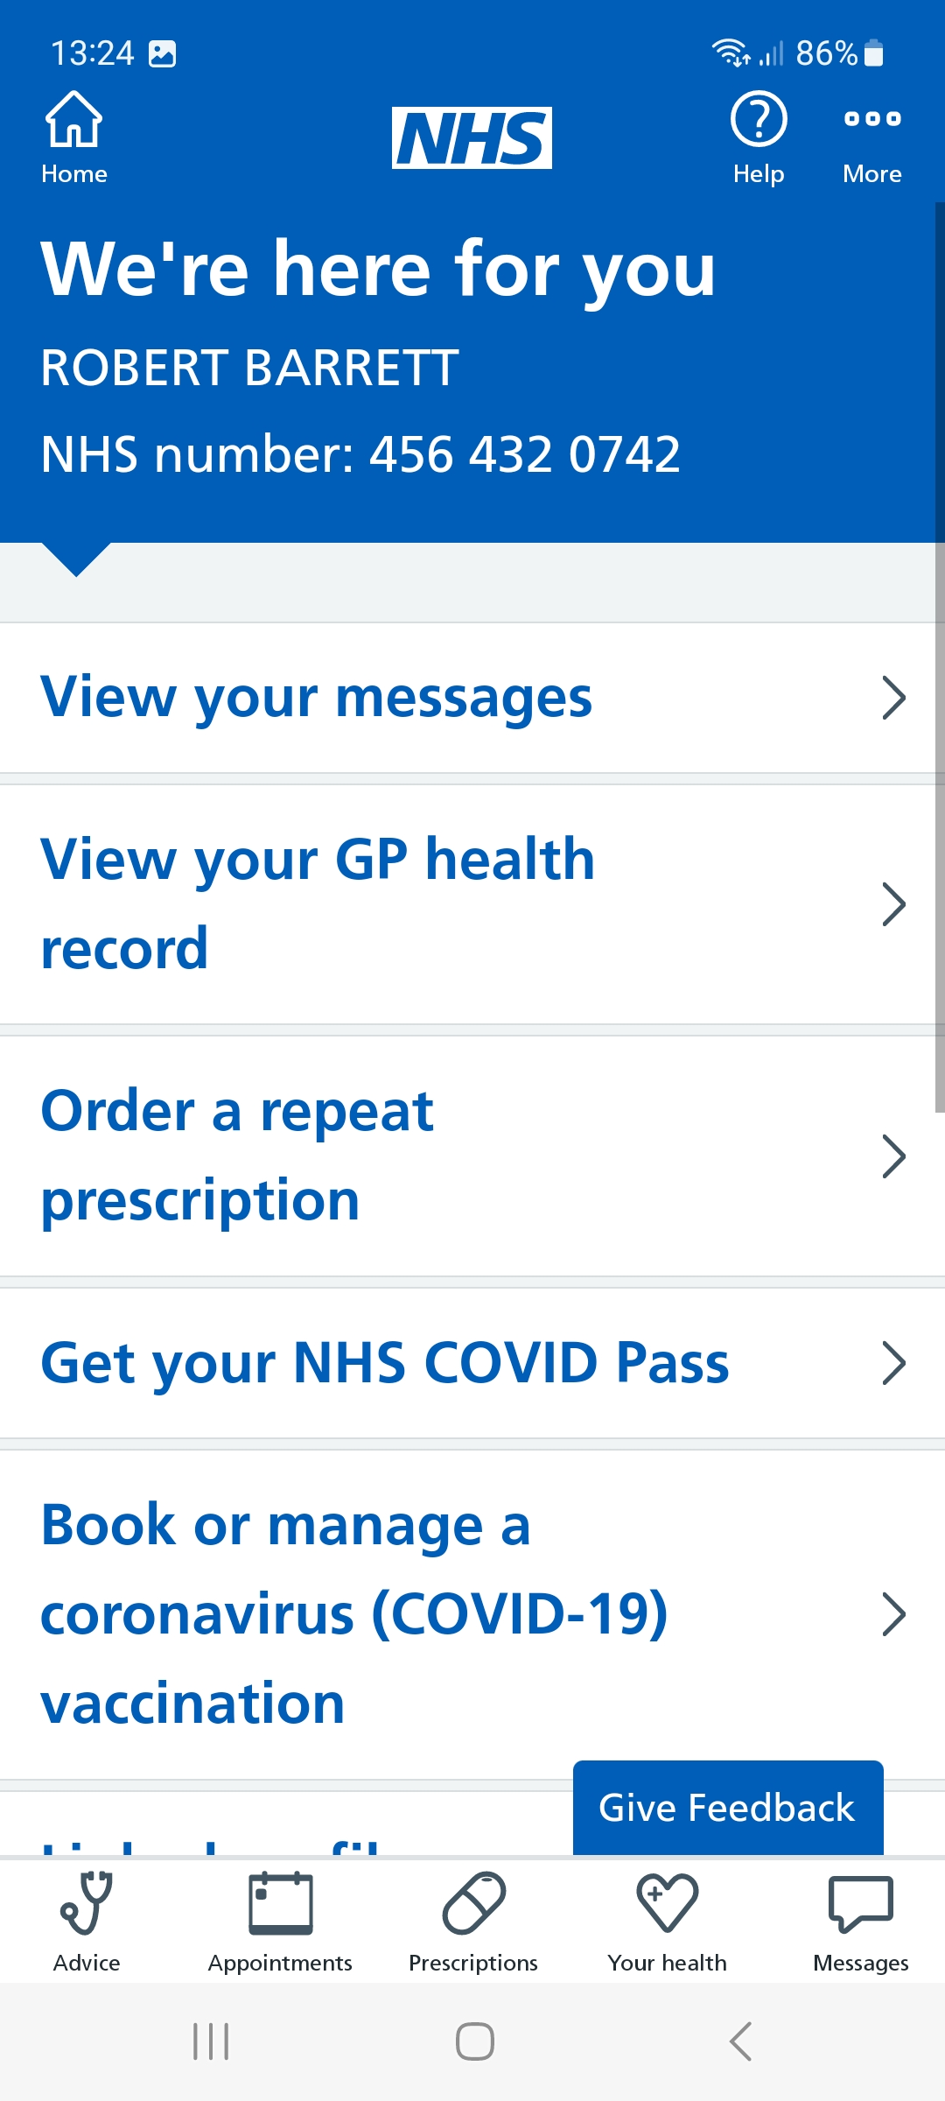
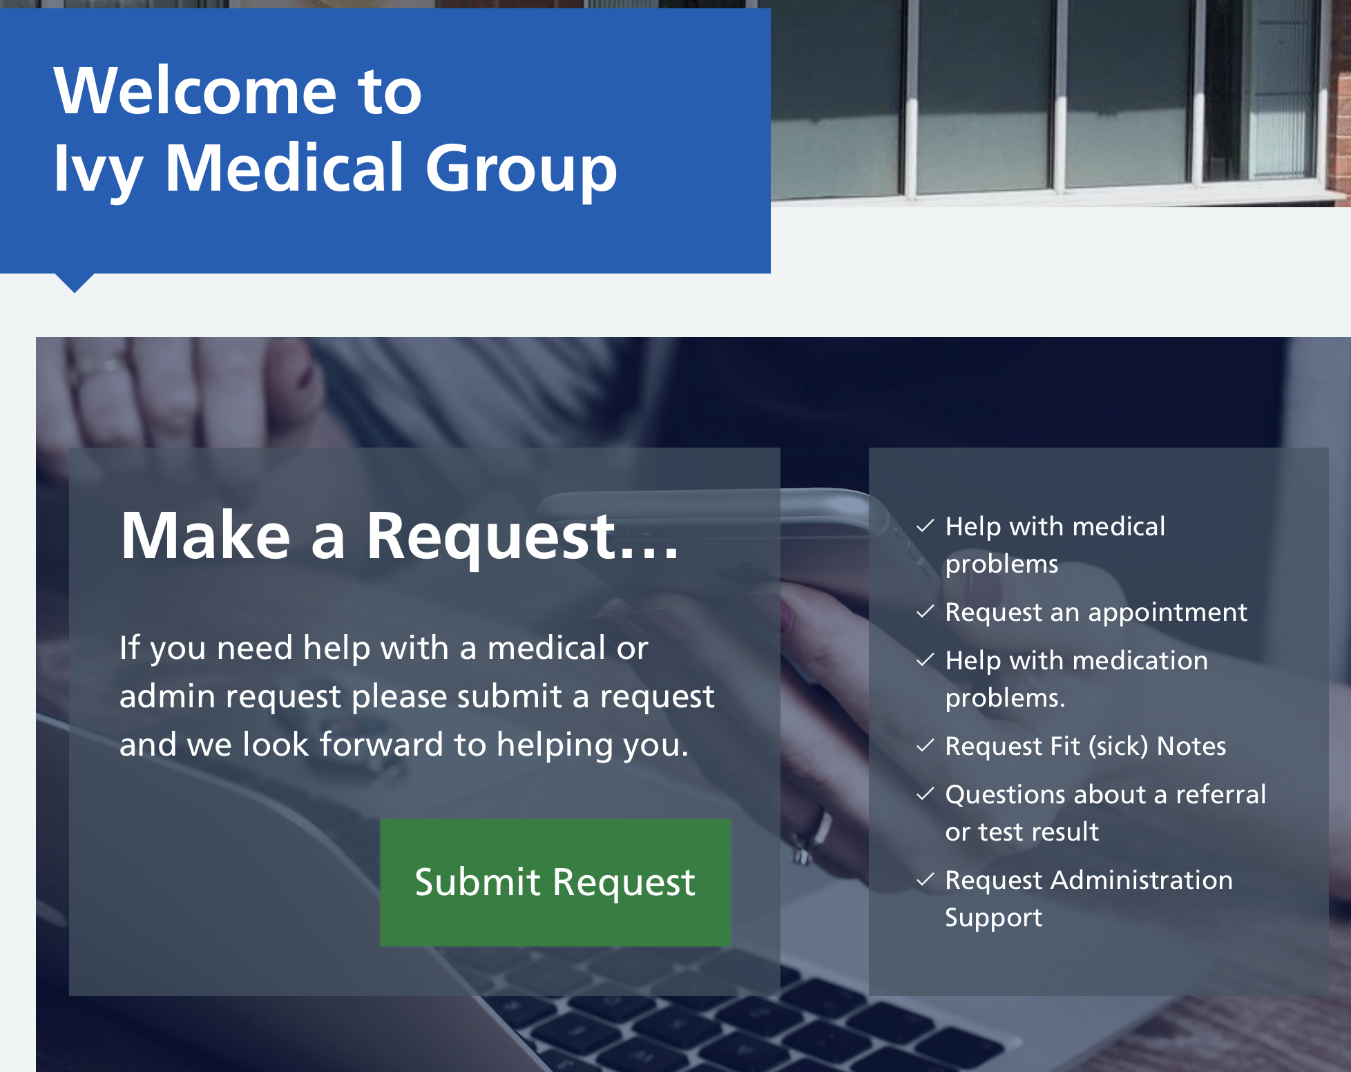
Patient Participation Group – Health Awareness Workstream
PPG Lead: Bob Barrett
PPG Contributors: Liz Breeze, Christine Juliff and Tracy Madge; NHS Contributor: James Hastings
Aim
How
Our Aim was to raise awareness of various topical health issues and to help patients with the NHS drive towards greater use of technology, such as the NHS App and the IMG’s use of the Patient Triage system.
For the NHS App and Patient Triage system we organized face to face workshops and handouts.
For broader health topics we carried out poster campaigns plus written articles (entitled Health Insights) in the Parish Magazines on Social Media and as leaflets in Waiting Rooms. We use the Ivy website to ensure these are always available.
What we did!
Health Insights Articles
#1 Lung Cancer #2 Bowel Cancer Testing #3 Mental Health Awareness #4 Diabetes Prevention
#5 Get Fit for Winter
NHS App and Patient Triage
Workshops
Multiple workshops in Lowdham, Burton Joyce and by request for specific groups.
One-on-one support provided by NHS Digital Inclusion Coordinator James Hastings at workshops and regularly at IMG surgeries
Seven workshops with >140 attendees – very positive feedback
IMG now overachieving target for NHS App logins and usage.
67% of IMG patient have the App, national average is 54%
Feedback (via questionnaires) from workshops overwhelmingly positive – see opposite. Green positive, Blue neutral, red negative.
Early days for Patient Triage, but about 500 requests per week being processed and majority of feedback is positive.
Major benefits for IMG workflow and knowledge of patient health trends plus no significant telephone queues.

Slide 11
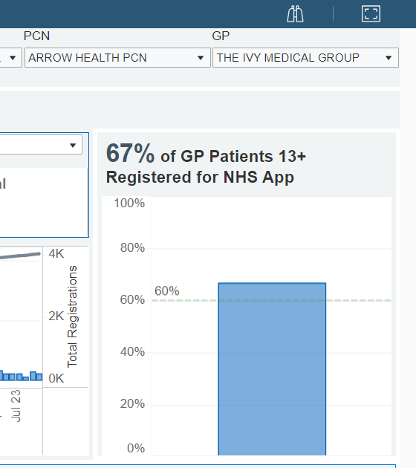
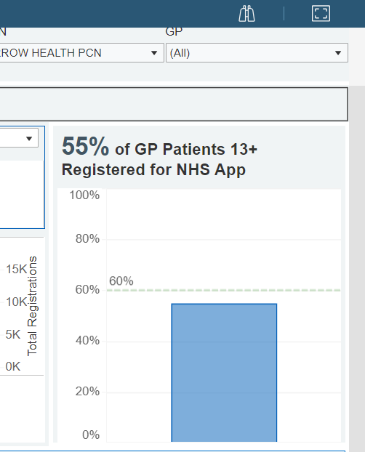
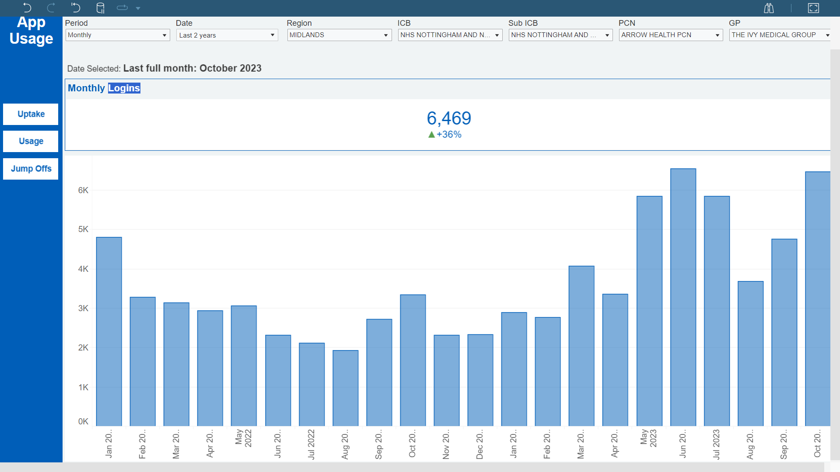
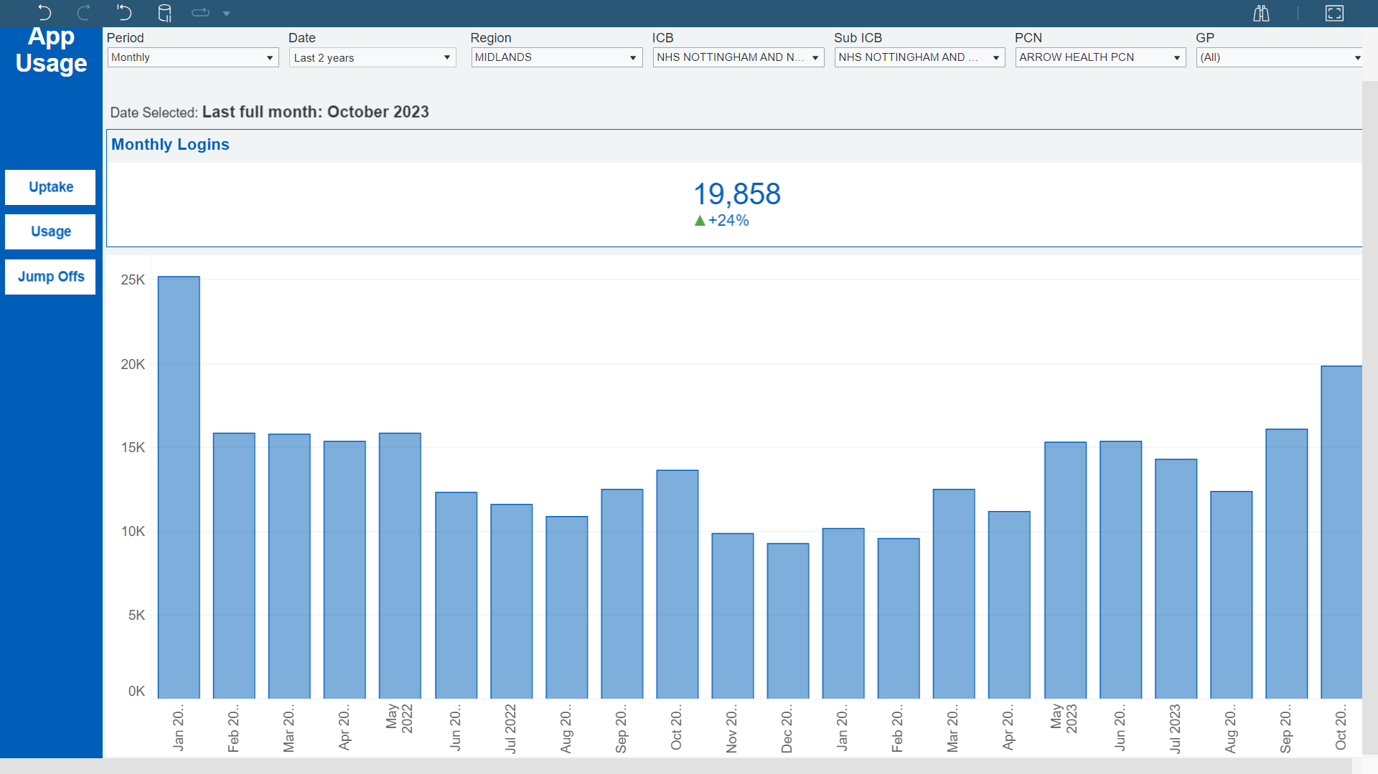
Did the Workshops Work?
NHS App Uptake and Usage – Data from NHS Digital Dashboard
Registered Patients with the App
IMG – 67% up from 61% in 2022
Registered Patients with the App
Whole of Arrow PCN – 55% (Without IMG 53%)
IMG 12% Ahead of the rest of its Primary Care Network. National Target is 60%
NHS App Usage - Avg. Monthly Logins
IMG – 64% increase from 2022
NHS App Usage - Avg. Monthly Logins
Arrow PCN – No change from 2022
2023 – 4600 logins per month
2022 – 14000 logins per month
2023 – 13600 logins per month
2022 – 2800 logins per month
Conclusion
IMG PPG Workshops increased both uptake and usage of the NHS App

Slide 12
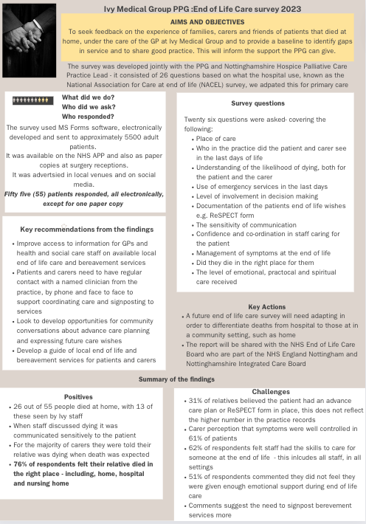
End of Life
End of Life

Slide 13
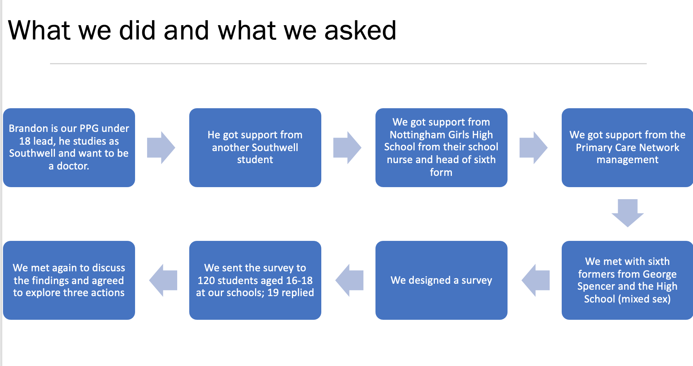
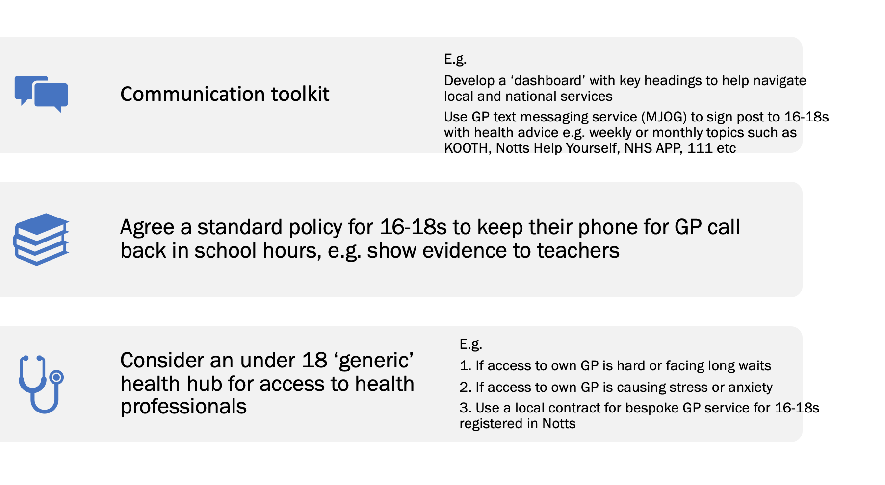

Under 18s
What we set out to do
To identify the needs and expectations of under 18s in relation to General Practice. This will enable production of a co-developed health support offer
What our three recommendations are
Survey and full responses are available on the Ivy Medical Group Website – under the PPG tab.

Slide 14
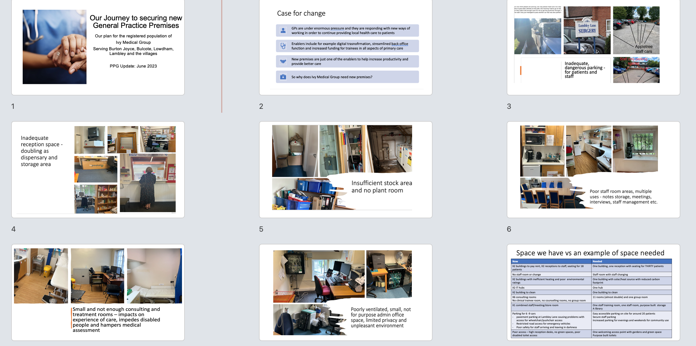
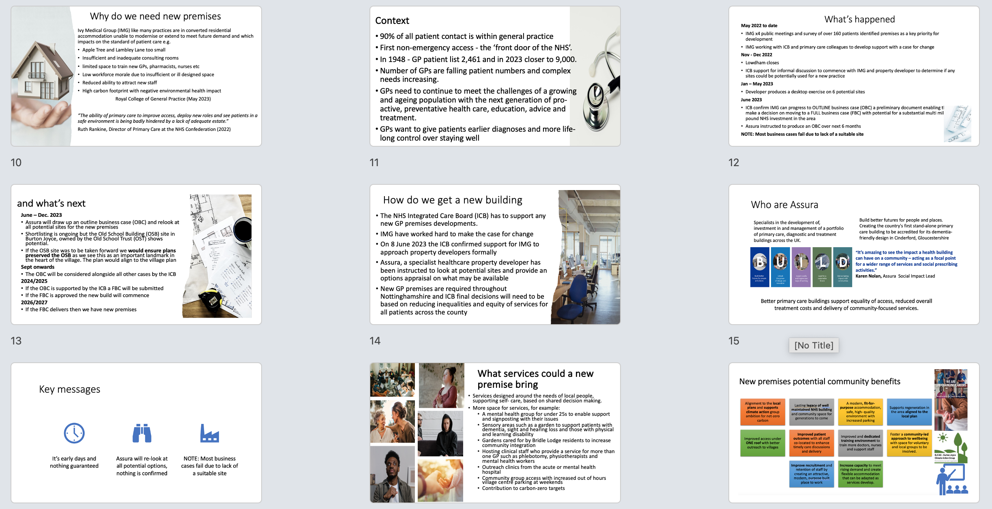
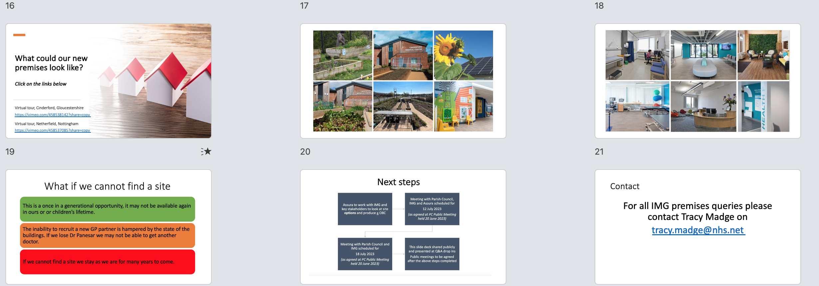
Our journey to new premises
A PPG led public meeting in July 2023 with over 80 attendees to keep patients informed
Sharing information via our communication channels (see website for all slides and Q&A)
Assura working to find suitable sites and will report in early 2024

Slide 15
Benefits of a PPG

Slide 16
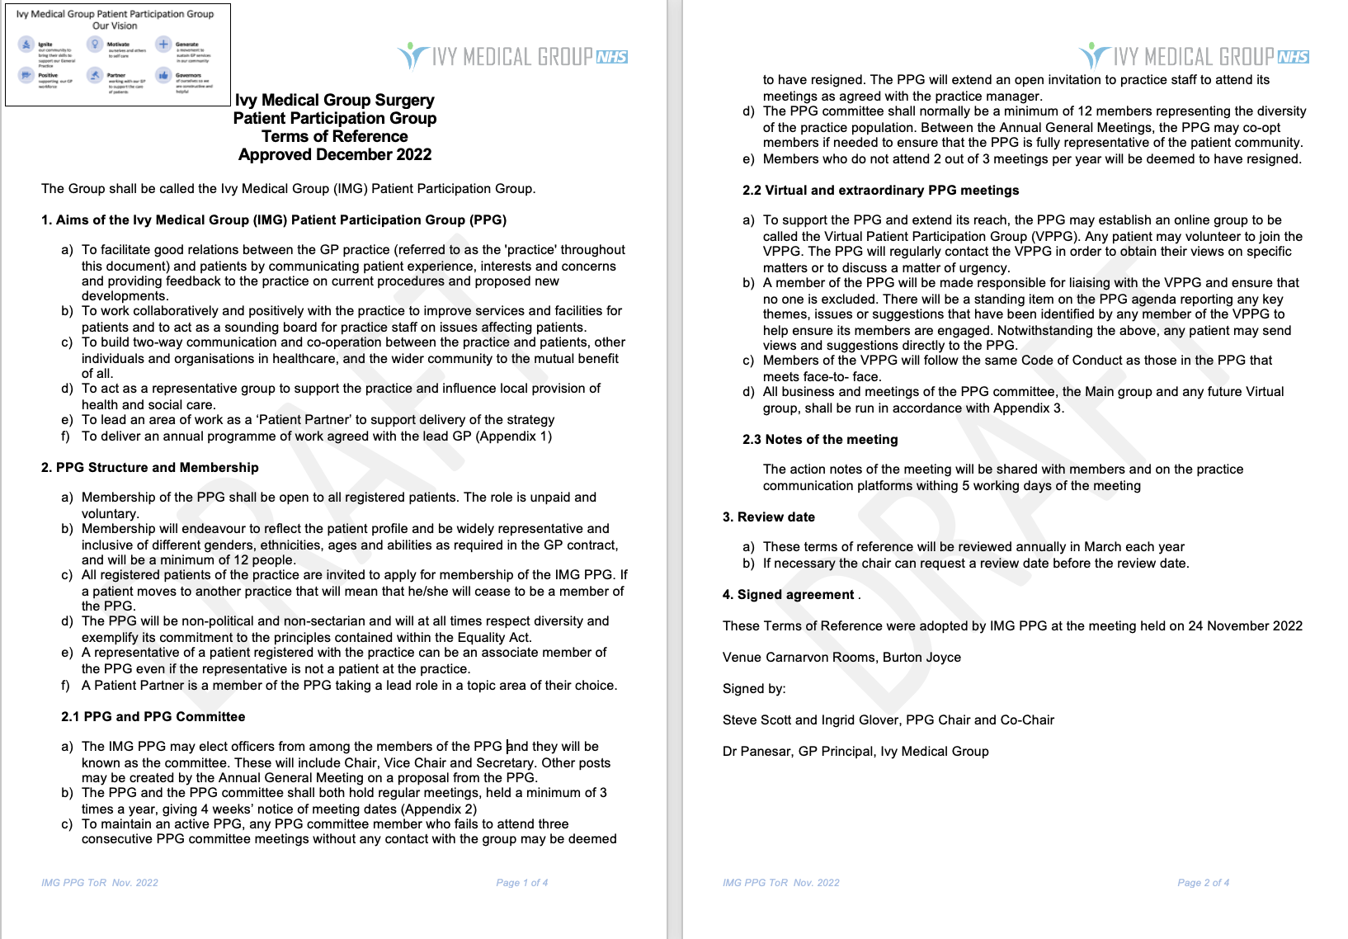
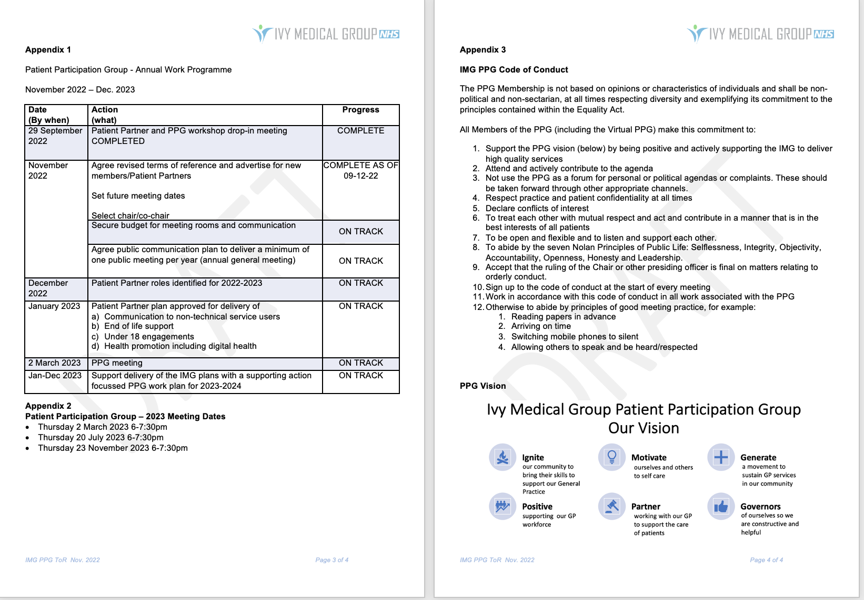
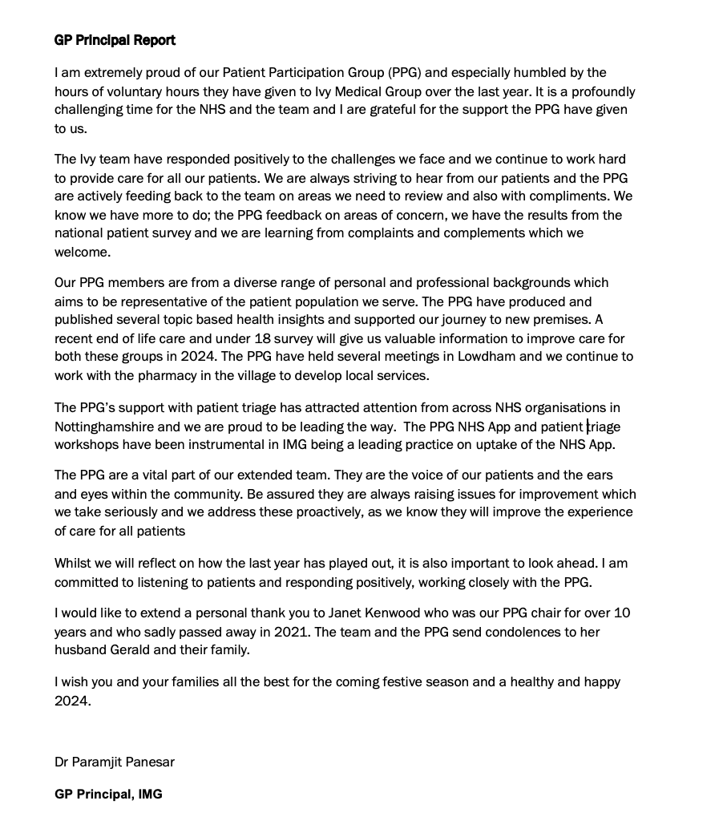
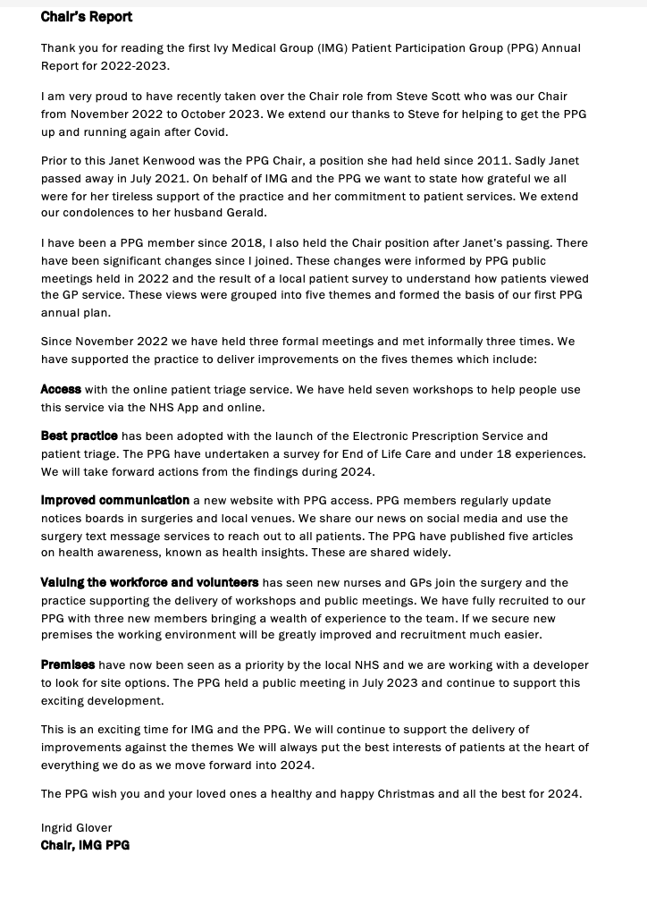
Our vision, governance, work plan 2022-2023 and our leaders
See website for more information

Slide 17
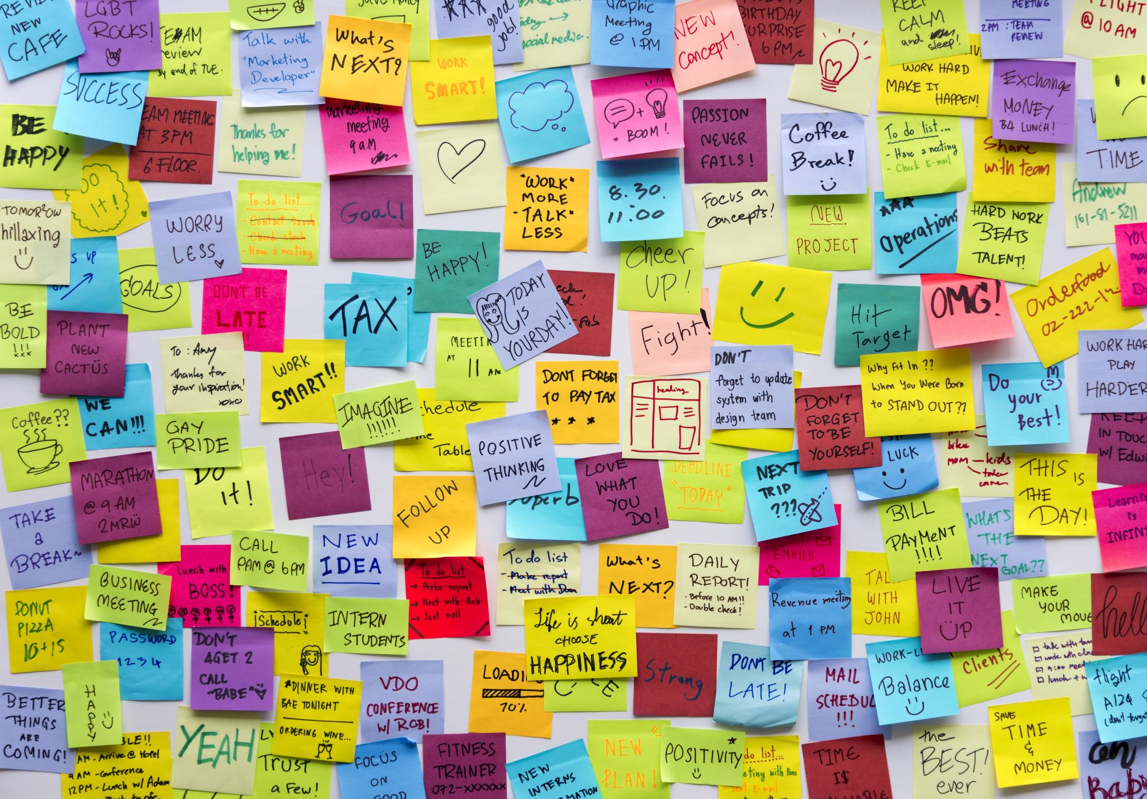
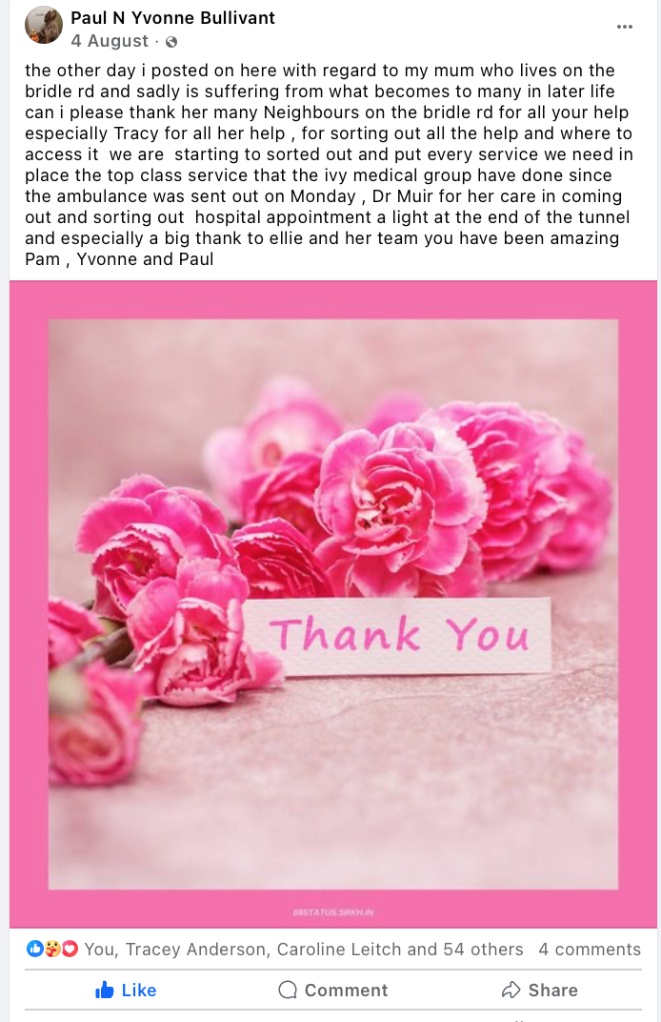
Patient views in 2023
The main duty of PPG members is gathering views from patients via friends, neighbours and people they meet at every opportunity
The PPG has held seven NHS App/Patient Triage workshops
The PPG has undertaken an End-of-Life care survey with 3 key recommendations (see poster)
The PPG has undertaken an under 18 survey on GP services led by sixth formers with 3 key recommendations (see poster)
Since summer 2022 the PPG has held 7 public meetings; four on views of the service, one on premises, one for Lowdham and one for End-of-Life care
At every workshop the PPG has sort patient views and fed these into Ivy (see poster)
The PPG has held three formal meetings to discuss the service, with minutes taken and shared widely with patients
PPG members have responded to patients who expressed views about the service on social media with positive feedback
Published a report in 2022 on the views of patients including those from a bespoke patient survey
Continually updated notice boards and the website with patient/practice news

Slide 18
Patient views
Please contact us about your experience of care at Ivy Medical Group - compliments and/or areas you may be concerned about. Please stick them on the space opposite
For personal issues please use the Ivy complaints process rather than social media when you have concerns – the practice see complaints as a way of learning - so they are seen as a positive
A complaints form is available from surgery receptions. Additionally, you can complain by sending a letter via email:
nnicb-nn.ivymedicalgroup@nhs.net
or post to:
6 Lambley Lane,
Burton Joyce,
Nottingham, NG14 5BG
If you need support to navigate the process, please email our PPG via tracy.madge@nhs.net
Please note that when practice is at capacity and has no more appointments, other NHS organisations provide urgent and emergency care, for example urgent care centres and Emergency Departments

Slide 19
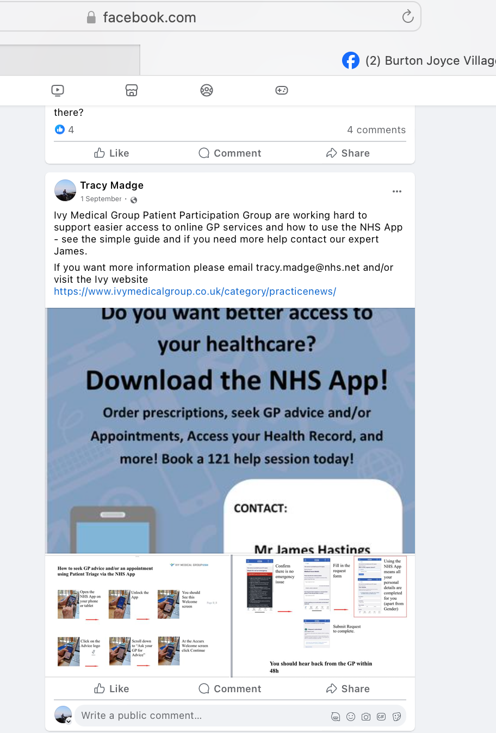
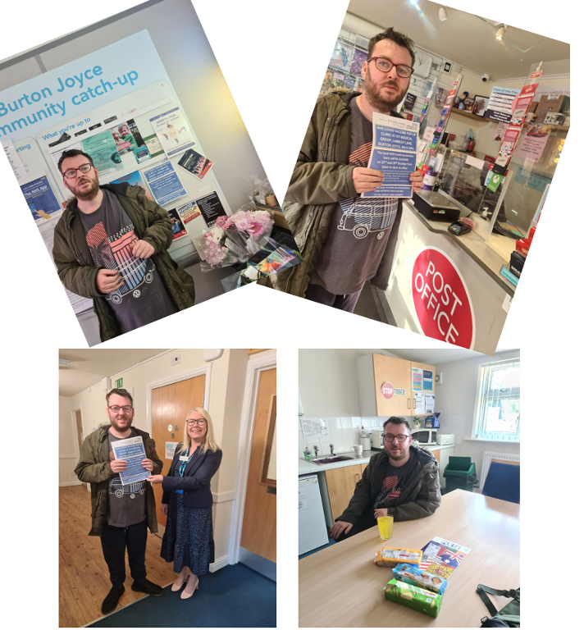
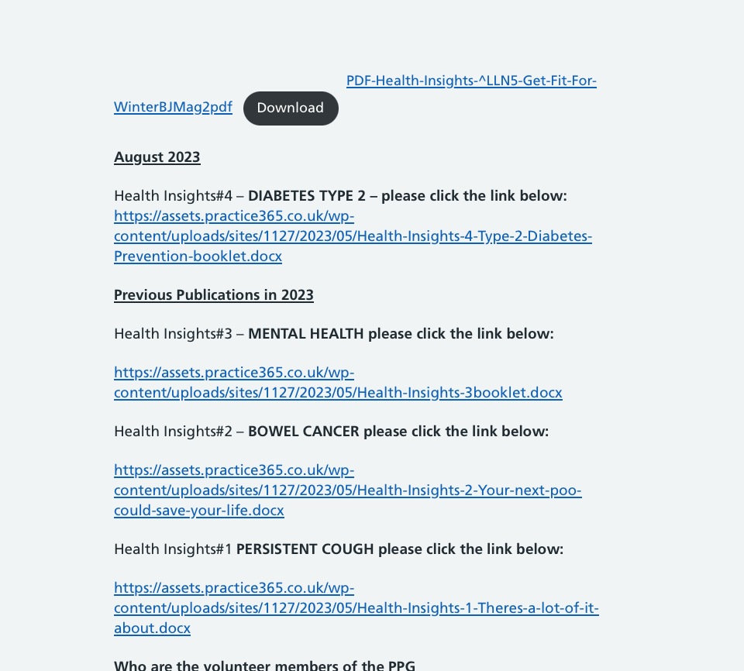
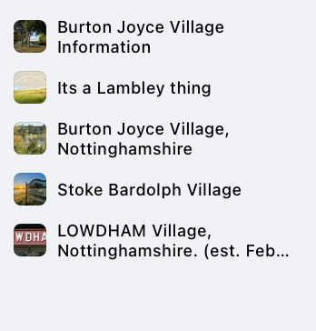
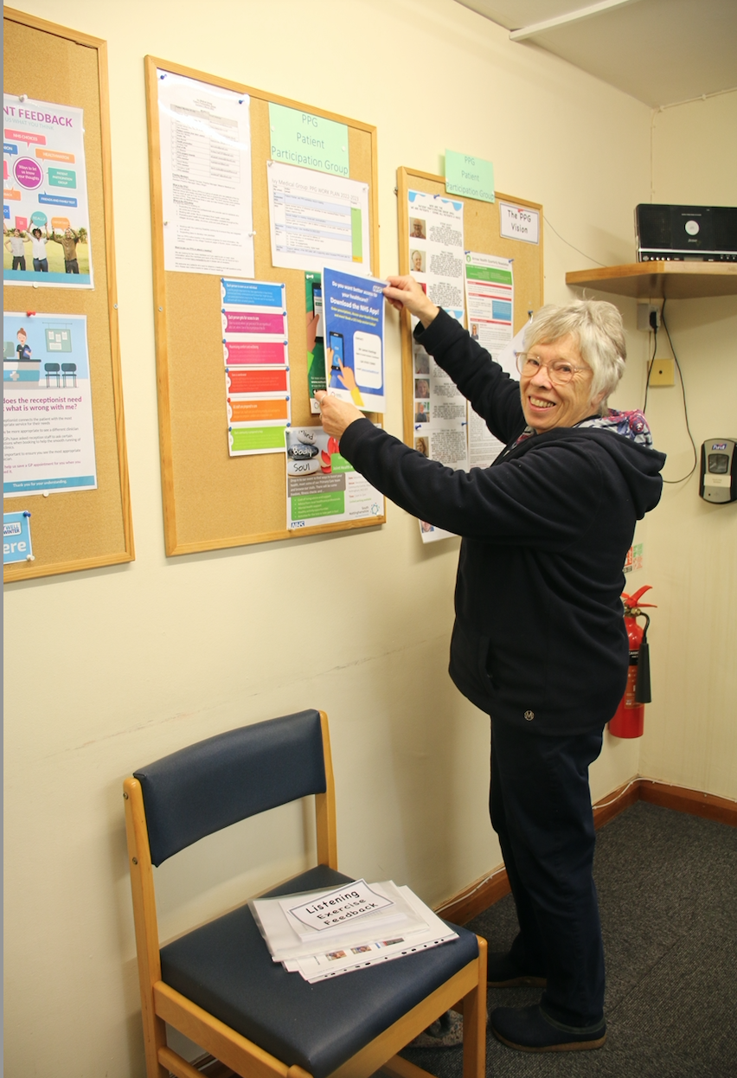
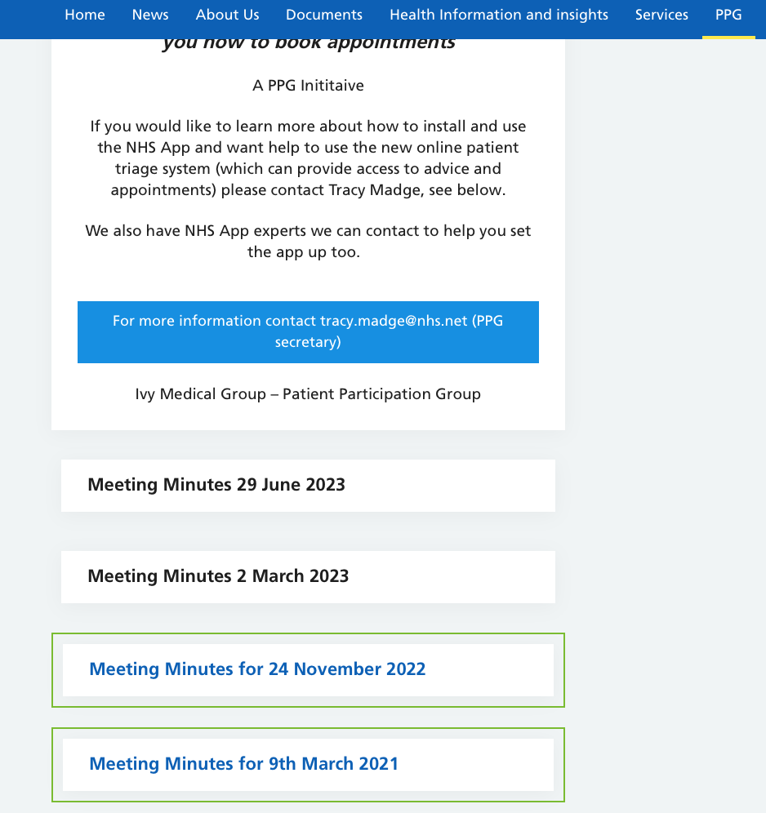

Communication
Dan and Liz have kept our notice boards up to date in our surgeries and local venues.
Our PPG regularly share information on website and social media.
We are currently working on a process to communicate news to non-technical patients.

Slide 20
Practice performance:
You said we did January 2023 – December 2023
You said – improve communication
What we are doing
We have supported the PPG to deliver several workshops on the NHS App, Patient Triage, End of Life and Premises
We have a new website which the PPG access to provide patient updates
We work with the PPG to ensure key news and updates are regularly shared across social platforms and on our notice boards
We are continuing to develop a system for identifying all patients who do not or cannot use technology so they can receive a postal service on all key news.
You said – improve access and adopt best practice
We installed automatic doors at Lambley Lane so people who find access difficult will be able to get into our service easily.
We moved to electronic prescriptions saving patient and staff time and increasing safety and therefore quality
We have delivered patient triage which has been highly effective in reducing waits. We are one of the top performing practices nationally using this service
We set up drop-in covid vaccination clinics
You said – value the workforce and volunteers
We have recruited new practice nurses and new GPs
We have supported the PPG to increase volunteers
Accredited as a training practice contributing to the national and local need for more GPs

Slide 21
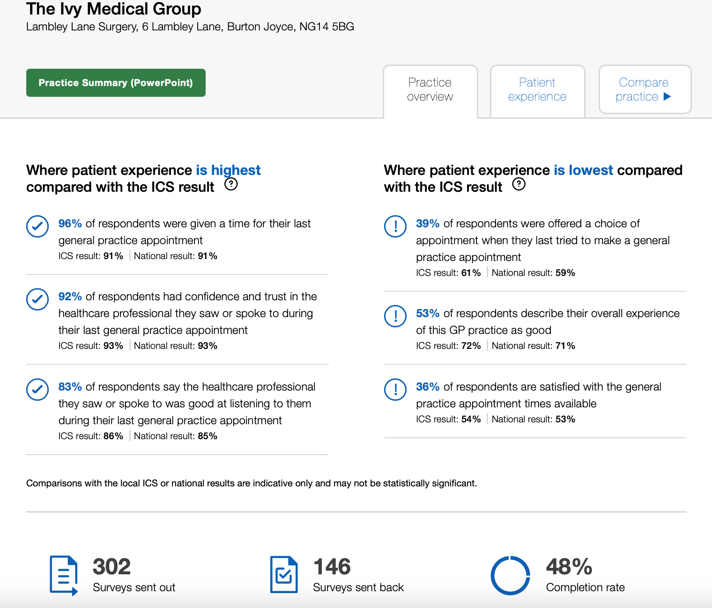
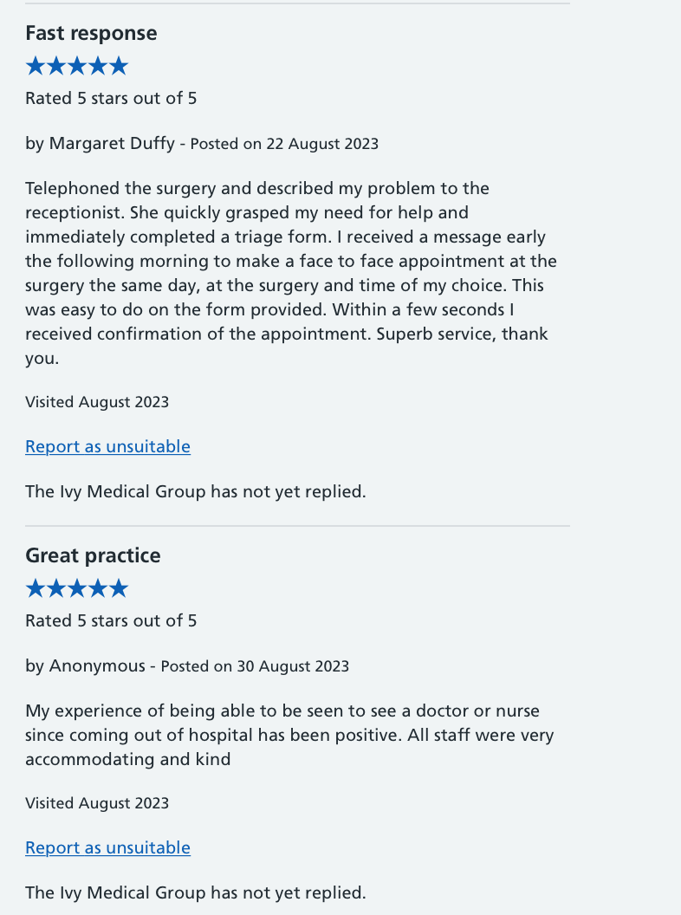
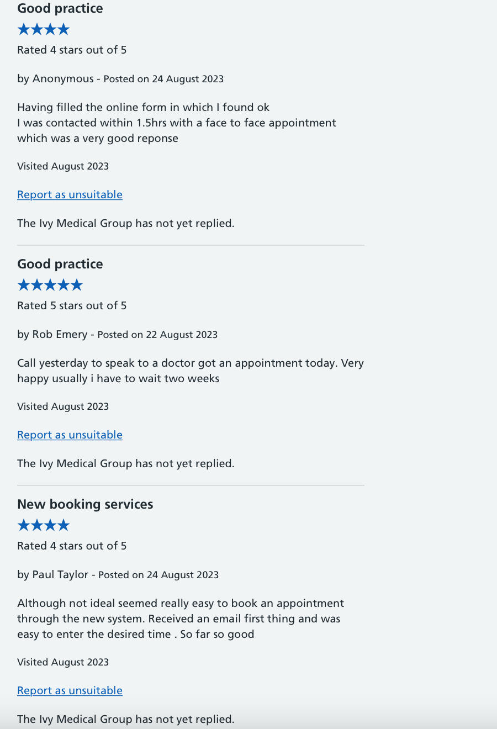
Practice performance:
Patient Survey 2023
We are a learning organisation and we have more to do but will build on our success. Our latest Patient Survey (2023) shows where we need to focus in the year ahead
(for a full data set please visit https://gp-patient.co.uk/compare?practices=C84646,C84613,C84010&s=0&w=1&g=0&a=0&e=0&h=0&l=0)
But the survey was BEFORE patient triage but we are starting to see the benefits already
(for more information see https://www.nhs.uk/services/gp-surgery/the-ivy-medical-group/C84646/ratings-and-reviews)

Slide 22
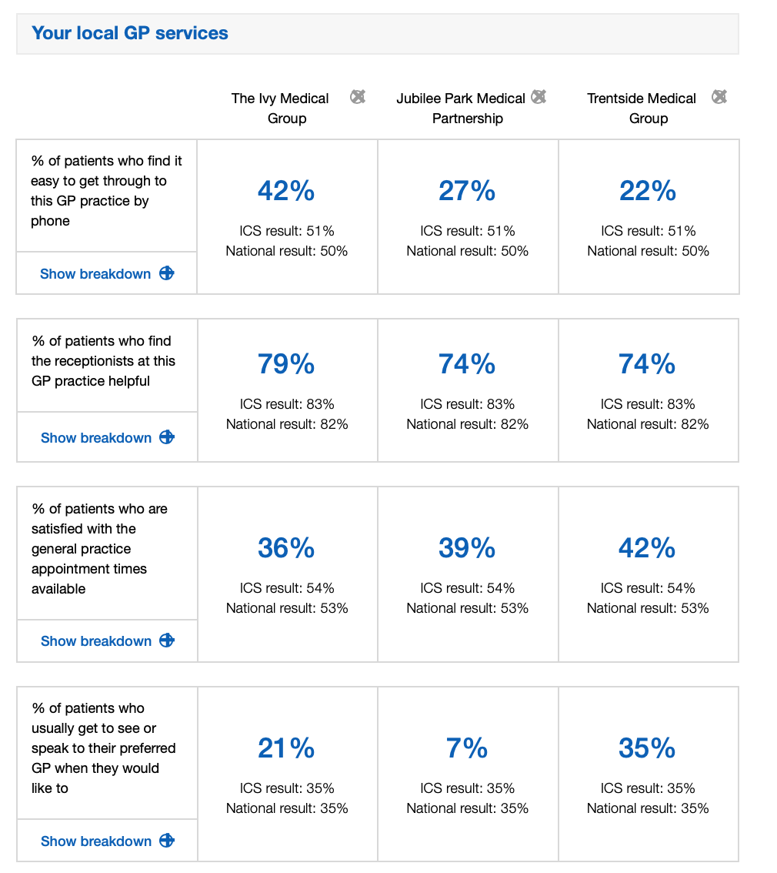


Practice performance:
Patient Survey 2023 comparisons
Our latest Patient Survey shows how we compare with other local GP services. For a full data set please visit
https://gp-patient.co.uk/compare?practices=C84646,C84613,C84010&s=0&w=1&g=0&a=0&e=0&h=0&l=0

Slide 23




Practice performance
Complaints and compliments Dec 2022 - Nov. 2023
Firstly, THANK YOU to all the patients who wrote compliments and complaints – we welcome both!
The purpose of gathering and reflecting on compliments and complaints:
To identify areas of good practice, strengths and what we do well.
To identify areas for improvement, lessons learned and any changes to be made as a result.
To demonstrate we value patients’ and others’ concerns and comments about our work by making changes as a result of the feedback we have received.
In 2022-23 Ivy received 24 compliments and over 12 thank you cards/letters.
Example of latest feedback:
patient called today and wanted to thank us for all our hard work and care.
The patient has felt very supported during the past year. She wanted us to know she
feels that we have had some unfair bad press. Well done #Teamlvy
After a night of the most excruciating pain. I have ever experienced I would like to
thank you for your prompt intervention in arranging for me to be taken back onto
the ward at the City Hospital. The Urology team responded swiftly, and I am pleased
to sav I am currently pain free and awaiting a CT scan.
Patient has asked me to pass on her heartfelt thanks to everyone. She said
herself, her husband & brother have had nothing but the best possible care … she is extremely happy with the service she receives & feels so cared for. She
also mentioned it was wonderful but sad to think some people feel differently. She is very, very happy with our patient care.
Complaint themes are reviewed at monthly team meetings with doctors, nurses and the support staff. Lessons learned are supported by any required service changes.
Themes are collated when more than 3-4 complaints are made on a certain subject.
In 2022-2023 the practice had 38 complaints from a registered patient list of approximately 6,800.
The themes are as follows:
Medication issues – e.g. queries on repeats and decline in issue from pharmacy
Response – get medication reviewed – these are flagged on the prescription or online. Please book your review
Locum doctors – not responsive to needs
Response - patient triage has almost stopped the need for locums, so they are used only when urgently required
Family members dissatisfaction and worry about their loved one's description of care
Response - care plan explained - when investigated the practice explanation almost entirely reassures the complainant of the plan of care. Please use or request proxy access so you and/or your loved ones can check the care plan online
Patient triage process – text messages and booking appointments
Response –the process is continually reviewed. Changes are made accordingly. It’s early days but the benefits to patients have been outstanding, see poster on patient triage
Individual complaints receive an acknowledgment in 3 working days. Complaints can take up to an average of 6 month, depending on the complexity of the issues.
PLEASE CONTACT THE PRACTICE TO COMPLAIN and/or compliment us by emailing
nnicb-nn.ivymedicalgroup@nhs.net
GPs and practice staff are increasingly facing abuse from a small number of patients posting on social media. In general, where a patient’s conduct is regarded as unacceptable when you meet them face-to-face, then it should also be considered as unacceptable for them to behave that way online.
British Medical Association

Slide 24

Practice performance:
Who monitors us?
The Care Quality Commission (CQC) is the independent regulator of health and adult social care in England.
They make sure health and social care services provide people with safe, effective, compassionate, high-quality care and we encourage care services to improve.
They monitor monthly, inspect and regulate services and publish what they find. Where they find poor care, they will use powers to take action.
Nottingham and Nottinghamshire Integrated Care Board (ICB) is part of NHS England and have had delegated responsibility for commissioning primary medical services under GP contracts since 1 July 2022, carrying over many of the delegated responsibilities that applied to clinical commissioning groups.
The core parts of a general practice contract:
The core part of the contract is to provide services for people with long term conditions and assess health problems issues on a routine and urgent basis, referring to other NHS services for more serious or emergency conditions
When the GP is at capacity other NHS organisations provide urgent and emergency care, for example urgent care centres and Emergency Departments
Agree the geographical or population area the practice will cover
Require the practice to maintain a list of patients for the area and sets out who this list covers and under what circumstances a patient might be removed from it
Establish the essential medical services a general practice must provide to its patients
Set standards for premises and workforce and requirements for inspection and oversight
Set out expectations for public and patient involvement
outline key policies including indemnity, complaints, liability, insurance, clinical governance and termination of the contract.

Slide 25


Ivy Medical Group
Catchment and Primary Care Network

