Slide 1
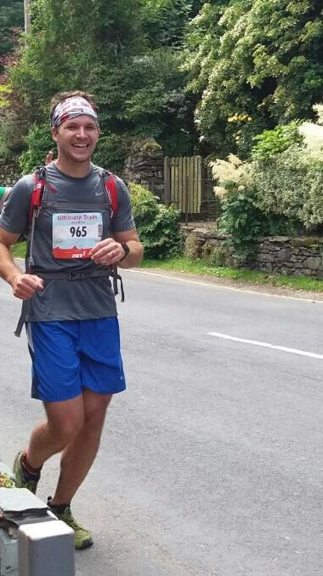
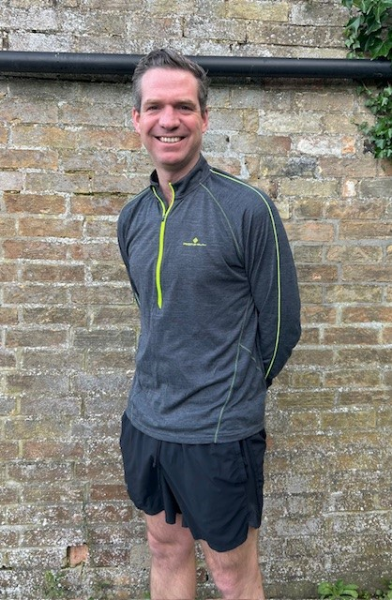
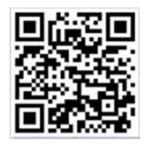
St Mary’s Surgery SMILE Fund
Dr Rayner and Dr Miller are running in support of the St Mary’s Immediate and Long-term Equipment fund (SMILE).
The fund enables us to buy equipment to directly benefit our patients. We would very grateful for any contributions to support the surgery.
Or scan the QR code below
To contribute use the payment link https://pay.collctiv.com/smile-80858
Or scan the QR code below

