Slide 1
Welcome to Almond Road Surgery

Slide 2
If you Miss any information on these slides or would like to discuss any of the slides further, please speak to a member of the reception staff.
Alternatively you can visit the Almond Road Surgery Website, where the Slide show is available to view in your own time.
If you have a suggestion on what we could add to the slide show please let the reception team know.
Our Website address - https://almondroadsurgery.org.uk/
Or use this QR code

Slide 4
Our Services
At Almond Road We offer the following Services
Sick / Fit Note Certificates*
When off work for a period or returning to work after a period of sickness
Urine Tests
Please ensure you complete the form, before processing the sample. Please don’t leave a sample without completing this form.
Blood Tests - Daily phlebotomy clinics
If you need a blood test you will be asked to book an appointment.

Slide 5
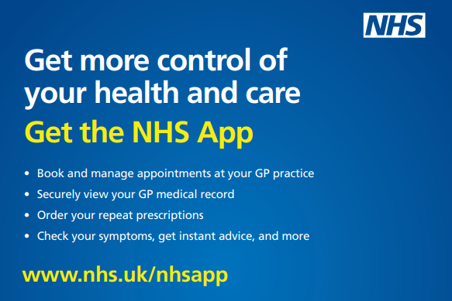

Slide 6
Our Services
At Almond Road We offer the following Services:
NHS Health Check
A check-up for adults in England aged between 40 -74, you should be contacted by your GP Surgery inviting you for a free NHS Health Check every 5 years.
NHS Travel Vaccinations
If you're planning to travel outside the UK, you may need to be vaccinated against some of the serious diseases found in other parts of the world.

Slide 7
Gp Appointment? Can’t make it? Don’t need it?
CANCEL IT!
80
In Dec 2023 over
Patients did not attend their
booked appointments
This Cost the Surgery approximately £2880.
It also meant 80 Patients were not seen, wasting over 20 hrs of precious GP Appt time.
If you find you are unable to attend an Appointment you have booked, please contact us as soon as possible in order to allow us time to fill your appointment slot.
Contact us in the following ways:
Tel: 01480473413
Text back to your reminder message
Visit Surgery in Person

Slide 8
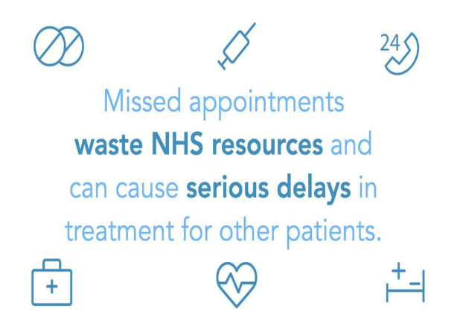
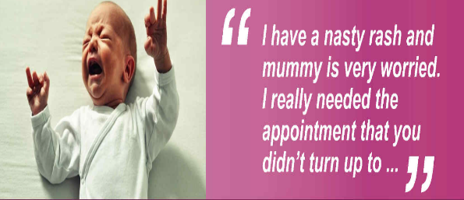
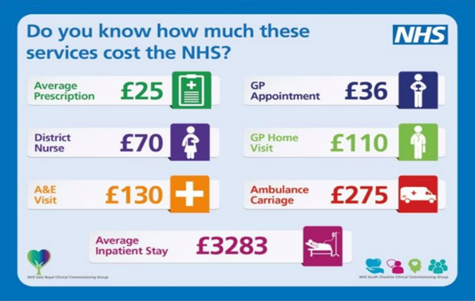

Slide 9
Enhanced Access
Your local GP practice is offering evening and weekend appointments at the surgery or at an NHS service nearby. Speak to the reception team when you book, or visit your GP practice website for more details.

Slide 10
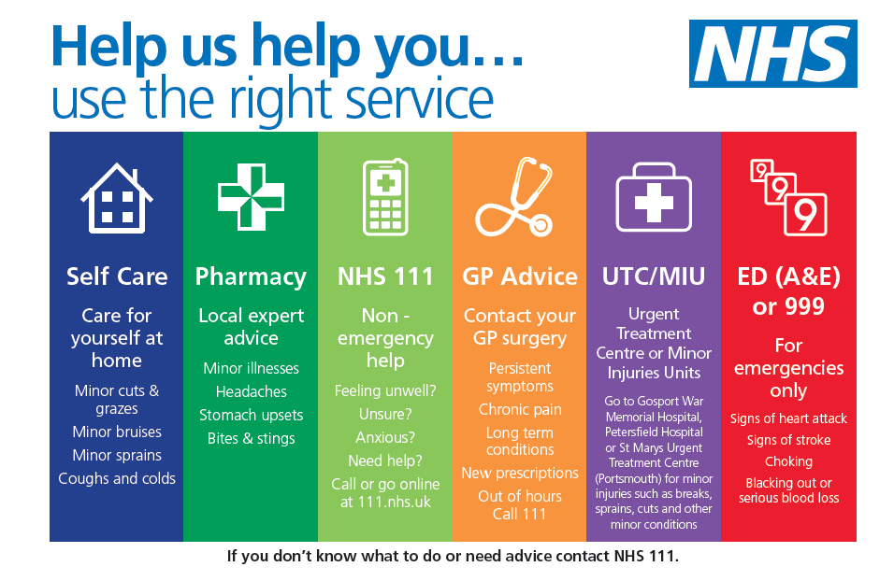
0

Slide 11
Our Services
At Almond Road We offer the following Services:
Joint Injections
Hydrocortisone injections are used to treat swollen or painful joints, such as after an injury or if you have arthritis.
Long Acting Reversible Contraception (LARC) sexual health
Including: intrauterine device/system and contraceptive injections.

Slide 12
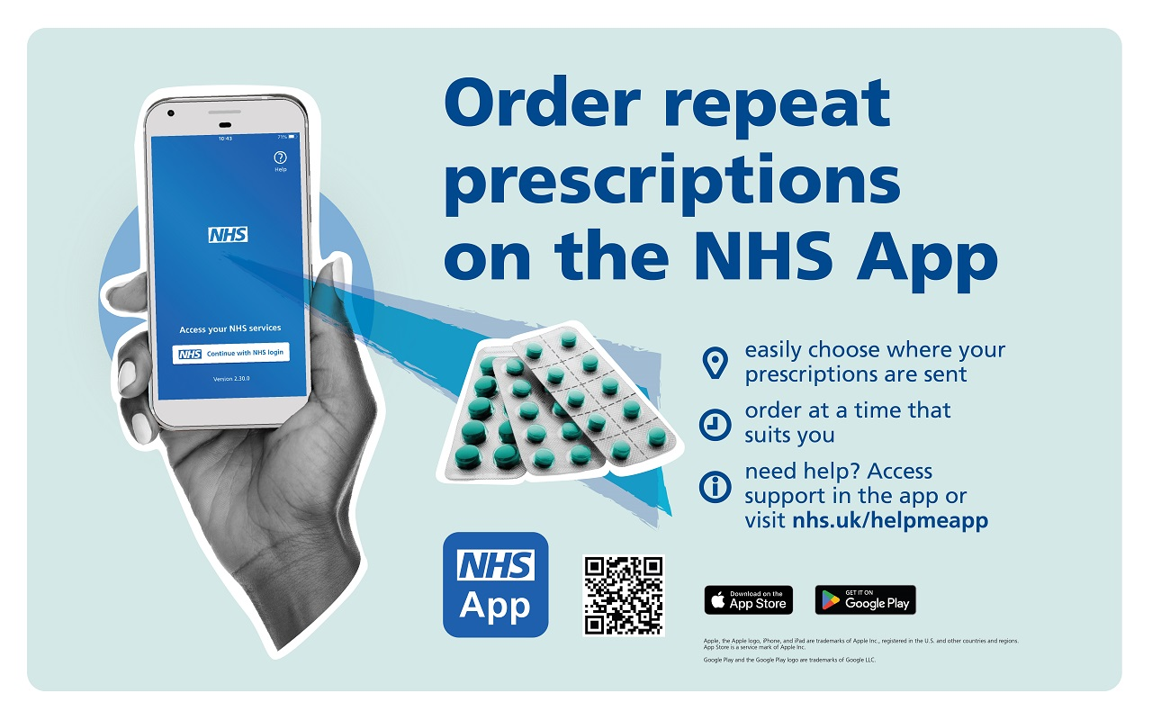
0

Slide 13
Our Services
At Almond Road We offer the following Services:
Test Results –
You may obtain your results by telephoning the surgery.
Results are given by staff or sometimes by text.
You can also check your results online or through the NHS App.
Please note:- For confidentiality reasons (except for children) results are only given to the person concerned, unless written consent has been give to another named individual. It is your responsibility to check your results and to make an appointment to discuss them with a doctor / nurse, if advised to do so.

Slide 14
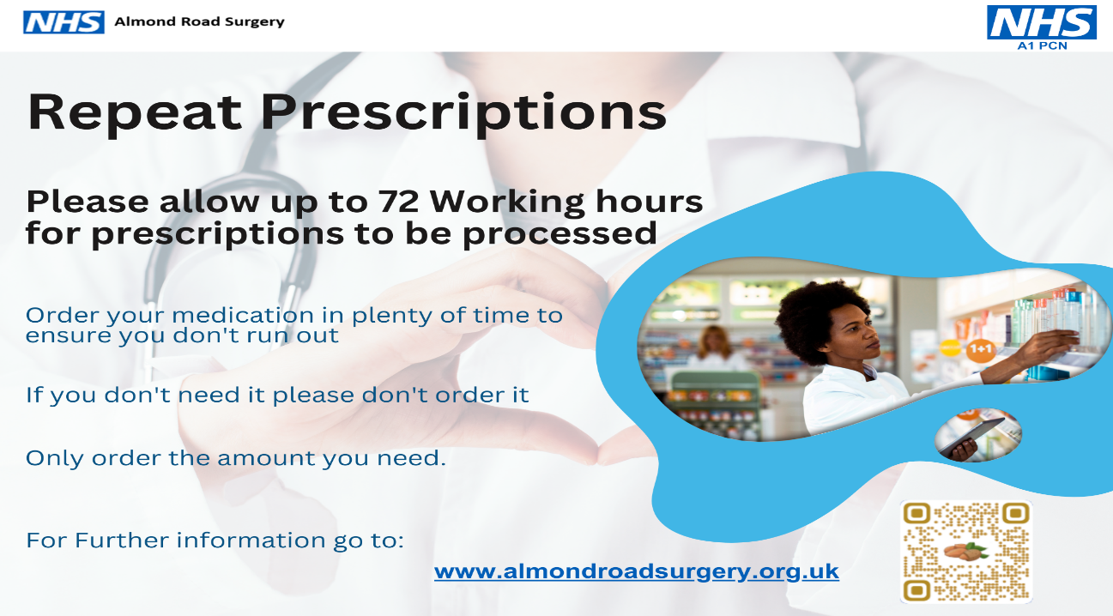
Our Services
At Almond Road We offer the following Services
Electronic Prescribing Service
The Electronic Prescription Service (EPS) is an NHS service.
What does this mean for you? –
Your GP will send repeat prescriptions electronically to the Pharmacy / place you choose, rather than having to visit your GP practice to pick up a paper prescription.
Or use this QR code:
For More Information please visit:-
https://www.nhs.uk/nhs-services/prescriptions-and-pharmacies/electronic-prescriptions/

Slide 15
Our Services
At Almond Road We offer the following Services
Electronic Prescribing Service
The Electronic Prescription Service (EPS) is an NHS service.
What does this mean for you? –
Your GP will send repeat prescriptions electronically to the Pharmacy / place you choose, rather than having to visit your GP practice to pick up a paper prescription.
Or use this QR code:
For More Information please visit:-
https://www.nhs.uk/nhs-services/prescriptions-and-pharmacies/electronic-prescriptions/

Slide 16
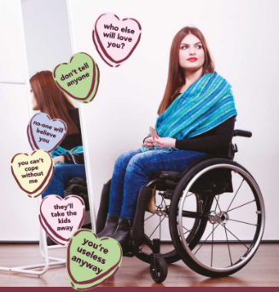
-

Slide 17
Clinics We Offer - Chronic Disease Clinic
We run a number of weekly clinics for patients who suffer from chronic illnesses. These clinics are run by clinicians who have specialist training in these areas. You will be invited to attend one of these clinics if you suffer from a chronic illness.
Hypertension (Blood Pressure) Clinic
Diabetic Clinic
COPD/Asthma
(Chronic Lung Disease) Clinic
Ischaemic Heart Disease Clinic

Slide 19
If you Miss any information on these slides or would like to discuss any of the slides further, please speak to a member of the reception staff.
Alternatively you can visit the Almond Road Surgery Website, where the Slide show is available to view in your own time.
If you have a suggestion on what we could add to the slide show please let the reception team know.
Our Website address - https://almondroadsurgery.org.uk/
Or use this QR code

Slide 20
-

Slide 21
Other Clinics We Offer
Antenatal
The community midwives offer advice on all aspects of antenatal and postnatal care. They hold regular clinics at the surgery. You will be referred to them by your doctor.
They can be contacted on 01480 357963/4.
Midwife
Self Referral to our Midwives. You are now able to self refer to the midwifery team. Please click the link below which provides you with instructions and the relevant links / information.
www.nwanliaft.nhs.uk/maternity/im-pregnant/

Slide 22
-

Slide 26
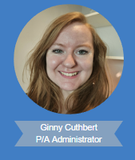
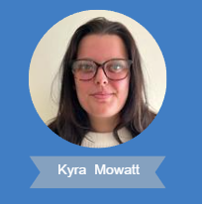
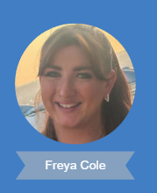
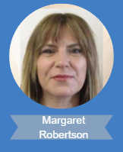
Meet The Almond Road Surgery Team
Administration team
Jane Nixon
Reception Team
Tina Ashford
Lisa Tarran

Slide 28
Appointments System
How you can help keep our Surgery running smoothly
Please arrive on time (if you are more than ten minutes late the Clinician may not see you)
Please let us know if you cannot keep your appointment
Please do not try to "squeeze in" other people in your slot
Please remember that the length of appointments are limited and that other people are waiting too!

Slide 29
HELP
BEAT
DEMENTIA
Let researchers
Know you want to
take part in their
studies

Slide 30
The Type of Appointments We Offer
Advanced Nurse Practitioners (ANP)
Doctors
Practice Nurse
Consultations: Face to Face, Online, Video or Telephone
Health Care Assistant
Sit & Wait
Home Visits
Telephone Advice

Slide 31
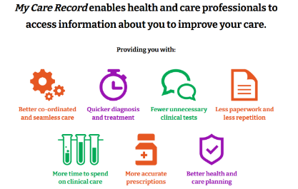
0
For more Information go to:
https://www.mycarerecord.org.uk/
Or use the QR code

Slide 32
The Type of Appointments We Offer
Social Care Prescriber
Extended Access – Evening, Weekend & Bank Holiday Appointments.
Physiotherapist
Occupational Therapist
Care Co-Ordinator
Pharmacist
Midwife

Slide 34
Other Appointment Services We Offer
Interpreter
Hearing Loop
Text Message Reminder
Chaperone
For any further details regarding these services please speak to the
reception staff

Slide 37
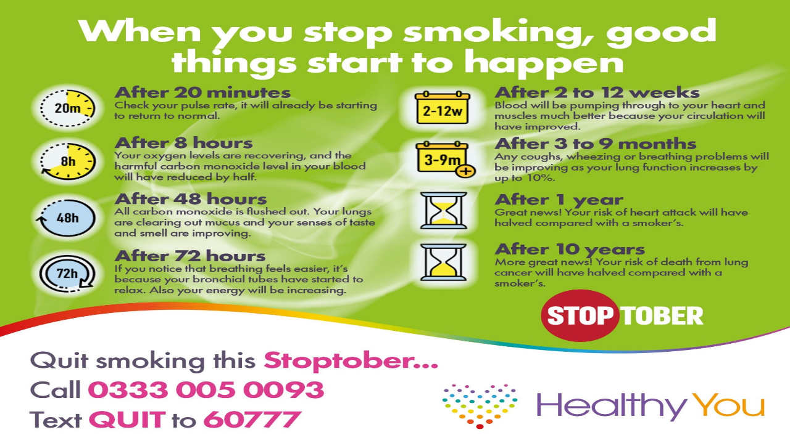

Slide 38
Different Ways to Make Appointment
Conventional Appointments
Cancelling an Appointment
Telephone Consultation
Either book online
(see link below) or ring the surgery to speak to reception.
Either book online
(see link below) or ring the surgery to speak to reception.
You can do this by telephoning the surgery or by texting back the appointment reminder with CANCEL .
https://systmonline.tpp-uk.com/2/Login

Slide 39
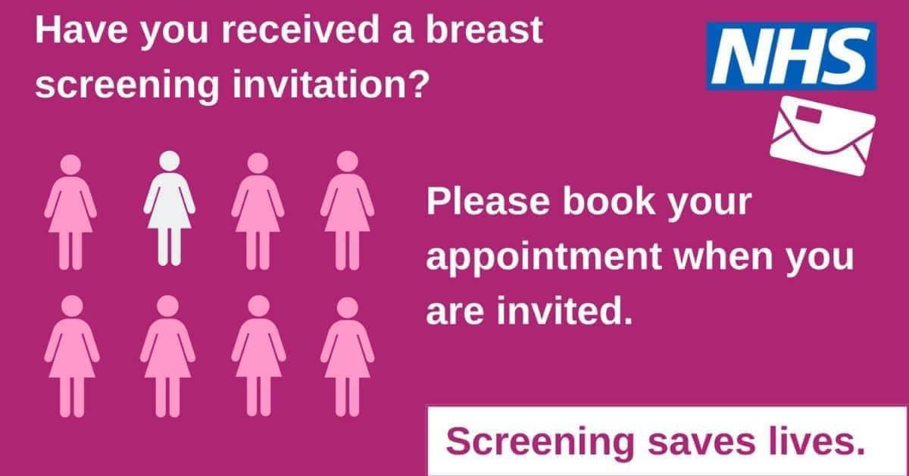

Slide 40
Gp Appointment? Can’t make it? Don’t need it?
CANCEL IT!
80
In Dec 2023 over
Patients did not attend their
booked appointments
This Cost the Surgery approximately £2880.
It also meant 80 Patients were not seen, wasting over 20 hrs of precious GP Appt time.
If you find you are unable to attend an Appointment you have booked, please contact us as soon as possible in order to allow us time to fill your appointment slot.
Contact us in the following ways:
Tel: 01480473413
Text back to your reminder message
Visit Surgery in Person

Slide 41
How to Requests a Repeat Prescription
By Using the NHS App - www.nhs.uk/nhs-app
By emailing – cpicb.prescriptions.almondroadsurgery@nhs.net
By posting or bringing in your computer generated repeat slip to us, clearly marking the items you require
Or by using SystmOnline Via this link :
https://systmonline.tpp-uk.com/2/Login
If you wish to collect your prescription from a pharmacy please indicate which pharmacy you use.
We are unable to accept requests over the telephone as this can lead to dangerous mistakes

Slide 42
Support Offered:
Assistance with forms and applications including welfare benefits, blue badges and grants etc.
Help with paperwork and liaising with third parties, organising bills and payments etc.
Assistance with housing choices, including care homes.
Adapting to a changing need, such as considering falls prevention equipment and aids.
Information about and / or referral to social groups or leisure activities,
Help to access a variety of services.
Support to access care provision.

Slide 43
ATTENTION
If you are coming in for a Vaccination, then please dress to be able to undress
Please try & wear something with short sleeves
Whilst you are in the waiting area please start to remove appropriate layers ready to be vaccinated.
Thank you in advance for your help with this request.
Almond Road Surgery Team

Slide 44
Here at Almond Rd Surgery, we are pleased to announce our NHS Health Check service. The check is aimed at people aged 40 between and 74 who do not have pre-existing conditions.
The checks are booked with
Katie (Care Co-ordinator) or Mandy (Healthcare Assistant).
To book a NHS Health Check please contact Almond Rd Surgery
on 01480 473413
or email us on
hhcdata.almondroadsurgery@nhs.net

Slide 47
Patient Participation Group (PPG)
Aims of the Patient Participation Group
Almond Road Surgery welcomes constructive criticism from our patients. We have established a Patient Participation Group. This is a group of patients who wish to become more involved in practice decision making, supporting the practice and facilitating communication.
If you are interested in signing up to join our group please ask reception for further details or come to the next meeting.

Slide 48
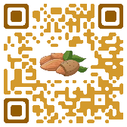
Friends & Family Test
How was our service today?
Please find a minute of your time
to log onto our webpage and leave us a review on
https://www.almondroadsurgery.org.uk/

Slide 50
Cambridgeshire & Peterborough Healthy Lifestyles Service
Get your, Calm back. Get your YOU back.
86% of people save money, 70% have better sleep & 66% have more energy.
Cutting down on how much you drink isn’t always easy, You won’t be alone.
If you feel you would need some support stopping Or cutting down on how much you drink. Healthy you Can support you 1:1 with our Alcohol Health Trainer Team
To find out more about our FREE services, you can get in touch and refer yourself.

Slide 51
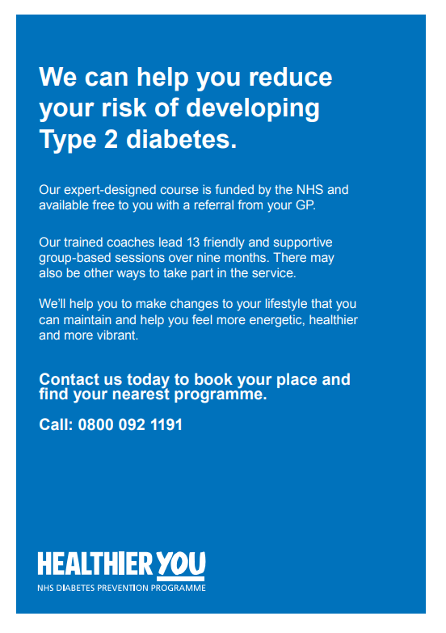

Slide 53
If you Miss any information on these slides or would like to discuss any of the slides further, please speak to a member of the reception staff.
Alternatively you can visit the Almond Road Surgery Website, where the Slide show is available to view in your own time.
If you have a suggestion on what we could add to the slide show please let the reception team know.
Our Website address - https://almondroadsurgery.org.uk/
Or use this QR code

Slide 57
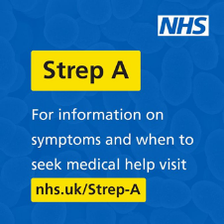
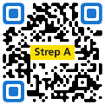
Most Recent Strep A Information
Most strep A infections are mild and easily treated, but some are more serious.
Visit the NHS website to learn more about symptoms to look out for, when to seek medical help and what to do in an emergency: http://nhs.uk/strep-a
Here's what you need to know about Group A Strep and what to look out for. Parents should trust their own judgement when their child is poorly. Read more on this blog for more info ➡
https://ukhsa.blog.gov.uk/2022/12/05/group-a-strep-what-you-need-to-know/
There is a brilliant guide available online about childhood illnesses. It covers lots of conditions including colds and coughs through scarlet fever and sepsis https://www.cpics.org.uk/guide-to-childhood-illnesses

Slide 58
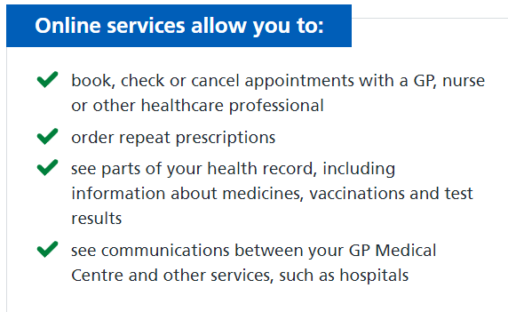
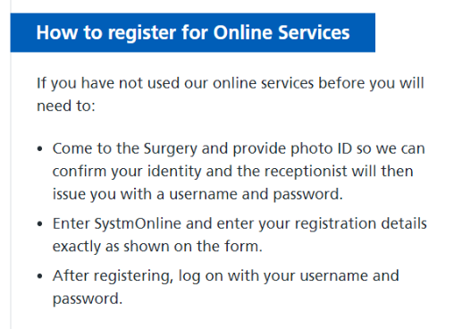

Slide 59
For more information visit
www.nspcc.org.uk

Slide 61
Enhanced Access
Your local GP practice is offering evening and weekend appointments at the surgery or at an NHS service nearby. Speak to the reception team when you book, or visit your GP practice website for more details.

Slide 63
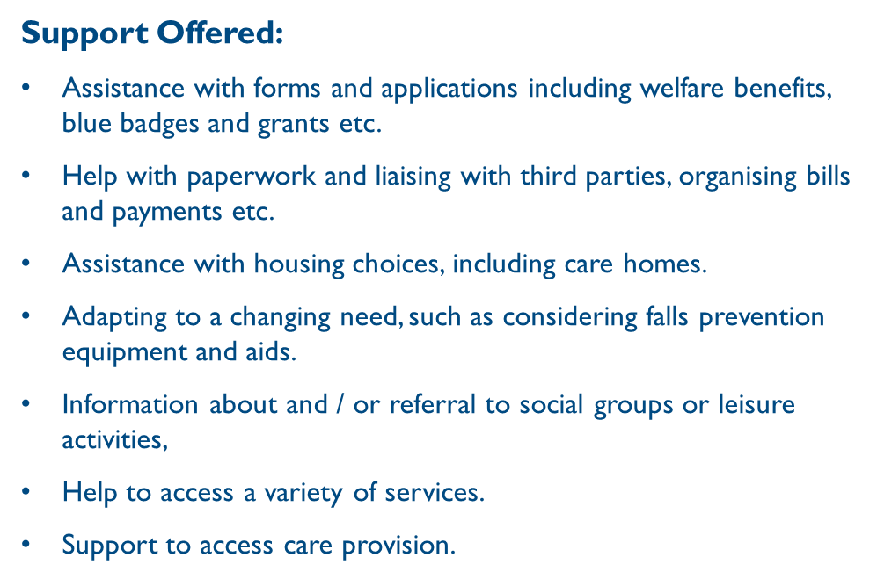

Slide 64
If you Miss any information on these slides or would like to discuss any of the slides further, please speak to a member of the reception staff.
Alternatively you can visit the Almond Road Surgery Website, where the Slide show is available to view in your own time.
If you have a suggestion on what we could add to the slide show please let the reception team know.
Our Website address - https://almondroadsurgery.org.uk/
Or use this QR code

Slide 69
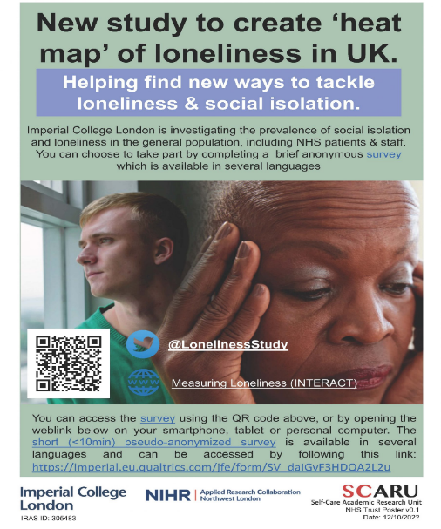

Slide 70
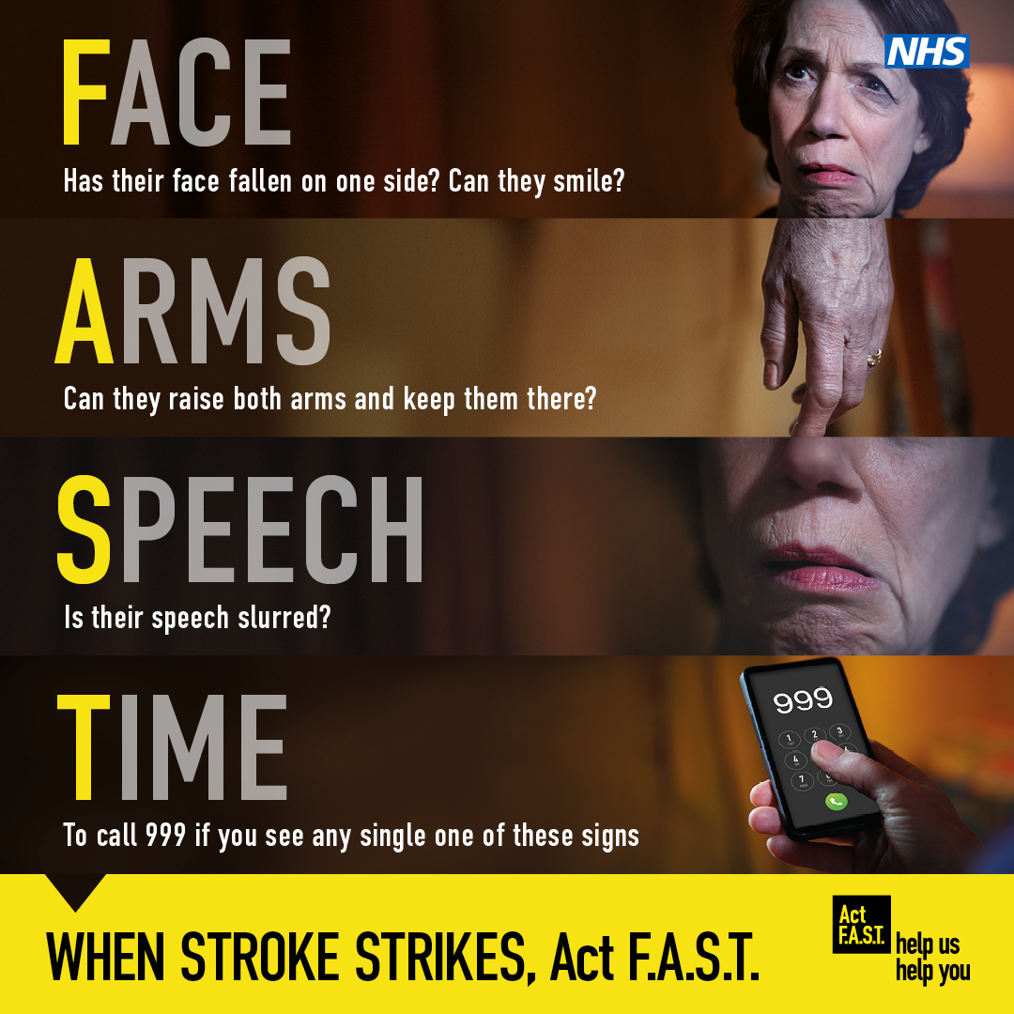

Slide 75
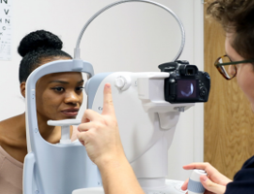
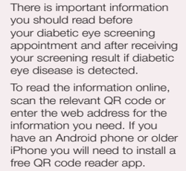
All these NHS diabetic eye screening digital leaflets can be found on GOV.UK at gov.uk/government/collections/diabetic-eye-screening-information-leaflets

Slide 76
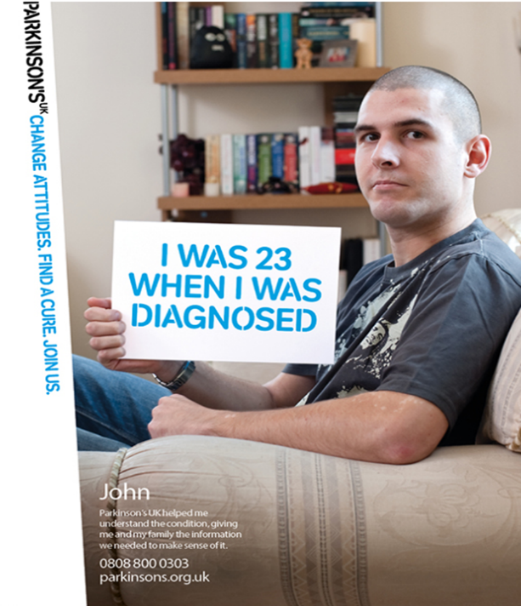
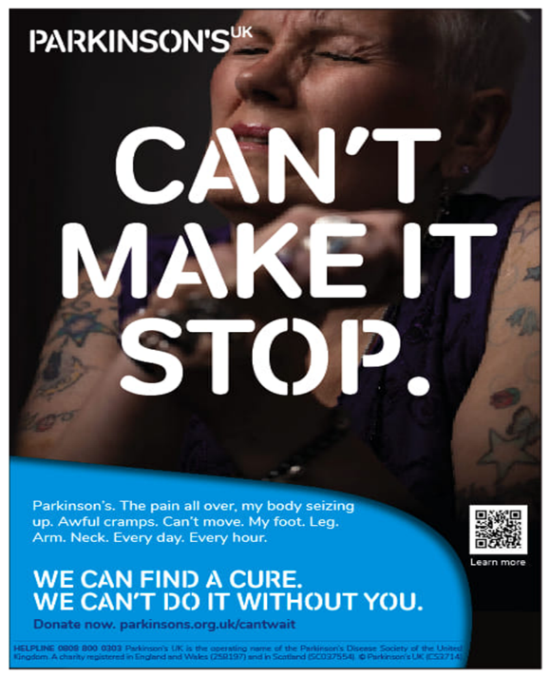

Slide 90
What your GP does all day…?
This is what a standard day for a GP can include:

Slide 92
Also Available for over 50 year olds with weakened immune systems (severely immunosuppressed)

