Slide 1
Staying Independent and Well at Home
There are a lot of things we can do to help ourselves or family and friends stay independent and safe at home
Some of these things are very simple changes you can make yourself at home

Slide 2
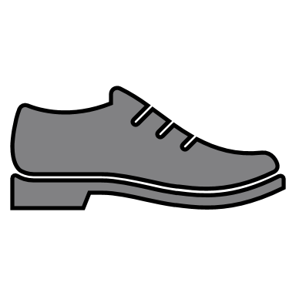
Are you having Trips and falls?
Top Tip!
Make sure your shoes and slippers have backs. A full shoe is more supportive and less likely to lead to falls
Did you know that 60yr old eyes need three times more light than someone who is 20yrs old?
Never walk about in the dark, if you regularly get up during the night, consider keeping a landing light on or purchasing a movement sensing light that will light up when it recognises movement.
Have you got any rugs or carpets that are frayed and curling at the edges? Make sure all rugs have a non slip backing and are tacked down; or better still, remove them so the risk of tripping is removed completely!
A surprising number of people trip over their pets. Consider buying them a bright collar with a bell to let you know when they are around and keep you both safe!
Always take the time to ensure all belts and cords on clothes and dressing gowns are secured or remove them all together
Do your shoes or slippers look a little worse for wear? If your footwear has holes in the soles, are frayed or the backs have been broken down, it's time to get a new pair that fit well, stay on and provide grip.

Slide 3
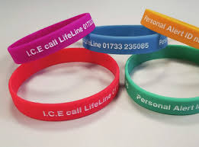
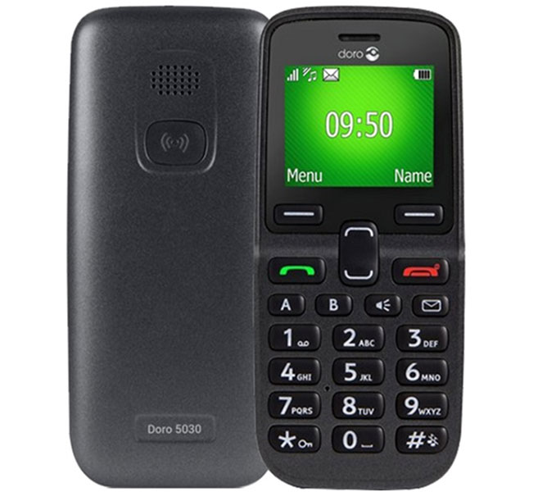
Are you getting lost or disorientated when out and about?
Consider signing up to the Lifeline Personal Alert Wristband. With this scheme if you become lost or need help, someone can call the number on the wrist band and alert your friends and family or the emergency services for help.
Have you got a smart phone? Save your home address in the maps app to help you get home. Or use tracking apps with family and friends so they can see your location if you get lost or need help.
Did you know some of the simple to use Doro mobile phones have GPS tracking ability built in and an SOS button to press in an emergency?

Slide 4
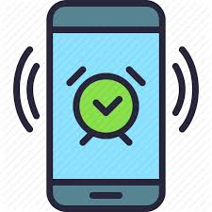
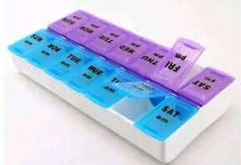
Having difficulty managing your medication?
In the UK up to 50% of medicines in England are not taken as intended
Here are some simple things to try first!
1. If you have a mobile phone, try setting a reminder alarm to take your medication
2. Keeping a checklist of medication and ticking them off every day when you have taken them
3. Organising your medication in to a dosette box or asking your pharmacist to dispense your medication into a blister pack

Slide 5
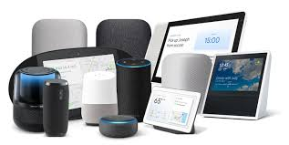
What about using technology?
Remind me to feed the cat every day at 09:00am
Technology is advancing all the time. You may even already have something in your home that can help you manage your everyday life more easily or help keep you in touch with family and friends.
If you already have a smart tablet or smart home system, there are a few ways it may be able to help:
- Adding smart bulbs to your home can allow you to turn lights on and off with simple voice control
- Setting reminders, these can be "one offs" or daily, and can also help with managing medication or remembering appointments
- Staying connected with your family and friends via video calls, voice messaging or social media

Slide 6
What sort of things can the TEC Team help with?
Independence with managing medication
Alerts if someone has fallen and is unable to summon help
Supporting people and their carers
People leaving the house and getting lost

Slide 7
TEC Smart Flat
At Peterborough City Council we have a "TEC Smart Flat" which members of the public and their families can visit by appointment, alongside an experienced member of staff from the Occupational Therapy Team.
In our Smart Flat we have lots of pieces of helpful and handy equipment installed and ready for demonstration. This allows people to get "hands on" experience with the equipment and help decide what might be useful for them.

Slide 8
Advice and Information
Everyone is different, and what works for some people may not work for others.
Sometimes people need a little help and advice in knowing what will work best for them as an individual.
Our TEC Team can be contacted for advice, information, assessment or visits to our Smart Flat via the Adult Early Help Team at Peterborough City Council on 01733 747474

