Slide 1
Sheringham PPG Year review 11th October 2023
what we’ve been up to!

Slide 2
What is a Patient Participation Group (PPG)
A PPG – is……
• A ‘critical friend’ to the practice by providing feedback on patients’ needs, concerns and interests and challenging the practice constructively whenever necessary.
• A support to the practice to communicate with the practice population.
• To build relationships with other PPG’s and groups in the area e.g. Healthwatch Norfolk and community groups
• To promote good health by supporting activities within the practice.
To give feedback to and get involved in local and national consultations.
To review and update constitution and purpose of the group as and when required.
A PPG is not......
A complaints forum
A place to air or resolve personal issues
A political lobby group
A group of elite patients
A place of ‘conflict’
The token voice of the patients

Slide 3
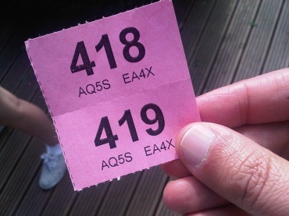
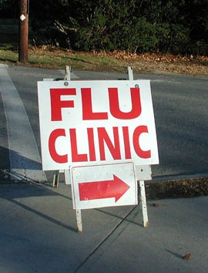
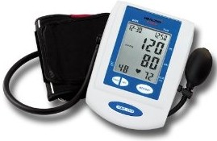
What do we do?

Slide 4
Moving on .................
We need a turn-over of members to keep ideas fresh
Listen to the needs of the community
Working with local PPG’s to form stronger network
Produce a quarterly PPG newsletter
Continue to fundraise for additiona equipment
Explore new ways of communicating with our residents
Build upon our good working relationship with the Practice team
Develop tools to support and encourage our practice population with new technology

Slide 5
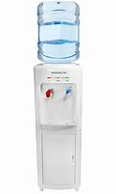
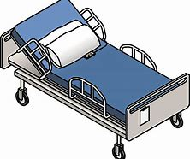
Finances

Slide 6
Thank you for listening
Any Questions?

