Slide 1
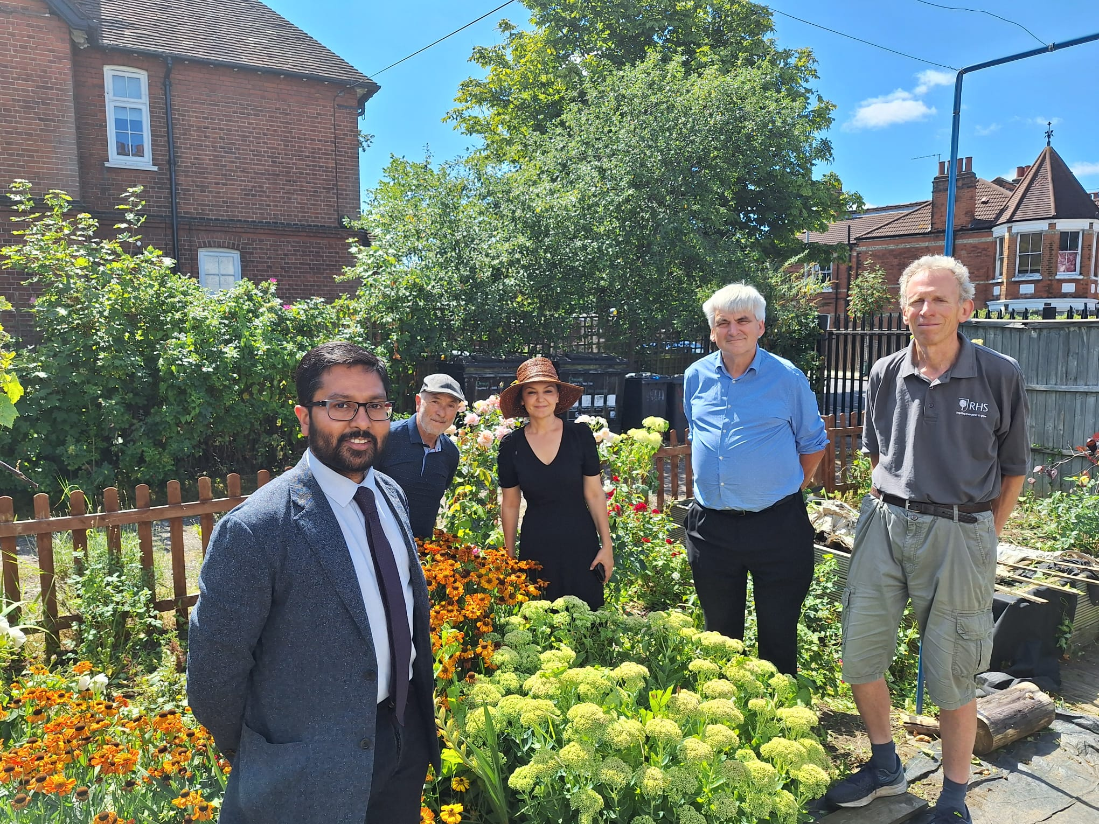
We are fundraising for Arcadian’s patient
allotment on Wolves Lane Allotments N22 5JD
www.arcadiangardenssurgery.nhs.uk/2024/02/05/practice-allotment-patient-group/

