Slide 1
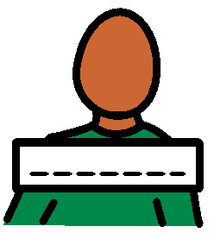
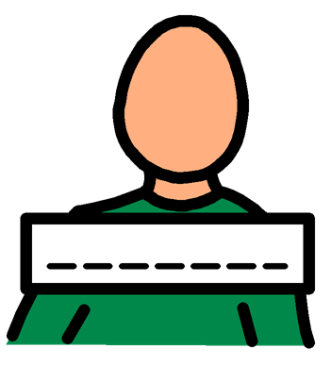
My name is …..
This is my story about going to the Doctor

Slide 2
I am going to see a doctor

Slide 3
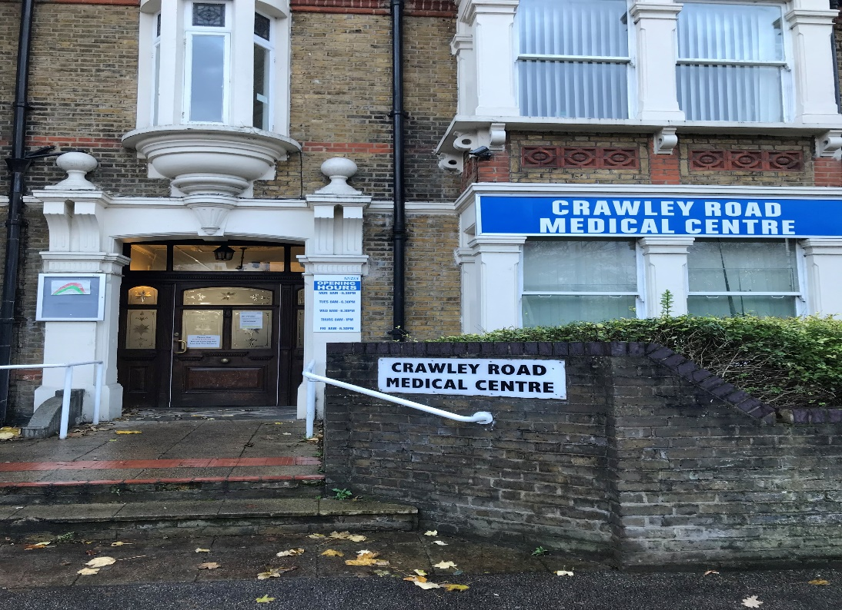
I will go to Crawley Road Medical Centre. The building looks like this:

Slide 4
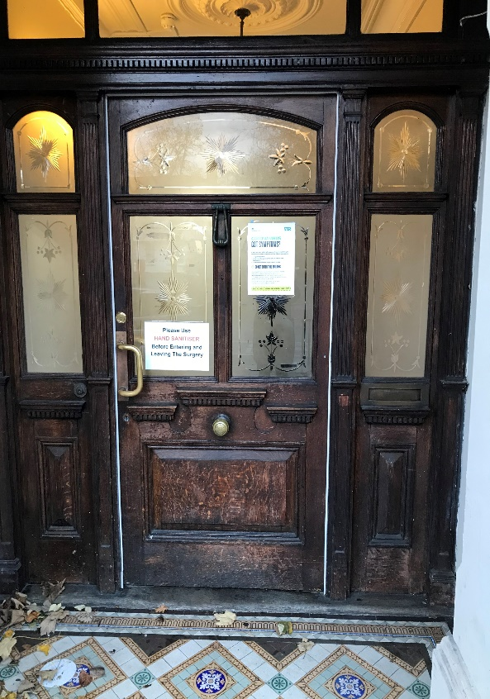
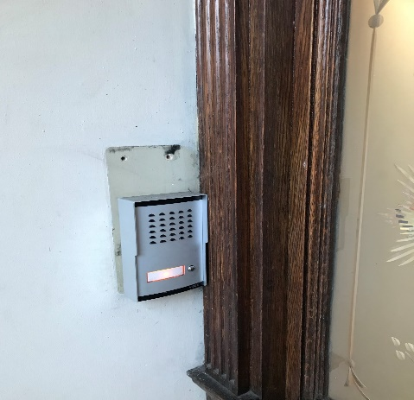
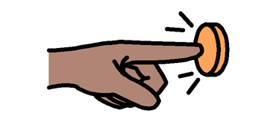
When I get to the door I need to press the button.

Slide 5
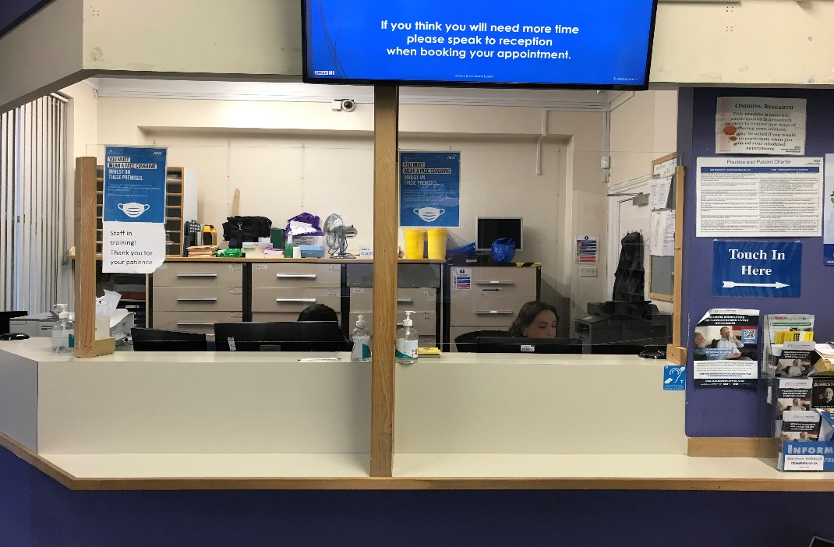
I will go to the reception area, and let them know I am here to see the doctor.

Slide 6
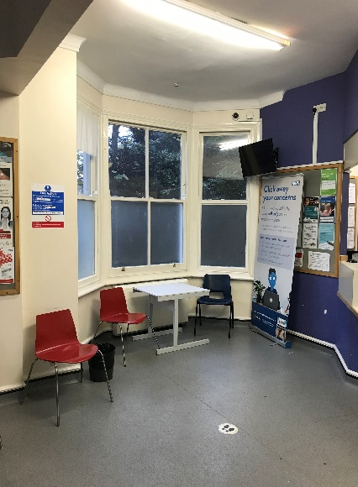
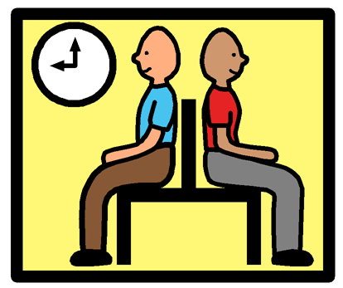
I will wait in the waiting room for my appointment. The waiting room looks like this:

Slide 7
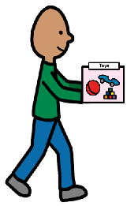
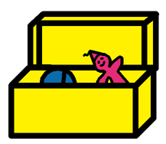
There are no magazines or toys in the waiting room as it has to be kept really clean and toys can get dirty, so I am going to bring something to do.

Slide 8
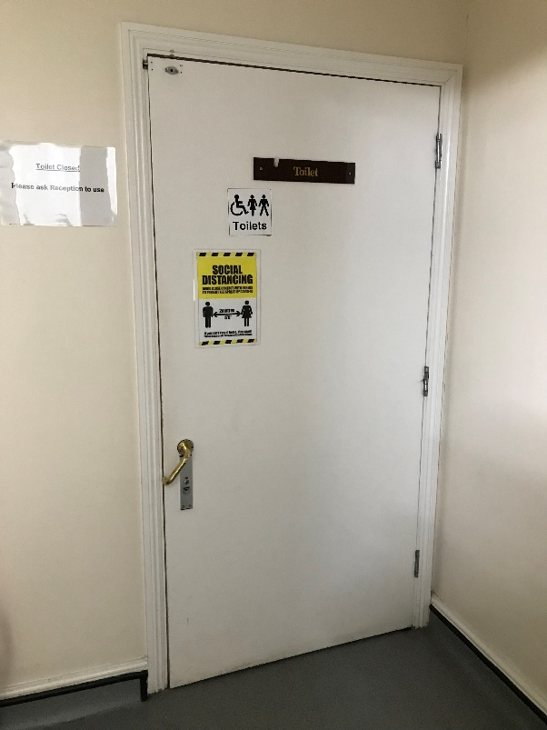
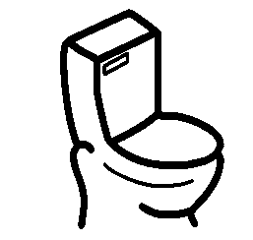
If I want to use the toilet, I need to ask the ladies at reception for the key

Slide 9
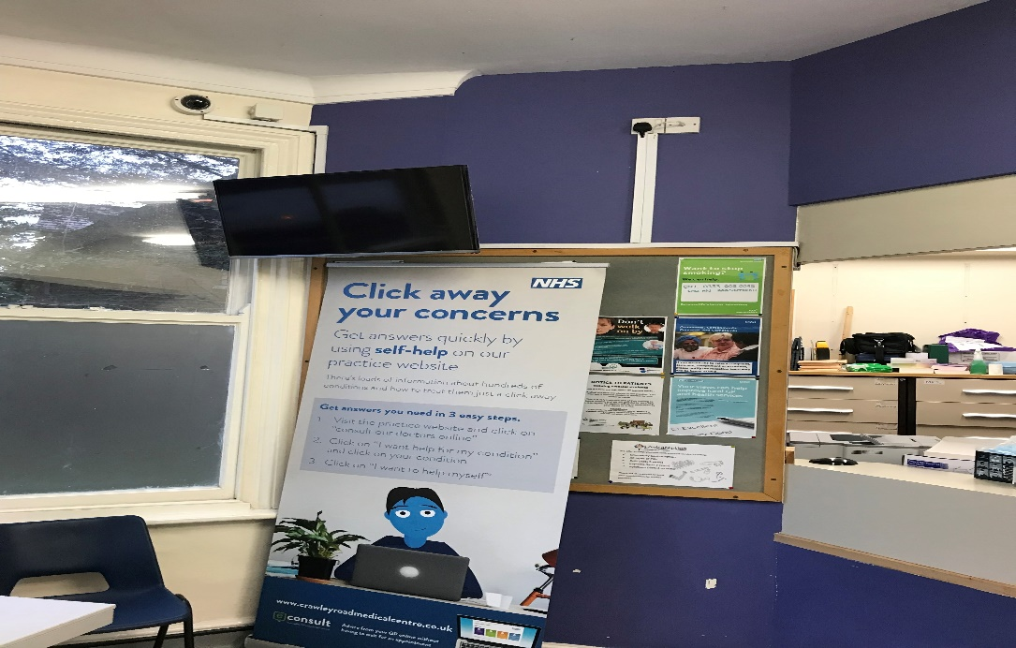
The ladies will say my name, or my name will come up on the television screen. Then its my turn to go to the doctors room.

Slide 10
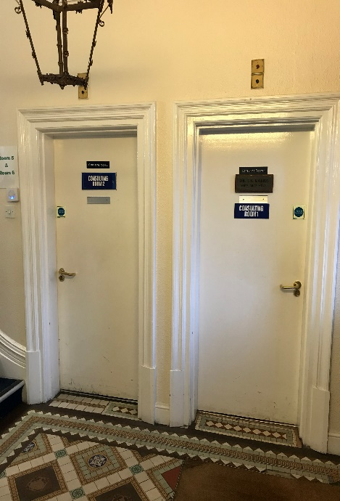
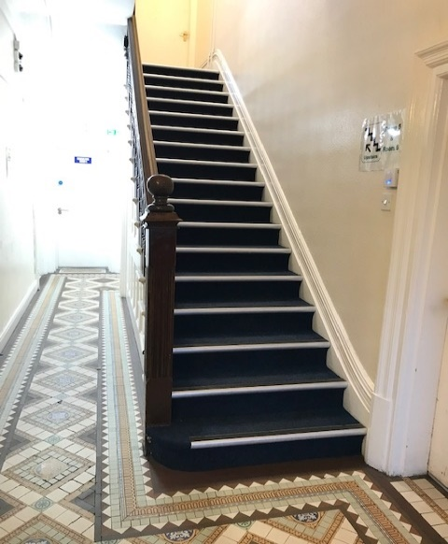
I might go upstairs, or stay down stairs. There are lots of different doctors rooms

Slide 11
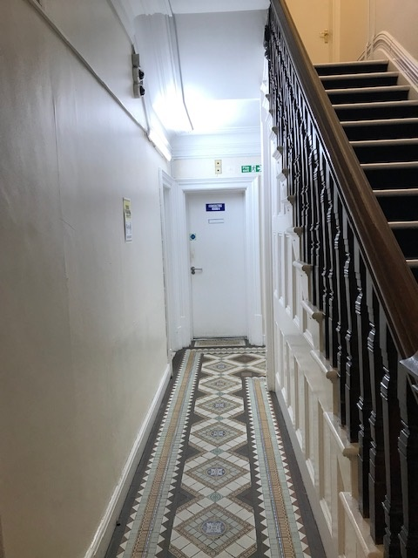
Sometimes I might see the nurse. She is down stairs in a different room

Slide 12
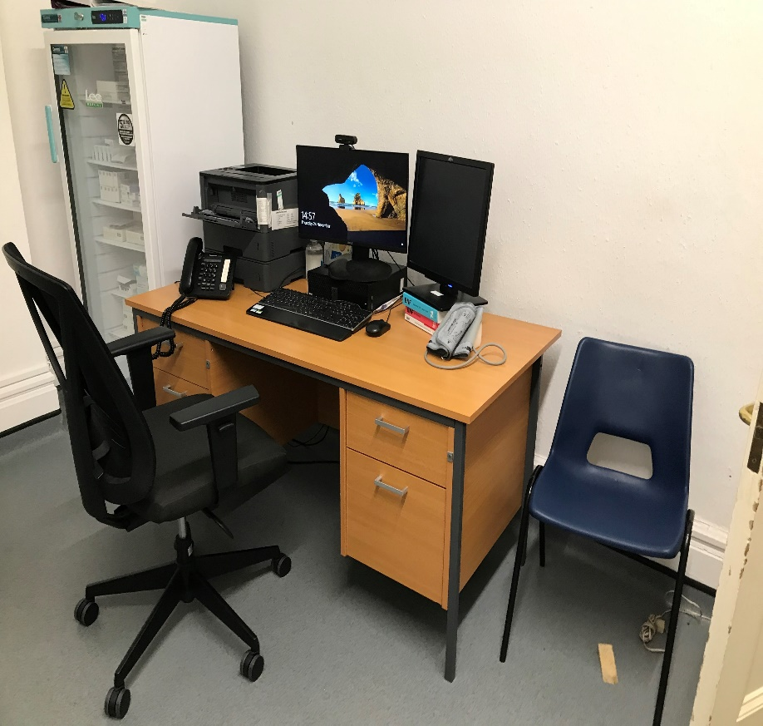
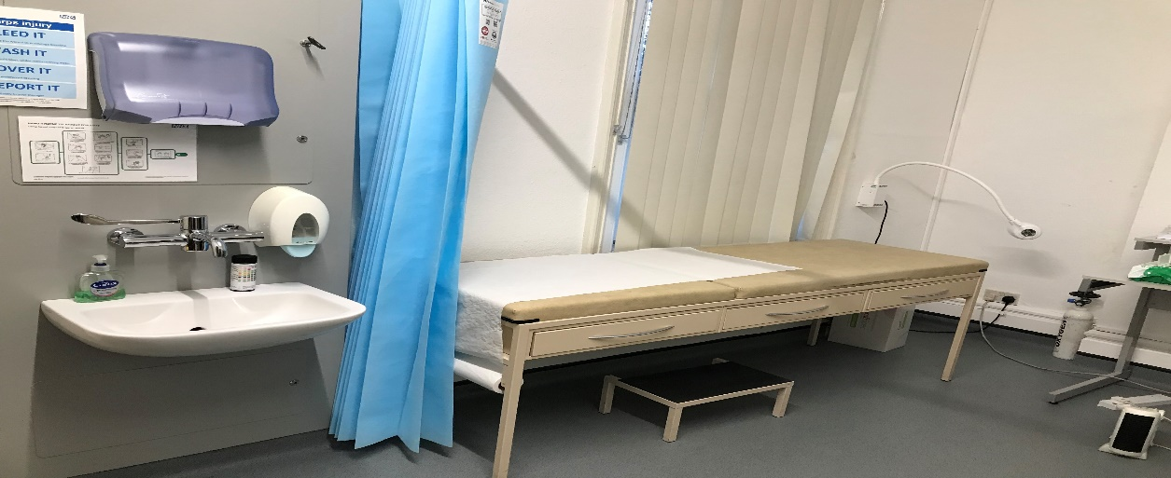
I will go to see the doctor in a room that might look like this:

Slide 13
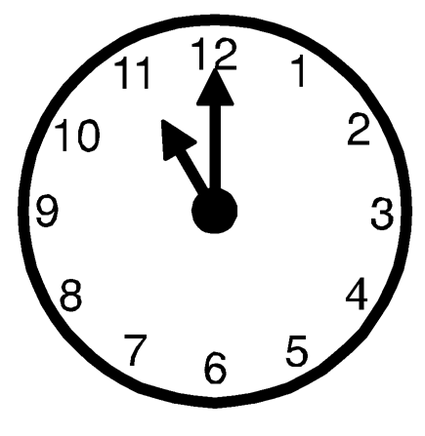
The appointment will last about 10 minutes

Slide 14
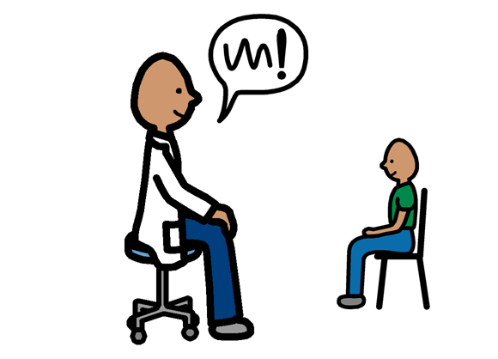
The doctor will speak to me aswell as my parents/carers

Slide 15
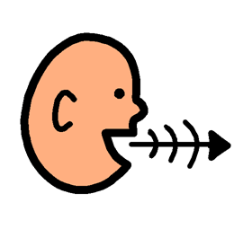
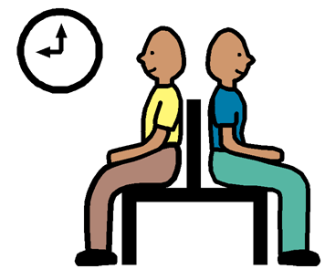
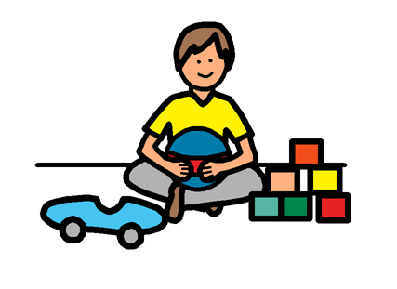
I can join in, but if I don’t want to talk, I can do something else.

Slide 16
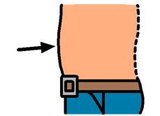
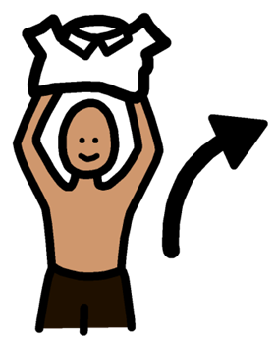
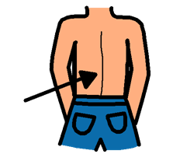
The doctor might want to examine me. This means that they might ask me to take off my top so they can see my back. They might press my stomach, but it won’t hurt.

Slide 17
Sometimes I might need to lie on the bed so the doctor can press my stomach. The bed is high up, and there is a step

Slide 18
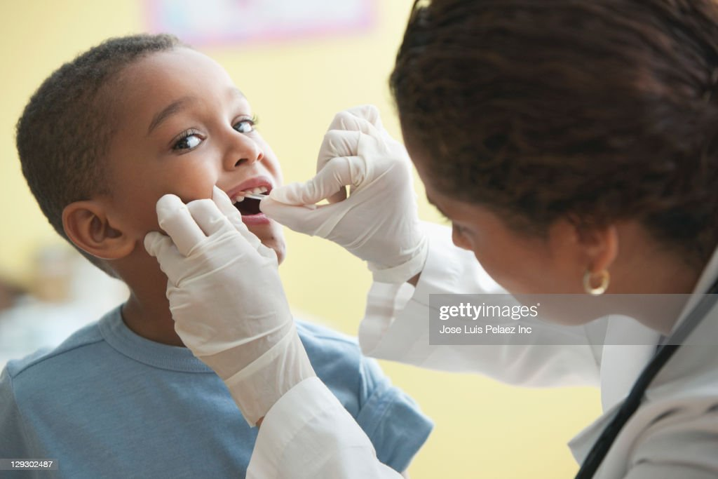
The doctor might look in my eyes, ears and mouth at my visit

Slide 19
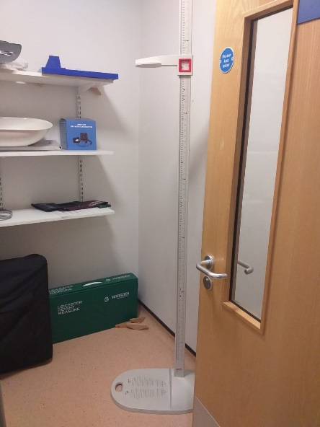
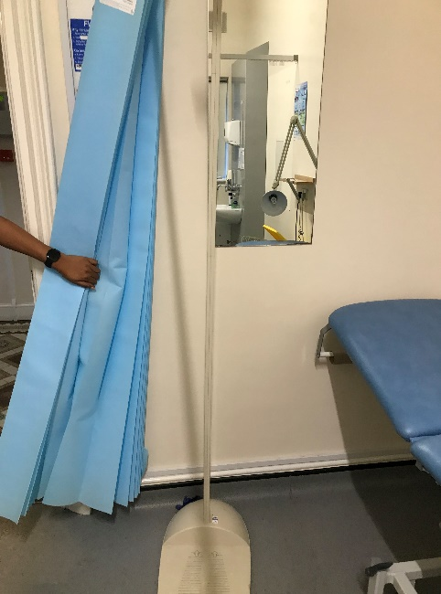
Sometimes the doctor will use a tape measure and measure my head or they might measure my height. This means that I need to stand against the measuring stands like these:

Slide 20
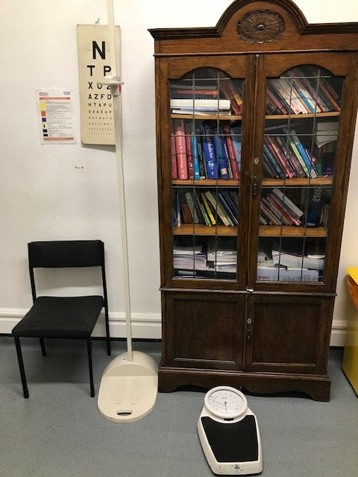
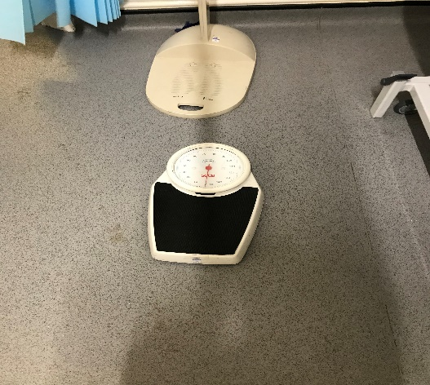
I might have to be weighed, this means I need to stand on scales like this one:

Slide 21
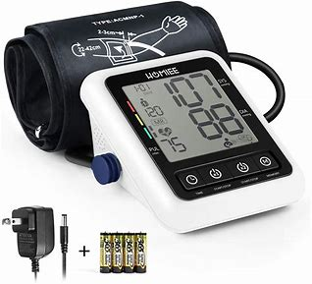
The doctors have blood pressure machines for your arm

Slide 22
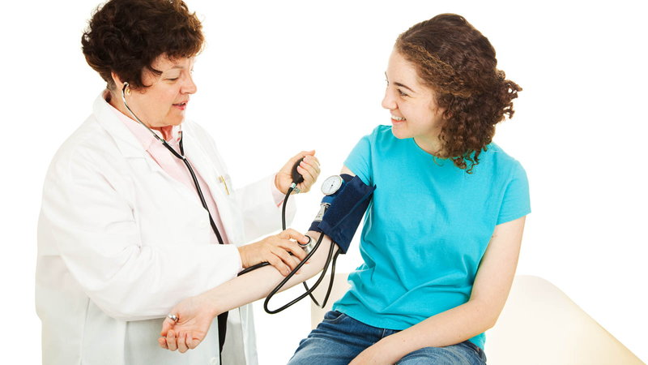
The doctor might take my blood pressure at my visit

Slide 23
None of this hurt me. My doctor visits will mean I stay fit and healthy

Slide 24
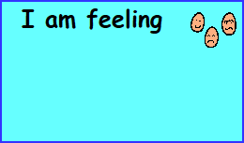
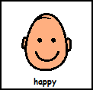
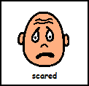
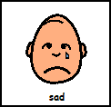
I might feel a bit scared about my appointment. It is okay to feel this way. We all get scared sometimes.

Slide 25
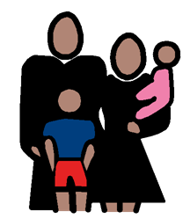
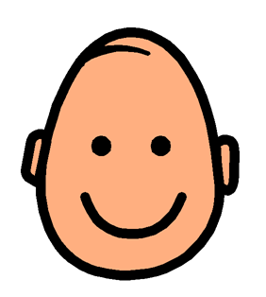
My parents or carers will be there to make sure that I am safe and well looked after.

Slide 26
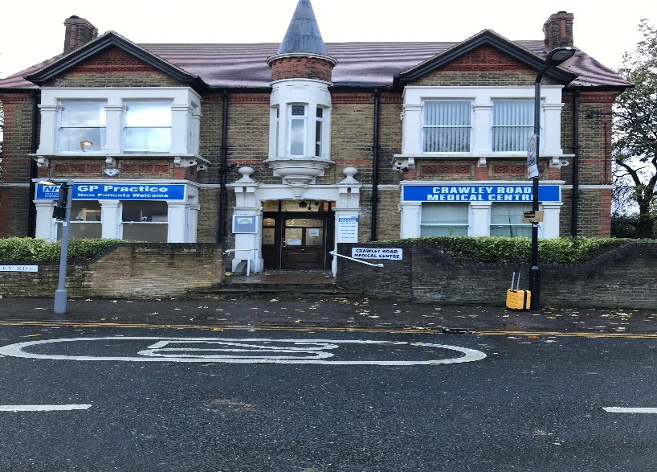
It will be okay to go to see the doctor at Crawley Road.

