Slide 2
What is Social Prescribing?
Many things that affect our health cannot be treated by doctors or medicine alone, like loneliness, isolation or stress due to problems with debt or housing. Social prescribing connects people to non-medical support to address these issues and other unmet needs.
This could involve a Social Prescribing Link Worker or an equivalent role:
Helping someone who is isolated to join a befriending group, an art class or a community gardening project, based on what matters to them.
Connecting someone struggling with financial stress to a service that helps with managing debt or claiming benefits.
Working with someone with high blood pressure to take up a form of exercise that they’re comfortable with.
Social prescribing involves understanding the complexities of people’s lives and the inequalities they may face. It can help change the circumstances that make people unwell, and empower people to manage existing health problems. It can help people to connect and to grow in confidence.

Slide 3
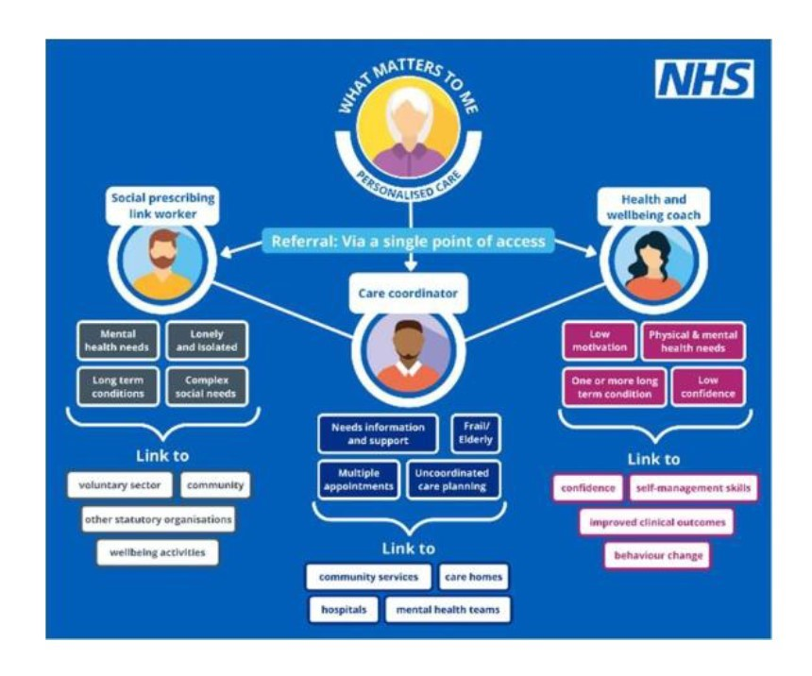
How does Social Prescribing fit into my Care?

Slide 4
Meet the team…
Tom Crisp – Digital Transformation and Wellbeing Lead
Jen Churcher – Social Prescriber
Jackie Monckton – Social Prescriber
Nicola Orman – Social Prescriber
Ziana Azariah – Social Prescriber CYP (Children and Young People)
Gina Witcomb – Social Prescriber/Lead Care Coordinator
Terrice James – Care Coordinator

Slide 5
Interesting local Social Prescribing facts
Over the course of the last year 1254 people were referred for Social Prescribing at the Blackmore Vale Partnership
Data taken from 1/3/23 to 1/3/24

Slide 6
Interesting local Social Prescribing facts
Our Social Prescribers supported 163 patients with Social Isolation difficulties over the course of the last year
Data taken from 1/3/23 to 1/3/24

Slide 7
Interesting local Social Prescribing facts
Our Social Prescribers have supported 214 patients with Lifestyle related difficulties over the course of the last year
Data taken from 1/3/23 to 1/3/24

Slide 8
Interesting local Social Prescribing facts
Our Social Prescribers have supported 211 patients with Mental Health difficulties over the course of the last year
Data taken from 1/3/23 to 1/3/24

Slide 9
Interesting local Social Prescribing facts
Our Social Prescribers have supported 69 patients with Housing and Homelessness related difficulties over the course of the last year
Data taken from 1/3/23 to 1/3/24

Slide 10
Interesting local Social Prescribing facts
Our Social Prescribers have supported 12 patients who have been victims of abuse
over the course of the last year
Data taken from 1/3/23 to 1/3/24

Slide 11
Interesting local Social Prescribing facts
We have registered 341 unpaid carers and 251 cared for patients over the course of the last year
Data taken from 1/3/23 to 1/3/24

Slide 12
Shared decision making…
Our Social Prescribers have utilised ‘shared decision making’ during 1386 interactions with patients
Shared decision making ensures that our patients are supported to make decisions that are right for them. It is a collaborative process through which our Social Prescribers support a patient to reach a decision about what happens next for them, and the support we provide them with.
The conversation brings together:
the Social Prescriber’s expertise, such as signposting and referral options, evidence, risks and benefits
what the patient knows best: their preferences, personal circumstances, goals, values and beliefs.

Slide 13
How can I get involved?
We have supported a range of people at The Blackmore Vale Coffee Companions.
Why not come along and join in the fun, have a nice hot drink and maybe even a slice of cake whilst making some new friends!
The Country Market, Held within the Exchange, Sturminster Newton
Every Tuesday 10-11am

Slide 14
How can I get involved?
Over the course of the last year, 276 people have been supported by The Blackmore Vale Health Champions at our Health Hubs (which only started in Nov 23).
Why not come along and pop into one of our Health Hubs, where you will find our friendly team of Health Champions who can answer your questions, provide you with signposting information, or put you in touch with our Social Prescribers!
Refreshments are also available!

Slide 15
Want to know more?
Get in touch with our Wellbeing Team if you need support or would like more information about Social Prescribing.
You can contact us via telephone or email with the details below:
bvpwellbeing@dorsetgp.nhs.uk
01747 856786

