Slide 1






MONTPELIER HEALTH
Montpelier Health Centre
&
Pilning Surgery
EASY READ PRIVACY NOTICE
20th September 2022

Slide 2



Who we are?
We help people with their health care needs
We are Montpelier Health Centre and Pilning Surgery (‘the Practice’). Our address is:
Montpelier Health Centre, Montpelier, Bristol, BS6 5PT
and
Pilning Surgery, Northwick Road, Pilning, Avon, Bristol BS35 4JF
We are a Data Controller of your information.
  This means we are responsible for collecting, storing and handling your personal and healthcare information when you register with us as a patient.
  There may be times where we also process your information.
  That means we use your information for a particular purpose, we may also be called a Data Processor.
We are registered with the Information Commissioners Office (ICO) to use information about the people we work with under the Data Protection Act 2018 and our registration number is …………………

Slide 3
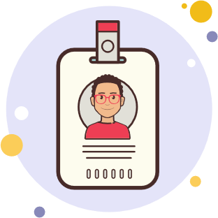




What information do you collect about me?
Your name
Your address, where you live
Your phone number so we can contact you
Who your family are, who looks after you
Your date of birth

Slide 4






What else might you know about me?
Your marital status
What you like to be called
Your job, if you have one
Your email address if you have one
Where you were born
Your religion if you have one

Slide 5




How do you keep my information?
Your records are stored on computer on an electronic patient record system and are kept safe.
Or they might be stored on paper file, these are also kept safe
All staff at the practice have to keep your information safe

Slide 6


Some information we keep about you may be sensitive
Your patient health records are sensitive
Any safeguards that you have in place to protect you
It is important for us to keep information about you so that we can help you in the best possible way.

Slide 7
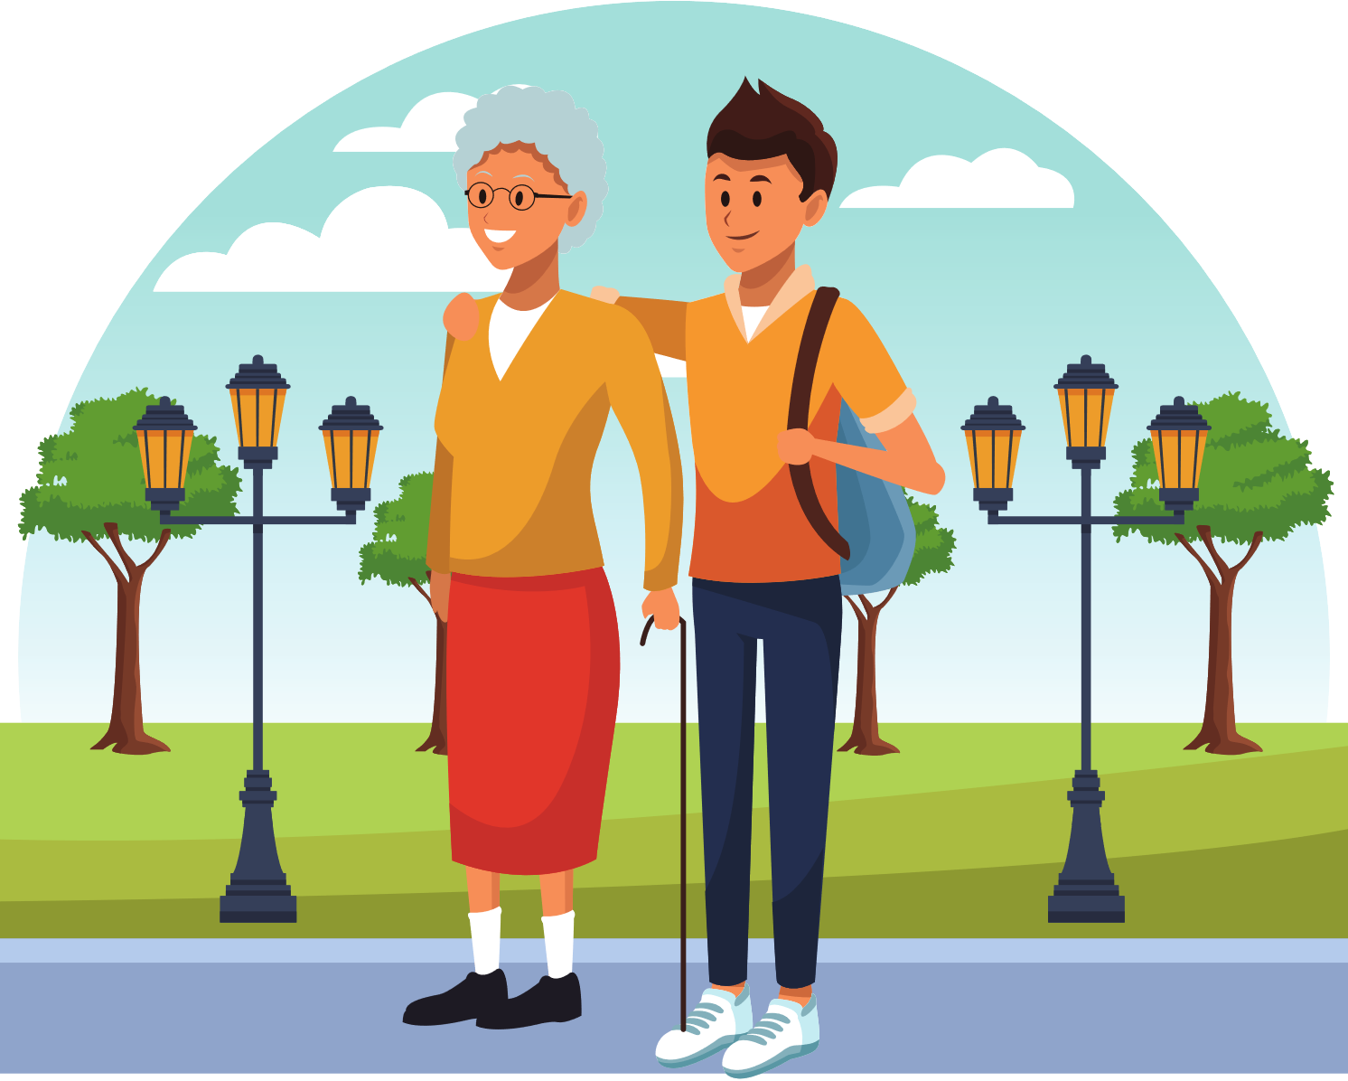


We might also use your information
To give to other people who are treating you
We might ask for your opinion on how to make things better for you at your medical practice.
To share with people organising your care, these are called commissioners.
For medical research purposes , we would ask you for your permission

Slide 8




Sometimes, we might need to share your information because it's the law
If the police require information as part of a criminal investigation
Information might be required by law due to fraud
If there is a court order
If the Care Quality Commission CQC require it during an inspection

Slide 9



By law this means that we must...
The law tells us how to keep your information
We have to follow the Data and the Common Law Duty of Confidentiality
Only let staff look at your records that are authorised to do and is part of caring for you.
Keep your records confidential and secure at all times
Keep your records secure
We will make sure your information is safe, using computer passwords for electronic information, and locks for paper information.

Slide 10



Why do we share information and under what conditions ?
We need to have a legal reason for using your information without asking you first
Sometimes special permissions will be given to use information that uses your name without your consent.
We need to tell you how personal information will be used

Slide 11




What is the reason for using my name without your consent?
This may be for medical research or checking quality of care. This permission is given by the Secretary of State for Health on advice from the National Information Governance Board for Health and Social Care under strict conditions.

Slide 12






Who do we share information with?
Ambulance Services
NHS England
Public Health England and other NHS Trusts
Social Services or private care homes to help them give you the best support.
General Practitioners (GPs)
Primary Care Agencies
This may also include those organisations that help the NHS to look after your health.

Slide 13

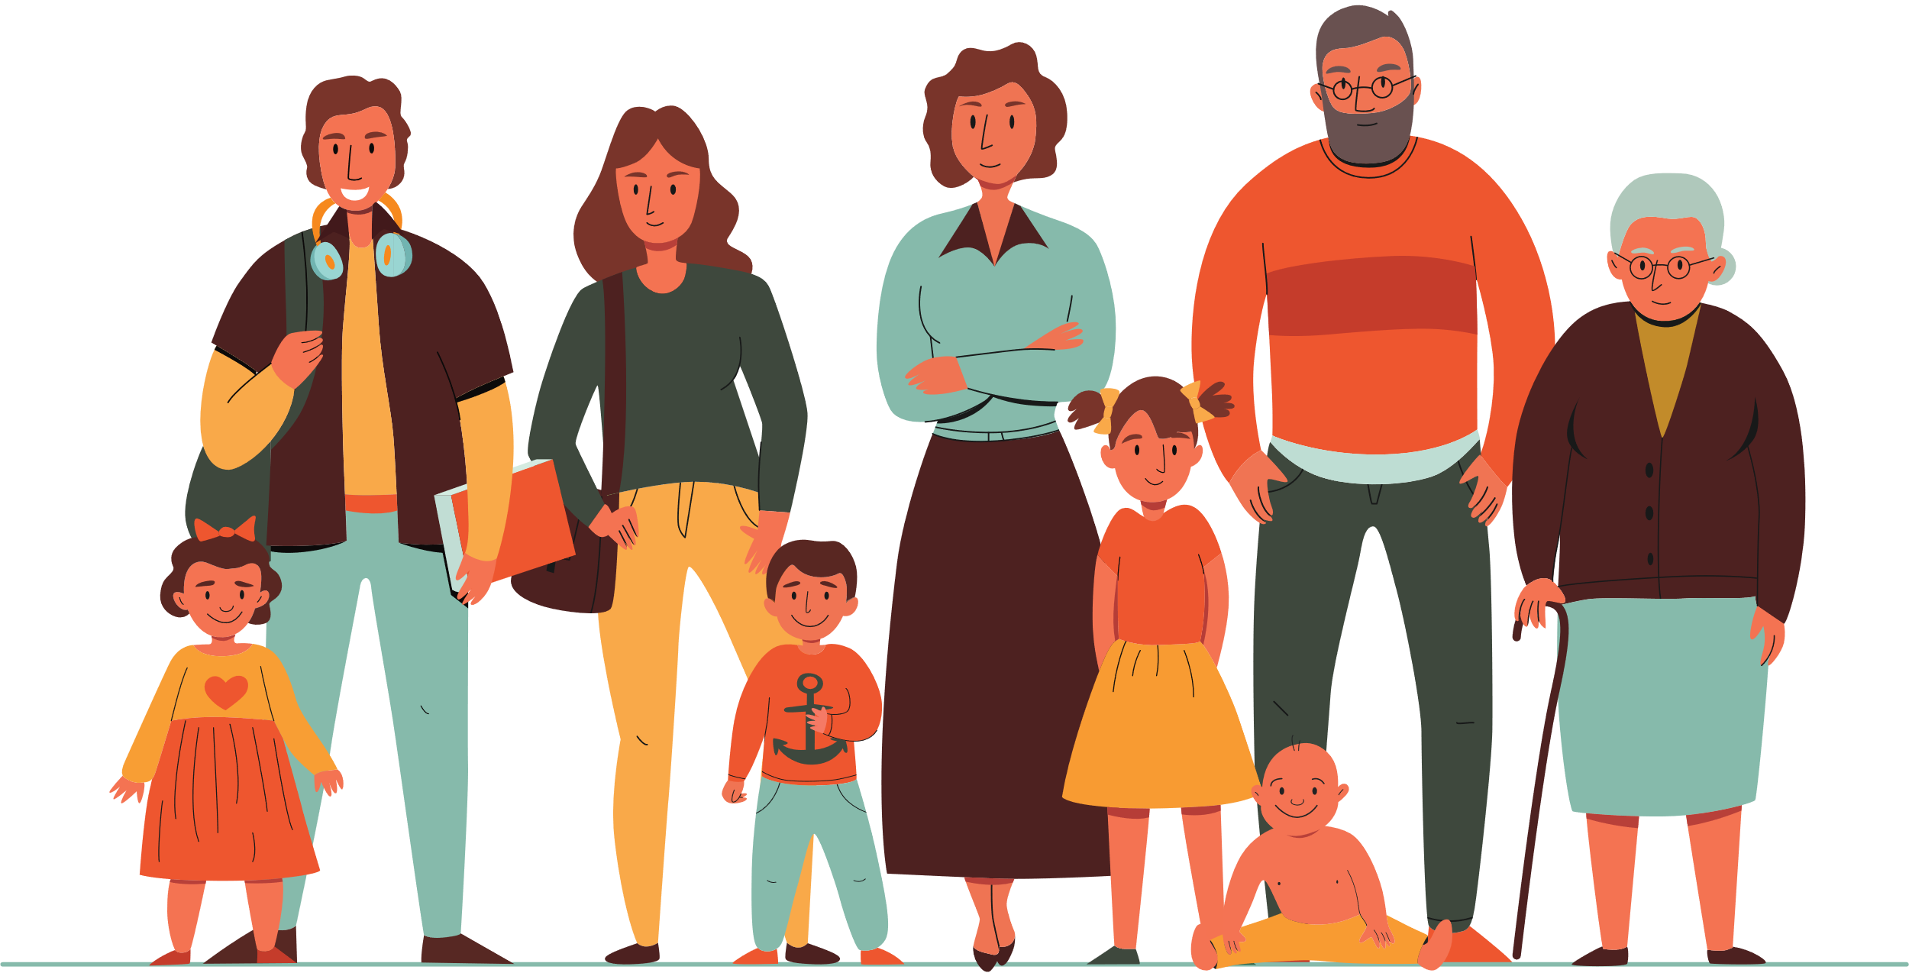



National Data Opt-Out
The information collected about you when you use our services can also be used and provided to other organisations for purposes beyond your individual care, for instance to help with:
Improving the quality and standards of care provided - research into the development of new treatments - preventing illness and diseases - monitoring safety - planning services
All these uses help to provide better health and care for you, your family and future generations.
www.nhs.uk/your-nhs-data-matters

Slide 14




You have a choice about whether you want your confidential patient information to be used in this way.
Confidential patient information about your health and care is only used like this when allowed by law.
Anonymised data is used for research and planning so that you cannot be identified in which case your confidential patient information isn’t needed.
If you are happy with this use of information you do not need to do anything. If you do choose to opt out your confidential patient information will still be used to support your individual care.

Slide 15





What are my rights?
Under UK law The Data Protection Act and GDPR you can……
You can tell us not to share your information if you really don’t want us to
If some information is wrong you can ask us to change it for you
You can ask us to give you a copy of your records, this is called a Rights of Access request
You can ask us to give copies to other organisations if they need it too
Unless we have to if it’s required by law

Slide 16

Who do I talk to if I’m not happy
You can speak to our Data Protection Officer:
Liberty Apted
Avon Local Medical Committee,
14a High Street, Staple Hill,
Bristol, BS16 5HP
Tel: 0117 4038446
Email: liberty@lmcukservices.co.uk
Website: www.avonlmc.co.uk
or
The Information Commissioners Office
call our helpline on 0303 123 1113
https://ico.org.uk/make-a-complaint/
Privacy Notice Next review Sept 2023

