Slide 1

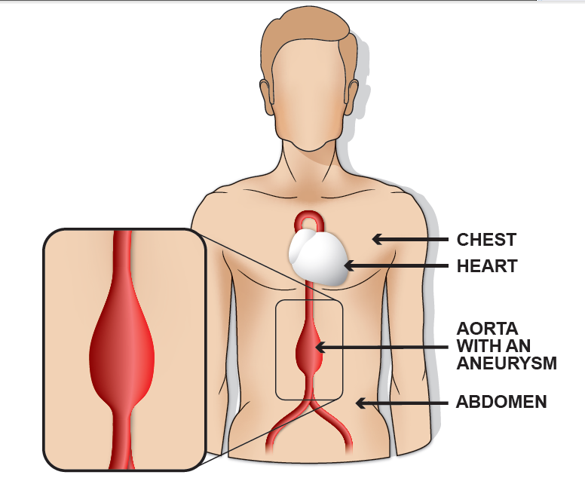
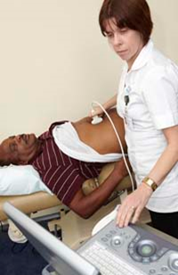
FREE SCREENING FOR MEN AGED 65 AND OVER
The aorta is the main blood vessel that supplies blood to your body.
In some people, as they get older, the wall of the aorta in the abdomen can become weak, can then start to expand and form an abdominal aortic aneurysm.
The condition is most common in men aged 65 and over.
With ultrasound we can identify men with an aneurysm and manage their care.
The NHS invites all men for screening in the
year they turn 65 for an appointment at a
surgery or community hospital near their
home address.
Men, over 65 who have not received an invitation, can contact us directly on 01803 655441 to arrange a test

Slide 2
Why is AAA screening important?
If you have an aneurysm you will not usually notice any symptoms. This means you cannot tell if you have one, will not feel any pain and will probably not notice anything different.
We offer screening so we can find aneurysms early and monitor or treat them. This greatly reduces the chances of the aneurysm causing serious problems.
Men, over 65 who have not received an invitation, can contact us directly on
01803 655441 to arrange a test

