Slide 1
National data opt-out update
East of England IG Forum - April 2019
Dawn Friend, Local Implementation Manager

Slide 2
Agenda
Update on national data opt-out
Patient information and setting service
National data opt-out policy
Becoming compliant
Further information

Slide 3
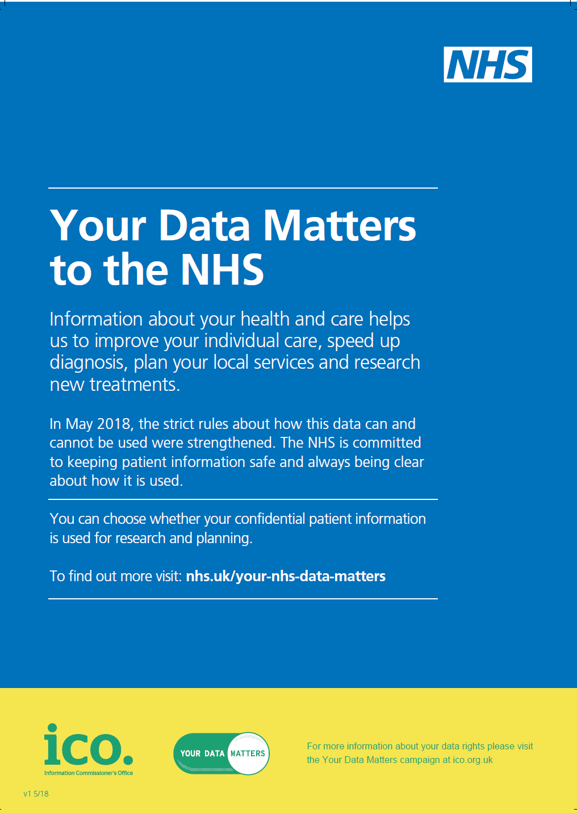
Where we are now
National data opt-out service launched to the public on 25 May 2018
A secure way for patients to express their preference about the use of their confidential patient information (CPI) for purposes beyond their individual care and treatment
Now for compliance….
Any health and care organisation which processes and/or discloses data that originates within the health and adult social care system in England is required to consider if national data opt-outs should be applied to uses of CPI for purposes beyond individual care.
All health and adult social care organisations must be compliant by March 2020
Information correct as of April 2019

Slide 4
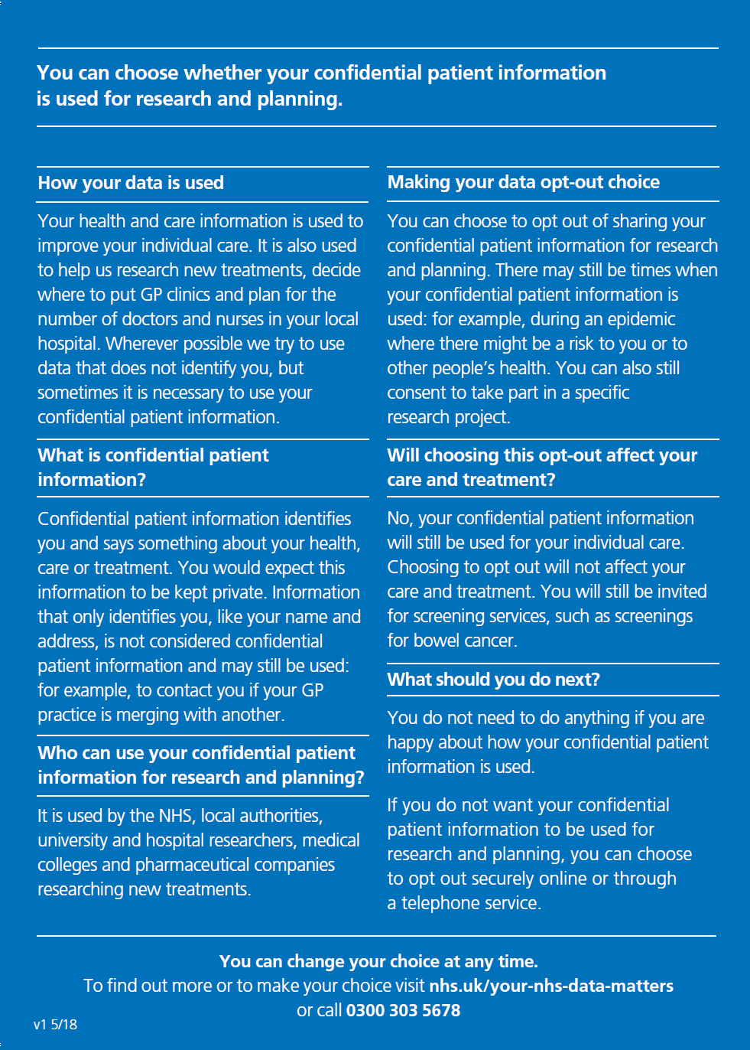
Notes:
This is the poster/handout
Starter packs of patient materials (posters and handouts) were delivered during June and July 2018, to:
GP practices, Trusts, Ministry of Defence, local Healthwatch, Pharmacies and dental practices.

Slide 5
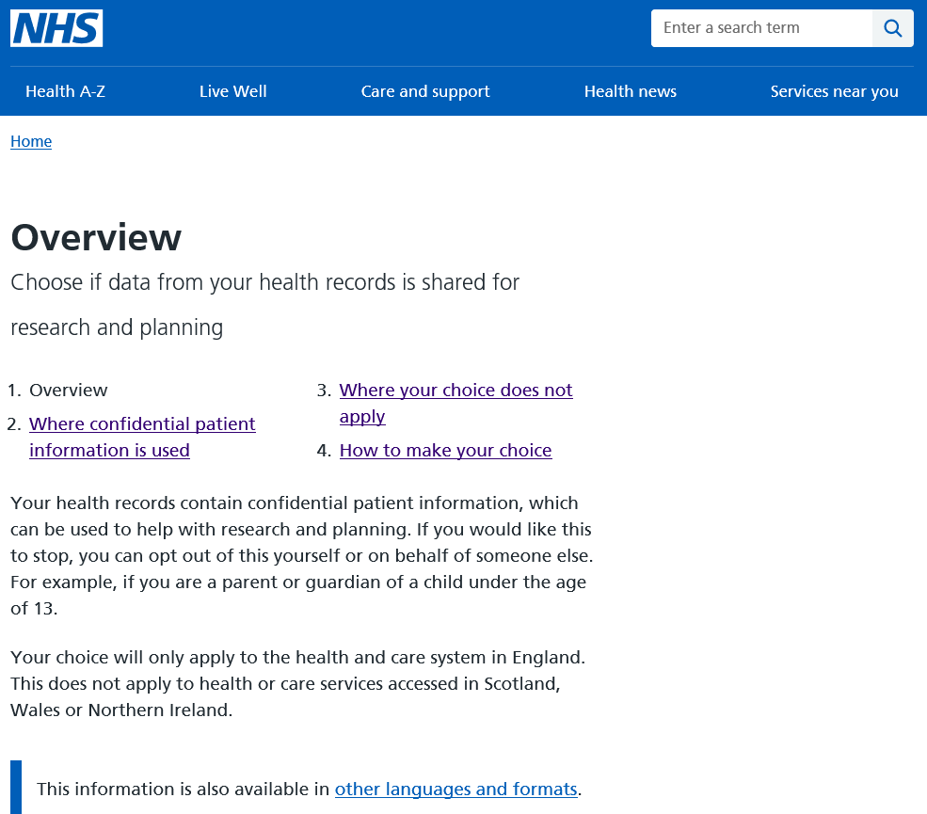
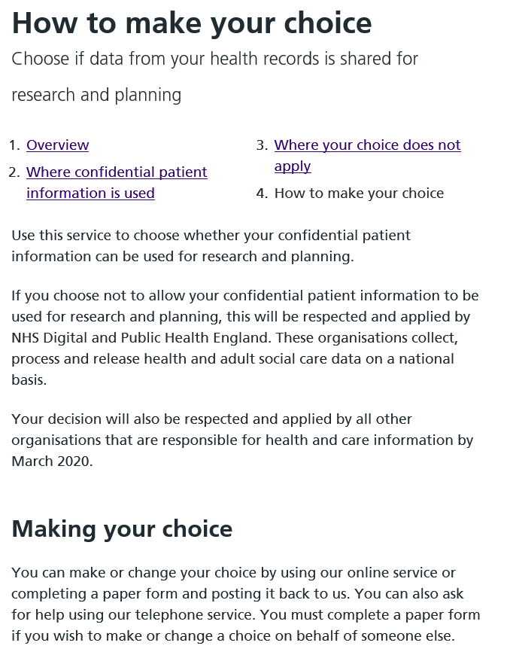
Notes:
People resident in Wales, Scotland etc. who have received care in NHS in England and have an English or Welsh NHS number can set an opt-out
Proxies include those with parental responsibility, a lasting power of attorney (both health and welfare and property and financial affairs) or a court appointed deputy.
Age 13 aligns with the Data Protection Act 2018 which sets 13 as the minimum age at which young people can give their consent to participate in digital services.

Slide 6
Informing your patients
Please ensure you:
Display the ‘Your Data Matters to the NHS’ poster, and make handouts available to patients
Review existing patient materials (posters, leaflet, website) and remove any that are out of date so that patients have the latest information about data uses beyond individual care and the national data opt-out
Check locally produced materials for accuracy if they refer to opting out, such as registration forms, questionnaires
Consider using the screen text for electronic displays in reception/waiting areas
Consider using the recommended standard text about the wider uses of health and care data, alongside or within Privacy Notices
All resources are available at: https://digital.nhs.uk/national-data-opt-out
​
Information correct as of April 2019
Notes:
Starter packs of patient materials were delivered during June and July 2018, to:
GP practices, Trusts, Ministry of Defence, local Healthwatch, Pharmacies and dental practices.
Printed patient materials (posters and handouts) can also be ordered free of charge through DHSC orderline
Range of accessible and language versions available on our pages and through the DHSC orderline
Remove references to care.data or type 2 opt-outs. Type 2 opt-outs are no longer valid.
Recommended text includes an option to state whether or not your organisation complies with the national data opt-out policy

Slide 7
Informing your workforce
Please ensure:
Your Information Governance lead, Caldicott Guardian, Data Protection Officer are aware of the national data opt-out
Your organisation has policies and procedures in place for handling enquiries about data use and opt-outs, which includes the national data opt-out
Clinicians and staff who deal with patients understand your policy and procedures for enquiries about data use and are aware of the national data opt-out
Clinicians and staff know to direct patients who ask for further information to the handouts, the NHS website at www.nhs.uk/your-nhs-data-matters or the telephone helpline (telephone no is in the handouts and on the website)
Materials for workforce and specialists needing more detail are available at: https://digital.nhs.uk/services/national-data-opt-out-programme/guidance-for-health-and-care-staff
Information correct as of April 2019
Notes:
General workforce should be familiar with the patient materials – this should be sufficient
There are simple short factsheets for staff who just need/want to know a little more
Much more detailed information available in the Operational Policy Guide for those with specialist roles – eg IG, those who deal with data uses/disclosures

Slide 8



How the national data opt-out works
National bodies
Empower patients
Make simple to uphold
Local health and care orgs
Store once –
use for all
NHS Digital applying national data opt-outs from May 2018
Public Health England started applying from September 2018
All other health and adult social care organisations must be compliant by March 2020
Information correct as of April 2019
Notes:
Set by patients themselves… not GP practice
Stored once – spine repository (not PDS)
NHS Digital have been compliant with the national data opt-out policy since 25 May 2018 (previously NHS Digital had been applying Type 2 opt-outs since 29 April 2016).
We have also delivered functionality to Public Health England as they were the next organisation to comply with the policy and are applying opt-outs.
NHSD have created a technical solution for health and care organisations to apply opt-outs to their data uses and disclosures – will come back to this later…

Slide 9
What does it mean to 'be compliant’?
Any health and care organisation which processes and/or discloses data that originates within the health and adult social care system in England is required to consider if national data opt-outs should be applied to uses of confidential patient information (CPI) for purposes beyond individual care.
Being compliant is:
Having processes and controls in place to authorise uses of CPI for purposes beyond individual care
Considering application of national data opt-outs as part of that process
….
….
Information correct as of April 2019
Notes:
Will come back to c&d …

Slide 10
Summary of operational policy guidance
Type of data – Confidential Patient Information
Covers health and adult social care in England only
Applies to publicly funded or co-ordinated care
Purpose and legal basis underpins application of opt-out:
  Purposes beyond individual care
  How the Common Law Duty of Confidentiality is met
  Applies when S251 (reg 2 or 5) is relied upon
Full operational policy guidance at
https://digital.nhs.uk/national-data-opt-out
Information correct as of April 2019
10
Notes:
Confidential Patient Information is a legal term in use across the health and care system. It is defined in section 251 (11) of the National Health Service Act 2006 (see below). Broadly it is information about either a living or deceased person that meets the following 3 requirements:
a) identifiable or likely identifiable e.g. from other data likely to be in the possession of the data recipient; and
b) given in circumstances where the individual is owed an obligation of confidence; and
c) conveys some information about the physical or mental health or condition of an individual, a diagnosis of their condition; and/or their care or treatment.
CPI cannot be defined by a specific data item (e.g. name or postcode) alone, as it needs to be considered more broadly to take into account the nature of the information and the circumstances of the disclosure. Section 251 has been updated to ensure that the definitions used expressly include local authority social care (i.e. care provided for, or arranged by, a local authority).
Beyond individual care: Individual care defined by NDG in review: - includes assurance of safe and high quality care and treatment through local audit, management of untoward incidents, outcomes measurement etc, if carried out by professionals/team with legit relationship, providing care. (see Factsheet 2 or Operational Policy Guidance)
Main consideration is what legal basis is being applied with Common Law Duty of Confidentiality – if relying on s251 then opt-out will most likely apply.
s251 - authorisation given under :
regulation 2 (medical purposes related to the diagnosis or treatment of neoplasia i.e. cancer); or
regulation 5 (general medical purposes including medical research)
of the Control of Patient Information Regulations 2002 under the NHS Act 2006 Section 251
The Confidentiality Advisory Group which provides independent expert advice on applications for data use under Section 251 can in some cases agree that opt-outs do not apply but have indicated that this would only be in exceptional circumstances

Slide 11



When does the national data opt-out apply?
Applies to data shared for planning and research purposes
Data shared for an individual’s care and treatment
Legal requirement / public interest / consent
Data is anonymised
Single option that covers: Research – finding ways to improve treatments and identify causes of and cures for illnesses
Planning – to improve and enable the efficient and safe provision of health and care services
E.g. where data is shared between the health and care professionals in a hospital and in a GP practice
E.g. There is a mandatory legal requirement such as a court order, to protect the greater interests of the general public, or there is explicit consent
The data shared is determined to be compliant with the ICO Anonymisation: managing data protection risk code of practice
This identifies you personally
This identifies you personally
This identifies you personally
This does not identify you personally
Notes:
The national data opt-out applies only where confidential patient information is being shared for purposes beyond an individual’s care and treatment e.g. it is intended to be used in research studies or to help in managing the efficient and safe running of the health and care system
Regardless of the national data opt-out confidential patient information must not be used for insurance or marketing purposes without the explicit consent of the patient
The national data opt-out is for purposes beyond an individual’s care and treatment not their individual care
The national data opt-out will not apply where:
Mandatory legal requirement such as:
CQC has statutory powers to require information for their inspection purposes
Reporting of notifiable diseases
Reporting of gunshot wounds
NHS Digital require a health and care organisation to provide data under s259 of HSCA 2012 (eg SUS)
NHS Counter fraud service
Other legal gateways e.g. Crime and Courts Act, Security Services Act etc
Positive public interest test – Data controllers expected to undertake their own public interest test. This should look at the individual circumstances of the case, examples of disclosures that may be made in the public interest are reporting gunshot wounds and knife wounds or reporting patient fitness to drive to DVLA.
Consent – eg explicit consent for a specific research study or clinical trial
Opt-out does not apply to data anonymised in line with the ICO CoP – note the CoP is being reviewed following introduction of GDPR. This currently covers a range of data from anonymous through to data which are de-identified for limited access with a wider suite of controls.

Slide 12
When does the national data opt-out NOT apply?
Communicable diseases and risks to public health i.e. Regulation 3 Control of Patient Information Regs 2002
Data flowing to ONS for statistical purposes
Flows to PHE for National Cancer Registration Service and National Congenital Anomalies and Rare Diseases Registration Services
Data for provision and oversight of national population screening programmes
National patient experience surveys (CPES and CQC)
‘Assuring Transformation’ data flows, until programme closure
Information correct as of April 2019
12
Notes:
Some specific uses and scenarios: (most covered in section 7 of operational policy guidance)
Communicable diseases/PH – (OPG 6.2)- regulation 3 of s251 – in public interest
ONS flows – opt-out will not apply for the purpose of producing national statistics. NDG review recognised importance of integrity of national stats.
Many currently have separate opt-out mechanisms:
NCRS etc – separate opt-out mechanism
National screening programmes (endorsed by UK national screening committee) – separate opt-out mechanism
National PE surveys – exemption for National Cancer Patient Experience Survey (CPES) and CQC NHS Patient Survey Programme – continue to operate separate opt-out.
‘Assuring Transformation’ (approved data collection related to care of people with learning disability/autism) separate opt-out mechanism

Slide 13
Clinical audit – local / national
Opt-out will NOT apply to local clinical audit
Falls within the definition of individual care, as set out in the NDG review “It includes the assurance of safe and high-quality care and treatment through local audit…”
NDG review also set out that data can be used for local clinical audit under implied consent, when undertaken by a team or professional with a legitimate relationship for the patient’s care
Opt-out will apply to national clinical audit (unless covered by another exemption)
Information correct as of April 2019
13

Slide 14
Payments, Invoice Validation and Risk Stratification
Payments and invoice validation
  Anonymised data to be used wherever possible
  Will NOT apply to non-contracted invoice validation
  WILL apply to purposes which rely on s.251 support*
  *other than approvals where CAG have waived the standard condition to apply opt-outs
Risk stratification
  Will NOT apply to data anonymised in line with the ICO code of practice on anonymisation
  Will NOT apply to risk stratification for case finding, where carried out by a provider involved in an individual’s care (or data processor). This is to be treated as individual care for purposes of the opt-out
  WILL apply to purposes which rely on s.251 support
Information correct as of April 2019
14
Notes:
Payments – wherever possible anonymised data should be used for payment/invoice validation.
Work is ongoing with a number of organisations and NHS bodies to further understand if there are any adverse impacts of these policy lines with respect to invoice validation and invoice challenge
*3 specific CAG approvals for invoice validation – see OPG 7.1

Slide 15
What you need to do to be compliant, and why!

Slide 16
What does it mean to be compliant?
Any health and care organisation which processes and/or discloses data that originates within the health and adult social care system in England is required to consider if national data opt-outs should be applied to uses of confidential patient information (CPI) for purposes beyond individual care.
Being compliant is:
Having processes and controls in place to authorise uses of CPI for purposes beyond individual care
Considering application of national data opt-outs as part of that process
Having the technical ability to submit and receive NHS numbers using MESH
Having the technical and business processes in place along with the controls to make sure the updated list of NHS numbers is applied before data is used/disclosed
Organisation can then provide patient-facing information to confirm compliance with national data opt-out policy (eg within its Privacy Notice)
Information correct as of April 2019

Slide 17
What if I don’t need to apply opt-outs?
An organisation may establish they do not have any current data uses which require the application of national data opt-outs.
In such cases these organisations can declare ‘compliance’ with the national data opt-out policy if they have:
Processes in place to continue to review and identify if opt-outs need to be applied, and
  recognise they would need to implement the technical capabilities should the need be identified, or
  put in place those technical capabilities just in case
Organisation can then provide patient-facing information to confirm compliance with national data opt-out policy (eg within its Privacy Notice)
Information correct as of April 2019
Notes:
To help with this slide a, b, c and d from previous slide are copied here :
Having processes and controls in place to authorise uses of CPI for purposes beyond individual care
Considering application of national data opt-outs as part of that process
Having the technical ability to submit and receive NHS numbers using MESH
Having the technical and business processes in place along with the controls to make sure the updated list of NHS numbers is applied before data is used/disclosed

Slide 18
How the national data opt-out works
National bodies
Empower patients
Make simple to uphold
Local health and care orgs
Store once –
use for all
NHS Digital and Public Health England are already applying national data opt-outs
All other health and adult social care organisations must be compliant by March 2020
Information correct as of April 2019

Slide 19


Check for National Data Opt-outs service
Provider will supply only NHS Numbers within a specific dataset
Encryption at the transit level through use of MESH*
NHS Digital
Spine Interface
NHS Digital return list of NHS Numbers where no national data opt-out is set
Encryption at the transit level through use of MESH*
Spine repository
Health and Care Organisation
All opt-outs are removed before returning list to organisation
To help GP practices to become compliant, the 4 GP system suppliers have been commissioned to embed this service into their systems.
* MESH = Messaging Exchange for Social Care and Health
Encryption at the business level not required
Information correct as of April 2019
Notes:
Trusts have been piloting the service – full guidance and information on our webpages for setting up MESH client for the service.
An option to provide a full list of those opted-out to providers was discounted on IG grounds. The reasoning behind this is that it was felt we would be sending them information about people that they don’t need and are providing more information than is necessary for people who are most concerned about the sharing of their data

Slide 20

Supporting organisations with compliance
NHS Digital – compliant since May 2018
Data Services for Commissioners Regional Offices (DSCROs) - compliant since May 2018
Public Health England – compliant since September 2018
Other national organisations: in progress
NHS Trusts: February 2019 – August 2019
GP practices and CCGs: May – October 2019
Local authorities and adult social care: April 2019 - March 2020
Others (eg pharmacies, NHS dental/opticians): October 2019 – March 2020
Information correct as of April 2019
Notes:
NDOP team programme of support – currently focussing on trusts…
SIGN groups
Pilots
DPO letters – contacting all NHS trusts at the moment

Slide 21

Compliance resources
Guidance on our compliance page to help:
  understand what being compliant with the national data opt-out policy means
  plan the tasks and actions required, e.g.
    consider and update data use and release policies and procedures
    to support technical implementation
    communicating compliance internally and externally
Coming soon (currently testing with organisations)
  examples of real data uses and position on whether opt-outs apply to help assessing own data uses
  information to help with DPIAs
​
Information correct as of April 2019

Slide 22
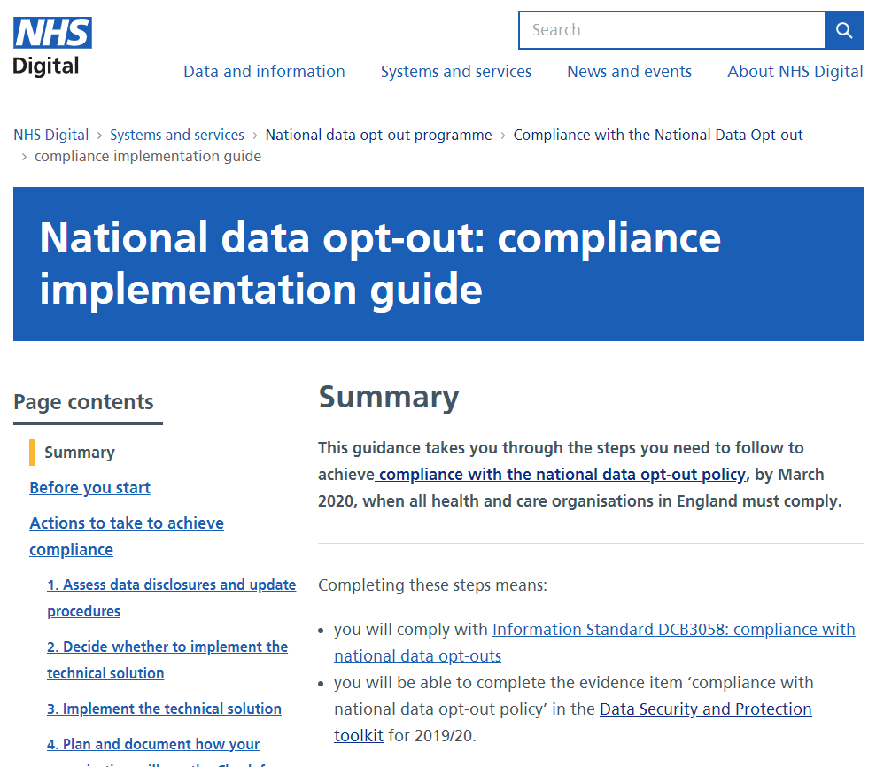
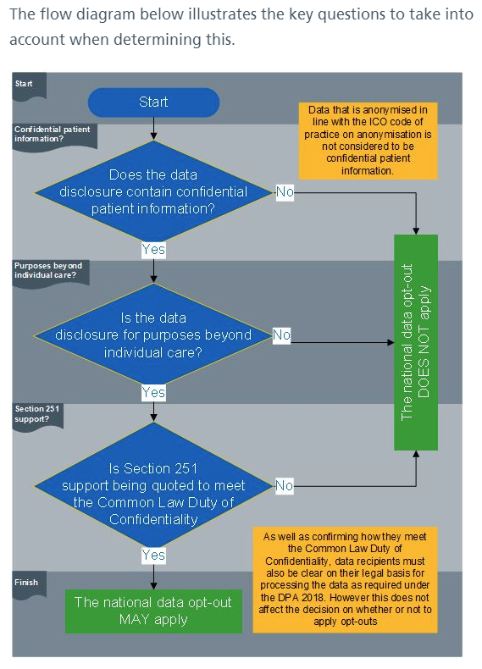
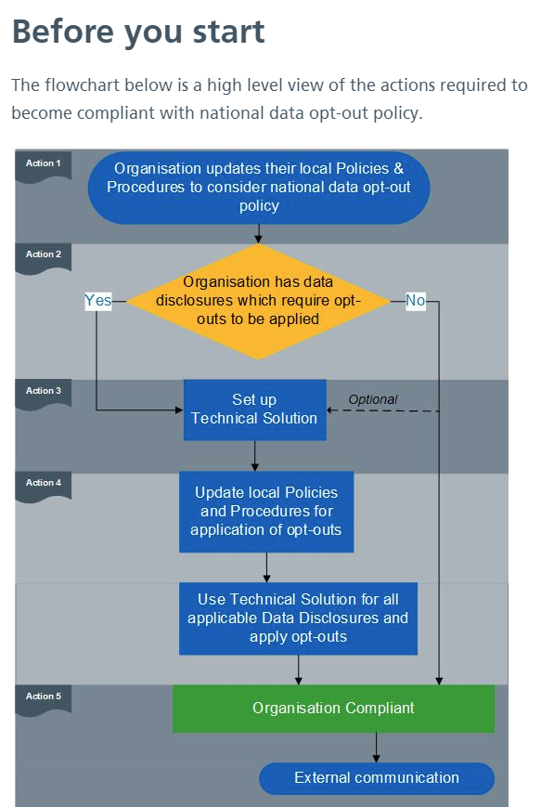
Information correct as of April 2019
Notes:
Screenshots to show CIG … and flowcharts

Slide 23

Embedding opt-out compliance
Information Standard for national data opt-out compliance
Mandates compliance with the policy and use of the Check for National Data Opt-outs service in accordance with required specification. All health and social care bodies must have regard to published information standards.
NHS Digital Code of Practice on Confidential Information
Adding information about complying with national data opt-out policy. Defines the steps that organisations must, should and may take to ensure that confidential information is handled appropriately. All health and social care bodies must have regard to the Code of Practice.
DSP Toolkit (2019/20)
Update to current content on national data opt-out to change it to a self assessment statement of compliance. Will require supporting evidence e.g. Privacy Notice statement if declaring compliance.
ICO position
Indicate a failure to implement the national data opt-out policy would be considered against the principle of lawfulness, fairness and transparency.
Information correct as of April 2019
Notes:
Information standard on compliance has now been published - March 2019. (Link on our compliance page)
Under Section 250 of the Health and Social Care Act 2012 public bodies exercising functions in connection with health services or adult social care and anyone providing publicly funded health services or adult social care commissioned by, or on behalf of, a public body are required to “have regard to” published information standards.
ICO has stated they would look at the principle of lawfulness, fairness and transparency if they received any complaint and consider how the national data opt-out has been positioned and communicated to public and patients.
The ICO’s checklist on Fairness include the following tests:
☐ We only handle people’s data in ways they would reasonably expect, or we can explain why any unexpected processing is justified.
☐ We do not deceive or mislead people when we collect their personal data.
---------
Contracts - NHS contracts and those based on NHS Standard Contract include a requirement to comply with information standards. Failure to do so may be considered a breach of contract. (quote from OPG v3)

Slide 24
Key messages for NHS Trusts
NHS Trusts must be compliant by March 2020
Assess data disclosures and update procedures
  Current data disclosures assessed to identify any that will be within scope of national data opt-out policy
  Process for handling new requests updated to make sure policy is considered before disclosure
Decide whether to implement the technical solution
  Data disclosures assessed, decision if need to implement the technical solution in order to apply national data opt-outs
Implement technical solution to access the Check for National Data Opt-outs service
  Messaging Exchange for Social Care and Health (MESH) client software installed, MESH mailbox in place
Plan and document procedures to apply national data opt-outs
  Processes for creating a list of NHS numbers that need to be checked, creating files to send to service
  Processes for using the returned files to create an updated set of data and confirming opt-outs have been applied.
  Data Protection Impact Assessment (DPIA) completed
  Processes documented and included in standard operating procedures (or equivalent)
Communications and declaring compliance
  Internal, external (other organisations), patient communications.
Further information and resources: https://digital.nhs.uk/national-data-opt-out
​
Information correct as of April 2019
Notes:
Edited highlights of what’s on our pages, in the CIG, service guidance etc.
*Technical capability may be provided within clinical systems provided by GP system suppliers, eg TPP
This may also apply to other clinical system modules from these suppliers

Slide 25
Key messages for GP practices (and CCGs)
www.nhs.uk/your-nhs-data-matters (and telephone, print-and-post service) live since 25 May 2018.
National data opt-out is set by patient themselves, cannot be set by the practice.
Previous ‘type 2’ opt-outs were converted, and patients informed by letter from NHS Digital.
Type 2 opt-out codes (XaaVL/9Nu4.) must not be used.
TPP and EMIS have inactivated codes in browsers. Vision/Microtest have not yet*@ March 2019
Actions for practices
Display ‘Your Data Matters to the NHS’ posters and patient handouts, use display screen videos, and ensure practice team are aware.
Review other materials about data use and opt-outs (posters, leaflets, website, privacy notice, registration forms) and remove/update any that are out of date (eg ‘care.data’, type 2 opt-outs).
Check for entries of XaaVL/9Nu4. in patient records after 11 October 2018. If found, practice must contact the patient to inform them and signpost to nhs.uk service.
Prepare to work towards compliance, by March 2020.
Further information and patient materials: https://digital.nhs.uk/national-data-opt-out
​
Information correct as of April 2019
Notes:
GP system suppliers have been commissioned to develop and embed the ‘check for national data opt-outs’ service into their clinical systems. You may not need to set up the MESH service separately unless your practice prepares and discloses data outside the clinical system. Further information will be made available as the GP system suppliers confirm their delivery plans.

Slide 26
Further information
For more information, workforce and patient resources, or to join our mailing list, go to the National Data Opt-out Programme web pages:
https://digital.nhs.uk/national-data-opt-out
To contact us about becoming compliant or any other enquires, email: newoptoutenquiries@nhs.net or dawnfriend@nhs.net (local contact)
The ‘Your Data Matters to the NHS’ patient-facing service:
www.nhs.uk/your-nhs-data-matters
Information correct as of April 2019
Notes:
Extra links, depending on audience
Understanding Patient Data - Wellcome Trust
https://understandingpatientdata.org.uk
Information Governance Alliance (IGA) information on GDPR:
https://digital.nhs.uk/information-governance-alliance/General-Data-Protection-Regulation-guidance
RCGP Patient Data Choices - resources for GP practices
Toolkit: http://www.rcgp.org.uk/patientdatachoices
E-learning: http://elearning.rcgp.org.uk/course/info.php?id=156
Implementation team support - contact for [eg Midland and East: dawnfriend@nhs.net ]

