Slide 1
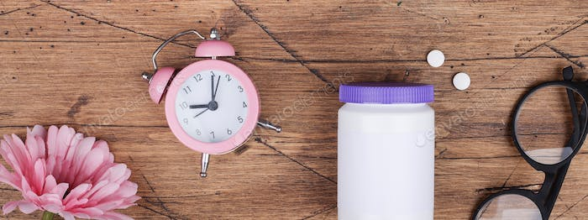
Menopause Coffee morning
Dr. Kanchana Imrapur
Strensham Road Surgery

Slide 2
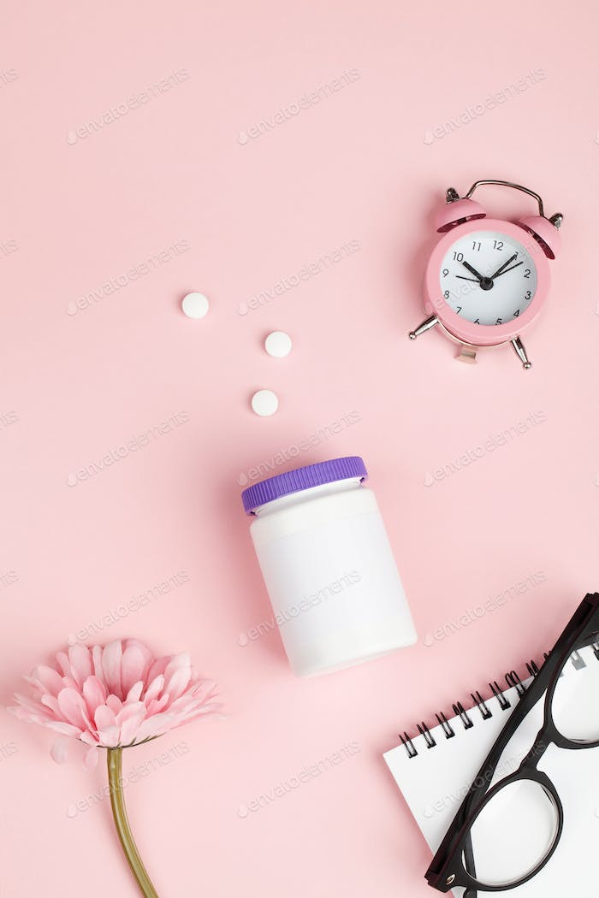
Welcome
Session 1: What is going on!?
What is the menopause
Symptoms, Symptoms, Symptoms
Vaginal and Brain Health
Session 2: What might help!?
HRT
Testosterone Replacement
Alternative treatment options
Sexual health & Contraception
Session 3: Lifestyle and long term
Weight / Diet / Exercise
Bone health
Cardiovascular health
When does the menopause end?

Slide 3
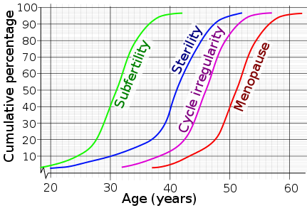
What is happening to my body!?
It’s all about Ovaries and Oestrogen

Slide 4
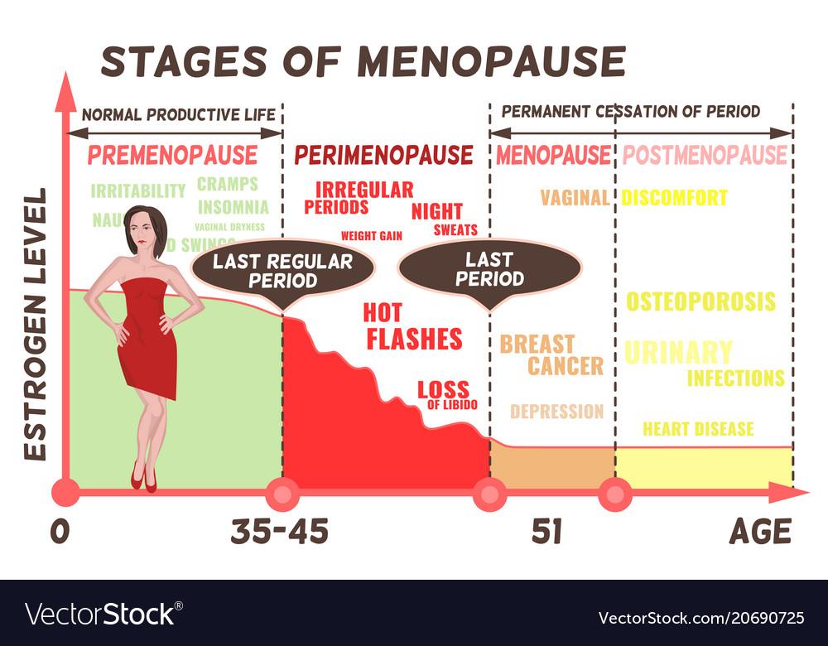
Am I Menopausal?

Slide 5
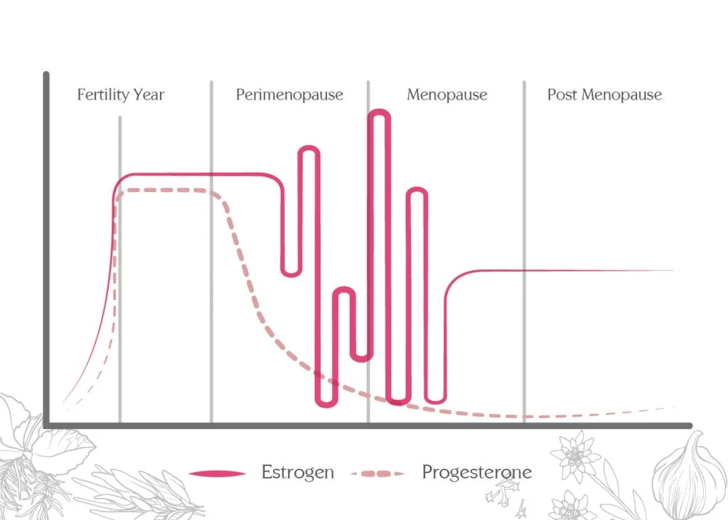
Will a blood test tell me if I’m Menopausal?
Not usually that helpful unless:
Under 45yrs
>45yrs with atypical symptoms
Women who have had a hysterectomy but still have ovaries
Women on HRT / hormone contraceptives
Fluctuating hormones…

Slide 6
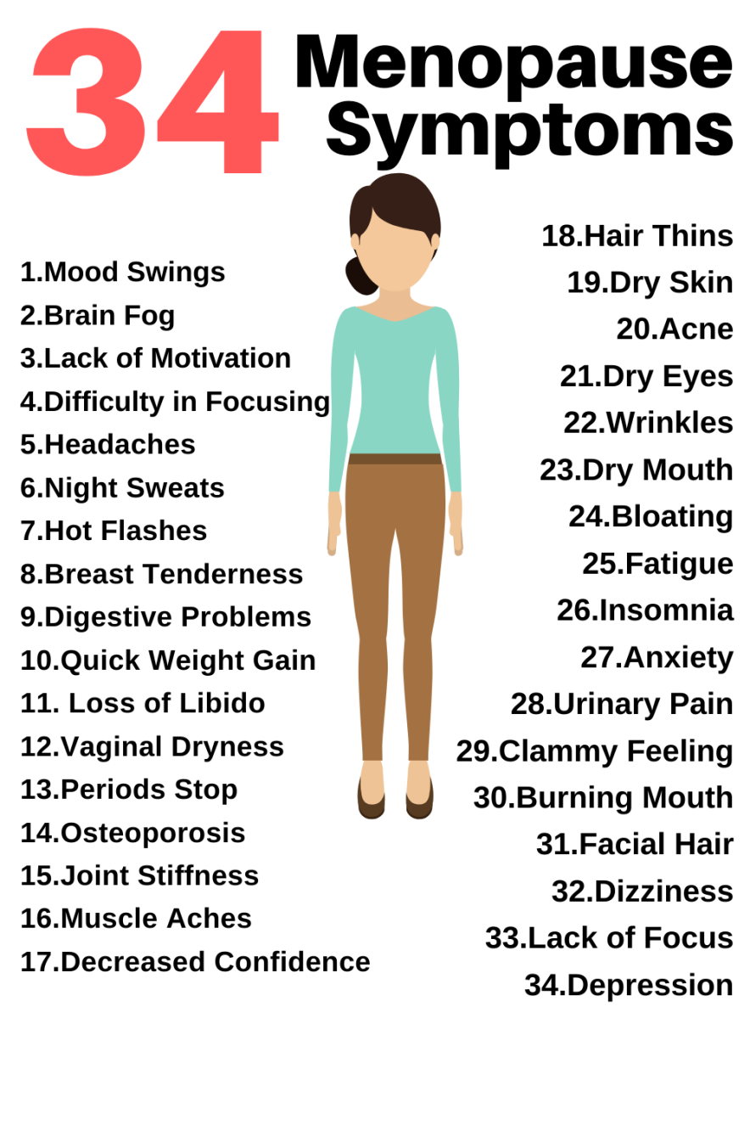
Symptoms:

Slide 7
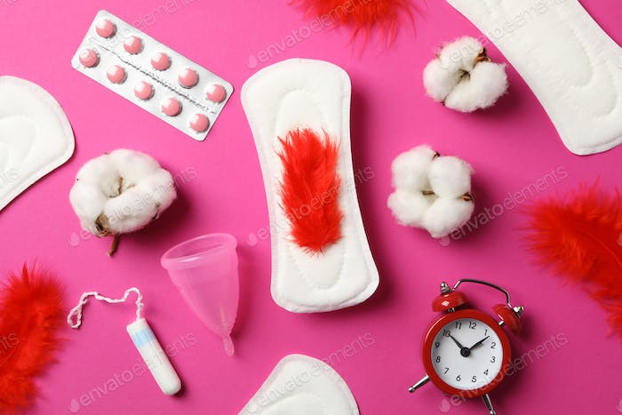
Symptoms:
Cycle Changes
Hot Flushes (75%)
Tiredness / poor sleep (68%)
Loss of Libido (65%)
Anxiety (62%)
Loss of memory / concentration / brain fog (53%)
Dry Vagina / discomfort on intercourse (48%)

Slide 8
What are the Implications?
Embarrassment
Arguments
Loss of intimacy
Self conscious at work
Divorce
Loneliness

Slide 9
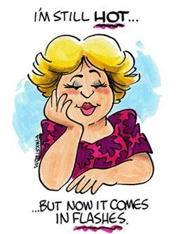
Hot Flushes (Vasomotor Symptoms)
Hormone pulses
The problem for sleep:
  Body temp falls in evening
  Lower temps help body fall and stay sleep
  Sleep is better when cooler
  Body temp rises in morning in preparation for wakefulness
Hot flushes = poor sleep!
Duration:
  Each last between 30 seconds & 5 minutes
  Frequency ranges from on occasion to up to 20 times per day
Flushes last average of 7.5yrs

Slide 10
Managing Hot Flushes
Non Medication Options
Medication Options
Regular low intensity exercise (but not late in evening)! Like Yoga
Layers of clothing
Weight loss (if needed)
Turn down central heating
Sleep in cooler rooms
Fans
Reduce stress
chill pillows
Avoid triggers: spicy food / caffeine / alcohol / smoking
HRT – 77% reduction in hot flushes and can directly improve quality of sleep
SSRIs / SNRIs – non hormonal
Alternative Therapies
Evidence that slightly better than placebo:
St Johns Wort
Isoflavones
Black Cohosh
Other options:
Foods high in phyto-oestrogen (soy)
Red clover
Evening primrose oil

Slide 11
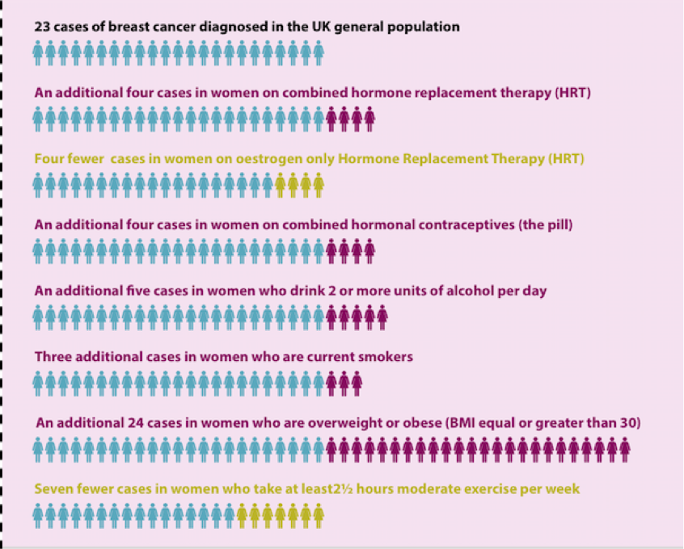
HRT & Breast Cancer Risk – Putting things in perspective

Slide 12
GENERAL OUTCOMES WITH HRT
HRT is not suitable for everyone due to medical and personal reasons.
However, for those who can consider HRT it is worth knowing…
Women who take HRT live longer and healthier lives than those not on HRT
Obesity
Or Sedentary lifestyle
Or Alcohol intake
Or Uncontrolled high blood pressure
Cause a greater amount of mortality and disease in
postmenopausal women when directly
Compared to HRT

Slide 13
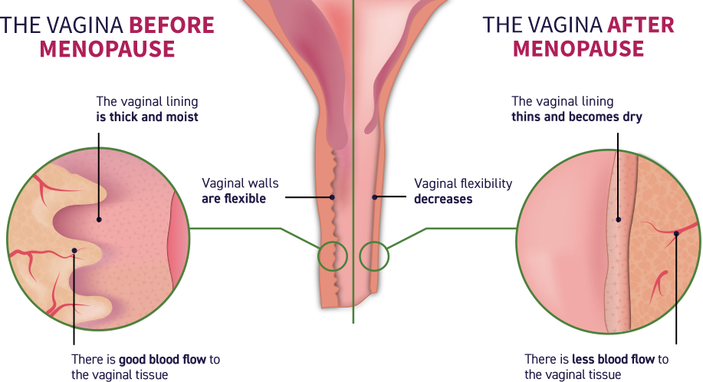
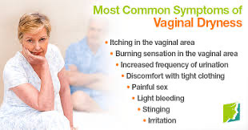
Vaginal Dryness & genitourinary Symptoms
Loss of enjoyment in sex
Loss of intimacy
Notes:
Pointing out here also that often women think they have a repeat urine infections when actually it is due to the vaginal / vulval skin being sore

Slide 14
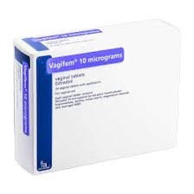
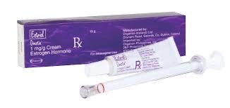
Oestrogen is missing – so oestrogen is needed
Topical Oestrogen
Benefits…
Improves tissue moisture level and elasticity
Reduced itch / burning
Intercourse more comfortable
Reduced recurrent urine infection rates
Helps slightly with some forms of incontinence
Additional Points
Minimally absorbed into body
No progesterone needed
Can be used lifelong
Can be used if had a past history of breast cancer
Can be used alongside full HRT if needed
Pelvic Floor exercises also help!
Notes:
Comment on the drawbacks: creams can be messy, needs to be used regularly, effects ware off when stopped using it, can sometimes sting a bit at first.
Should still continue to moisturise

Slide 15
Menopause and our mood - Some experiences…
I swing from joy to irritation and anger
Sudden overwhelming lows
Uncontrollable crying
Feeling invisible to society and to my husband
Lonely and not understood
Frustrated with my family and with myself
Like I just don’t want to be alive anymore
An emotional rollercoaster
I feel like my world is spinning out of control
I feel low, anxious and tearful and I never used to be like this

Slide 16
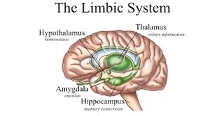
Memory issues / Mood / anxiety / Irritability
Well established association with the menopause
Decline in memory at onset menopause - but rebounds later
Due to effects of low oestrogen on nerves in brain particularly in: amygdala / hippocampus / frontal brain
These are the areas associated with Mood and Memory!
Hijacking the Amygdala
Very old primitive part of human brain
Fear / aggression / anxiety – fight or flight
Brain evolved better control over it
We learn to control it
Low oestrogen = poorer emotional control
Notes:
Amygdala was a very early part of the brain to develop so it is very “old” in evolutionary terms. It was essential back on cave man days in rapidly processing emotions like fear / aggression so that we could respond rapidly to threats / predators and keep us alive – the fight or flight response.
The brain then developed more sophisticated responses and these helped regulate and dampen down some of the primal amygdala responses. Since low oestrogen appears to affect some of these nerve pathways involving the amygdala some think it may explain why some emotional lability occurs through the menopause.

Slide 17
Are my brain and emotions doomed?
Some cases of low mood / anxiety due to underlying depression so need to consider how we manage it carefully
HRT
Improves memory in short and long term
Improves sense of brain fog
Improves mood / reduced anxiety / reduced irritability
Psychological Therapies
Breathing exercises
Mindfulness
Talking Therapies
CBT
Counselling
Antidepressants / Anti-anxiety Medications
Helpful in some situations

Slide 18
Low Libido
Not feeling emotionally interested
Vaginal Discomfort
Low
Libido
Not feeling attractive / low self esteem
Feeling Low
Relationship Difficulties
Feeling Tired

Slide 19
Managing low libido
Vaginal Health
Moisturisers +- oestrogen topically for healthy hydrated surfaces
Lubricants for intimacy
Testosterone gels and patches
Can be very effective for low libido
Need blood test before starting
Potential side effects
Acne / hair growth / irritability
  One study suggested small increased risk of breast cancer but other studies have not shown this
HRT
Transdermal Patch oestrogen form
Tibolone
Improves libido
Helps flushes
Promotes bone strength
But not suitable >60yrs / small increased risk endometrial cancer
Relationship counselling
Psychosexual counselling
Relate

Slide 20
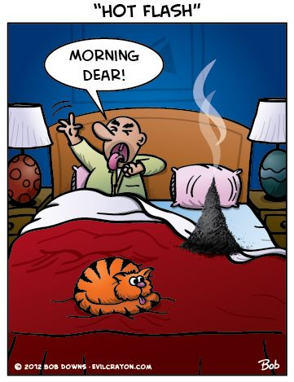
Poor sleep and tiredness
Addressing the underlying issues of the menopause often helps sleep!
  Improving the hot flushes helps improve sleep and some forms of HRT promote restorative sleep
Stress and anxiety management
Good sleep hygiene
  check out the sleepio app
Regular exercise
Other important reasons for good sleep:
Memory
Cardiovascular Health

Slide 21
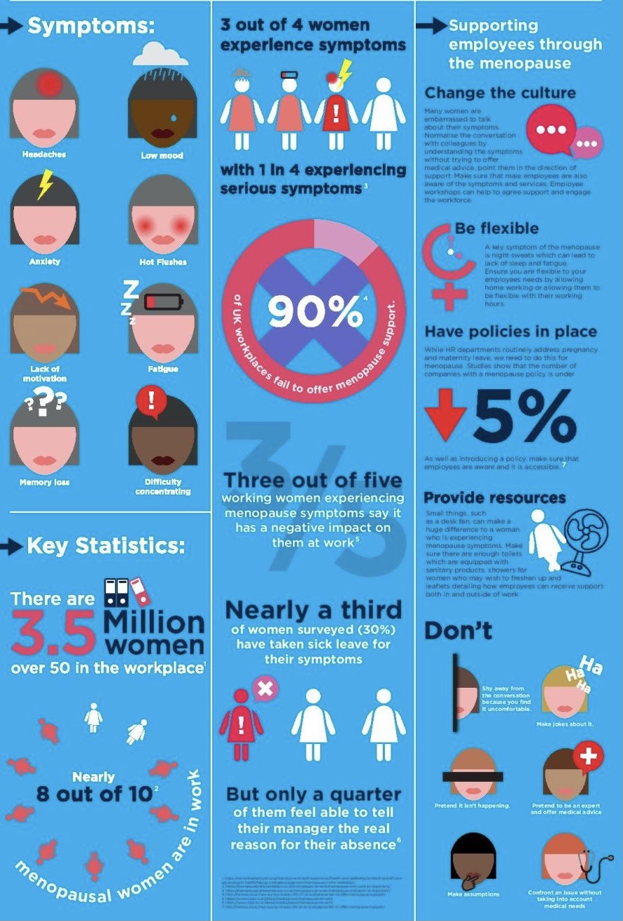
Menopause causing workplace Inequality
“She’s Being Menopausal”
“She’s having a moment”
“Hormonal”
Managers need training
Talking to managers and occupational health
Talking to your GP about all options
Fans / windows open
Uniform adjustments
Counselling and support
All of us talking more about menopause issues
2016 Well Woman Study: found that when women do understand the symptoms and ways to manage them, their lives (and work) can get back to normal quickly
Notes:
Interestingly if someone is pregnant people are happy to talk about this and make adjustments in the workplace. This should be the same for people suffering with the menopause

Slide 22
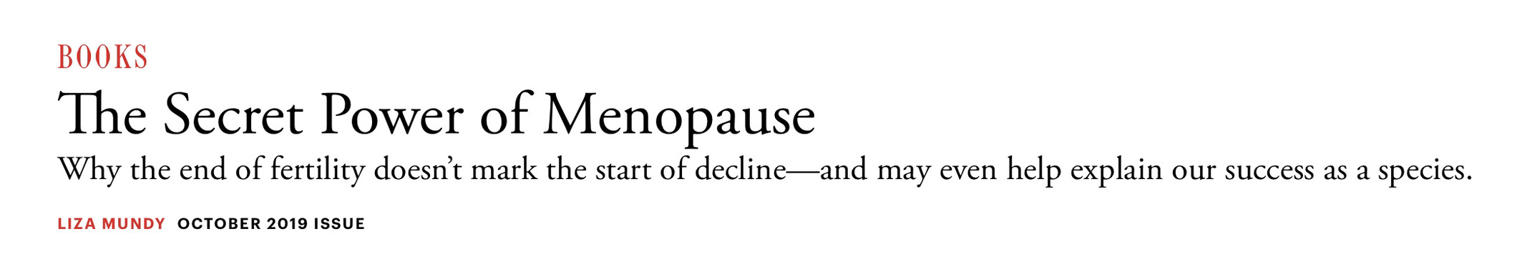
Life after menopause
“Fertility, which typically ends in a woman’s mid-40s, occupies less than half of her adult life. And then, if she’s lucky, she has 30 or 40 years in which to do something else”

Slide 23
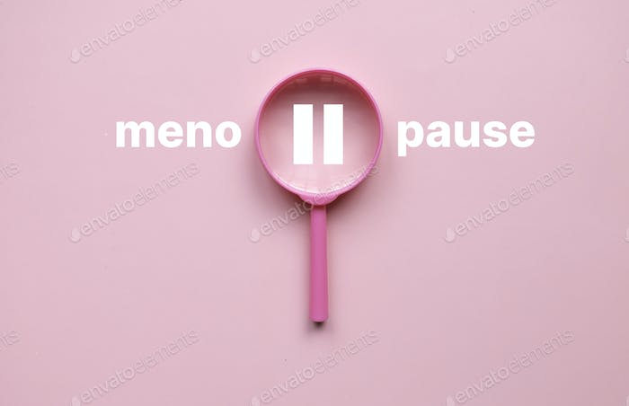
Any Questions?

