Slide 1
Aughton surgery ppg meeting
Thursday 24th November 2022

Slide 2
Agenda
Welcome/Introductions
Updates On:
Current Challenges – Staffing, Demand, Expectations, Workload, Estates etc.
New Telephone System
Online Consultations
Enhanced Access
Discussions about:
What topics would PPG like to be covered in future
Current issues affecting patients
Any ideas or suggestions for improvements
Any other business
Future meetings

Slide 3
Current challenges
Lots of significant challenges in General Practice at the moment, all of which are happening at the same time which is leading to extensive problems that we are constantly trying to find solutions for
Staffing – Explain problems we have had trying to recruit Practice Nurses, HCA and GP.
Explain issues surrounding Reception/Admin staff recruitment and retention – Numerous staff retired, other staff left for better paying jobs/less pressured jobs because of verbal abuse. At the same time, difficult to recruit; so has lead to staff shortages.
All of the above affect patients – Less appointments, less chronic disease reviews being completed (Clinical) and less staff to answer phones and deal with administrative tasks such as referrals, queries and prescription requests (Admin).
Demand – At the same time as dealing with staff shortages, we are dealing with an exponential increase in demand.
Surgery is actually offering more access, more appointments and dealing with more patient encounters than ever before. See following slides for graphs.

Slide 4
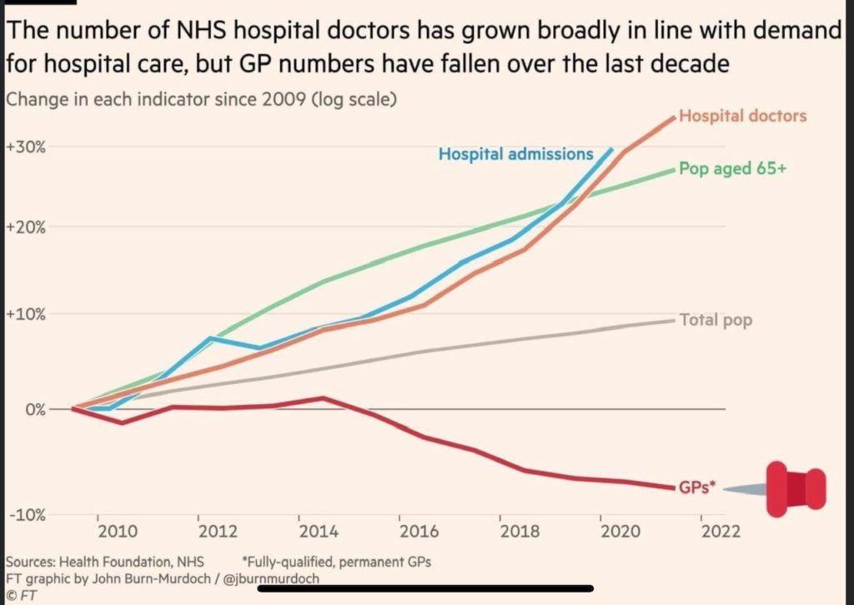

Slide 5
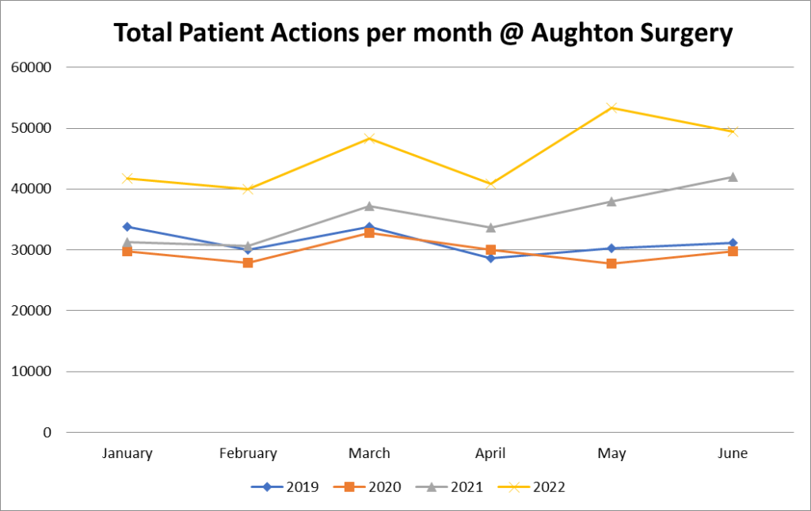

Slide 6
Current challenges
Expectations – Another issue that goes hand in hand with demand is expectations. A number of patients are now expecting to be seen whenever they require. Large increase in number of calls at various points throughout the day demanding to be seen, and unwilling to attend walk-in centre.
Cannot accommodate such demands when we are already full to capacity.
Patients strongly indicated that they preferred a return to face-to-face consultations, we listened to this and the vast majority of our appointments are now F2F. However, since returning to this method of consulting, we have seen an increase in the number of patients complaining about the amount of time they are kept in the waiting room (sometimes when it’s less than 15 minutes).
Clinicians are trying to deal with multiple problems in one consultation which is causing them to run behind, but patients unwilling to make separate appointments for different issues.
Private Work – Patients who ask us to complete private work such as forms and medicals, are complaining that the work is not being done quick enough but not understanding that we have to prioritise NHS work.
We appreciate that to individual patients, their own issues and requests are important to them, and we try our best to accommodate when we can; however, we have over 6000 patients that we provide primary care services for and we have to ensure that there is sufficient access available. We also have to remember that our staff are only human!

Slide 7
Current challenges
Workload – Clinicians work does not just involve seeing or speaking to patients. There are test results to action, hospital letters to read, prescriptions to issue, home visits to go on, meetings to attend, patient enquiries and online consultation requests to respond to. This list is not exhaustive!
It is becoming difficult for us to actually take on any additional work without any additional staff to cover it, but we are constantly being given more to do by the government and NHSE.
Estates – A lot of the additional work that we are being given involves the need for us to see patients for various reasons and reviews. At the moment, we struggle to fit any more appointments in than we already have, because we don’t have any room.
More often than not, we have more clinicians in the building than we do rooms available. Therefore, GP’s are doing remote consultations from upstairs, Nurses working out of Hants Lane etc. – We are trying to find alternative ways of working, as well as trying to work with the ICB to extend our building
Building work involves funding which is extremely difficult to get hold of.
We are not using all of this as a chance to try and gain sympathy. We are simply trying to explain all of the different challenges that we are currently facing, and why sometimes it might feel as though we aren’t listening to patients but trust me, we are!

Slide 8
Practice updates
New Telephone System – Cloud based, and much more user friendly.
Allows us to edit in real time, add additional options and far more advanced functionality than our previous system.
Incoming and Outgoing calls are recorded
Queue call back function
Online Consultations – Recently launched through AccuRx (our current provider for text messaging)
Patients able to submit online consultations between 12pm and 6pm, Monday to Friday
Useful for minor problems, and things that clinicians can look at pictures for (i.e. Rashes, infections etc.)
GP’s will review within 2 working days and either advise a routine appointment, book a slot, or action based on information provided (i.e. prescription, referral etc.) and patient will be notified of the outcome.
Enhanced Access – Now offering more appointments of an evening through the week, and all day on a Saturday
Reception can book appointments with GP’s, ANP’s, Phlebotomists and Practice Nurses.
Increased availability and capacity.

Slide 9
DISCUSSIONS
What topics would you like to see covered in future meetings?
How often would you like to have meetings?
Are you happy to attend F2F or would you prefer Online?
Current issues affecting patients that we haven’t already covered?
Ideas or suggestions for improvement within the practice?
Any other business?

Slide 10
Thank you for attending

