Slide 1
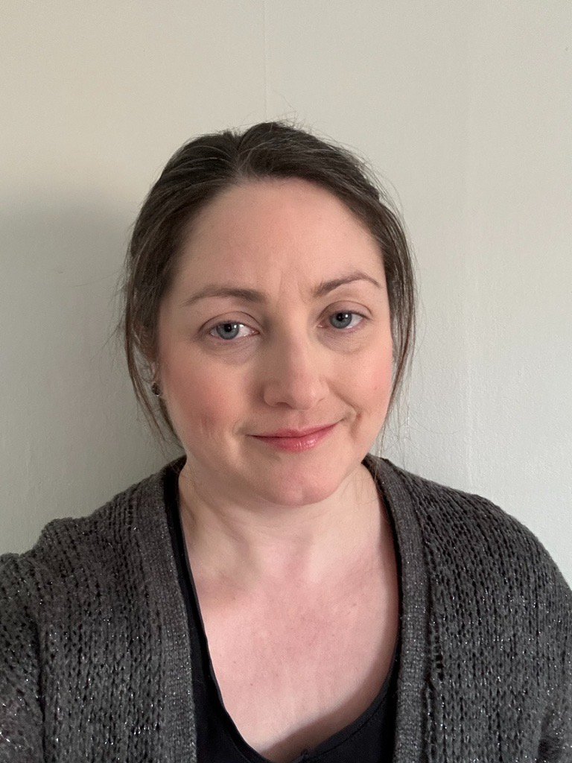
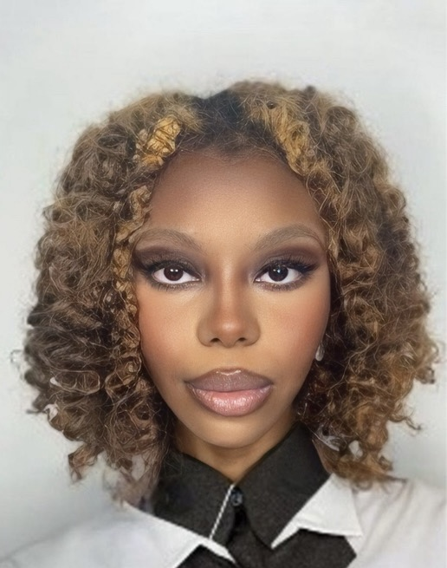
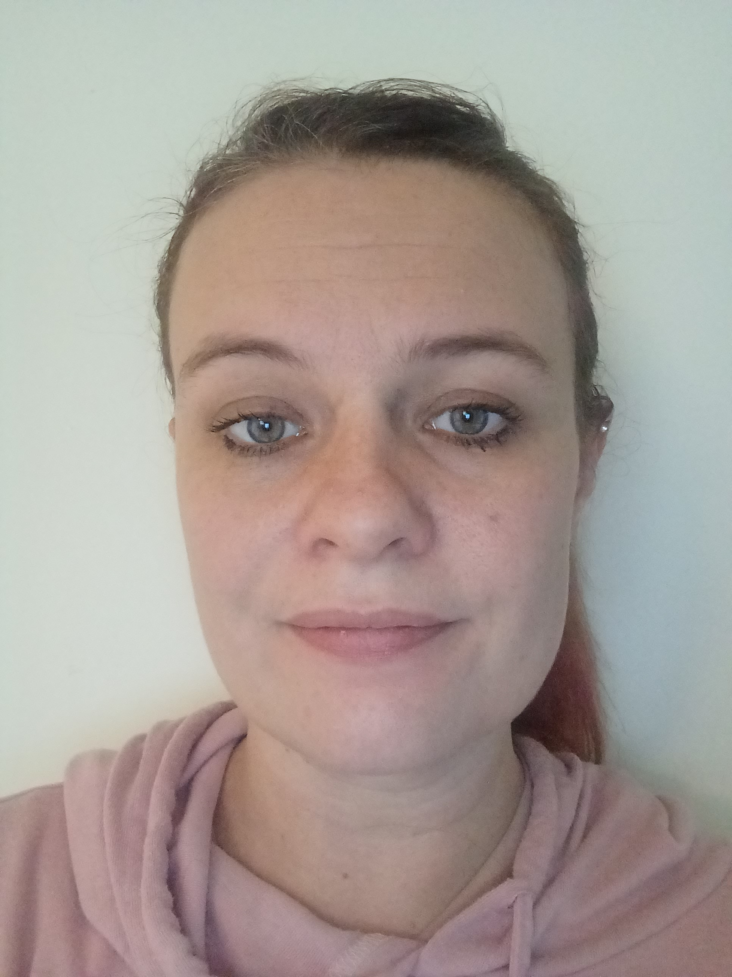
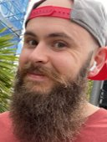
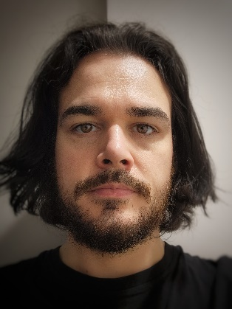
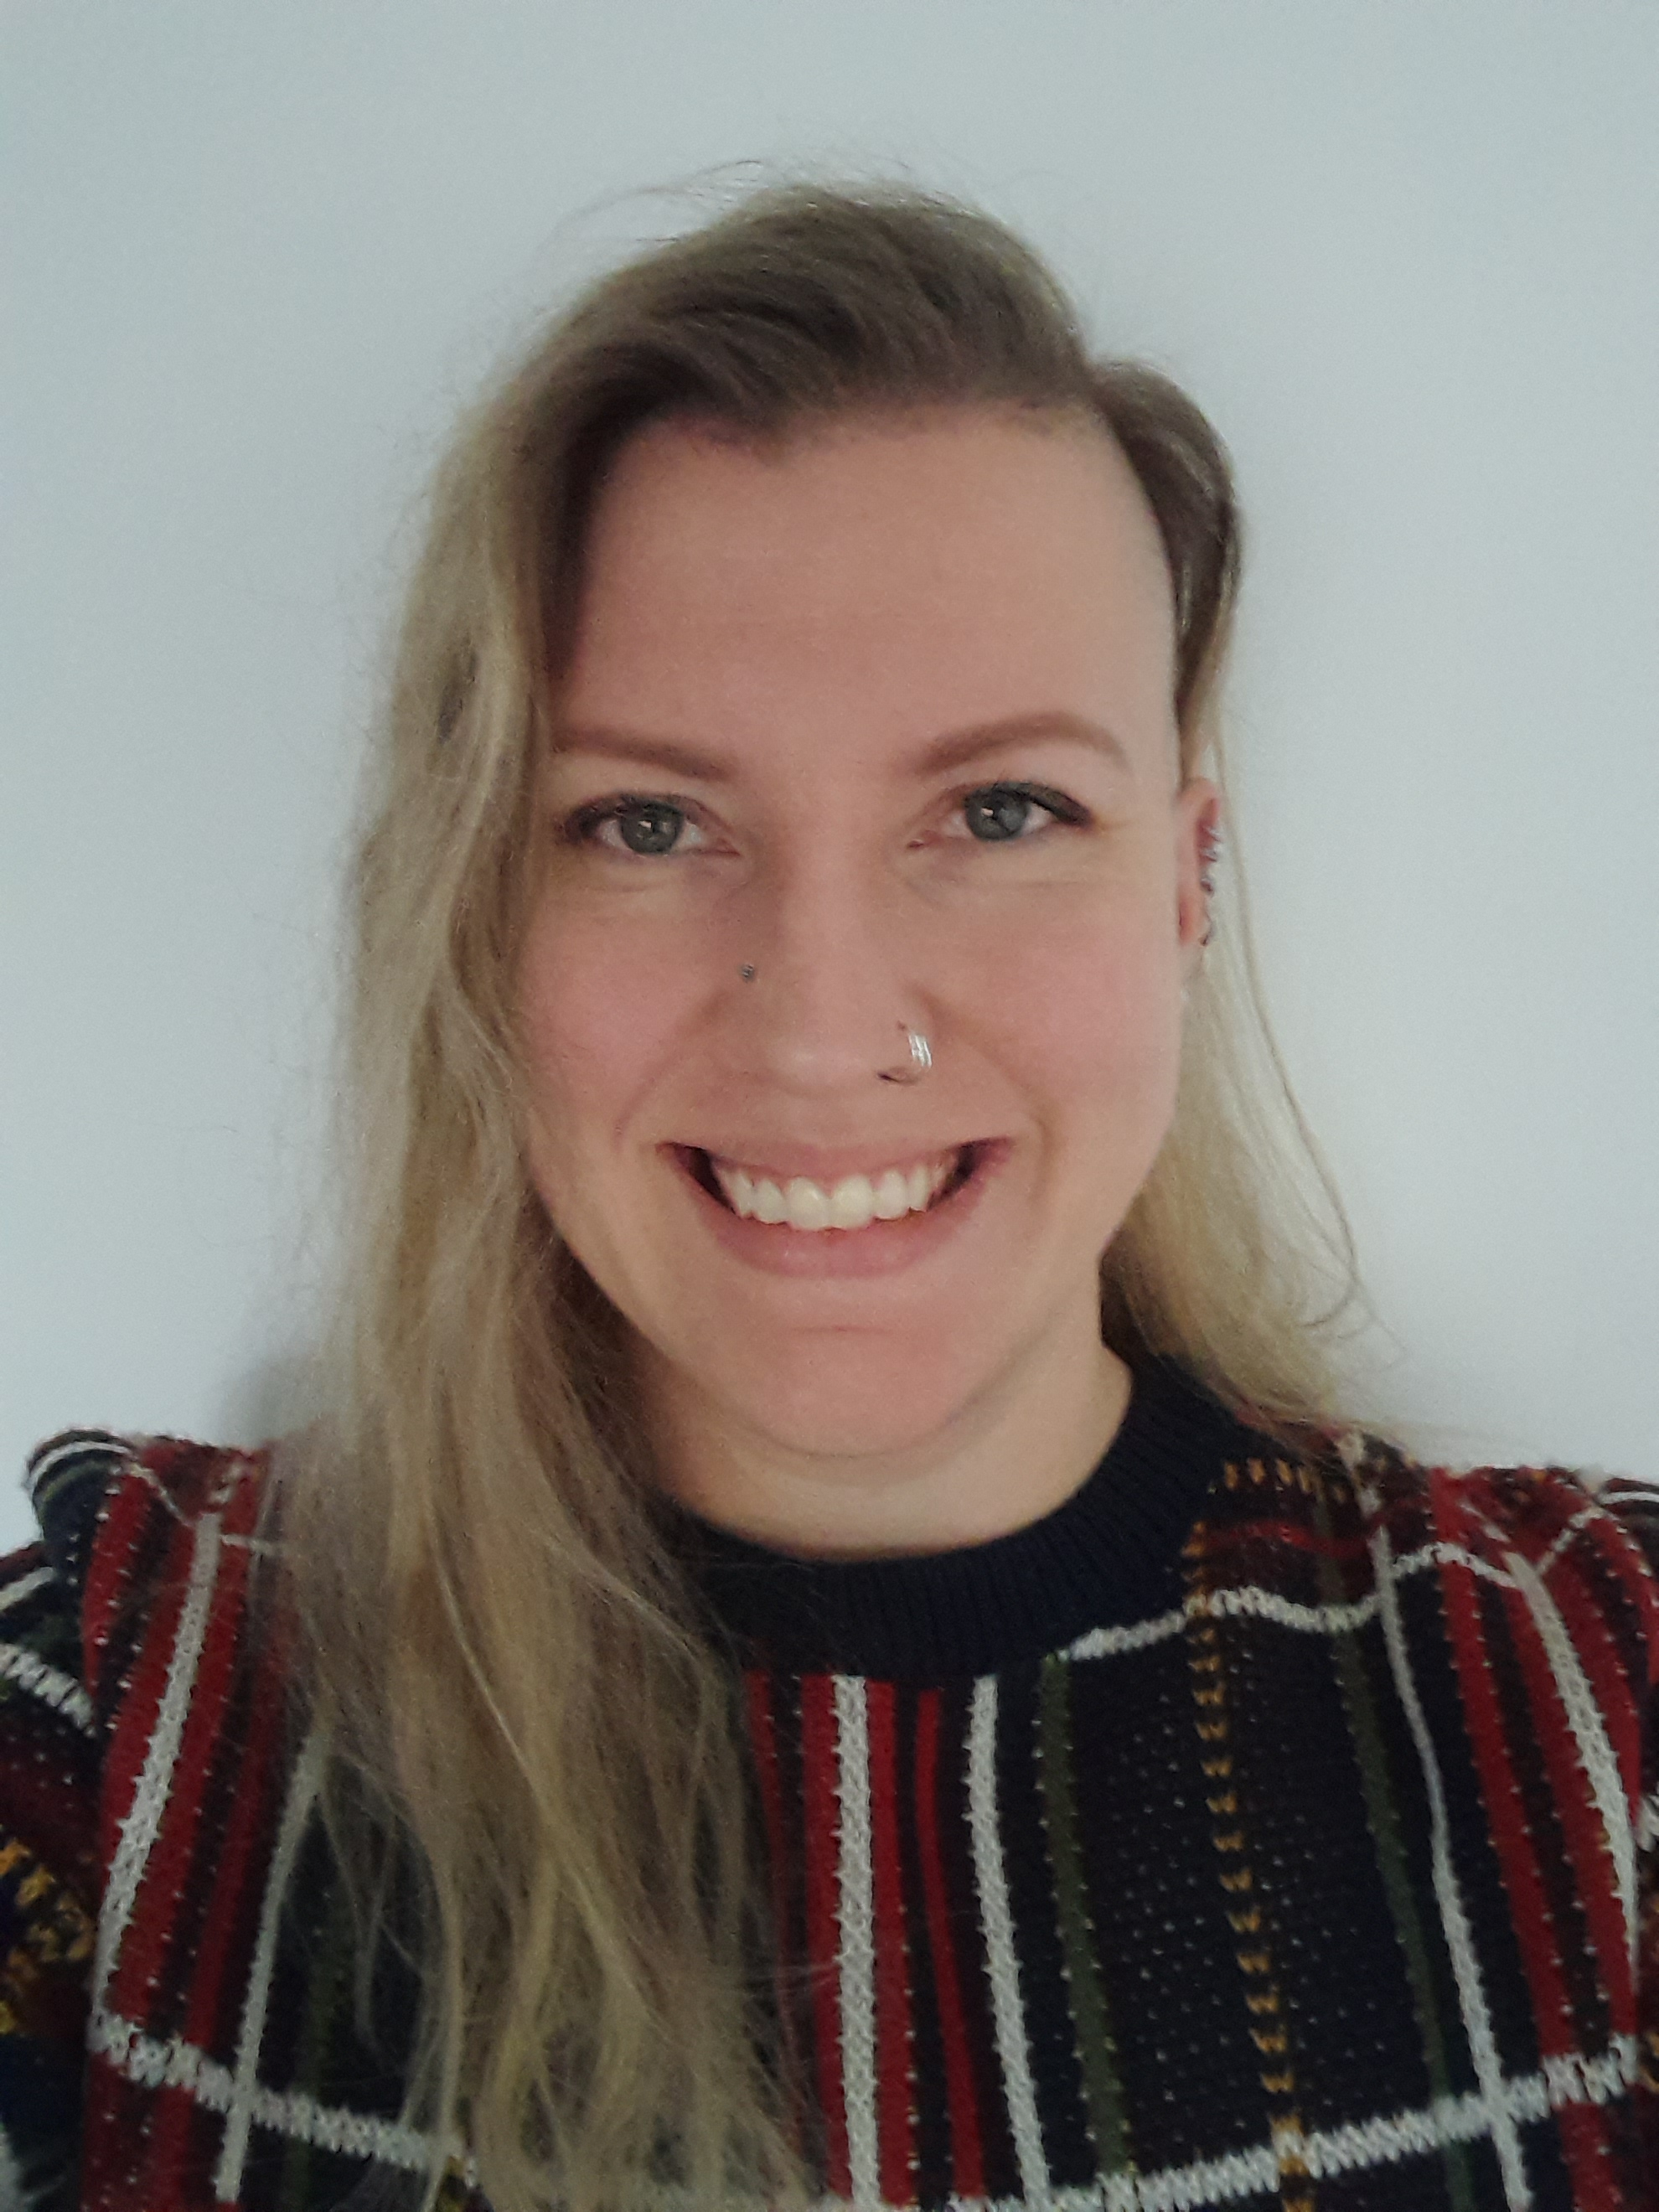
Leeds Mental Wellbeing Service
Primary Care Mental Health: BHR PCN
Contact us:
Mental Health Support
Workers
Leshai Ottley Steph Nichols
Anne: 07870 992750
Anthony: 07881 463516
Joe: 07712 324192
Natasha: 07484 910912
Stephanie: 07484910917
Leshai - 07484910923
_________________
Manager:
Danni Brett :07484910930
danni.brett@nhs.net
Clinical Team Manager
Emily Hatley
Emily.hatley@nhs.net
Updated – Feb 2024
Anne Metcalf
Mental Health Specialists
Anthony Rouse Joe Kolbohm Natasha Champion
Mental Health Practitioners

