Slide 1
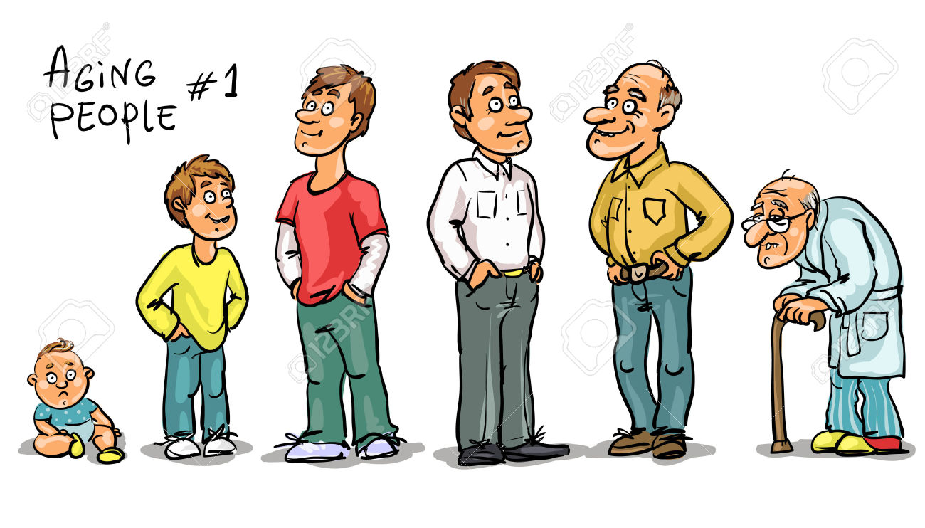
November 2024 – March 2025
Ivy Medical Group: Performance Report Complaints and Compliments
approx. 6,800 patients
We had around 9,000 patient contacts
face to face and/or telephone appointments.
10 formal
Themes:
Clinical care 1
Telephone delay - 1
Triage/comms - 7
Private work delay - 1
We had 10 compliments
Around 750 patient contacts/week
Social Media 3 posts
Mixed views on registering
Travel vaccinations
Relatives view of care

