Slide 1
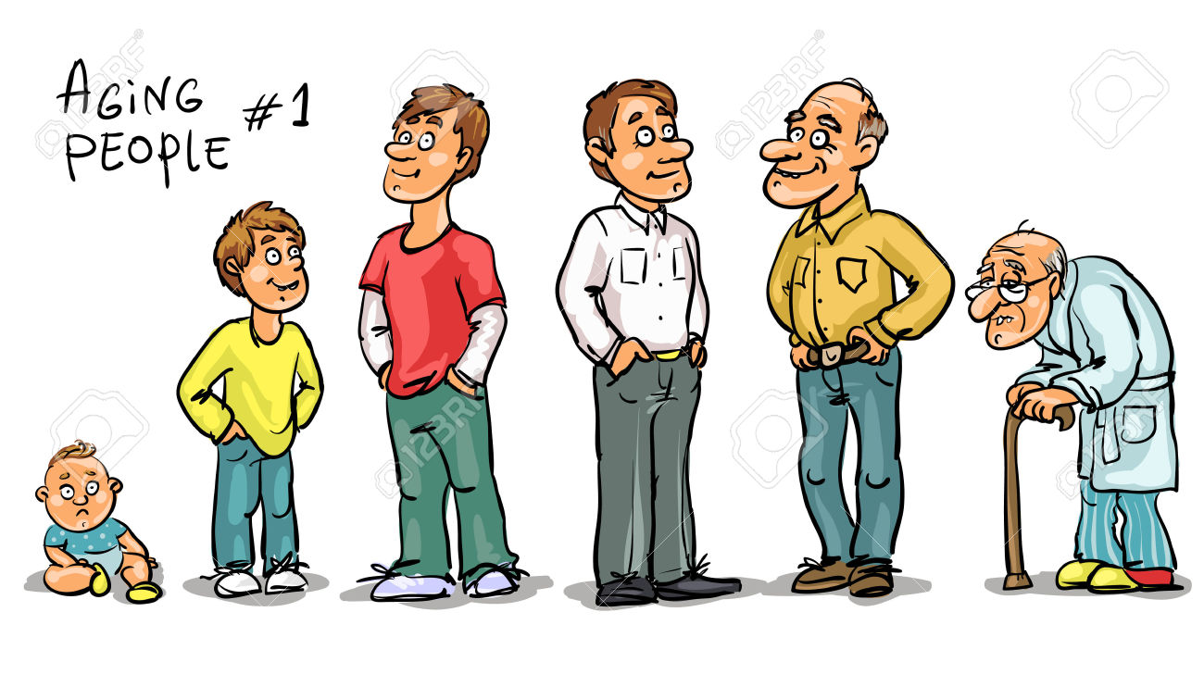









March – May 2025
Ivy Medical Group: Performance Report Complaints and Compliments
We have 6,500 patients approx.
We had around 9,000 patient contacts
face to face and/or telephone appointments.
13 formal
9 informal
Themes:
Clinical services –choice of Dr.
Prescription waits, MSK process
Triage – e.g. new-born care,
Reception staff
Waiting times – inc. results, letters and in waits in waiting room
We had 11 compliments
Around 750 patient contacts/week
Social Media 1 positive;
2 complaints – 1 removed by owner after practice contact; other about online access

