Slide 1

Patient Participation Group
6th August 2025

Slide 2
PPG Members
12764 | Jayne Gillen
19658 | Jeanette Dodd
35884 | Patricia Davies
37805 | Mary McOnie
52966 | Lesley Rawson
58281 | Vincent Santos
32980 | Margaret Artell
12846 | Robert Griggs
35297 | William Bergin
30123 | Kate Barber
508232 | Marc Cockbain
35790 | Alan Critchley
508100 | Liam Edwards
508356 | Graeme Foster
33261 | Hayley Ingham
507541 | Svetlana Moldovan
508298 | Ratnateja Mondithhoka
15981 | Joan Roberts
58593 | Nicola Daniels
501955 | Deryck Sawyer
36286 | George Foster
30893 | Carl Dowdall
506211 | Jacqueline McNulty
14526 | Tracy Bell
32141 | Nicola Whitby
9861 | Kathleen Bottoms
54039 | Cynthia Roe
36651 | Susan Powell
31661 | Margaret Caldwell
11607 | Michael Perkins
38712 | Deborah Miller-Sewell
39151 | Kenneth Walker
10771 | Michael Gerrard
505856 | Aimee Brennan

Slide 3
AGENDA
Actions from previous meeting Joanna Beard
Looking back at the last meeting to review the next steps
Local News Chris Stewart Mental Health Collaboration
Practice and Digital Updates Chris Stewart
Blinx PACO- New Patient Facing Booking System
Health Matters Chris Stewart
NHS 10 Year Plan- Launch
AOB ALL
Refurbishment Update
New ANP- Barbara Noble

Slide 4

Actions from previous meeting
· Patients wanted their details passed onto Sam Minshall PCN Executive Administrator so they can be
invited to the PCG Patient champion meetings.
Completed- PPG members have been shared with Sam Minshall so they can be invited to the Ellesmere Port Patient Champion Meetings.
· Send a link to patients to the self-refer section of the website.
Completed- 16,000 texts were sent out in July to advertise the self refer options available at the practice.
· Allow patients from the PPG to have access to the new prescription ordering phone system to gather feedback for the next meeting. Completed- All PPG members have been set up to use telephone prescription ordering service. All should have received a message with set up instructions.
· Look into how we can spread wider news, if we can get news into local supermarkets, Ellesmere Port town centre. Potentially putting up a notice board outside of the practice to keep patients up to date with local news and changes.
This has been discussed at both practice level and PCN level recently. The PCN have agreed to publish a quarterly newsletter and the practice will also begin to do this from September.
In addition to this, the current newsletter has been passed to Morrissons and the United Reform Church, as they have a outside display cabinet on the main road. We would also like your opinion on if we should send this to patients?

Slide 5
Mental Health Collaboration
At the last meeting we discussed how structural issues, communication and funding can get in the way of patient care.
Mental Health is an area where this is huge problem for doctors and patients.
There is no formal communication pathway for new services, changes in service provision and for when services are discontinued or frozen.
Funding is siloed, so services only get paid for certain patients or when they take patients through certain pathway.
There is no collaborative approach or plans to address these challenges.

Slide 6
Mental Health Collaboration- Example
John has been experiencing symptoms of psychosis, and he has a history of trauma. The doctor has referred John to the specialist psychiatrist at a specialist Hospital.
John has been put on anti-psychotic medication to help him, which he may need long term. The psychiatrist thinks that John would also benefit from NHS Talking Therapies and CBT.
Because Talking Therapies and CBT are a primary care service, the psychiatrist cannot refer John himself, nor will Talking Therapies accept John, even if the psychiatrist tries. Therefore, the psychiatrist must now discharge the patient from his specialist team, back to the GP’s care with a letter explaining this. The GP must then agree to take back John in order to complete his referral to Talking Therapies.
The GP rejects the discharge, as John has only been on his anti-psychotic medications for 1 month and must be deemed ‘stable’ before the GP can take John back. GP’s are not able to oversee specialist medications. Titration could take 3-6 months.
The GP then writes back to the psychiatrist, rejecting the discharge as the GP is not allowed to accept it. The psychiatrist new this, but was hoping the surgery would make an exception, since John would benefit from Talking Therapies. John must now go back under the care of the specialist team and wait until he is stable on his medication before he can be discharged. He could privately seek a counsellor or CBT.
The service commissioning rules not only differ and change throughout the year, they are different based on postcode. The situation is very complex and needs to be resolved locally.

Slide 7
Mental Health Collaboration- Example
Problems:
John is stuck in the middle
Time delays
Shows inadequate service provision in tertiary care or a system failure.
John was about to be discharged early
The GP may have agreed to take John back before he was safety titrated
Waste or resources and time eg letter writing and politics
Demonstrates how services are not accessible.
Does not build patient trust
Does not build trust within NHS organisations
Encourages siloed working or working to rule.
Any More???
This is a real example, locally.

Slide 8
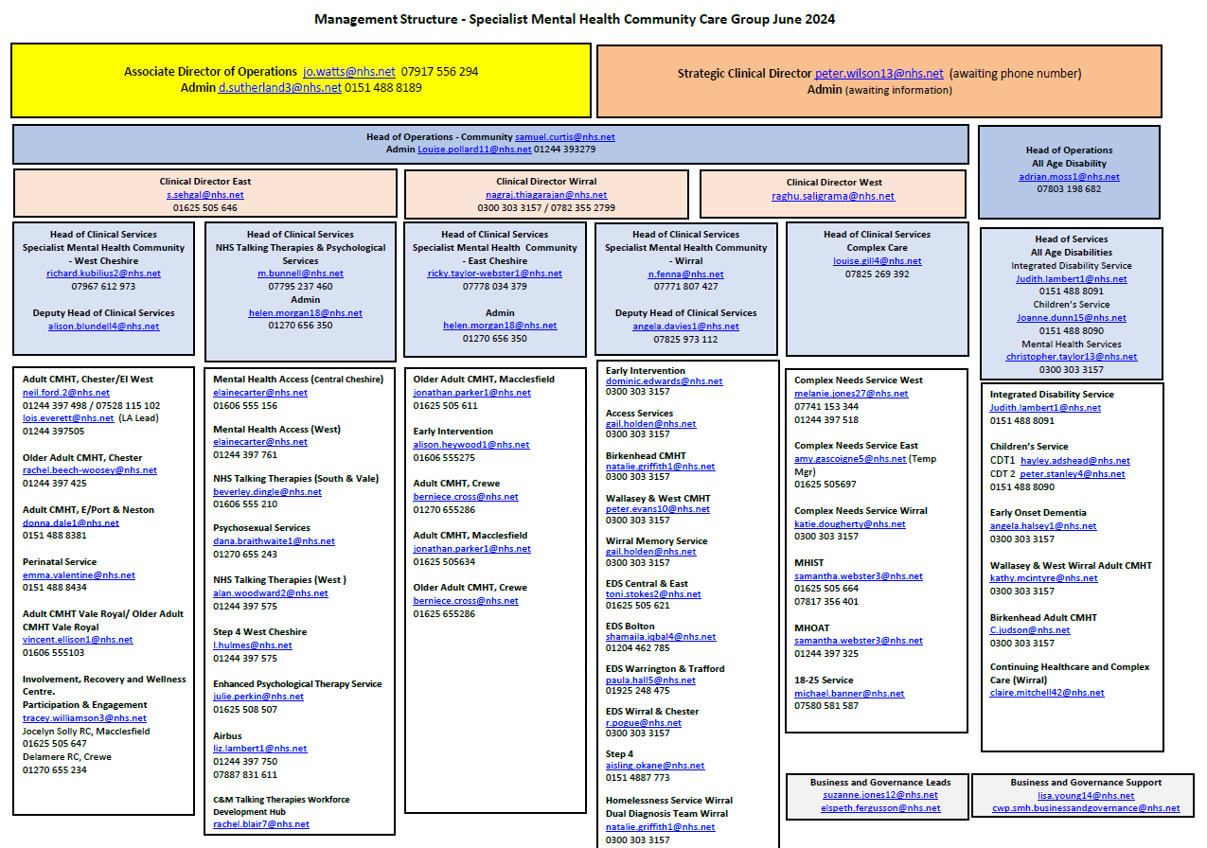

Slide 9
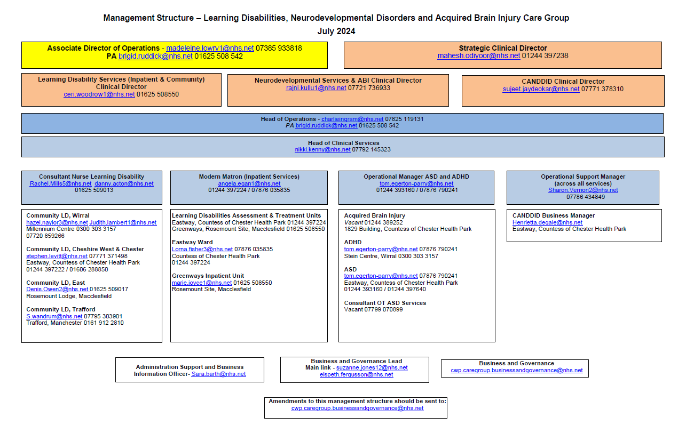

Slide 10
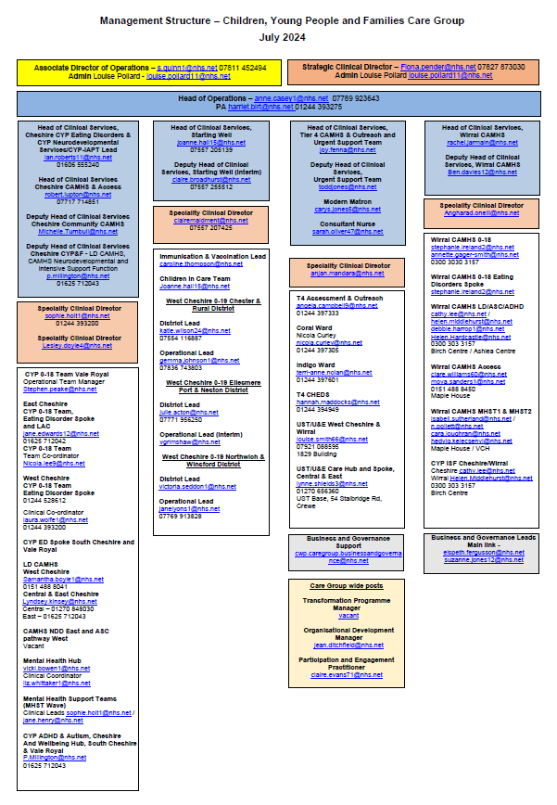

Slide 11
Mental Health Collaboration - Aim
To map out who and what services there are in our town.
This will include, primary, secondary and Tertiary centres. Private sector and charity organisations.
2. Invite key stakeholders to a local event where they will have a platform to introduce themselves, share what they do and how their services can be accessed.
3. Circulate this map to all of the mental health services locally.
4. Improve communication , collaboration and build trust amongst individuals and organisations.

Slide 12
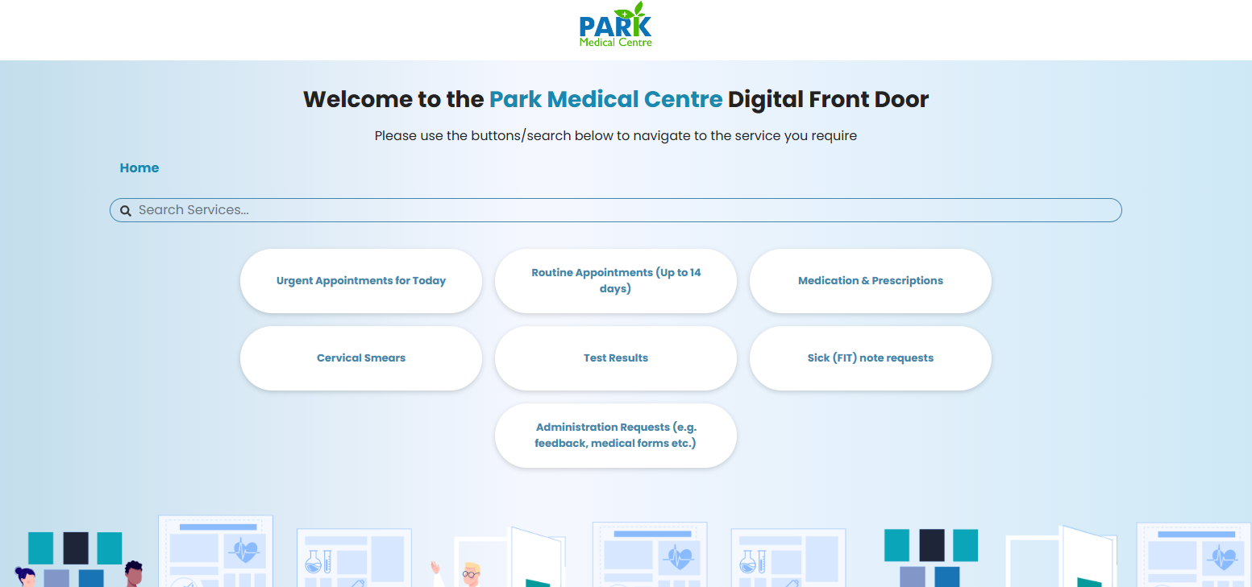
Practice and Digital Updates
Blinx Paco & Total Triage

Slide 13
Health Matters
NHS 10 Year Plan
From Hospital to Community
  Creation of Neighbourhood Health Services (NHS) and Neighbourhood Health Centres (NHCs) to deliver integrated, local care.
  Expansion of community diagnostic centres and urgent care services outside hospitals.
  Greater investment in primary care, community pharmacy, and mental health services.
  Aim to end hospital outpatients as we know it by 2035.
From Analogue to Digital
  Expansion of the NHS App to become a “doctor in your pocket” with features like appointment booking, care plans, and self-referrals.
  Full digitisation of hospitals and rollout of AI-enabled care.
  Implementation of a Single Patient Record and use of genomics and predictive analytics.
  From Sickness to Prevention
  Focus on predictive and preventative care, including genomics-based health checks.
  Investment in public health, mental health hubs in schools, and youth wellbeing strategies.
  Expansion of personal health budgets and care plans for people with complex needs.

Slide 14
Refurbishment Update
Dr Warren Retirement
AOB
New Clinical Rooms
Barbara Noble ANP
Practice Nurse Vacancy

