Slide 1
Presentation for PPG meetings
Fenglin Guo, Senior Research Facilitator
RDN East Midlands: Northamptonshire

Slide 2
Regional RDN Overview & Who We Are
Funded by the Department of Health and Social Care to attract, and deliver research across England. Our team supports the delivery of research in Primary Care and Social Care.
To provide the infrastructure, expertise and support required to deliver and grow research across the county.
Our main role is to work with Primary Care sites, to help support them to get involved in research. We performance manage sites that are on our research scheme and support them to deliver high quality research across East Midlands.

Slide 3
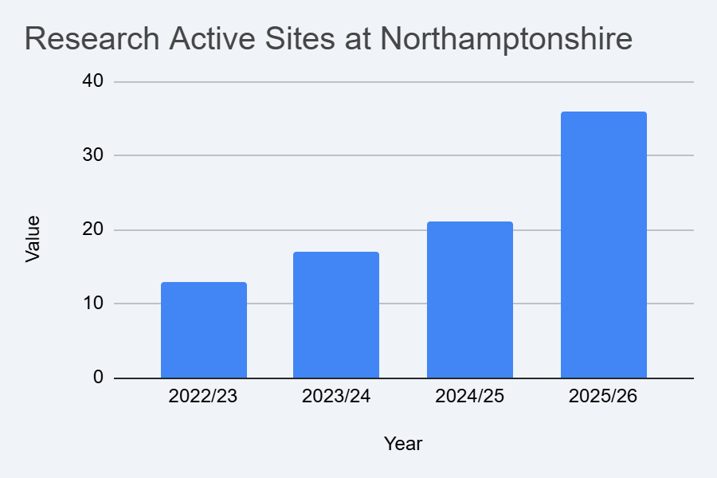
Research in Primary Care at Northamptonshire

Slide 4
Surgery’s Support for Research
By joining the RDN Research Site Initiative Scheme, the practice are giving their staff and patients the opportunity to participate in and benefit from lots of different research

Slide 5
Why engage in research?
It can help shape new practices/standards of care
It is in the NHS constitution; your right to access research
Your health may be monitored more regular
If you have an illness or condition, you might be able to try a new treatment or device
It can help to improve your health condition, or others in the future

Slide 6

Ways to get involved in research?

Slide 7
Ways to get involved in research?
Complete surveys/questionnaires
Online activities
Participate in studies that you are eligible for, to support your health condition
Register with Be Part of Research (BPOR)
Sign up to Join Dementia Research (JDR)

Slide 8


Slide 9

Register Be Part of Research
https://bepartofresearch.nihr.ac.uk/

Slide 10





www.joindementiaresearch.nihr.ac.uk

Slide 11
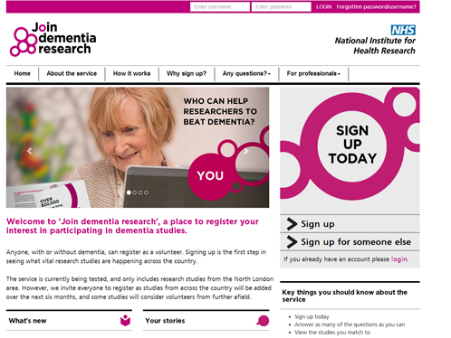
Join Dementia Research
A nationwide service that helps anyone in the UK find and take part in vital dementia research studies.
People with dementia, their carers, and anyone interested in research can sign up. It’s also possible to register on behalf of someone else.
www.joindementiaresearch.nihr.ac.uk
Notes:
Join Dementia Research Animation

Slide 12
Talk to other patients about research - do they know it is happening here? Are they aware that they may receive a text or letter?
keep a research notice board up to date within the practice.
complete a PRES form if you are eligible to do so.
PPIE events
What can you do as a PPG?
Keep an open mind about research - talk about your experiences with other patients if you do take part.
Share information about research happening at the practice - word of mouth, social media, leaflets.

Slide 13
Any questions?

