Slide 1
Candidate Information Pack Reception Administrator
March 2025

Slide 2
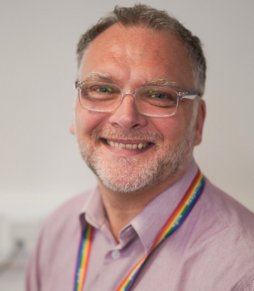
Welcome to GPS Healthcare
I am really pleased that you are taking an interest in working with us at GPS Healthcare. I'm Simon Tunnicliffe and I have been the Chief Operating Officer since 2022, and I am proud to lead this great organisation.
Working in primary care is both challenging and rewarding. GPS Healthcare is on a journey of transformation in respect of how we deliver services to our patients. This is an exciting time to join us and we're looking forward to bringing new people along with us.
Our Vision matters: to deliver safe, effective and culturally responsive healthcare services, empowering individuals to thrive and communities to flourish.
GPS Healthcare is a single practice PCN with six sites based in central/south Solihull. We are rated 'Good' by the CQC and collaborate with key stakeholders within the Integrated Care System to focus on local health needs and population health and improve the delivery of primary care services at a locality level.
Good luck with your application.
Simon Tunnicliffe
Chief Operating Officer
Simon Tunnicliffe
Chief Operating Officer

Slide 3
Our Strategic Goals and Values:
Our Strategic Goals:
Strengthen collaboration and communication.
Develop proactive strategies to promote healthier lifestyles.
Implement change based on feedback and evidence to meet established standards of excellence.
Our Values:
Care
Agile
Respect
Efficient

Slide 4
Our Structure:
Our Executive Team
Chief Operating Officer
Head of Operations
Head of Clinical Services/Chief Pharmacist
Head of Corporate Services/Accountant
Head of Governance, Stakeholders and Business Development

Slide 5
Our Structure:
Head of Operations
Operations Manager
PCN Projects Manager
Contracts Manager
Clinical Administration Services Manager
Resource Manager
Health and Wellbeing Team Leader
Hub Administrators and Clinical Summarisers
Site Managers x 2
Site Based Teams including Medical Secretaries, Senior Reception and Reception

Slide 6
What we are looking for:
The ideal candidate will have experience of working in a busy reception or administration environment and have strong customer service skills.
Key Responsibilities for our Receptionist includes
Dealing with patient enquiries both face to face and over the telephone.
Answering inbound prescription queries
Administrative tasks such as scanning reports, tasks, letters and new patient registrations
Full details about what is required for the role can be found in the Reception Administrator job description

Slide 7
What experience is required?
We are looking for someone who has administrative experience looking to work in a primary care setting.​​
​The successful candidate will have:​​
​Have previous experience with a reception/administraive role working within a busy environment
Excellent customer service skills
Experience of dealing with large volume of telephone enquiries
Experience in data entry
Ability to manage own workloads, understanding own priorities and sourcing help to achieve them whenever appropriate

Slide 8
What we can offer:
An opportunity to join a forward thinking and innovative Primary Care Provider
Hourly rate £12.21 per hour
Flexible working options – part time positions available
NHS Pension Scheme
A professional, friendly and supportive culture
Generous workplace benefits, including enhanced sickness, maternity & paternity entitlement

Slide 9
How to apply:
If you are interested in applying to be the Reception Administrator with GPS Healthcare, please submit your CV and a supporting statement outlining how you meet the essential criteria and why you are interested in the role to humanresources.gps@nhs.net by Wednesday 19 March 2025.

Slide 10
What can I expect if shortlisted:
If you are shortlisted and invited to attend for interview, the panel will be looking for evidence that your knowledge, skills and experience meet the criteria outlined within the Job Description and your suitability for the role.
We will use a number of assessment techniques throughout the process, these may include:
Interview
References
All interviews will take place at our Tanworth Lane Surgery.
Recruitment Timetable
Closing date for applications | Wednesday 19 March 2025
Interviews to be held | Week commencing 24 March 2025

