Slide 1
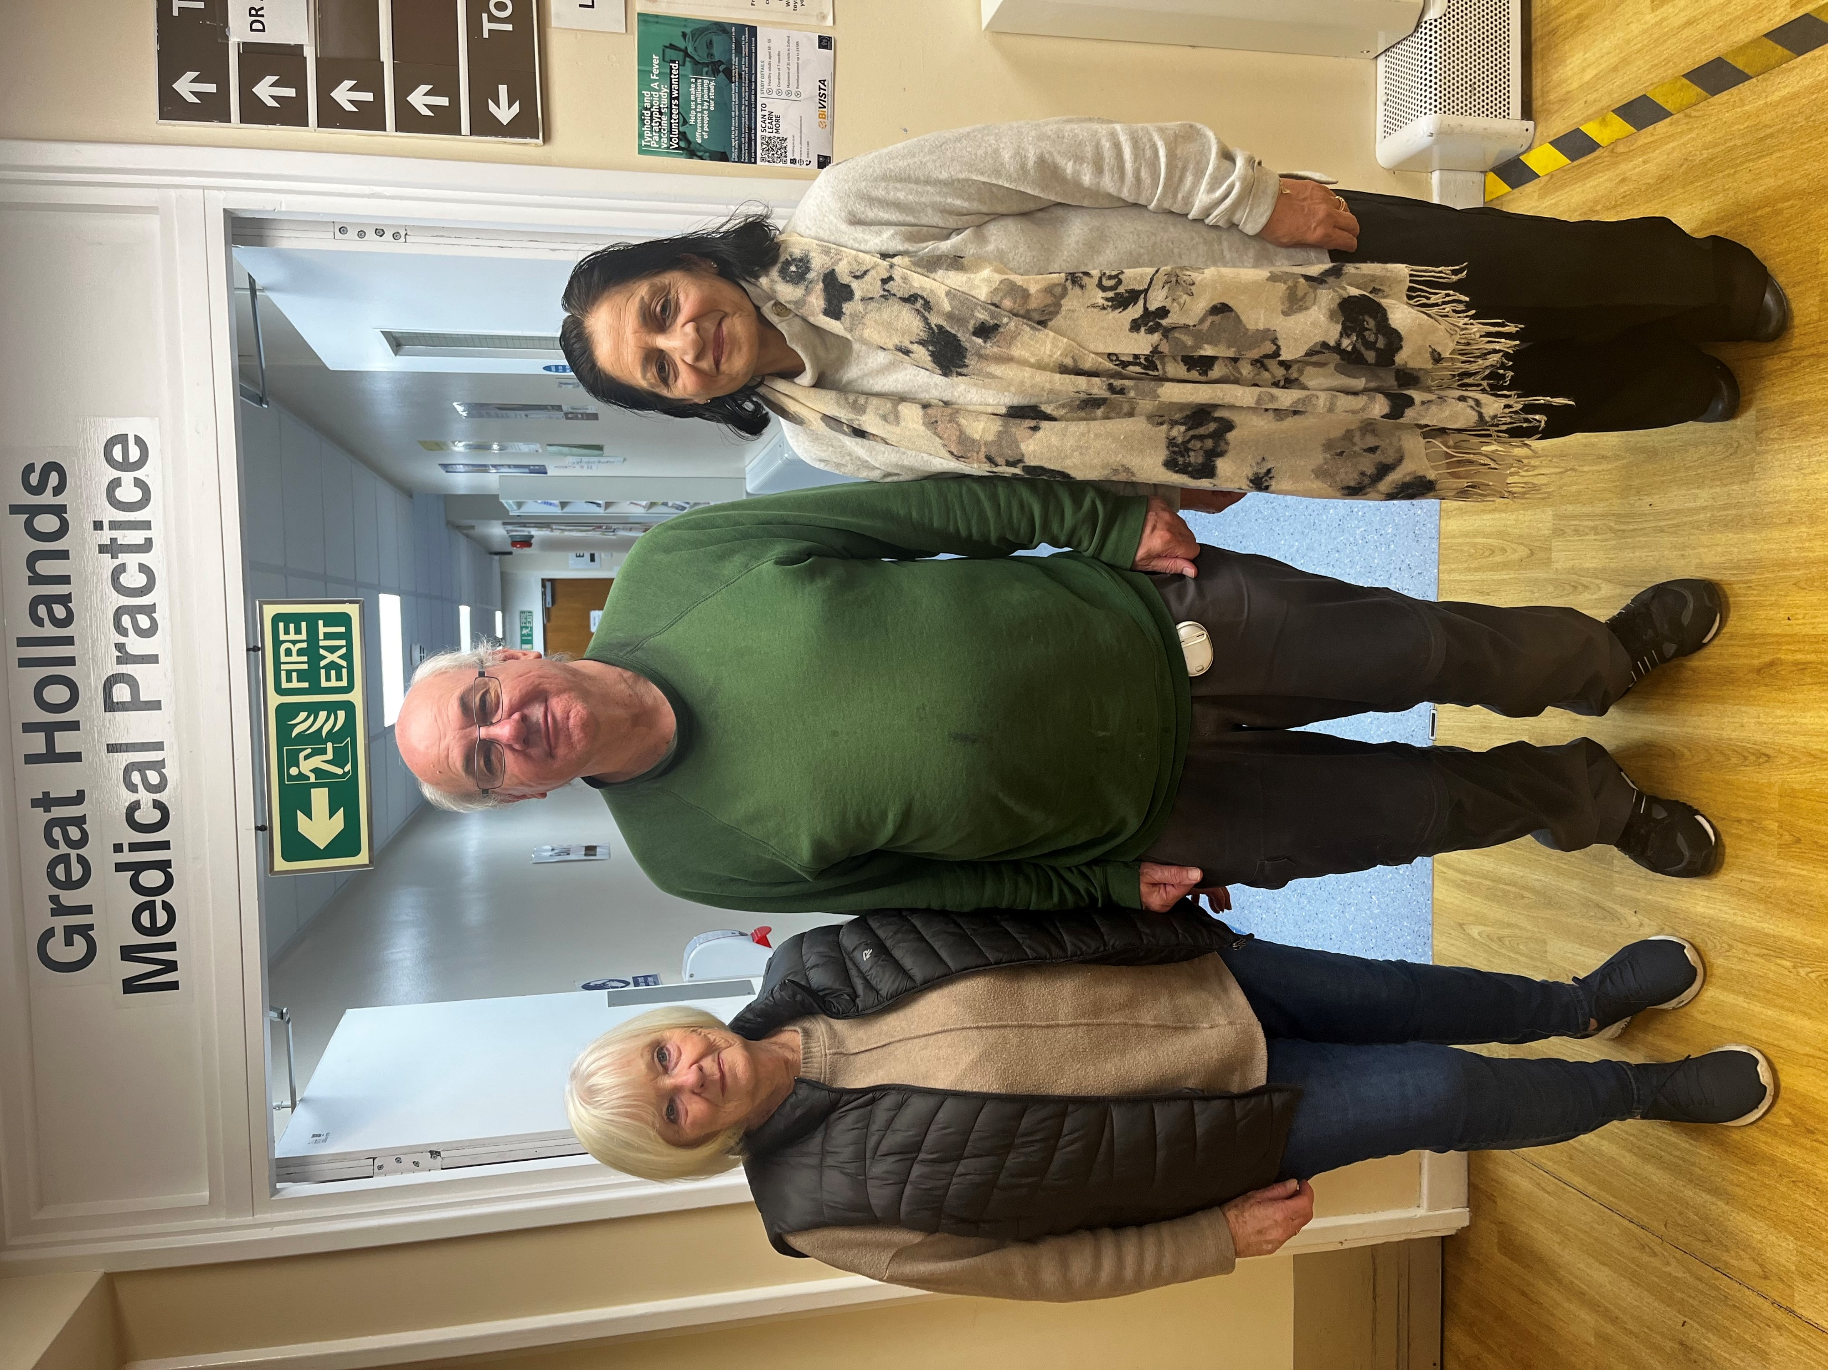
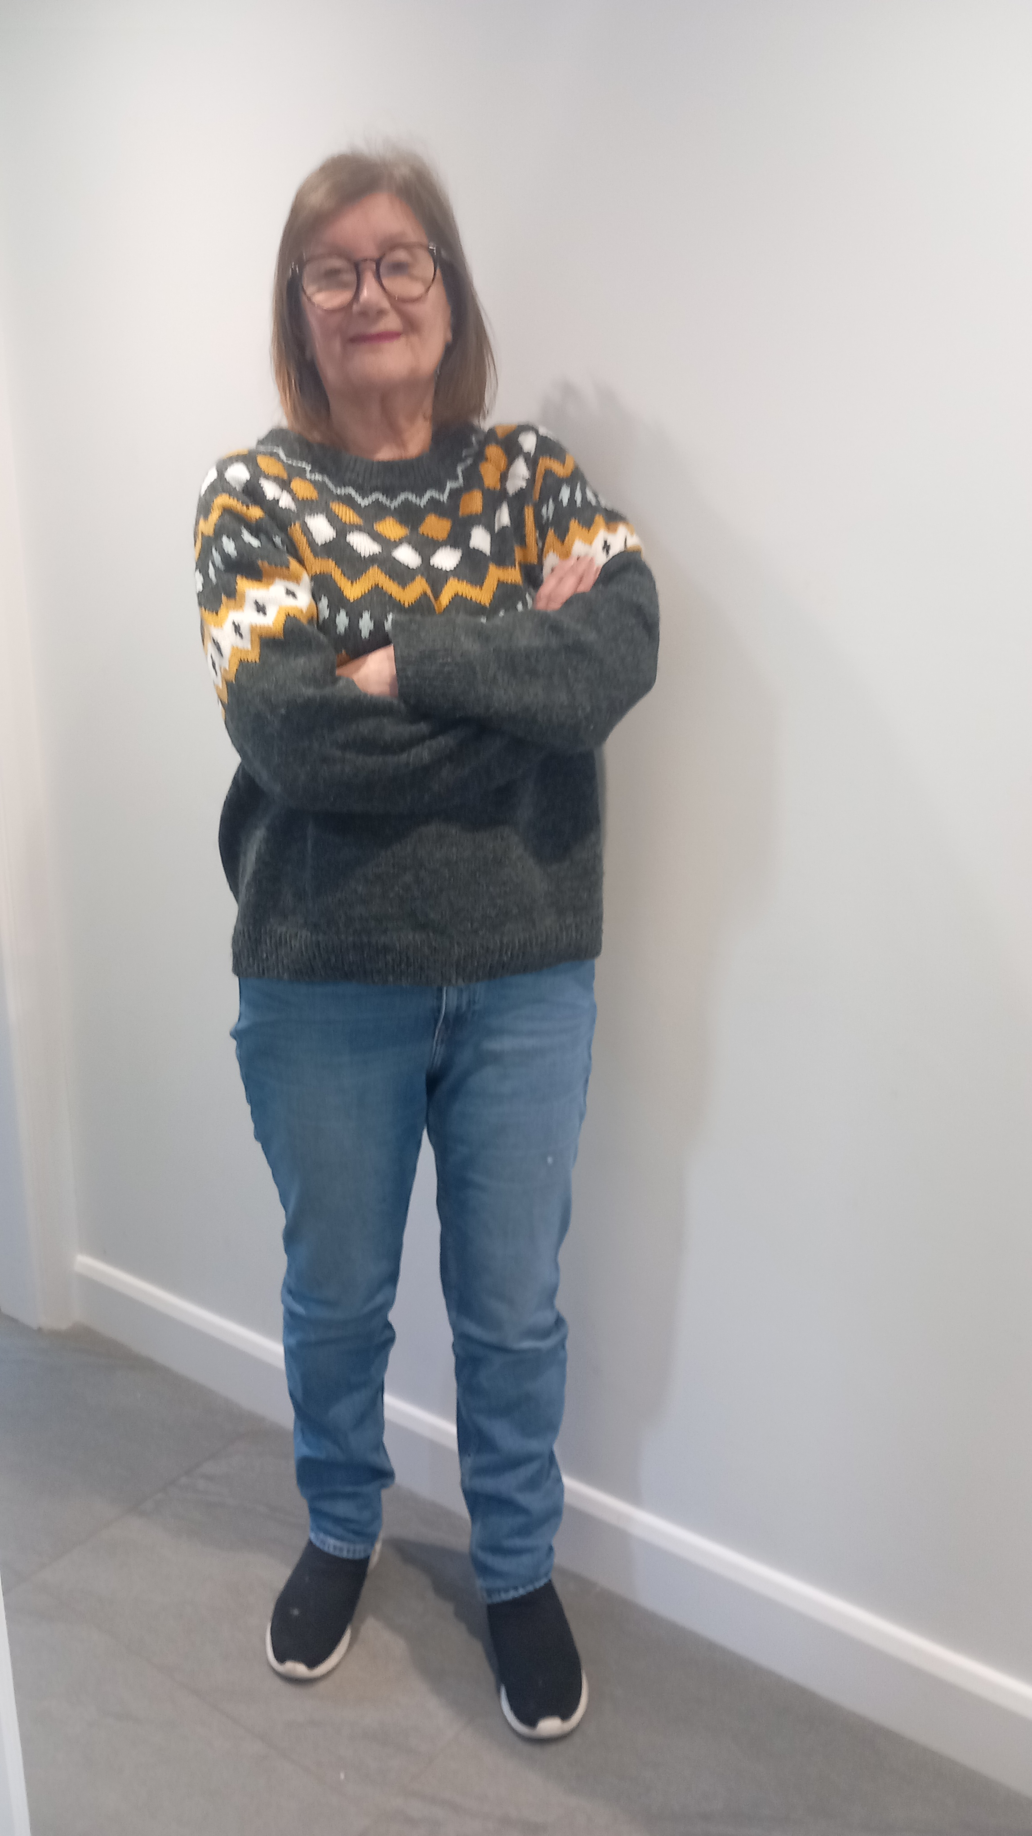
Patient Group, Great Hollands Practice
Come and Join us
Email: david.jones8@nhs.net

Slide 2
Introduction
The Great Hollands Practice Patient Group was set up in 2009 and continues to work effectively through regular meetings. The members of the PG include volunteer patients, the practice manager and the practice’s GP. We meet to discuss the services on offer and how improvements can be made for the benefit of patients and the practice.
In this catalogue, we have collated some information on voluntary services offered in Bracknell. We hope you would find it useful.

Slide 3

Come and join the Happiness Hub
First Thursday of every month from 10 a.m- 12 noon
Brew Coffee Bar
Easthampstead Works
Town Square
Bracknell RG12 1BH

Slide 4

Mental Health Support through Sport
Sport in Mind is a multi award winning charity that delivers fun, weekly sport and physical activity sessions to improve the lives of children, young people and adults experiencing mental health challenges.
Text or call: 0118 9479762
info@sportinmind .org
Registered charity no: 1161323

Slide 5

60 and Beyond
Treat yourself to a coffee and join in the conversation
Waitrose Café’
Bond Way
Bracknell
RG12 1RQ
Second Monday of each month
1.30 p.m until 3 p.m

Slide 6
For People living with dementia and their family members
Coffee morning
Every Monday ( excluding bank holidays)
At Admiral Cunnigham Pub
Priestwood
Bracknell
RG42 1 TUZ
From 10.30-12.00 noon.

Slide 7
Connecting Minds
Connecting Minds is a social group run with Peers 2 Pals and Friends in Need.
The group meets twice a month, providing a relaxed space to hang out, share ideas and enjoy fun activities.
Age: 18 to 35
If you are 17 years old and want to join, email: ansa.khan@bucksmind.org.uk.

Slide 8

Friends in Need
Friends in Need serves Bracknell, Windsor, Ascot, Maidenhead, Slough, Buckinghamshire.
The foundation of the group is based on the Five Ways to Wellbeing; to give, be active, take notice, learn, and give back. The group has a timetable of events and activities for members to attend and promote these values. New members are always welcomed into a safe and supportive environment.
Fees: There is no charge for this service.
Phone: 07496874882
email: ansa.khan@bucksmind.org.uk

Slide 9

Going through a storm or just been through one?
ANDYSMAN club are talking groups for men to help them through these storms.
Find out: info@andysmanclub.co.uk
More: www.andysmanclub.co.uk
Registered charity in England and Wales: (1179647)

