Slide 1
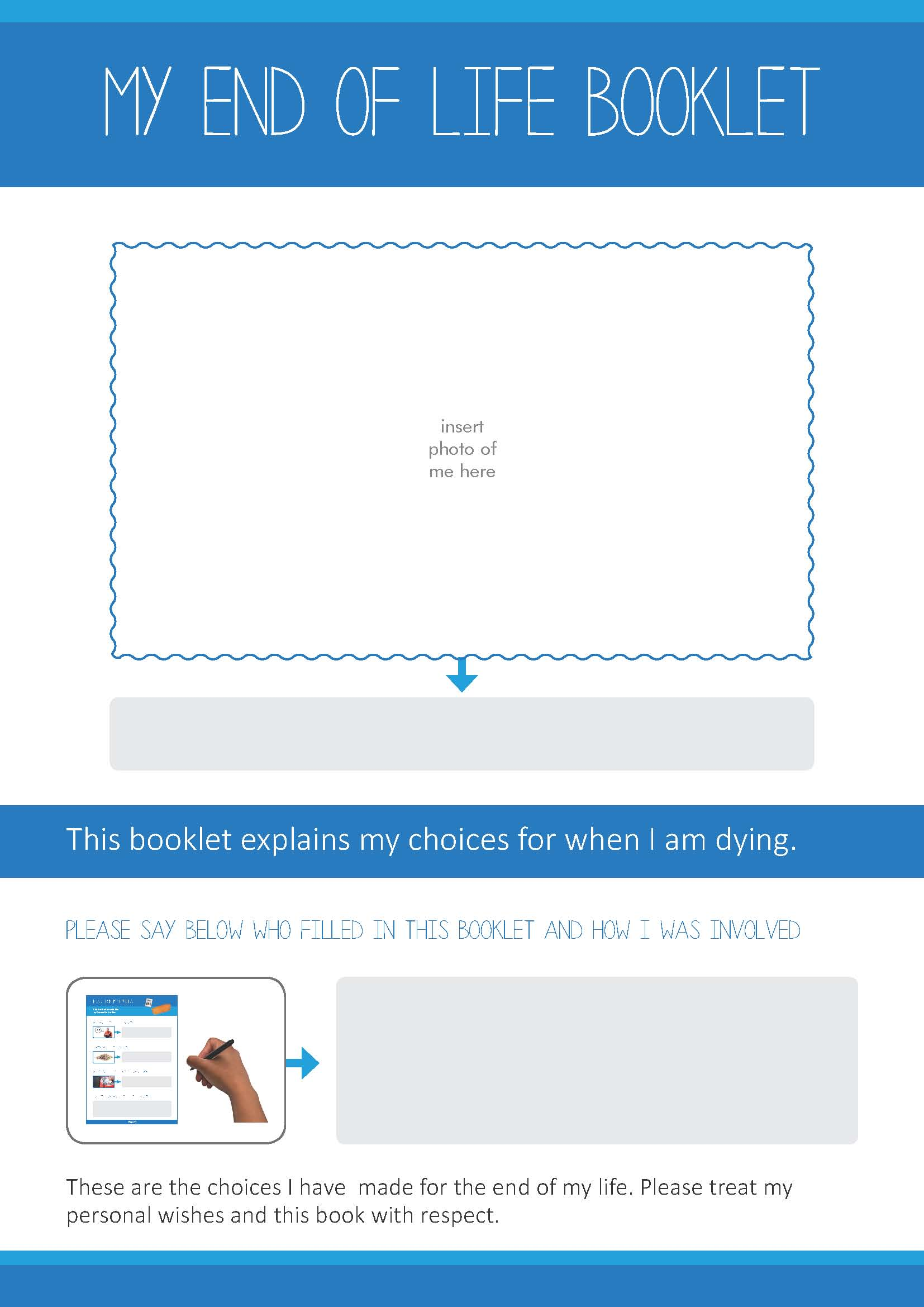
Replace text with my name
Replace text with names of people involved

Slide 2
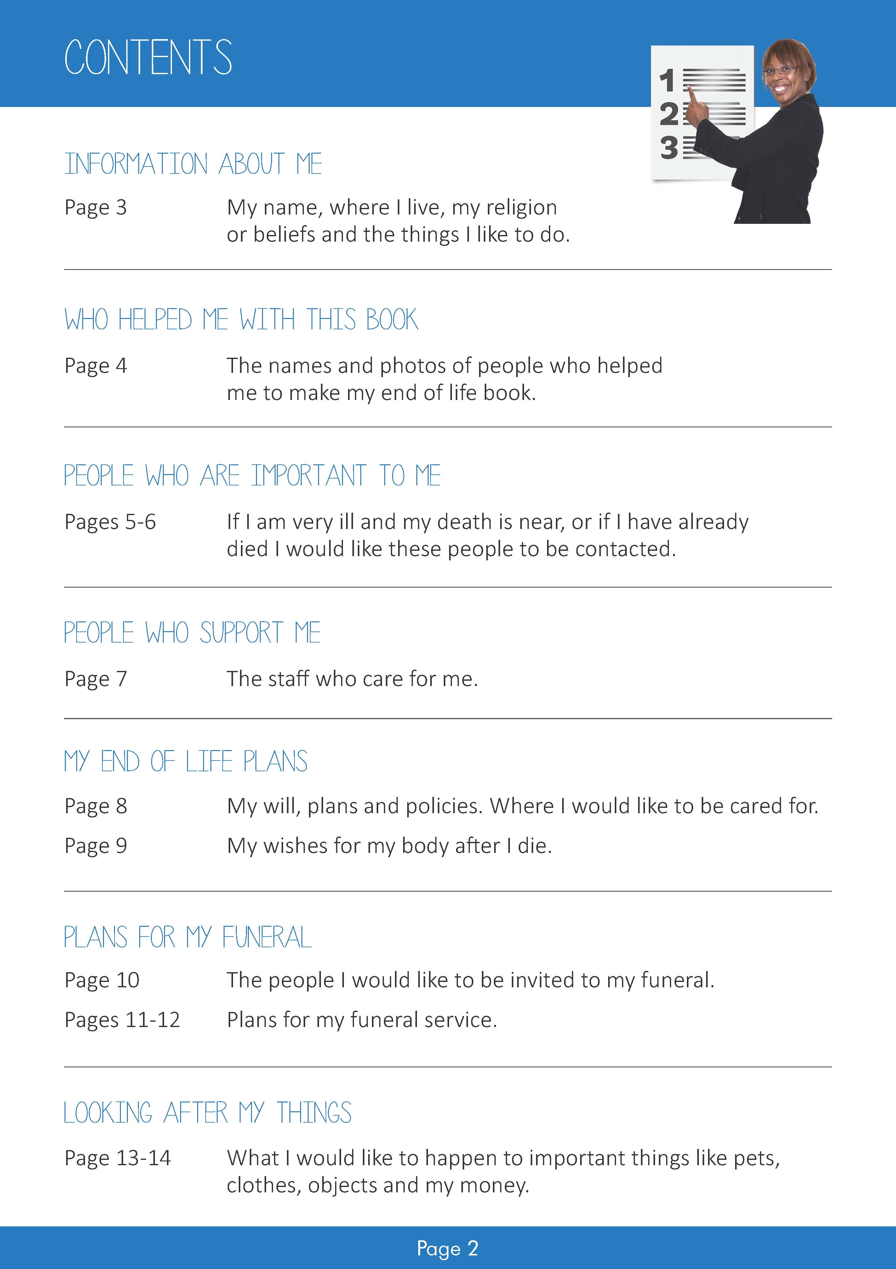

Slide 3
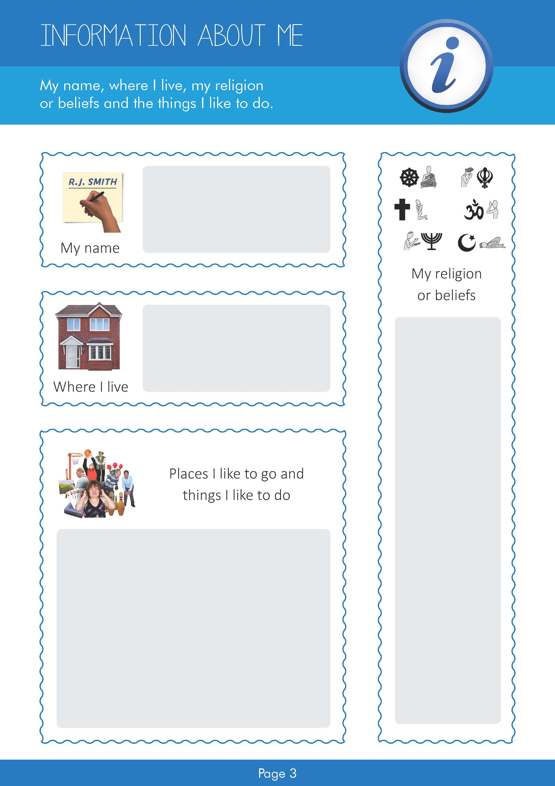
Replace text with my name
Replace text with my address
Replace text with details of my religion or beliefs
Replace text with details of my likes

Slide 4
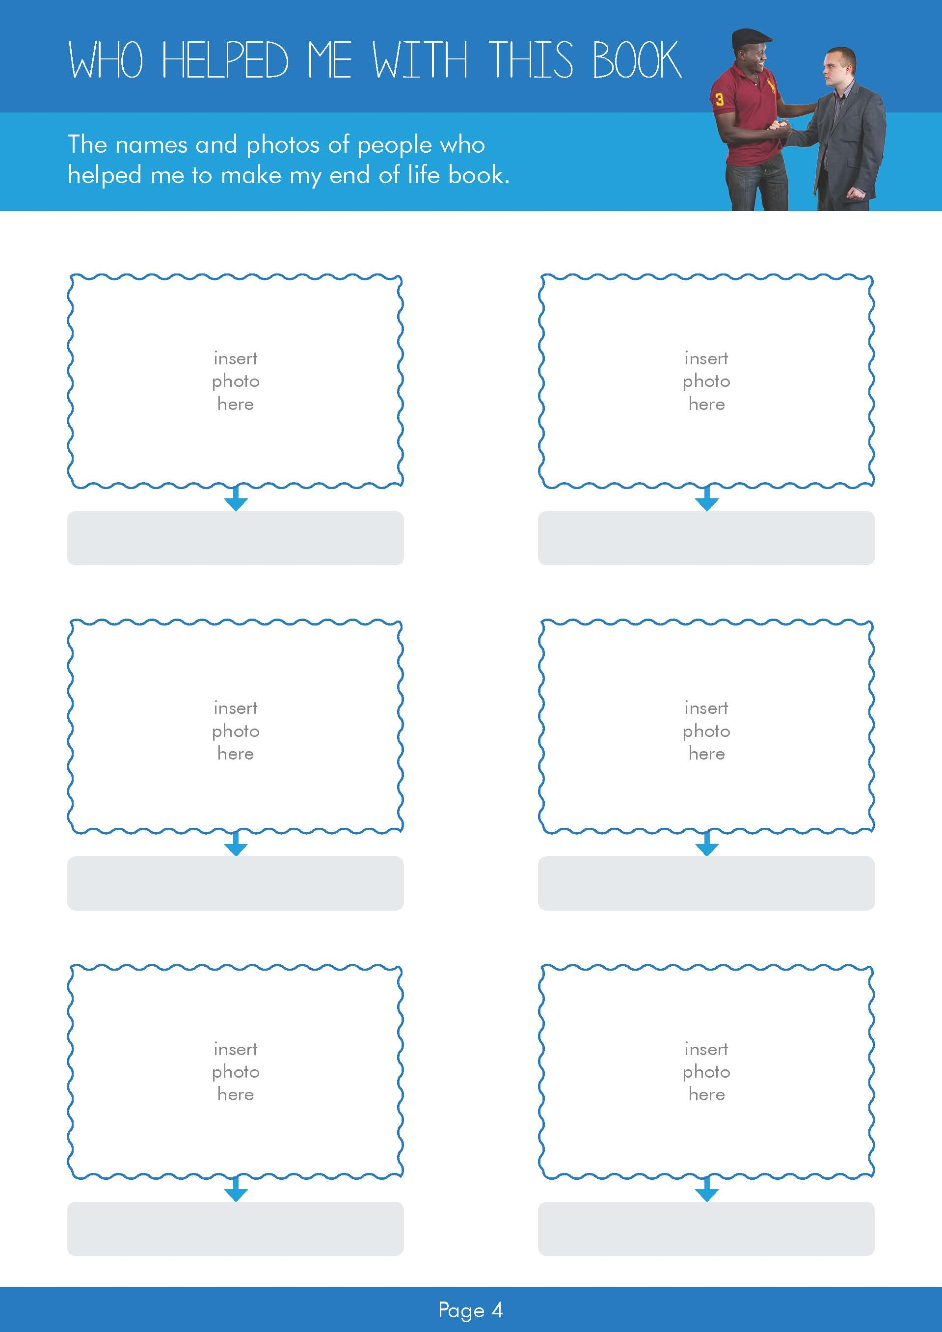
Replace text with name
Replace text with name
Replace text with name
Replace text with name
Replace text with name
Replace text with name

Slide 5
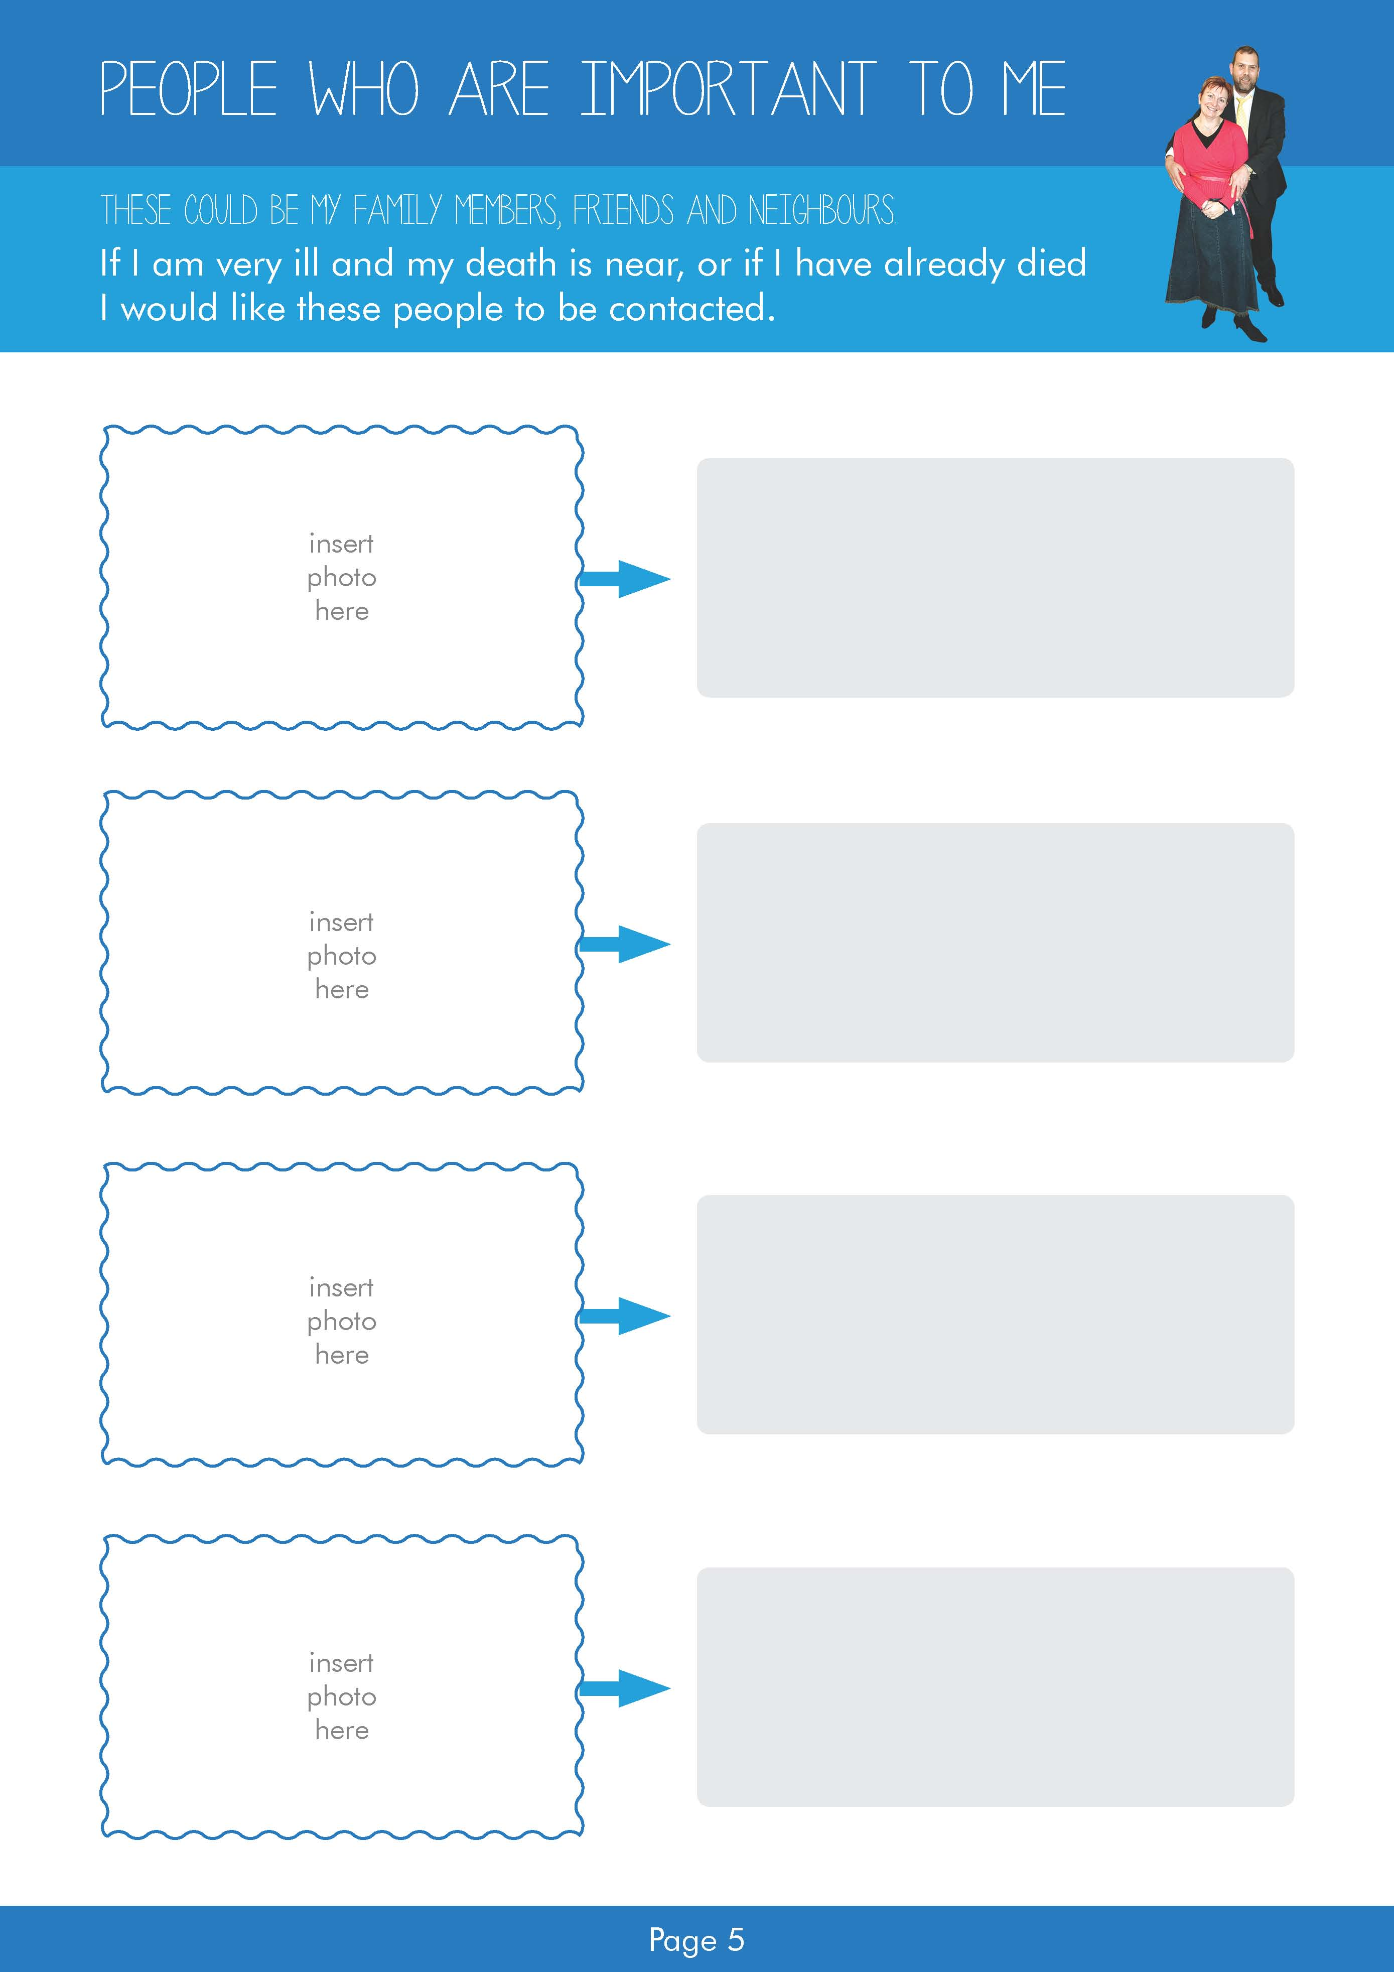
Replace text with name and contact details
Replace text with name and contact details
Replace text with name and contact details
Replace text with name and contact details

Slide 6

Replace text with name and contact details
Replace text with name and contact details
Replace text with name and contact details
Replace text with name and contact details

Slide 7
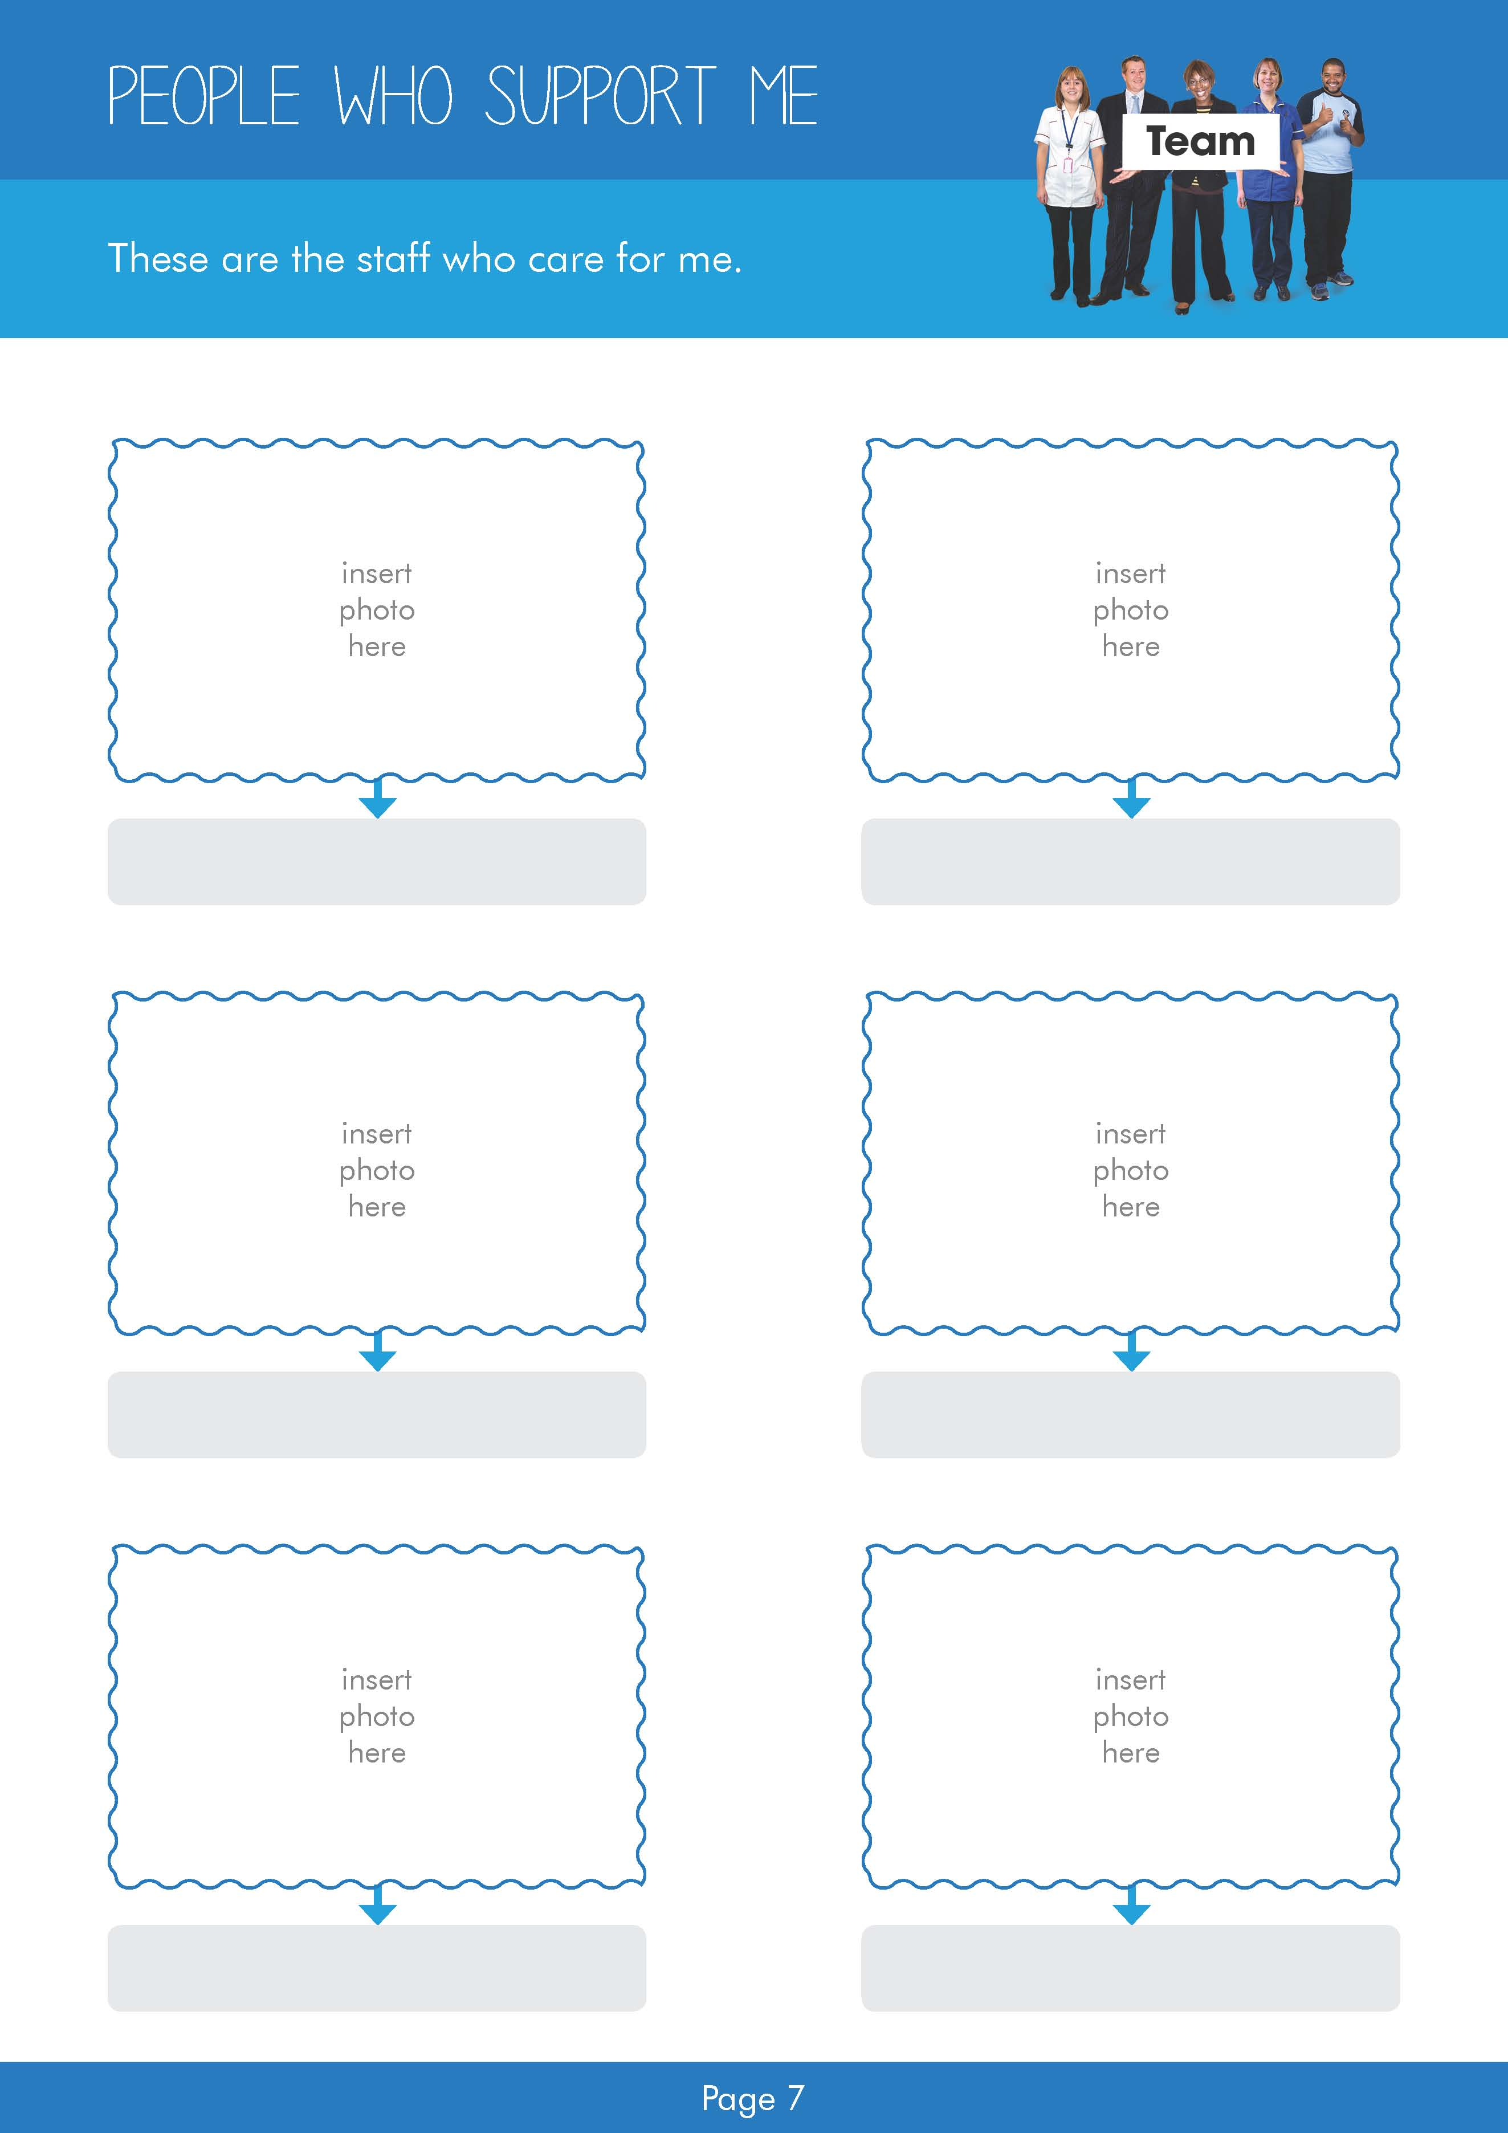
Replace text with name
Replace text with name
Replace text with name
Replace text with name
Replace text with name
Replace text with name

Slide 8
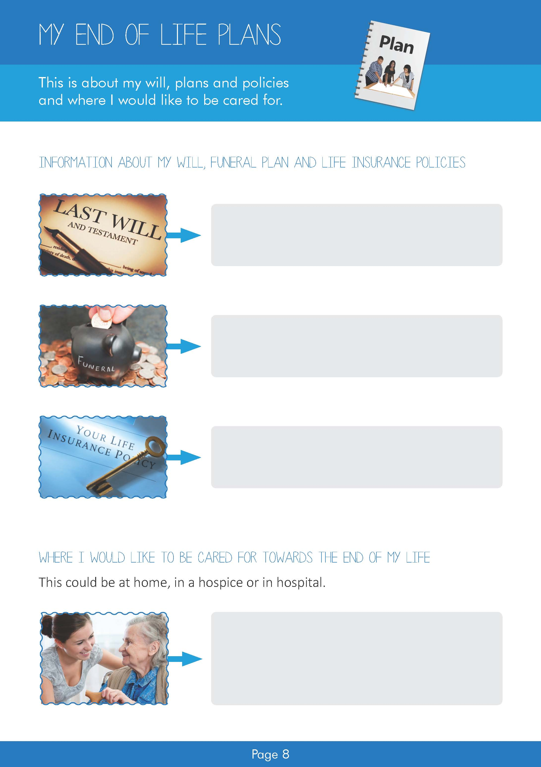
Replace text with details about my will
Replace text with details about my funeral plan
Replace text with details about my life insurance
Replace text with details about where I would like to be cared for

Slide 9
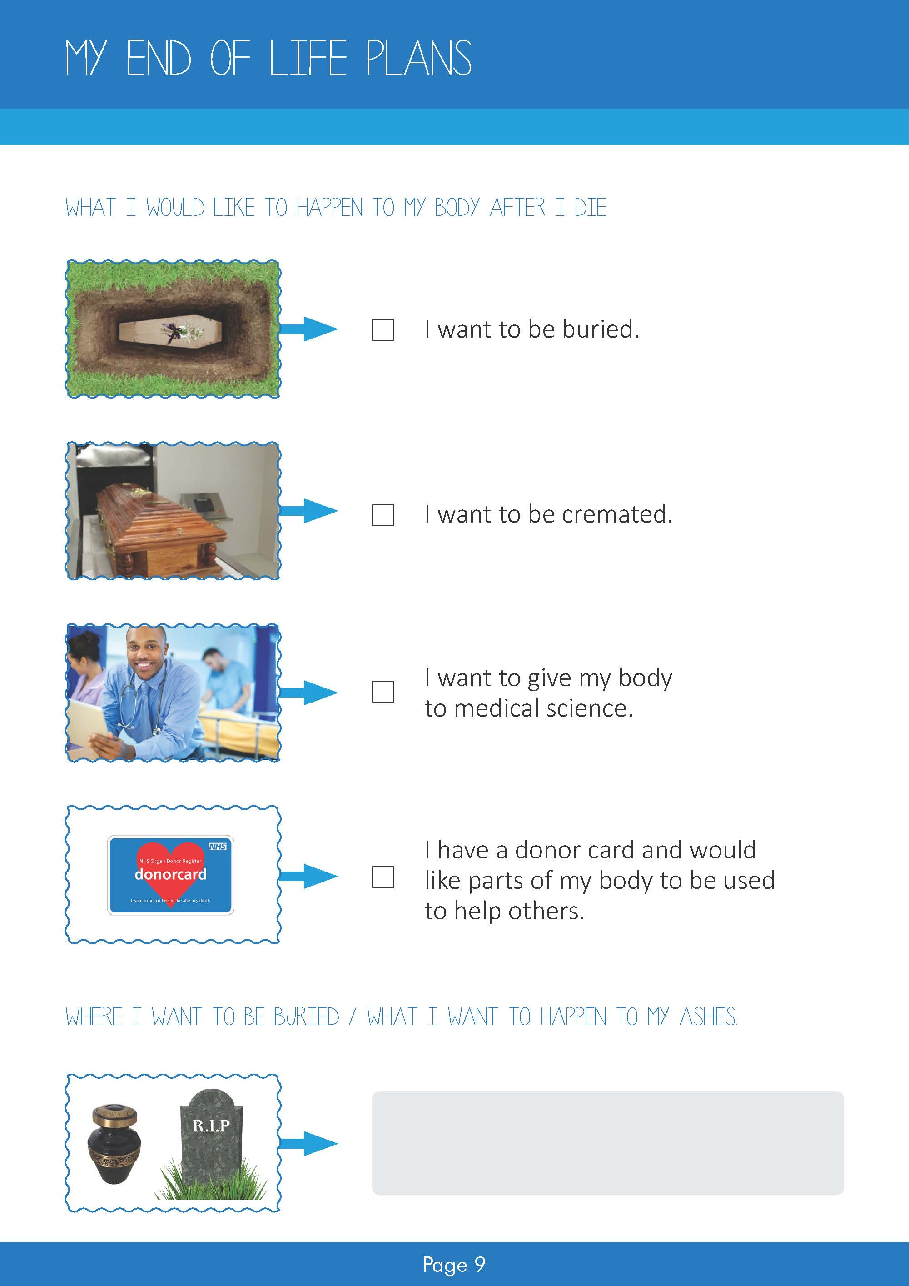

Use the ticks you need for this page then delete the others and this text box
Replace text with details about where I want to be buried or wishes for my ashes

Slide 10
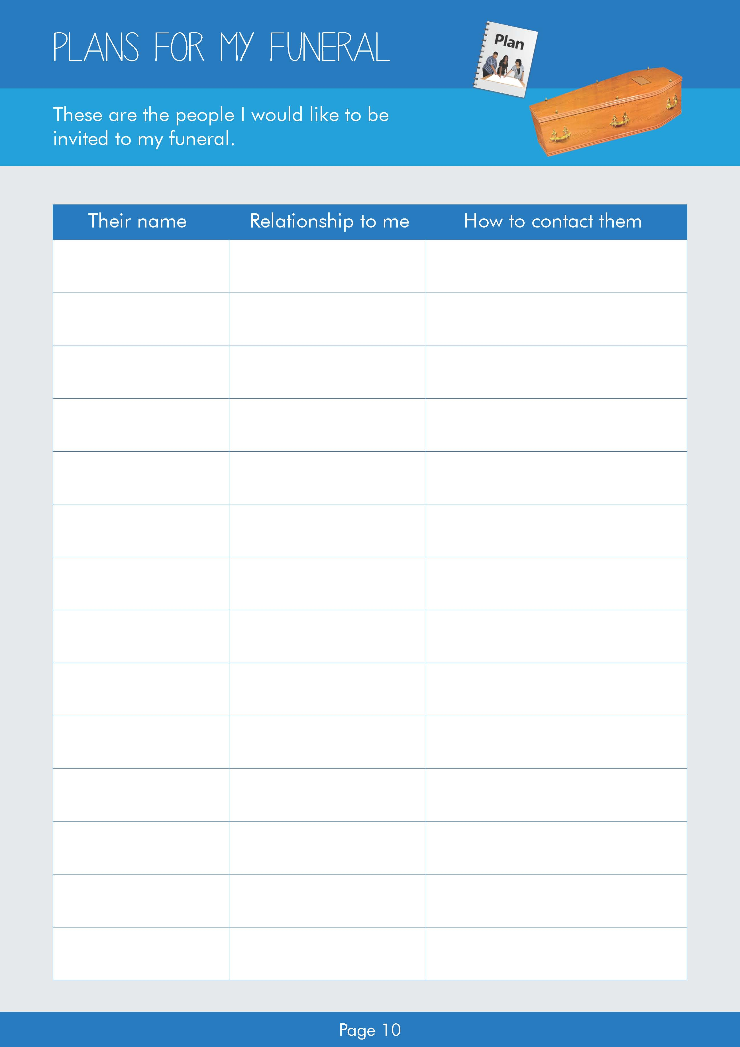
Replace text with details about each person
Replace text with details about each person
Replace text with details about each person
Replace text with details about each person
Replace text with details about each person
Replace text with details about each person
Replace text with details about each person
Replace text with details about each person
Replace text with details about each person
Replace text with details about each person
Replace text with details about each person
Replace text with details about each person
Replace text with details about each person
Replace text with details about each person

Slide 11
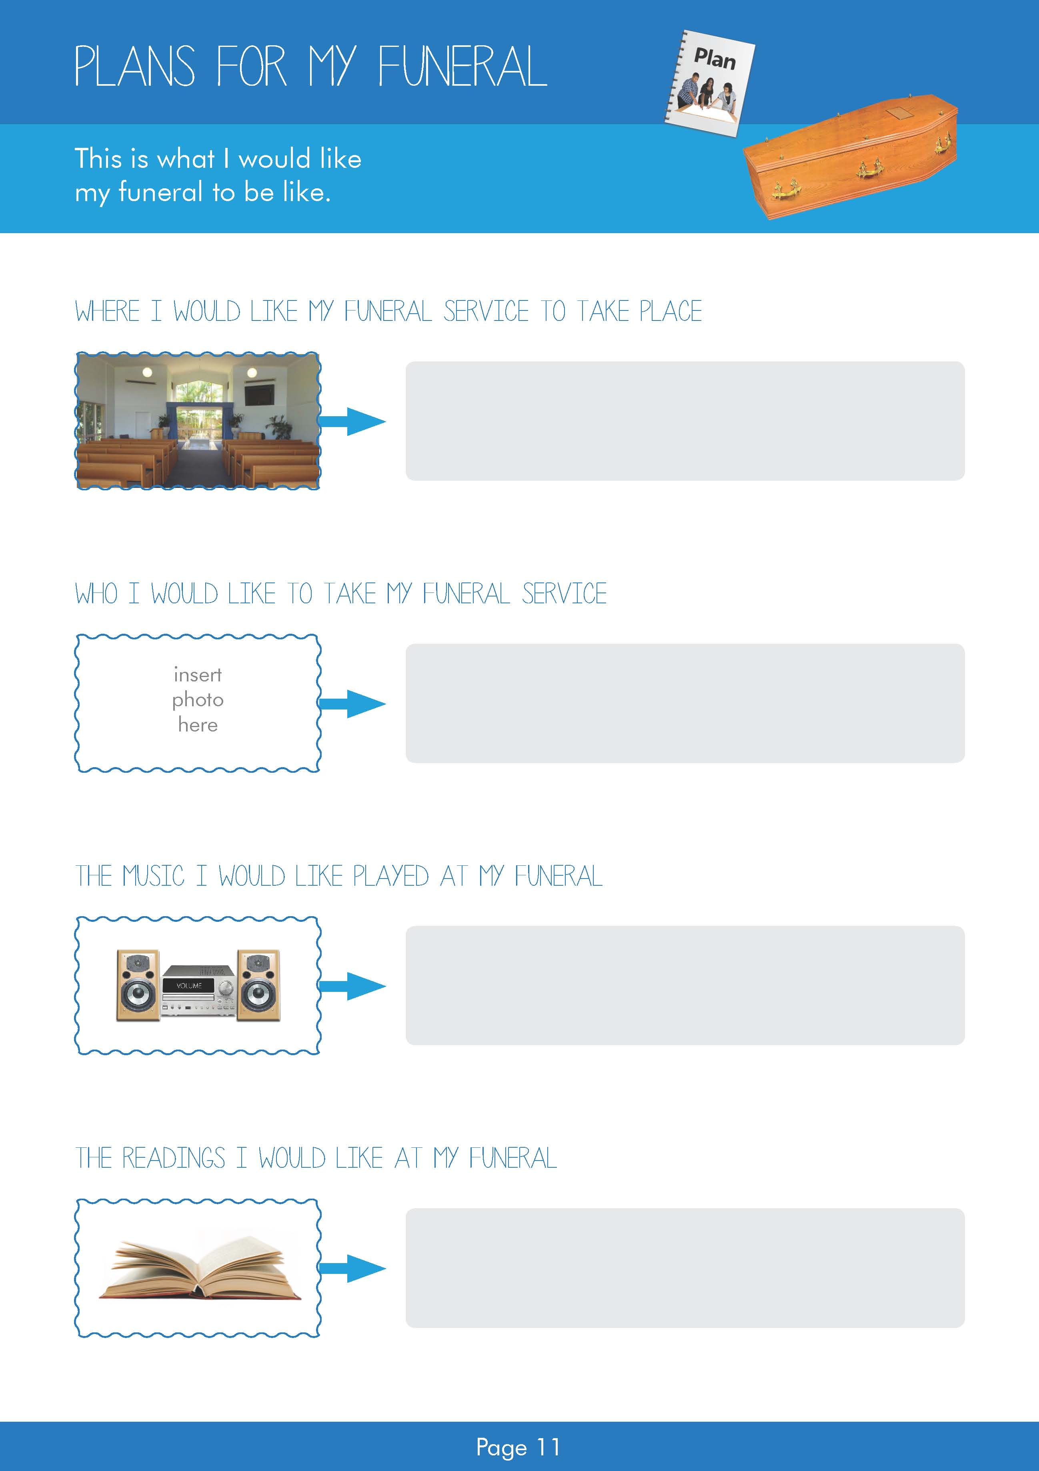
Replace text with details about where my funeral service will take place
Replace text with details about who I would like to take my funeral service
Replace text with details about the music I would like played at my funeral
Replace text with details about the readings I would like at my funeral

Slide 12
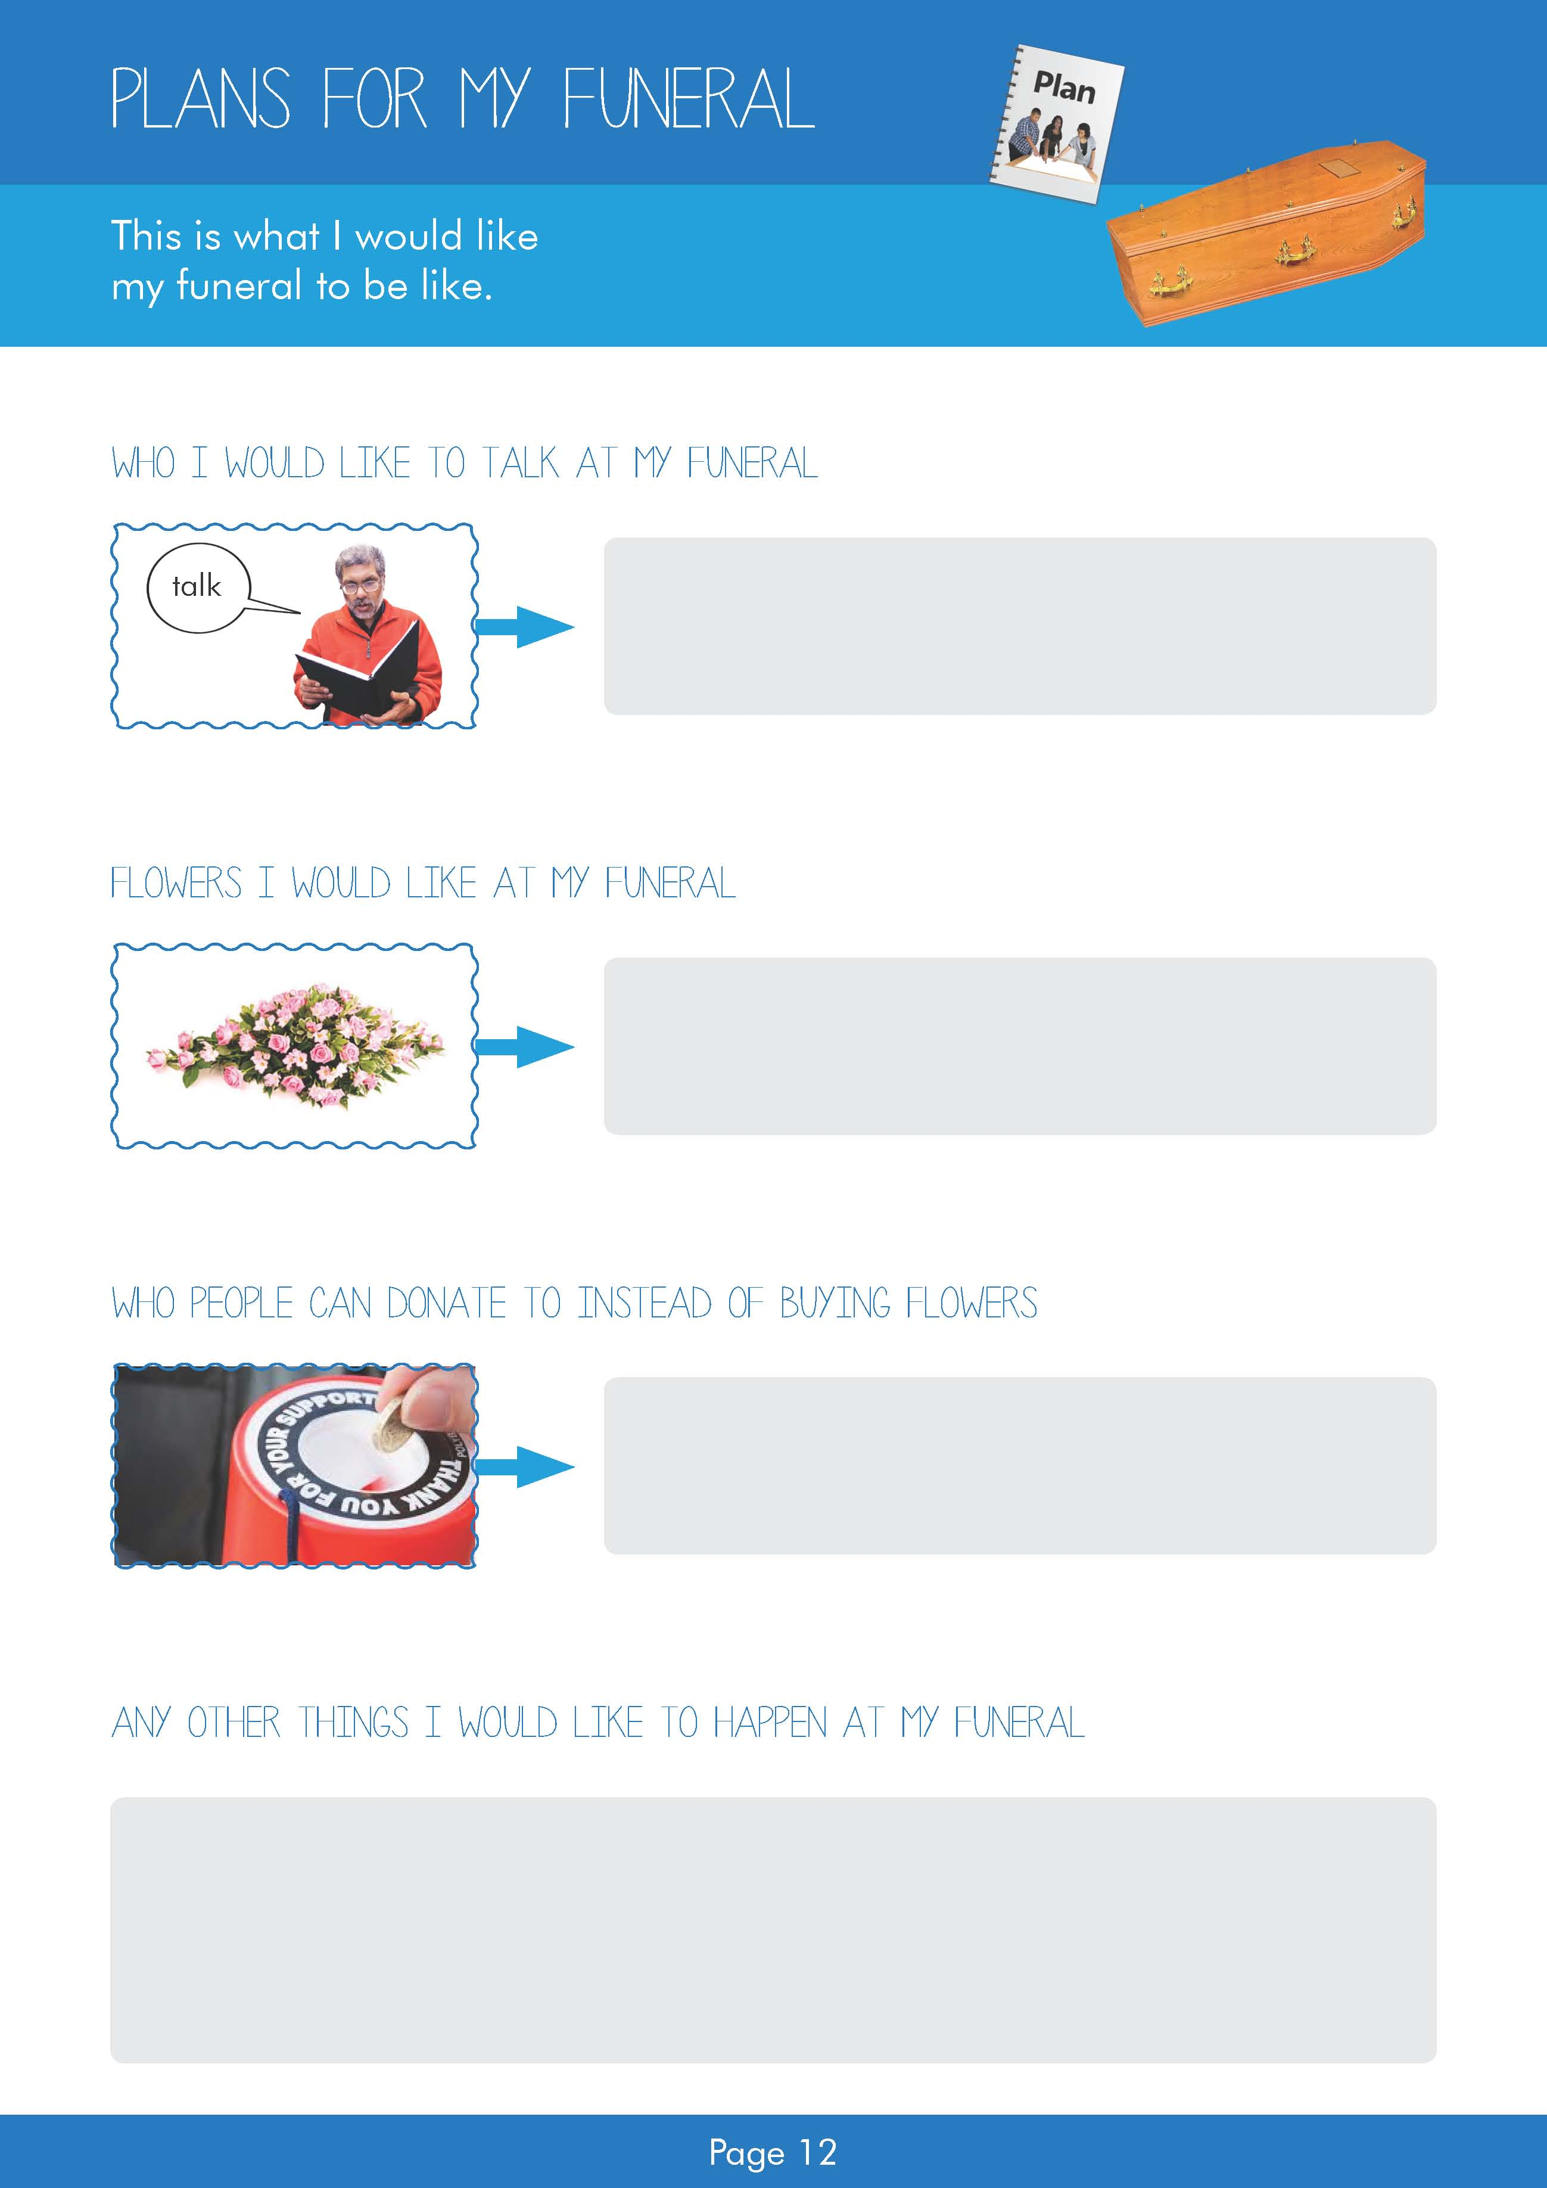
Replace text with details about who I would like to talk at my funeral
Replace text with details about flowers I would like at my funeral
Replace text with details about donations
Replace text with details of others things I would like to happen at my funeral

Slide 13
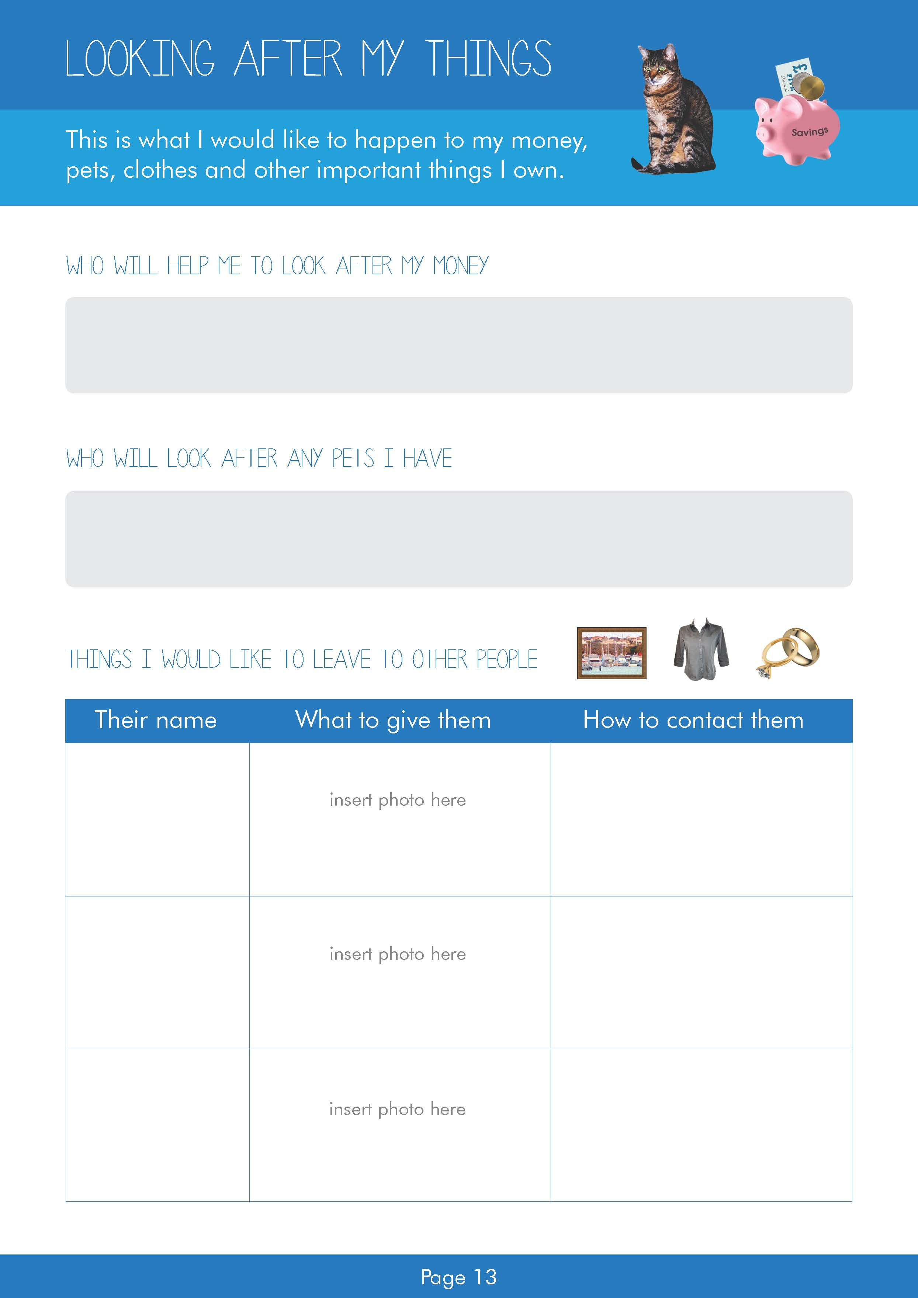
Replace text with details about who will help me with my money
Replace text with details about who will look after my pets
Replace text with name
Replace text with contact details
Replace text with name
Replace text with contact details
Replace text with name
Replace text with contact details

Slide 14
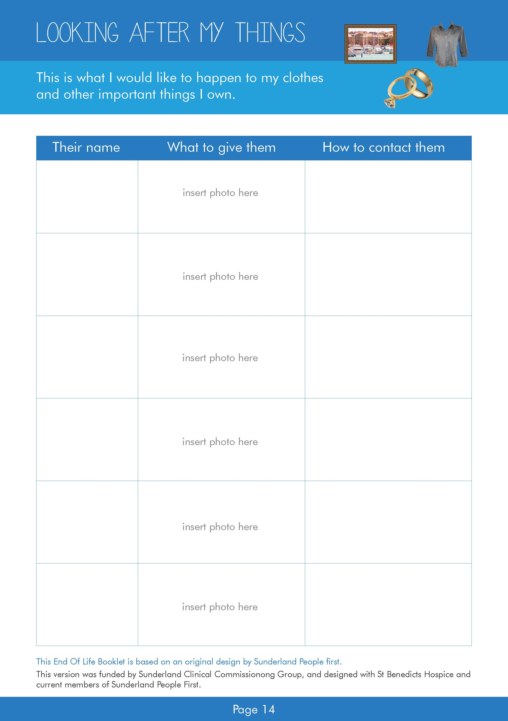
Replace text with name
Replace text with contact details
Replace text with name
Replace text with contact details
Replace text with name
Replace text with contact details
Replace text with name
Replace text with contact details
Replace text with name
Replace text with contact details
Replace text with name
Replace text with contact details

