Slide 1

Delivering Excellence in Learning Disability and Palliative Care
What can I do in Sunderland?

Slide 2
Speakers
Dr Lisa Baker - Consultant in Palliative Medicine
Ashley Murphy - Acute Liaison Team Lead, Learning Disabilities
Dr Rebecca Theobald - Consultant in Palliative Medicine
Wendy Johnson – Specialist Palliative Care Nurse
Shaleen Mercer – Community Nurse Learning Disabilities
Lyndsay Stephenson - Specialist Nurse Learning Disabilities
Beverley Brown - Self Advocate

Slide 3
Learning from today
National recommendations
Locally working together
Local resources
What can I do?

Slide 4

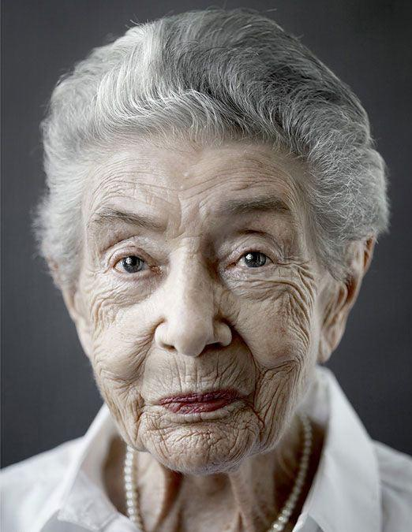

Slide 5

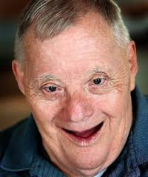

Slide 6


Slide 7


Slide 8
Delivering Excellence in Palliative Care and Learning Disability
November 9th 2017
St Benedict's Hospice and Northumberland, Tyne and Wear NHS Foundation Trust.

Slide 9
Background
The average age of death for people with learning disabilities was 65 years for men and 63 years for women.
This is significantly less than for the UK population of 78 years for men and 83 years for women.
Thus men with learning disabilities died, on average, 13 years sooner than men in the general population and women with learning disabilities died 20 years sooner than women in the general population.
Overall, 22% were under the age of 50 when they died.’

Slide 10
Reasons for Premature Deaths
Poor uptake of cancer screening programmes
Late detection and delayed treatment.
Treatment options sometimes not offered as assumption made person can not comply.
Referrals between services are not made timely.
Diagnostic Overshadowing.

Slide 11
What we are doing in Sunderland to change this
Reasonable adjustments made to bowel pathway.
Initial discussion taken place in regards to AAA Screening.
Direct support offered to people who are registered with GP to support for breast screening and cervical screening.
Annual health checks offered by all practices so an opportunity to detect health conditions early.
An easy read 2 week referral information sheet provided.
Easy Read week Referral Form
Training to all practices re co-morbidities in learning disability.

Slide 12
Regional Work
LEDER Programme Implemented
Learning From Deaths Reviews.
All services as well as parents and carers can notify a death. (www.bristol.ac.uk)
Themes are fedback through local quality assurance groups so practice can be changed where appropriate
All agencies who have been involved could be part of a multi agency review, it’s a review not an inquiry.

Slide 13
Making reasonable adjustments to end of life care for people with learning disabilities (Public Health England)
The key considerations
timely diagnosis and equal access to the full range of investigations and interventions
skills to break bad news to the person with learning disabilities and support discussion of end of life care, in collaboration with their family carers and/or support services
the needs of others (for example, where the person shares a house), including the needs of peers to understand what is happening and the needs of staff for support to continue to provide appropriate care
support for palliative care services to understand the person’s communication and other needs related to their learning disability
good co-ordination, taking account of the complex range of issues there may be for a person with learning disabilities

Slide 14
Ambitions for Palliative and End of Life Care:
A national framework for local action 2015-2020
Each person is seen as an individual
Each person gets fair access to care
Maximising comfort and wellbeing
Care is coordinated
All staff are prepared to care
Each community is prepared to help

Slide 15
PCPLD Palliative Care for People with Learning Disability Network.
We aim to raise awareness of the palliative care needs of people with learning disabilities, to share and promote ‘best practice’ and to enhance collaboration between all services providers, carers and people with a learning disability.
www.pcpld.org

Slide 16
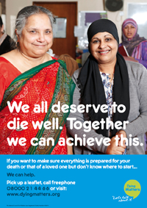
People with learning disabilities are some of the most marginalised groups in society. Many of the 1.5 million people with learning disabilities in the UK have to cope with death, dying and bereavement without being fully informed about what is going on. They also face particular barriers if they come to need end of life care and support.
People with a learning disability and a life-limiting or terminal illness should be able to access the same quality of palliative care as the general population.
It is essential that people with a learning disability are always kept at the centre of decisions made about their own lives.
Every person involved in end of life care must always do their very best to give every person with a learning disability the support they deserve and need. Not many people with learning disabilities will be encouraged to explore issues of such a sensitive nature such as loss, death or dying as part of their everyday lives. Many will not be aware that they have an illness.

Slide 17
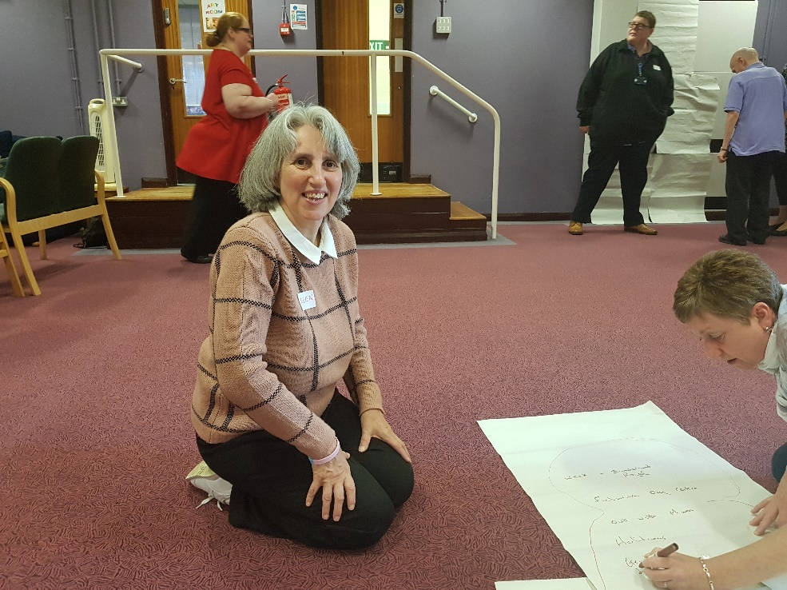
Celebrating Life Workshops
What makes me, me?
What is important to me, when I die?
Completing my end of life booklet
My bucket list.

Slide 18
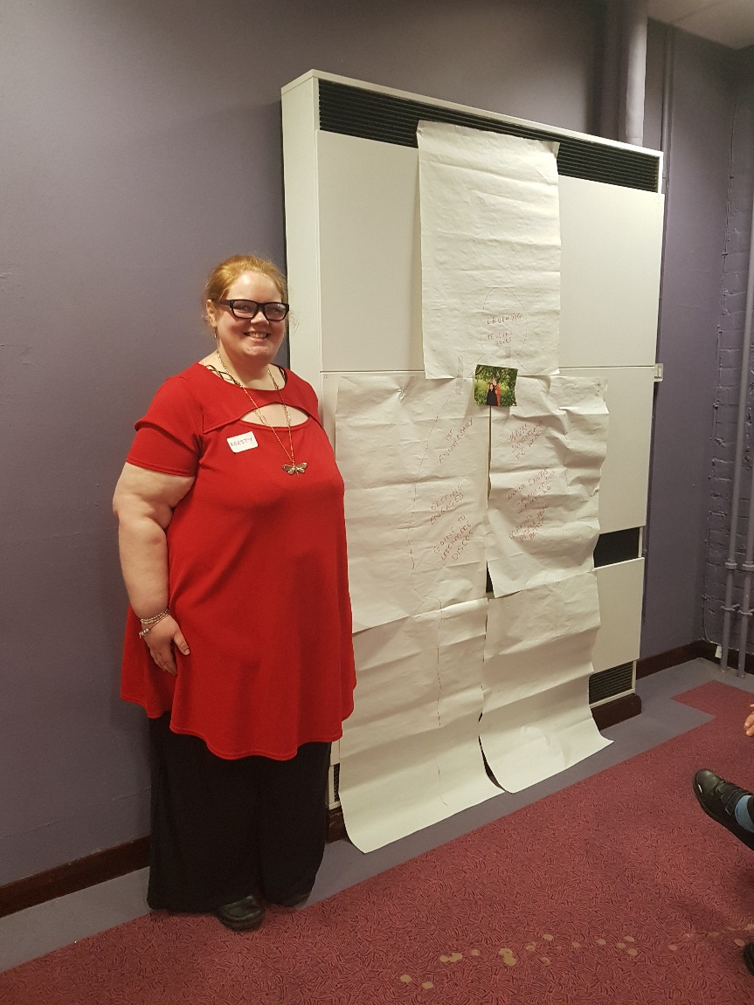
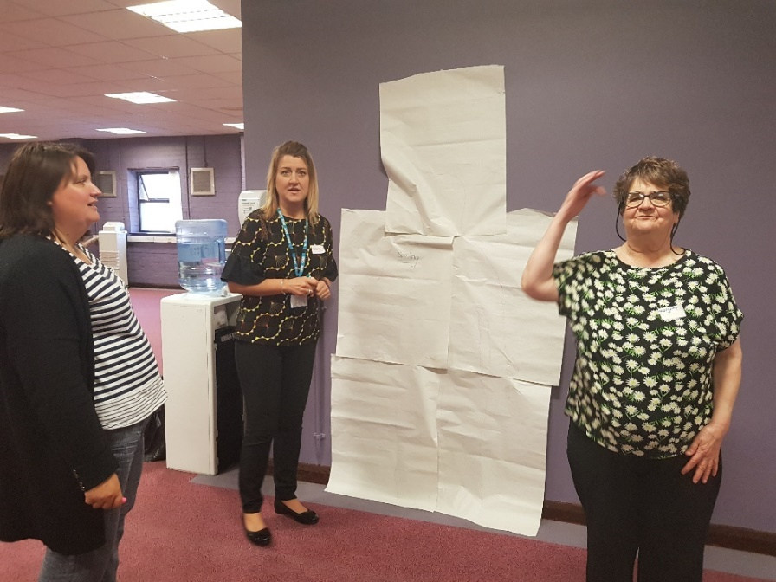

Celebrating Life Workshops

Slide 19
Bucket Lists Clip

Slide 20
Evaluation from Workshops
‘I will be a star one day, like my dad shining next to him’
‘It was good to talk about things that we would like to happen’
70% of the people involved in the workshop wanted more information about end of life planning.
100% enjoyed talking about their lives, what makes them happy and what is important to them.

Slide 21
Our catalogue of resources
End of Life Booklet
How you might Feel if you are dying
Making Choices about the Future
End of Life – The last few days
Word Bank

Slide 22
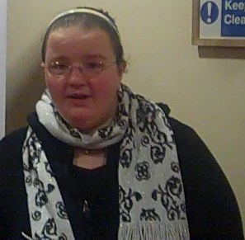
Beverley's Story

Slide 23
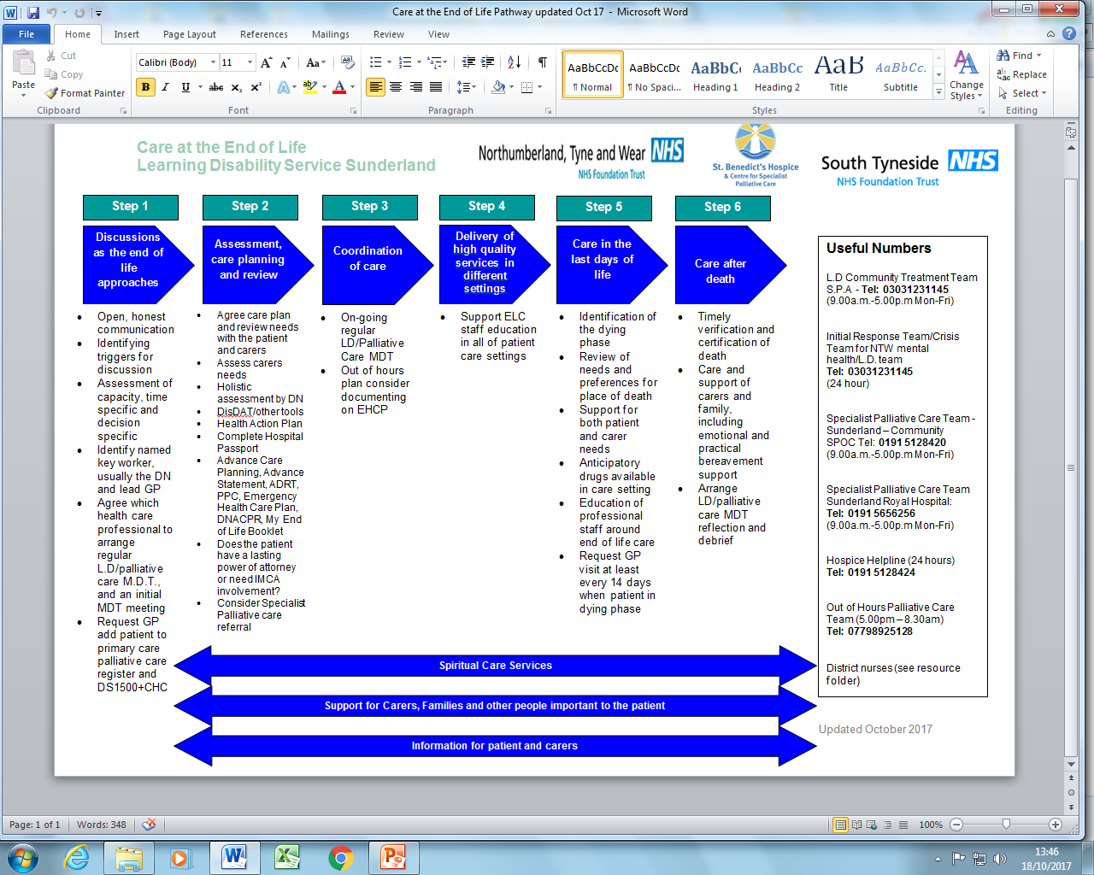
Notes:
DOH end of life stategy

Slide 24
Step 1
Discussions as the end of life approaches
Open, honest communication
Identifying triggers for discussion
Assessment of capacity, time specific and decision specific
Identify named key worker, usually the DN and lead GP
Agree which health care professional to arrange regular L.D/palliative care M.D.T and an initial MDT meeting
Request GP add patient to primary care palliative care register and DS1500+CHC

Slide 25
Step 2
Assessment, care planning and review
Agree care plan and review needs with the patient and carers
Assess carers needs
Holistic assessment by DN
Disdat/other tools
Health Action Plan
Complete Hospital Passport
Advance Care Planning, Advance Statement, ADRT, PPC, Emergency Health Care Plan, DNACPR, My End of Life Booklet
Does the patient have a lasting power of attorney or need IMCA involvement?
Consider Specialist Palliative care referral

Slide 26
Step 3
Coordination of Care
On-going regular LD/Palliative Care MDT
Out of hours plan consider documenting on EHCP

Slide 27
Step 4
Delivery of High Quality Services in Different Settings
Support ELC staff education in all of patient care settings

Slide 28
Step 5
Care in the last days of life
Identification of the dying phase
Review of needs and preferences for place of death
Support for both patient and carer needs
Anticipatory drugs available in care setting
Education of professional staff around end of life care
Request GP visit at least every 14 days when patient in dying phase

Slide 29
Step 6
Care After Death
Timely verification and certification of death
Care and support of carers and family, including emotional and practical bereavement support
Arrange LD/palliative care MDT reflection and debrief

Slide 30
Spiritual Care Services
Support for Carers, Families and other people important to the patient
Information for patient and carers

Slide 31
Useful Numbers
L.D Community Treatment Team
S.P.A - Tel: 03031231145
(9.00am- 5.00pm Mon-Fri)
Initial Response Team/Crisis Team for NTW Mental Health/L.D. Team
Tel: 03031231145
(24 hour)
Specialist Palliative Care Team - Sunderland – Community
SPOC Tel: 0191 5128420
(9.00am- 5.00pm Mon-Fri)
Specialist Palliative Care Team - Sunderland Royal Hospital
Tel: 0191 5656256
(9.00am- 5.00pm Mon-Fri)
Hospice Helpline
Tel: 0191 5128424
(24 hours)
Out of Hours Palliative Care Team
Tel: 07798925128
(5.00pm – 8.30am)
District nurses
(see resource folder)

Slide 32
So how are we doing in Sunderland?

Slide 33
Audit -12 months 2016-2017
Demographics
5 patients 3 female 2 male over a 12 month period
4 deaths
Diagnosis
4 cancers - GIST, Gynae cancer, Gastric cancer, Bowel cancer
1 non cancer - Complex epilepsy/challenging behavior/recurrent aspiration pneumonia

Slide 34
Step 1 Discussions as end of life approaches
LD key worker -1/5 patients carer declined LD input
Planned LD/Palliative care MDTs

Slide 35
Step 2 assessment, care planning and review
MDT agree care plan with action points
Family Carer assessment
  4/5 yes
  x1 patient had no biological family, MDT appointed an IMCA
Professional Carer assessment applicable in 2/5
Identify lead GP
Identify lead DN
Holistic assessment
Add to GP PCR
DS 1500
Health Action Plan
EHCP
Advance statement or Best Interests Decision re PPC
DNACPR
ADRT n/a
LPA x1/5 checked was for property and financial
IMCA 3/5 referred from MDT
SPCN
SPC Consultant

Slide 36
Step 3 coordination of care
Regular MDTs
Frequency/period of care
Patient 1 5 months of care – 7 MDTs
Patient 2 3 months of care - 5 MDTs
Patient 3 No MDTS but care coordinated as per standards by SPCN
Patient 4 5 months of care – 8 MDTs
Patient 5 6 months of care – 6 MDTs ongoing monthly

Slide 37
Step 4 Delivery of high quality care in different settings
Education of family carers
  2/5
Education of professional carers
  3/5

Slide 38
Step 5 care in the last days of life
Identification of dying 4/5, 1 improving
Reversible causes of dying assessed 5/5 1/5 not dying now frail but stable
Support of family carers 2/5
Support of professional carers
Increase in care package for patient
  1/5 Yes over 24 hour period from familiar bank of staff in supported living home
  1/5 Moved from residential side of care home to nursing side, same home
  2/5 yes in own home
Increase incare package for other residents in same care setting 1/5
Anticipatory drugs in place
Known to OOHPCT
GP asked to visit every 14days
GP visits every 14 days

Slide 39
Step 6 care after death
Preferred place of death identified?
  2/5 supported living
  1/5 own nursing home
  2/5 at home
Place of death
  4/5 achieved PPD
  1/5 improved not dying
PP death achieved 100%
Verification of death by DN 1/4
Verification of death by OOHPCT 1/4
Verification of death by OOHGP 2/4
Coroners referral 0%
Bereavement follow up to family carers by DNs 1/4
Bereavement follow up to professional carers by DNs 1/4
Bereavement follow up to family carers by SPCNs 2/4
Bereavement follow up to professional carers By SPCNs 3/4

Slide 40
Unplanned Hospital Admissions
Patient | Before MDT | After MDT
1 | 7 in 6 months | 0 in 5 months, died PPC
2 | 3 in 2 months | 0 in 3 months, died PPC
3 | 2 in 2 months | 0 in 3 months, died PPC
4 | 1 in 2 months | O in 3 months, died PPC
5 | 8 in 5 months | 0 in 6 months ongoing

Slide 41
PPC
100% (4/4) died in their own home
  supported living shared house
  residential home ( stayed in same home moved over to nursing)
  home with private welfare carer
  home with parents
1/5 has improved and likely to be discharged from SPC
Notes:
unable to swallow meds so had a subcutaneous infusion of midazolam for seizure prevention, woke up started eating swallow reliable, no challenging behavior, no further pneumonias.
MDT agreed joint plan before new AED regime. Remains frail but not dying. May soon be discharged from SPC.

Slide 42
Some of the challenges managed in the Community
Recurrent bowel obstruction managed in supported living home (SLH)
Large bleeds recurrent bleeding managed with symptom control in NH
Peritoneal fluid drainage by implanted catheter (DNs) in SLH
Symptom management with unreliable yes/no in SLH
Increased behavioural needs of other residents in SLH whilst patient has increasing care needs …pebble in a pond
Carer uncertainty about their own coping and experiences of death. Huge efforts by carers to try and maintain normality, really up and above the call of duty….pebble in a pond
Notes:
-assessed by SALT therefore used Disdat +carer assessment plus professional assessment for symptom control medication
-What to say? Who to call for advice –in hours and out of hours?

Slide 43
Benefits
Patient gets best care possible with existing resources available in Sunderland
Patient has opportunity to die in their PPC
Patient maintains a normal routine for as long as possible as change is more difficult for a person with LD. Can’t change the disease trajectory but we can influence place of care
Avoidance of unplanned hospital admissions
Coordinated and planned care amongst teams
Avoidance of referral to coroner/police attendance and “unexpected death”
Verification of death by DN/OOHPCT
Job satisfaction
Impact on bereavement

Slide 44
Challenges
Who’s job is it?
Training Education and Support = mutually beneficial . None of us are expert in this but together as an MDT we can be. We are like a jigsaw.
Time consuming or time saving?
Need for increased care hours in supported living homes to support patient and other residents

Slide 45
To Take Forward
Maintaining normal routine and care settings for as long as possible, as change is more difficult for a person with LD. We often are unable to change the disease trajectory but we can influence place of care.
Patient identification
Learning disability bereavement follow up for other people who were important to the patient or to other residents in a supported living home.
  “How people die remains in the memory of those who live on” DCS
Support specific educational support on a case by case need to carers and managers in supported living housing
Continue to educate the wider Community Team in Sunderland around the MDT pathway that we have in place
More Celebrating life Workshops

Slide 46


Slide 47

Learning Disability and Palliative Care
November 2017
Wendy Johnson

Slide 48
Background
38 year old lady referred from GP and District nurse for symptom control and carer support.
Lives at home with Mam, Dad and brother.
Diagnosed with a Lymphoma with a poor prognosis (<12 months)
Refuses any kind treatment
  -has a needle phobia
  -dislikes going to the dentist
  -refuses to be examined by health professionals
  -can be very anxious and can get verbally aggressive

Slide 49
Background
Has a learning disability and epilepsy
Known to the learning disability team since early age
Has been assessed and found to not have capacity to make complex decisions only basic ones eg. food choices
MDT including her parents make a best interests decision not to inform her of cancer diagnosis
She refers to the disease as her lumps that hurt.

Slide 50
Background
Hospital MDT discussion with parents who have Lasting Power of Attorney
Best interest decision for supportive care only as thought unlikely to tolerate the treatments

Slide 51
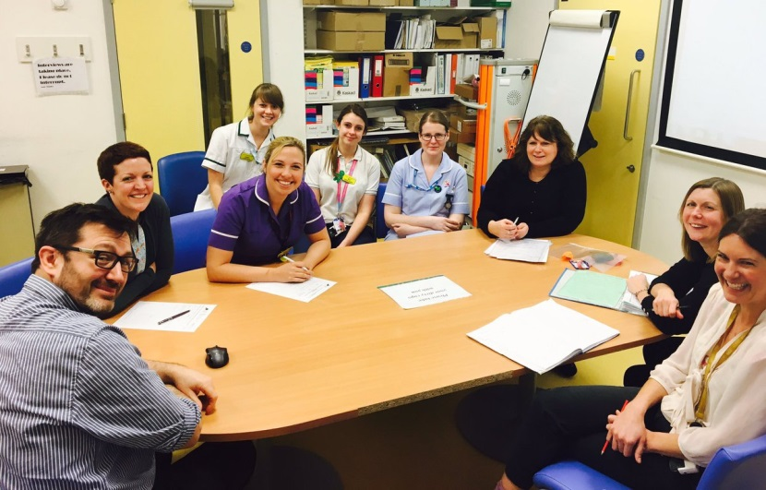
What might your priorities be as an MDT?
What would your assessment + care plan include ?
Notes:
Explain each table is set up as an MDT

Slide 52
Holistic Assessment
Identified a Key worker- district nurse and learning disability key person
Regular MDTs with all professionals every 6 to twelve weeks according to symptoms
DS1500 and CHC applied for by DNs
Introduced pain tools with the support of the learning disability team. Disdat tool, Pain Chart to which she would draw

Slide 53
Holistic assessment
Needs assistance with hygiene needs, diet and mobilising - 24 hour care
Mam and Dad main carers and has a younger brother
Attends day centre Monday to Friday 10am to 3pm for 22 years – good rapport with staff + Key Worker, to continue
Has 40 respite days in respite care

Slide 54
Holistic Assessment
Unable to complete ACP so best interests decision made about PPC
Parents expressed that they would like to care for her at home with support as she does not adjust well to change
Dad also recently diagnosed with palliative illness he died in hospital during patients illness

Slide 55
Ongoing Assessment
Pain & symptom control over months varied according to disease progression involving patient, parents, day care and respite centre.
Routine was kept as much as possible for day centres and respite. After 24 months rapid deterioration with multiple tumours, in abdomen, left leg DVT, causing reduced mobility and pain ++
MDT discussion and referred to haematologist, with support from learning disability team for appointments. Best Interest decision for palliative radiotherapy
Visual aids used for the patient about radiotherapy, lots of preparation for radiotherapy, visited the cancer centre with mam, carer and Learning Disability Nurse

Slide 56
Ongoing Assessment
Agreed in best interest for radiotherapy and lady agreed following visit to the department (lay on table, met staff, saw equipment etc).
Symptoms more controlled for a few weeks and attended day centre up to one week prior to death, respite etc, also had a short break holiday with Mam and friend.
Respite increased to 66 days per year to help support mam and carers at home, visits continued from District Nurse and SPCN in respite care to support staff with ongoing changes.

Slide 57
DNACPR completed
Deteriorated ++, complex pain issues.
Weekly MDTs
Carers introduced at home – only three for continuity.
Anticipatory drugs in place, deteriorated+++ unable to attend day centre and bed bound due to fungating tumours and oedema++
Oxycodone change to fentanyl patch due to swallowing difficulties and compliance.

Slide 58
Ongoing Review
Daily to twice daily reviews by District Nurse and SPCN and OOH on a evening
Required 2 stat doses of sub cut medication and died peacefully with mam at home
Bereavement support for mam, brother and all carers + professionals involved
Reflection also took place for all involved

Slide 59
Learning Points
What was involved?
Regular assessment according to condition changes and support needed for all professionals and carers involved.
Effective communication between multiple multi disciplinary professionals.
Careful planning.

Slide 60
Learning Points
Who was involved?
Patient, parents, carers, day centre, respite centre, LD team, DNs, GP, palliative care, consultants, OOH, specialist palliative care nurse, social worker, OT, lymphoedema.

Slide 61
Learning Points
Specific considerations in LD
Extended multi professional teams involved
Continuity from team
Effective communication, regular commitment between team
MDT team approach re changes in condition and planning
Use of appropriate tools ie pain charts, Distat tool, pictures etc

Slide 62
Learning Points
Bereavement support
For family, carers and professionals
Reflection offered between professionals – learning opportunities / support.

Slide 63
Summary
Patient died at home with Mam
No unplanned hospital admissions
Able to attend day care respite up to one week prior to death with ongoing adaptions and support
Patient had familiarity with staff, carers throughout palliation
Reflection for all involved – positive and extensive learning for all involved all felt had valued part

Slide 64
Learning Disability and Palliative Care
Case 2
BW

Slide 65
BACKGROUND
GIST tumour diagnosed in 2013
Third line treatment with Regorafenib discontinued. No surgical options available
CT scan showed progressive disease
Recurrent ascites requiring drainage

Slide 66
BACKGROUND
Learning disability
Able to communicate verbally but difficulty understanding complex concepts
Lived in assisted living
Had a girlfriend but no identified NOK

Slide 67
BACKGROUND
In your tables
  What would your priorities be?
  What might your plan of care look like?
Notes:
Ask small groups to think about the information they have so far and consider what their priorities/care plan would be
Encourage a member of each table to feedback
Anticipated learning points- need to refer to the pathway, involve the right people, form an MDT, holistic assessment, gather information

Slide 68
INITIAL ASSESSMENT
Re-referred to Specialist palliative care nurse by DN May 2016 for symptom control, psychological support and carer support
Specialist Palliative care input
  More frequent ascitic drainage required
  Indwelling drain not previously inserted due to concerns about infection but requiring antibiotics after each temporary drain
  Increased abdominal distension would cause discomfort
  Assessment of capacity
  Liaised with gastroenterology and radiology who agreed to arrange an indwelling drain
  DS1500 organised. Need for OT input. Allocated Social worker. LD team referral
  Need to consider future care and support for carers
Notes:
Consent 4 used for previous procedures

Slide 69
INDWELLING ASCITIC DRAIN
As an MDT what would need to be considered and arranged prior to a planned procedure?
Notes:
Ask small groups to discuss depending on how amenable audience is to discussion
Anticipate points of discussion- investigations required pre procedure eg bloods, assessment of capacity, support in hospital, consent, best interest
Highlight MCA and deciding right, involvement of LD support workers, care staff

Slide 70
WHAT HAPPENED NEXT…
Regular MDT meetings and reviews by members of the MDT
Arranged visit to the hospice
LD support worker supported Billy achieve his wishes with trips out to Whitby etc
Involvement of an IMCA
Carers supported completion of a Will and documentation of BW’s wishes for his funeral
EHCP
  Falls, infection and possible bowel obstruction
DNACPR
  Decision made in best interest
Notes:
Initially felt admission to treat reversible causes of a deterioration was appropriate given his QOL
Also commenced on trail of dexamethasone for appetite. Discuss that BW was distressed when visiting the hospice re future care planning. He held the door frame when being shown a Sideroom. The carers struggled as they wanted hospice care for him.

Slide 71
ONGOING ASSESSMENT
Increased support over night
DISDAT tool. Commenced on regular Morphine
Commenced on steroids to help appetite but developed diabetes
Excoriated skin and antibiotics for infected ascites
Ascitic drain stopped draining
Communication session arranged for carers to guide how to respond to Billy’s questions relating to dying
Carer’s efforts to find relatives was extensive

Slide 72
ONGOING ASSESSMENT
Deteriorating condition noted
Preferred place of death established as home and team agreed that escalation of care to hospital would no longer be in best interest
Anticipatory drugs arranged including crisis midazolam
Regular GP reviews encouraged
Continued MDT meetings and weekly support for carers
Introduction to OOH palliative care team
Bereavement support for carers

Slide 73
SUMMARY OF OUTCOMES
BW died in his home December 2016
Decisions made in best interest after assessment of capacity
No hospital admissions since drain inserted June 2016
BW achieved the wishes identified on his bucket list

Slide 74
LEARNING POINTS
What was involved?
  Regular assessment
  Communication between services
Who was involved?
  Individual, carers, IMCA, LD team, DN, Pall care team, Oncology, GP, OT, SALT
Specific considerations in LD?
  Need for continuity
  Need for familiarity
  Need to observe changes as a team
Bereavement support
Notes:
Give example of seeing oncologist who didn’t know Billy who mentioned he could die on the table if he had surgery or said that Billy could be discharged as things stable. Emphasize significance of the depth of the relationship the carer’s had with BW

