Slide 1

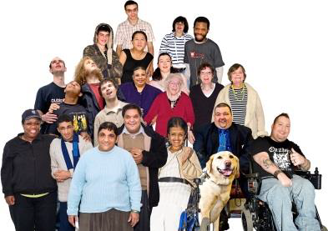
Make People with learning disabilities part of your Winter Plan this year!

Slide 2
Aims of session
Tell you about why people with learning disabilities are high priority for the flu vaccine.
Tell you how learning disability community teams can help you ensure this group of people receive their flu vaccine.

Slide 3

What did the Confidential Enquiry into the premature deaths of people with learning disabilities tell us?
The confidential enquiry into the premature deaths of people with learning disabilities reviewed 247 deaths and found the cause of death in a third of these individuals was due to respiratory disease.
Therefore the report recommended that people with learning disability should be identified as a high risk group in seasonal influenza vaccination programmes.

Slide 4
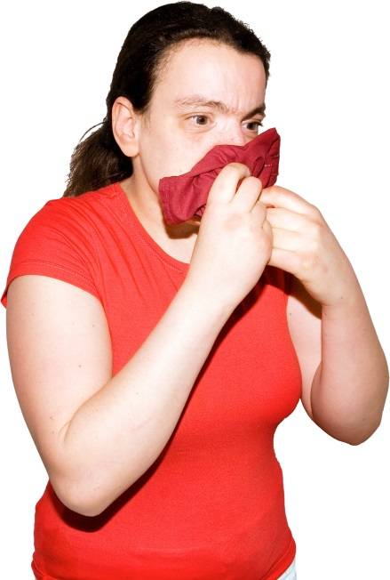
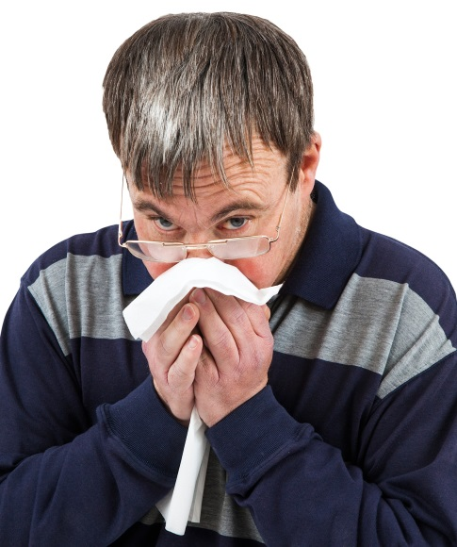
The Plan
Following discussions with NHS England and Public Health England it was agreed that the flu plan would specifically emphasise that people with learning disability were in a clinically at risk group by merit of their learning disability alone and should be a priority group.

Slide 5

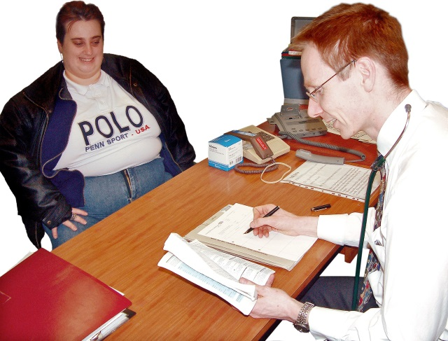
What do we need to do?
It is therefore strongly recommended that GP practices should not just vaccinate those coming forward, but should be proactively offering vaccination to this group

Slide 6
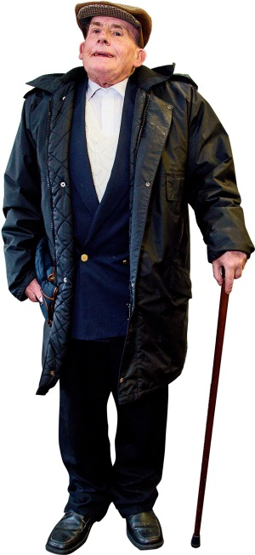
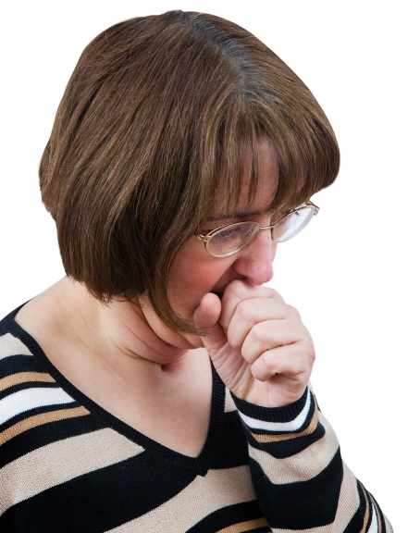
What do we need to do?
People with learning disabilities are offered a free flu vaccination because they may be more susceptible to the effects of flu and at increased risk of developing complications including bronchitis, pneumonia, and a painful ear infection that may be severe

Slide 7

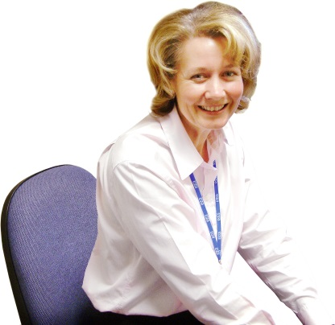
How can community learning disability teams help?
There are community teams in each locality who have nurses within them
If you have complex people on your register who can not access the surgery or easily tolerate the flu vaccine, seek support and advice from the Community Team who will help

Slide 8
Community Learning Disability Teams
They are all tasked with promoting good health in people with learning disabilities
They have expertise in caring for people with complex needs
They can work intensively with people and help reduce their anxieties and help desensitise them to needle phobia
They may already know the individual very well
They can come along to practice meetings to raise awareness in relation to people with learning disabilities and the support that is available

Slide 9
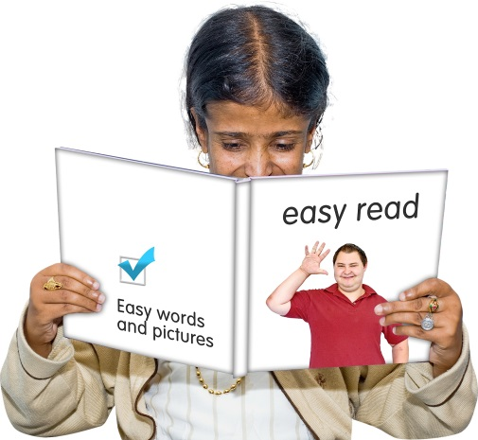
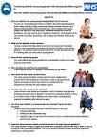
Accessible information
We must ensure that people are invited in a way they understand
They need to understand what the vaccine is for and how it can benefit them

Slide 10
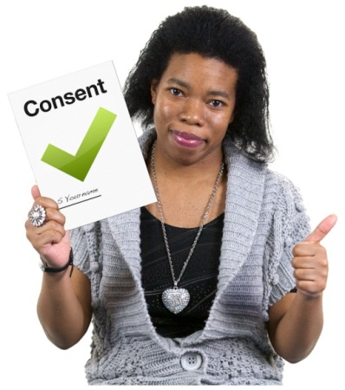

Issues that may arise
Establishing if the person has the capacity to agree or disagree to the flu vaccine
Determining if it is in a persons best interest to have the flu vaccine
Deciding if it is too anxiety provoking to provide the vaccine
People not coming along to the practice because they have not understood the importance of it

Slide 11
Making reasonable adjustments
You need to be prepared to sometimes carry out a home visit to administer the vaccine
You might need to build a relationship up with the individual first over a period of a few appointments
You need to send an accessible picture based information sheet out to the person
You might need to consider a seeking advice or support from the community learning disability team
You may need to consider use of the patch rather than a needle?

