Slide 1
Menopause
Patient Information
Note: This presentation contains links to websites, click on blue underlined text to access
Authors: Dr Holly Vaughan / Lisa Jack
Involved in development: Dr Louise Bramble, Dr Jo Jenkins, Kirsty Hinton

Slide 2
Menopause
When a woman has not had a period for 12 months
Usually between the ages of 45 and 55 years
Average age in UK is 51 years
1 in 100 women will be under 40 years
1 in 1000 women will be under 30 years
1 in 10000 women will be under 20 years
Menopause can also follow surgery (hysterectomy) or cancer treatments
MENOPAUSE

Slide 3
Perimenopause
MENOPAUSE EDUCATION SESSION
The perimenopause can start 5-10 years before periods stop
Symptoms can start gradually and are multiple, making it difficult to diagnose
Levels of hormones and therefore symptoms can fluctuate during this time
When a woman is still having periods but experiences symptoms because of declining hormone levels (oestrogen)

Slide 4
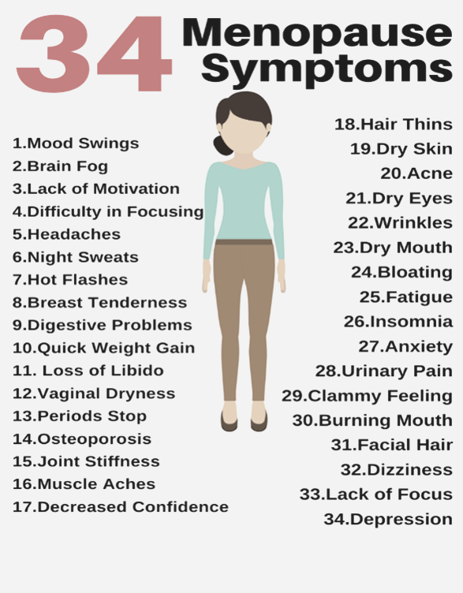
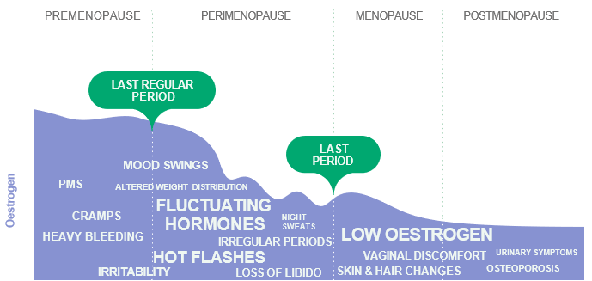
MENOPAUSE

Slide 5
"I feel like I have spiders crawling all over me"​
"I have never been anxious but I now struggle to leave the house"​
What Women Say
MENOPAUSE EDUCATION SESSION
"I feel I have lost part of myself"​
"The joy has gone"​
“I can forget the name of somebody I have known for years"
"I have to get up several times at night to change the sheets"​
“I lie awake at night worrying and over thinking"​
It serves a variety of purposes, making presentations powerful tools for convincing and teaching.
It serves a variety of purposes, making presentations powerful tools for convincing and teaching.

Slide 6
01
02
Lifestyle measures
Diet, caffeine, alcohol, exercise/movement, sleep, smoking, mental health
Topical vaginal oestrogen
Pessaries, creams
Management options
MENOPAUSE EDUCATION SESSION
03
04
CBT
Medication
Cognitive behavioral therapy
Non hormonal medication for flushes/mood
Hormone Replacement Therapy (HRT) tablets, gels, sprays, patches, Mirena coil

Slide 7
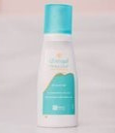
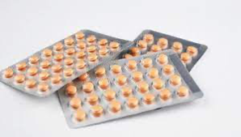
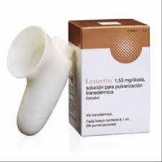
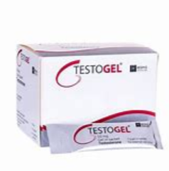
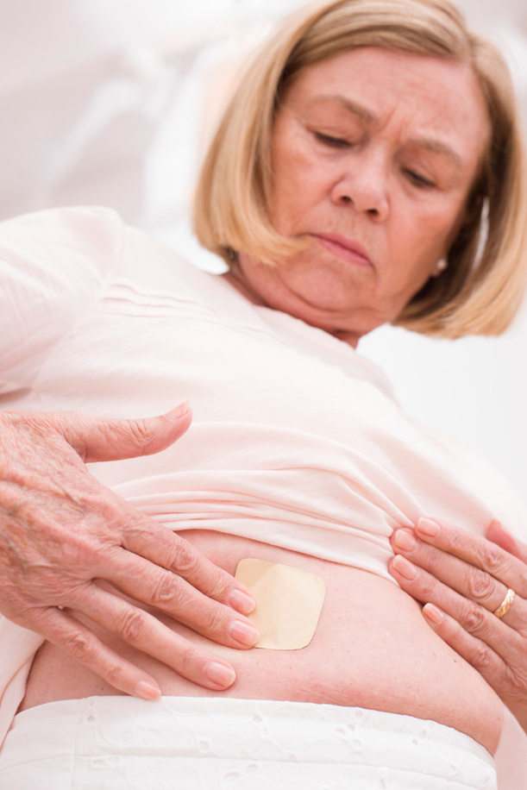
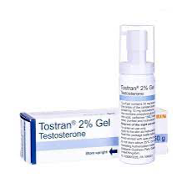
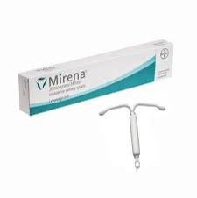
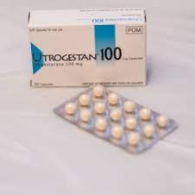
Testosterone
For some women when libido is low
Oestrogen
To reduce symptoms and improve future health​
MENOPAUSE
Benefits
For the majority of women, benefits outweigh risks
To heart, bones and pelvic health (possibly brain)
Risks
Small increased risk of breast cancer, less than being overweight or drinking 14units of alcohol a week
Progestogen
To protect the womb

Slide 8
Looking after you…
MENOPAUSE EDUCATION SESSION
HRT pre-payment certificate available
Book your cervical smear and attend your mammogram
Complete the bowel screening test
Take up STI / HIV screening
Attend health checks if offered
Smoking cessation service

Slide 9
Diet and Menopause
MENOPAUSE EDUCATION SESSION

Slide 10
Why is diet & nutrition important in menopause?
Many symptoms of perimenopause and menopause including weight gain, hot flushes, night sweats, joint pains, mental health changes.
Perimenopause and menopause increases the risk of several chronic health conditions, for example; weight, heart conditions, diabetes, blood pressure and osteoporosis.
Improving diet and nutrition can increase the chances of improving symptoms and reduce chronic health conditions in some people.
MENOPAUSE

Slide 11
One of the most common conditions associated with perimenopause or menopause is weight: *Oestrogen levels reduce causing fat to increase *Metabolism slows down *Hunger is affected
Weight Management
What is the scientific evidence for 'long term' weight loss in menopause?
MENOPAUSE EDUCATION SESSION
Many different 'fad diets' & popular diets on social media
Use a registered Dietitian
Use a registered nutritionist
Science based information
No long-term evidence of popular diets for menopause e.g. keto / Time Restricted Eating / Fasting
Majority regain weight
Low Calorie Diets not recommended especially lower than 1200 calories
Why?
Nutrient deficiencies have been found & relapse is very common.

Slide 12
Long term weight management
Balanced Healthy eating principles with strength training does have evidence (over 2-4 years).
Mediterranean Diet - evidence that this diet can positively affect weight management, blood sugar control, cardiovascular disease, blood pressure & other symptoms.
It is anti-inflammatory & high antioxidants.
Recommended if can be adapted and sustained
MENOPAUSE

Slide 13
The Mediterranean Diet:
High intake (daily) to include:
vegetables & fruits
Legumes, beans, nuts, seeds & herbs
Cereals & grains (mostly whole)
Healthy unsaturated fats such as olive oil (& avocado).
Fish & seafood (2/week).
Moderate intakes of dairy, eggs & occ poultry
Low intakes of red meat
Occasional/rare sweets

Slide 14
Weight management behaviours to aim for:
Be mindful of eating and why you are eating
Eat slowly, chew slowly
Regular 'balanced' meals through day
Reducing unplanned unhealthy/processed foods/snacks
Stop or reduce sugar & sugar drinks
Increase vegetables, fruit and fibre overall
Increased protein or ¼ plate each meal (& plant proteins)
British Nutrition Foundation – Protein in the diet
If appropriate, smaller portions – check your portion size
Special care with portions of white refined carbohydrates e.g. white bread
Most important find what works for you from the evidence and what you can maintain.
Activity build in anyway can sustain & include weight bearing exercise for muscle mass
MENOPAUSE

Slide 15
01
02
Breakfast
x2 eggs
Wholegrain toast (1-2) & 1-2 veg e.g. spinach / mushrooms
OR
Plain/Greek yogurt, large wholegrain oats/granola, berries, nuts /seeds
Lunch
Chickpea / tuna salad with olive oil & avocado & a grain & fruit
OR
Bean & vegetable soup & whole grain bread & fruit
Ideal day
MENOPAUSE EDUCATION SESSION
03
04
Dinner
Snacks
Fish / chicken, vegetables 2 portions (soya beans) & grain
Fruit & yogurt
If required: 1 handful (30g) nuts and /or piece fruit
Fruit / seeds

Slide 16
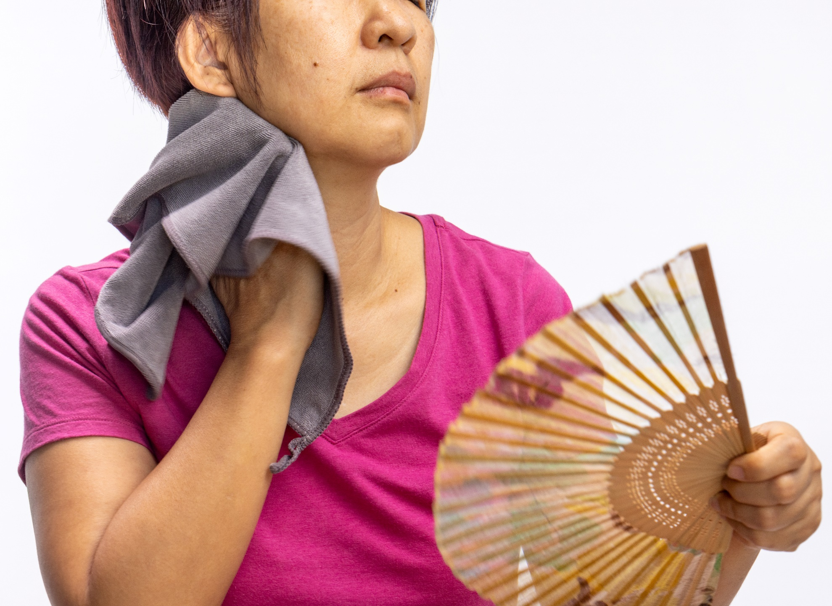
Common symptom: Hot sweats/night sweats
What can worsen?
Being overweight, alcohol, caffeine, spicy foods.
High sugar diets
What can help?
If overweight -> weight loss
Mediterranean style diet or more plant based, low fat
Trial including some phytoestrogens (e.g. soy-beans/soy products).
Aim for 1- 2 servings of phytoestrogen-rich foods per day, 1 serving = 80g soya/edamame beans or 100g tofu or tempeh or 250ml soya milk or 200ml Greek-style soya yogurt. Also, pulses, beans, flaxseeds etc.
MENOPAUSE

Slide 17
Symptoms: Sleep
What helps?
Regular meal pattern day: 2-3 hours no eating prior to bed
Quality of diet
Some evidence Magnesium may help
Sleep hygiene
What worsens sleep?
MENOPAUSE

Slide 18
Mental health, brain fog & concentration
MENOPAUSE
Recommend:
Regular meal pattern
Hydration – fluids/water ensure achieving 8 glasses/day
Mediterranean Style Diet – tweaked with more plants, berries & phytoestrogens
Omega-3 fats
Oily fish ideally 1 week or more/plant-based alternatives walnuts, seeds, or Supplement
(possible B vitamins)

Slide 19
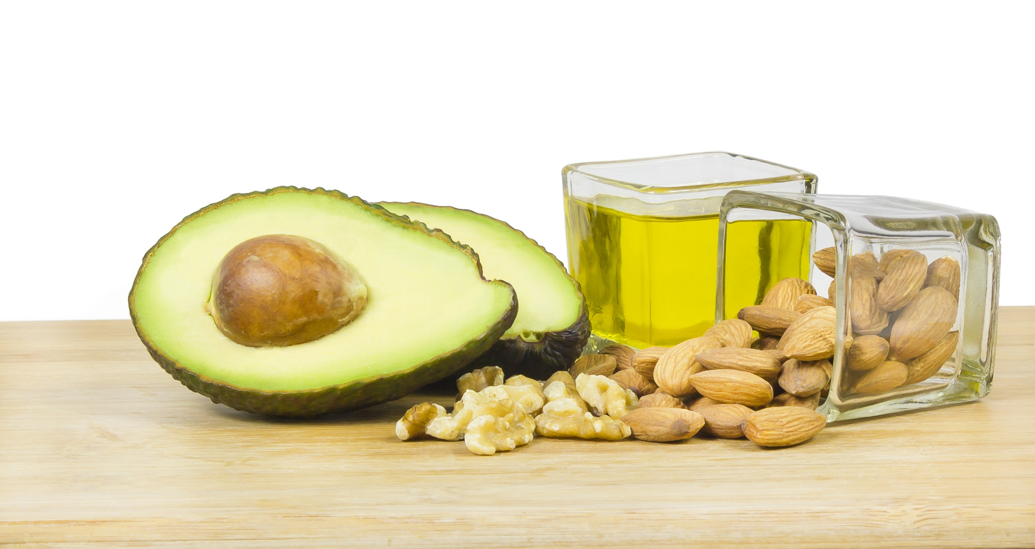
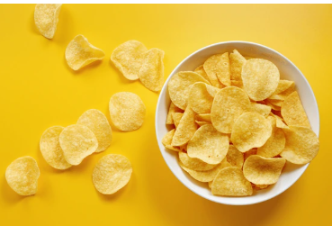
Heart Health
What Helps?
Managing risk factors e.g.
High cholesterol
High blood pressure
Pre-diabetes
Principles of healthy eating / mediterranean diet & unsaturated fats (olive oil, avocado, nuts)
A diet rich in fruit and vegetables, wholegrains
Oily fish or alternative omega-3 sources (walnuts, linseeds etc).
Limit:
Saturated fat & ultra-processed foods high fat foods
Sugar & salt.
MENOPAUSE EDUCATION SESSION

Slide 20
At higher risk during perimenopause and menopause
Recommendations:
Ensure sufficient protein
Vitamin D 10micrograms
Calcium sufficient intake e.g. dairy or fortified non-dairy or supplement
Reduce/stop alcohol
Physical Activity & weight bearing exercises
Access the calcium calculator
Osteoporosis
MENOPAUSE

Slide 21
Supplements in menopause:
Not regulated industry / heavily marketed
Maximise diet first, only need supplements if lacking in diet
Recommend:
Vitamin D (10-25mcg or 400-1000 units)
Possibly Magnesium if difficulty sleeping/ anxiety/tiredness/fatigue - max dose 300-400mg
Correct any nutrient deficiencies
British Nutrition Foundation – Managing menopause with diet
MENOPAUSE EDUCATION SESSION

Slide 22
MENOPAUSE EDUCATION SESSION

Slide 23
Overall recommendations currently suggest there is insufficient evidence to recommend for menopause…
Some people may benefit but unknown.
If choose to take: look for Traditional Herbal Registration stamp or use Registered Herbalist.
Examples are:
Red Clover - (isoflavone)
Not recommended for history of breast cancer
Black Cohosh – small evidence for some studies for hot flushes / night sweats but inconclusive.
Might help some.
Associated with major adverse effects.
DO NOT TAKE IF on tamoxifen.
St John's Wort – Some effect on hot flushes / night sweats & mental health).
Not recommended in breast cancer as due to unknown effects of doses.
Herbal Supplements
MENOPAUSE EDUCATION SESSION

Slide 24
Further Information
Dietary Advice
Nutrition in Menopause (Women’s Health Concern)
The Association of UK Dietitians – Food Fact Sheet
Heart UK – Guide to Eating Well – During the Menopause
British Nutrition Foundation – Nutrition and the Menopause
British Nutrition Foundation – Managing menopause with diet
Oldways – Cultural Food Traditions
Heart UK – The Mediterranean Diet
Menopause Information
Royal College of Obstetricians & Gynaecologists Patient Information
Cycle of change – understanding menopause
NHS Menopause
Recipe Idea’s
BBC Good Food
Healthy living - HEART UK
Books
Food for Menopause – Dr Linda Patel

Slide 25
Social Prescribing: Social prescribing is an innovative approach where healthcare professionals refer patients to non-clinical services to improve their well-being. For women experiencing menopause, social prescribing can be particularly beneficial. It includes activities like exercise classes, art therapy, and support groups, which can help manage symptoms and improve overall quality of life. Would you like to know more about specific activities or programs available through social prescribing for menopause?
Contact ONSIDE on 01905 27525 to self-refer to your surgery social prescriber.
Wellbeing Coaching: A wellbeing coach can be incredibly supportive during menopause, offering personalised guidance and strategies to help manage symptoms and improve overall well-being. Here are some keyways a wellbeing coach can assist:
Emotional Support: Menopause can bring about a range of emotions, from anxiety to mood swings. A coach provides a safe space to discuss these feelings and helps develop coping strategies.
Goal Setting: Whether it's health-related goals or personal aspirations, a coach can help you set and achieve these objectives, providing motivation and accountability along the way.
Navigating Life Transitions: Menopause often coincides with other significant life changes. A coach can help you navigate these transitions, whether they involve career shifts, children leaving home, or other personal developments
Contact ONSIDE on 01905 27525 to self-refer to your wellbeing coach.
Other support available:
MENOPAUSE EDUCATION SESSION

